Slide 1
530 Area Code Overlay
California Public Utilities Commission

Slide 2
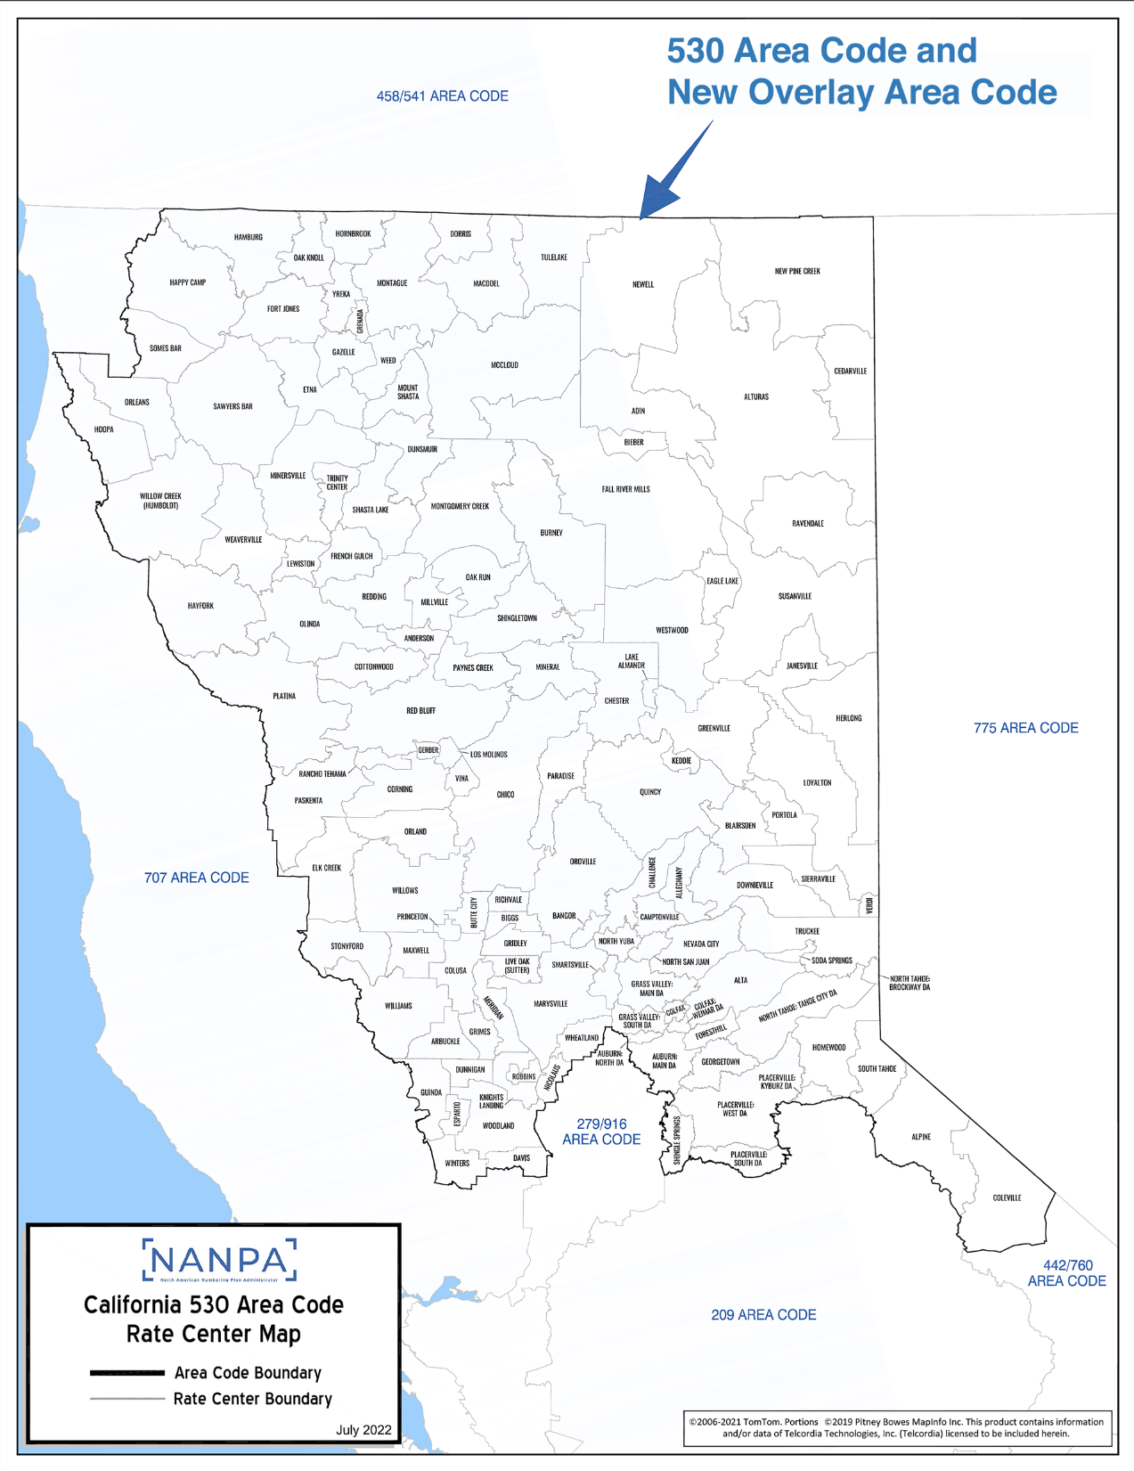

Slide 3
California Public Utilities Commission’s Role
FCC holds full jurisdiction over the telephone numbering system and area code administration.
FCC has delegated area code relief responsibilities to each state.
The CPUC conducts area code relief and determines method to introduce a new area code in accordance with Public Utilities Code Sections 7930-7943.
Area codes are managed and assigned by the North American Numbering Plan Administrator (NANPA).

Slide 4
Purpose and Objectives
Present
Area code relief plan
Provide
Provide estimated implementation schedule of new area code
Solicit
Solicit opinions and feedback
Effects of an overlay

Slide 5
530 Area Code History
1997
The CPUC ordered a split of the 916 area code and introduced the 530 area code.
2025
NANPA forecasted the 530 area code will exhaust all prefixes by September 2025.

Slide 6
NANPA’s Responsibilities
Assigns area codes and prefixes
Tracks number usage, receives numbering reports from the service providers
Forecasts when area codes will run out of available prefixes, or “exhaust”
Coordinates planning to introduce a new area code which starts 36 months before the forecasted exhaust

Slide 7
Factors to Consider in Area Code Exhaust Forecast
Assignment history of prefixes
Current growth in the telecommunications industry
Annual increase in the demand for prefixes in the area code

Slide 8
Rate Centers
Area codes are geographically specific.
Each area code is divided into local serving area called rate centers.
There are 131 rate centers in the 530 area code.
ADIN | BLAIRSDEN | CORNING | FORESTHILL | GUINDA | LIVE OAK (SUTTER) | MONTAGUE | OAK RUN | PORTOLA | SHINGLETOWN | VINA
ALLEGHANY | BURNEY | COTTONWOOD | FORT JONES | HAMBURG | LAKE ALMANOR | MONTGOMERY CREEK | OLINDA | PRINCETON | SIERRAVILLE | WEAVERVILLE
ALPINE | BUTTE CITY | DAVIS | FRENCH GULCH | HAPPY CAMP | LOS MOLINOS | MOUNT SHASTA | ORLAND | QUINCY | SMARTSVILLE | WEED
ALTA | CAMPTONVILLE | DORRIS | GAZELLE | HAYFORK | LOYALTON | NEVADA CITY | ORLEANS | RANCHO TEHAMA | SODA SPRINGS | WESTWOOD
ALTURAS | CEDARVILLE | DOWNIEVILLE | GEORGETOWN | HERLONG | MACDOEL | NEWELL | OROVILLE | RAVENDALE | SOMES BAR | WHEATLAND
ANDERSON | CHALLENGE | DUNNIGAN | GERBER | HOMEWOOD | MARYSVILLE | NEW PINE CREEK | PARADISE | RED BLUFF | SOUTH TAHOE | WILLIAMS
ARBUCKLE | CHESTER | DUNSMUIR | GREENVILLE | HOOPA | MAXWELL | NICOLAUS | PASKENTA | REDDING | STONYFORD | WILLOW CREEK (HUMBOLDT)
AUBURN:MAIN DA | CHICO | EAGLE LAKE | GRENADA | HORNBROOK | MCCLOUD | NORTH YUBA | PAYNES CREEK | RICHVALE | SUSANVILLE | WILLOWS
AUBURN: NORTH DA | COLFAX: WEIMAR DA | ELK CREEK | GRIDLEY | JANESVILLE | MERIDIAN | NORTH SAN JUAN | PLATINA | ROBBINS | TRINITY CENTER | WINTERS
BANGOR | COLEVILLE | ESPARTO | GRIMES | KEDDIE | MILLVILLE | NORTH TAHOE: BROCKWAY DA | PLACERVILLE: KYBURZ DA | SAWYERS BAR | TRUCKEE | WOODLAND
BIEBER | COLFAX | ETNA | GRASS VALLEY: MAIN DA | KNIGHTS LANDING | MINERAL | NORTH TAHOE:TAHOE CITY DA | PLACERVILLE:SOUTH DA | SHASTA LAKE | TULELAKE | YREKA
BIGGS | COLUSA | FALL RIVER MILLS | GRASS VALLEY: SOUTH DA | LEWISTON | MINERSVILLE | OAK KNOLL | PLACERVILLE:WEST DA | SHINGLE SPRINGS | VERDI

Slide 9
530 Area Code Background
The 530 area code is in the northeastern portion of California.
73 service providers provide phone service within the 530 area code.
The 530 geographic area covers all or portions of Alpine, Butte, Colusa, El Dorado, Glenn, Humboldt, Lassen, Modoc, Mono, Nevada, Placer, Plumas, Shasta, Sierra, Siskiyou, Solano, Sutter, Tehama, Trinity, Yolo, and Yuba counties.

Slide 10
Number of Prefixes Remaining
As of October 11, 2022, the 530 area code has 40 available prefixes or about 5% remaining. The available prefixes are expected to run out or “exhaust” by September of 2025.
A new area code, or relief, is needed to replenish the supply of prefixes.
Each prefix is uniquely assigned to a rate center.

Slide 11
530 Area Code Overlay Relief Method
An additional area code is the only relief option for the 530 area code.
California has introduced fourteen new area codes using the overlay method.
The 530 area code geographic area is already an overlay region.
There has not been an area code split implemented in the United States since 2007.

Slide 12
Impacts of the Proposed Overlay
All current customers will keep their existing area code and telephone number.
Customers in this area may be assigned a number in the new area code when 530 area code prefixes are no longer available for assignment.

Slide 13
Impacts of the Proposed Overlay
Dialing ‘1+ an area code’ does not change what a call costs and does not mean that a call is a toll or long-distance call.
Calling areas and rates will NOT change.
What is a local call before the introduction of a new area code will remain a local call after the new area code is implemented.
Calls to 911 and 988 as well as 211, 311, 411, 511, 611, 711 and 811 will not be affected, and will continue to be dialed with 3 digits.

Slide 14
Estimated Implementation Schedule of the Proposed Overlay
Estimated Implementation Intervals:
NANPA filed application with CPUC
3rd Quarter 2022
CPUC Decision
4th Quarter 2023
Introduction of the new area code
1st Quarter 2025

Slide 15
Questions & Comments
Questions and comments concerning the information in this presentation may be submitted to the Public Advisor’s Office no later than March 7, 2023.
Email: public.advisor@cpuc.ca.gov
Postal mail: CPUC Public Advisor’s Office 505 Van Ness Avenue San Francisco, CA 94102
Phone: (866) 849-8390

