Slide 1


IBM
—
Mary M Glackin
Director, Science and Forecast Operations, IBM

Slide 2
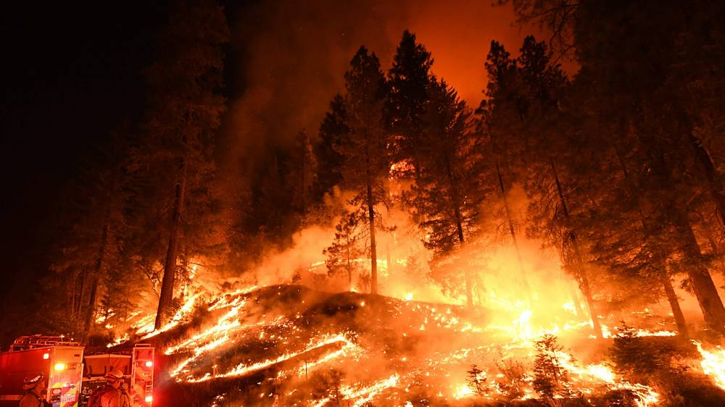

Weather forecasting accuracy continues to improve with improved observations, physical understanding, and AI/ML
Key Messages
Application of IOT and AI/ML will improve detection and predication of wildfires
2

Slide 3
The Weather Company Forecasts on Demand System
HUMAN OVER THE LOOP
GLOBAL WEATHER DATA
Government
Weather Obs.
Forecasts on Demand Engine
ON DEMAND USERS
Proprietary Weather Obs.
Real-time
Publication
& distribution
Government NWP Models
Obs. on Demand Engine
Proprietary NWP Models
3
Notes:
This shows how we make a forecast. Basically any forecast starts with observational data and we do too. And, I think you know we bring in other proprietary data sources like those from PWS.
However, we also use what is know as numerical weather predication models. We have had one on these but our exciting news is we are replacing it and leaping at least a generation ahead. Before I dig in more that I do want to highlight the second part.
SECOND CLICK: I want to highlight that we use AI/ML to produce our forecast. And I’ll tell you more about how we are improving that. In a moment.

Slide 4
Global Hi-Resolution Forecasting (GRAF) System
Next generation physics packages
Designed to leverage IOT – cell phone pressure data, aircraft data, etc.
Utilizing next generation of compute for enhanced performance
Inflection point for forecast improvement
4

Slide 5
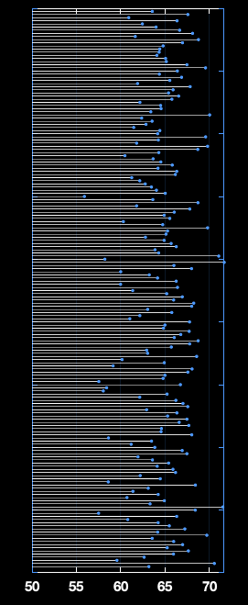
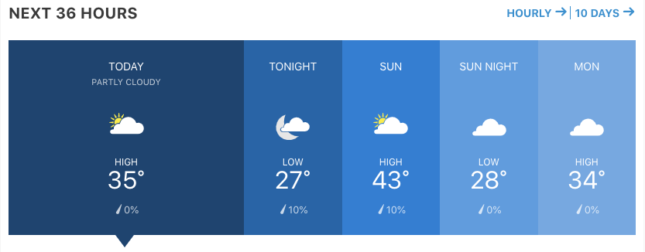
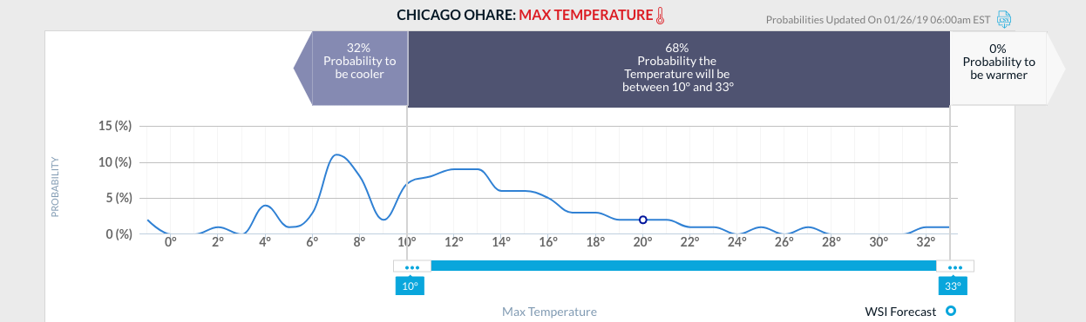
We use AI to calibrate each element of the 178 individual inputs to generate our deterministic and probabilistic forecasts
}
{
FOD
AI Calibration
PFP
5
Notes:
… and applies weighting factors to each of the 162 forecasts to arrive at a single final forecast. Individual weights are applied to each component of the weather such as temperature, precipitation, wind direction and speed, humidity, pressure, etc. The weights are generated through machine learning and vary continuously based on factors like geography, how recently readings have been taken, time of day, type of weather, and how accurate recent forecasts in comparison with actual results.

Slide 6
From Deterministic to Probabilistic
SINGLE NUMBER OUTPUT
PREDICTION DISTRIBUTION
Probability
Wind Gusts
is 50 knots
Threshold
The likelihood of
Wind Gusts
Exceeding 50 knots is 75%
vs.
The likelihood of wind gusts exceeding 50 knots is 75%
Likelihood of the wind gusts exceeding the threshold
Wind Gusts
Wind gusts above 50 knots
Ceiling below 1,000 feet
Visibility below 3 miles
6

Slide 7
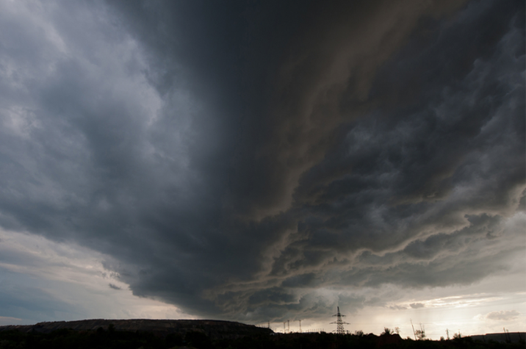
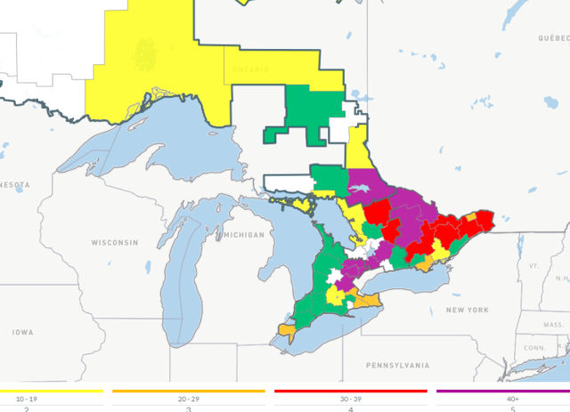


Monitor Weather Forecasts
Anticipate Storm Damage and Prepare for Response
“Heads-up” situational awareness using automated outage prediction
72+ hours
Proactively
Prepare
Automated prediction refined, run scenario planning tool
72-48 hours
The Outage Prediction model translates weather information into actionable intelligence about impact to the Utility electric system
Mobilization
Decision
Automated and scenario planning predictions set
48-24 hours
Execute Mobilization
Compare outage prediction to real time
24-00 hours
7

Slide 8
Objective
Evaluate the state-of-the-art in wildfire detection, risk assessment and prediction
IBM Academy of Technology
Initiative on Detection and Prediction of Wildfires
Lloyd Treinish
IBM Distinguished Engineer
Several sub-groups, including the following:
  Remote sensing
  Physical modelling
  Data-driven modelling (e.g., machine learned)
  Risk assessment and response
Volunteer Participants Environmental scientists, physicists, mathematicians, computer scientists, and engineers including many with experience with electric utilities
8
Notes:
https://ibm.box.com/s/392f15fra3sd3xob2sxezid07x9i3t5f

Slide 9
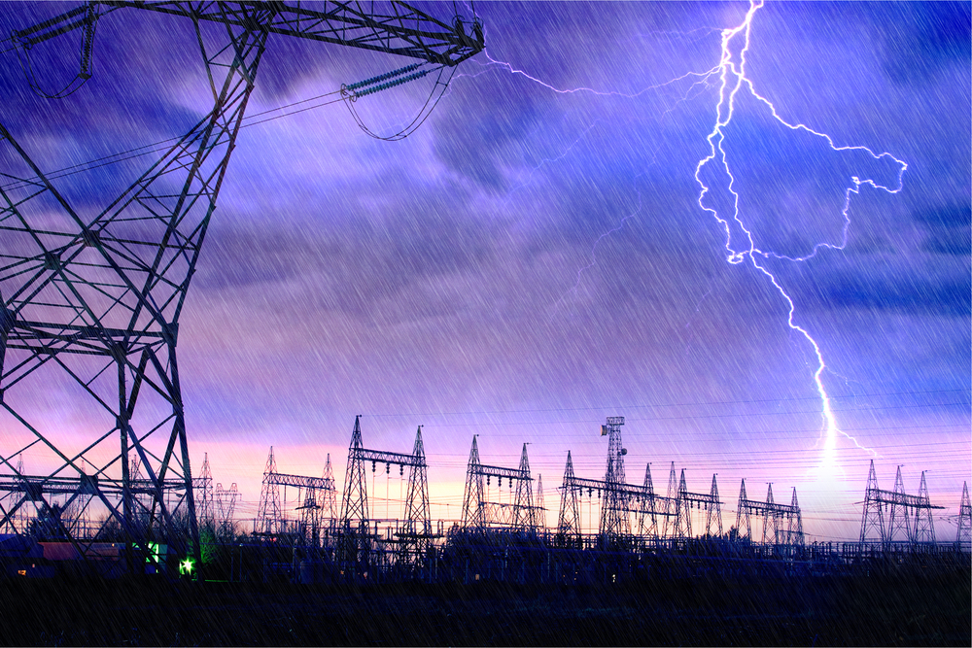


Some Efforts to Date
Assessment and characterization of current methods of detection, risk assessment and prediction (academic to operational)
  Coupled systems (i.e., with weather) for propagation vs. empirical risk
  Machine-learned
Remote sensing
  Fire detection
  Fuel estimation
  Post-event impact
Identification and inventorying of relevant data sets
9

Slide 10
Thank YOU
Mary M Glackin
VP, Science and Forecast Operations, IBM

