Slide 1
SDG&E’s Fire Potential Index
Presented by: Steve Vanderburg
SDG&E Principal Meteorologist
March 20, 2019

Slide 2
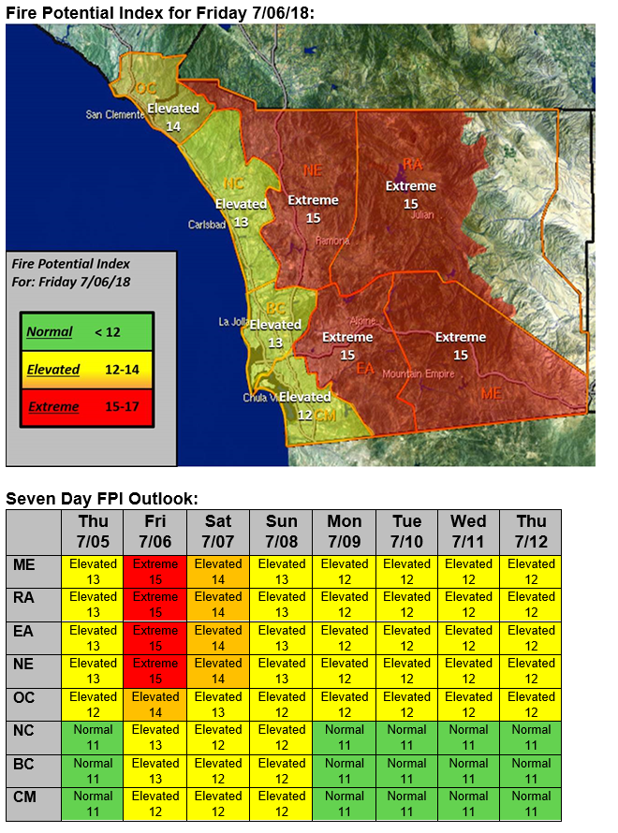
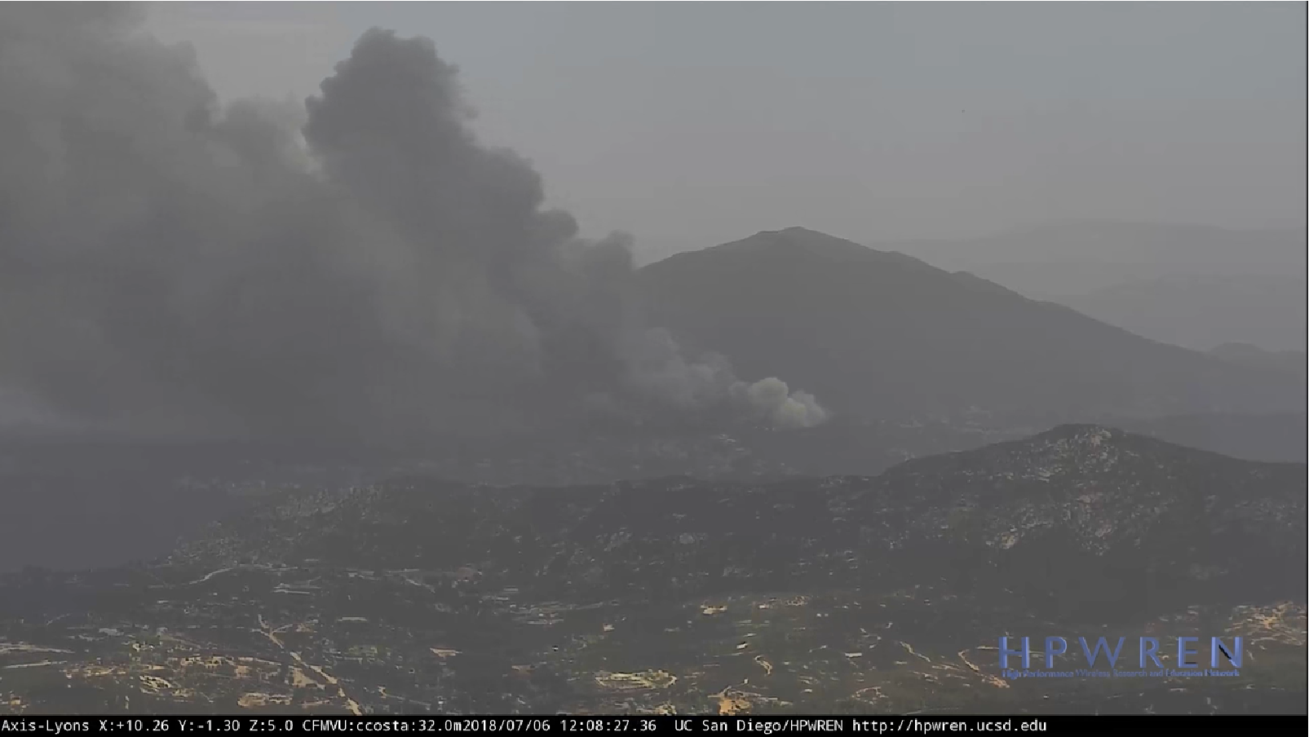
Assessing Fire Potential: Example from July 6, 2018
West Fire in Alpine, CA
504 acres
56 structures destroyed
No Red Flag Warning
First ever summertime “Extreme” FPI

Slide 3
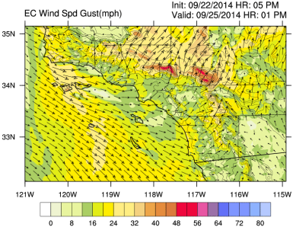
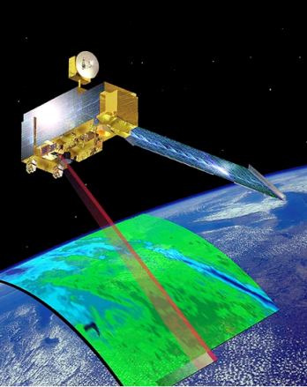
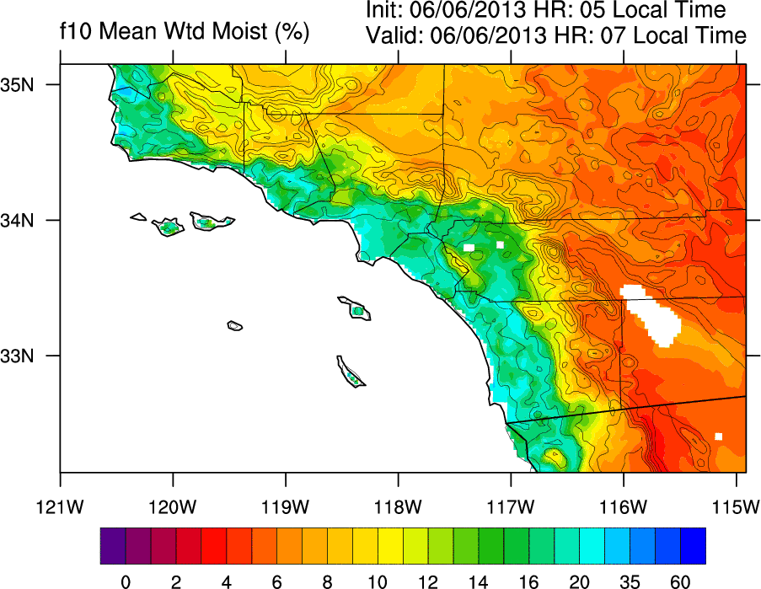
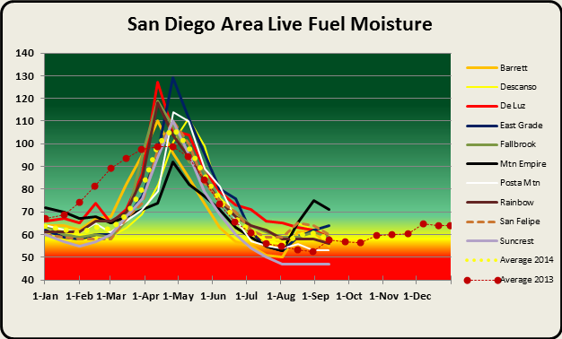
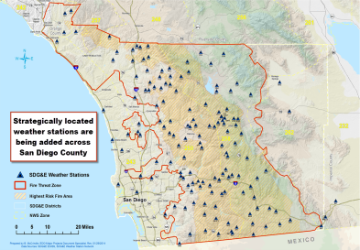
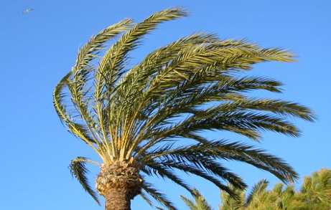
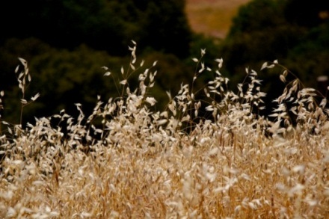
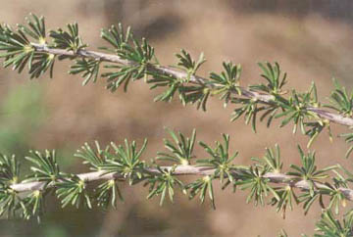
SDG&E’s Fire Potential Index (FPI)
Weather
(wind speed & humidity)
Grasses
Dead Fuels
Live Fuels
Fuel Moisture

Slide 4
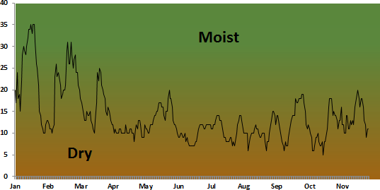
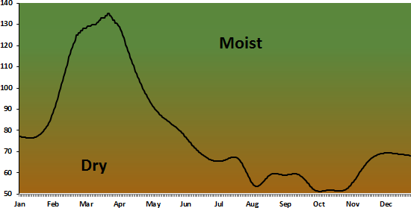
Fire Potential Index: Fuels Component
Green
Cured
Grasses
Dead Fuels
Live Fuels

Slide 5
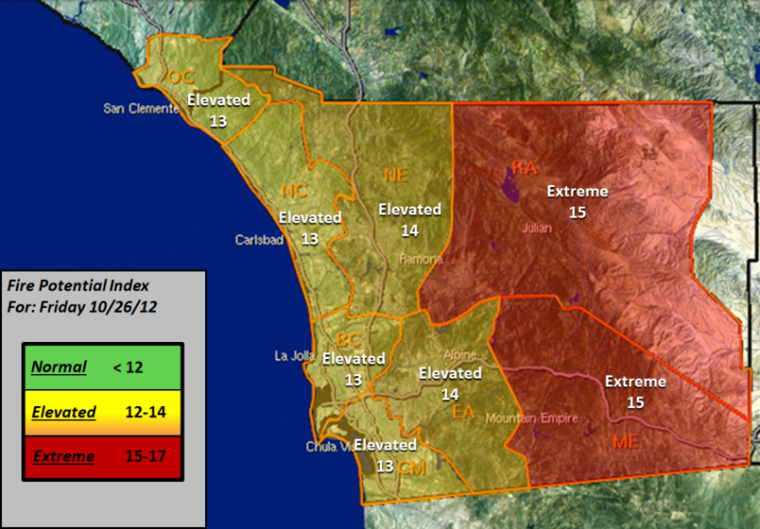
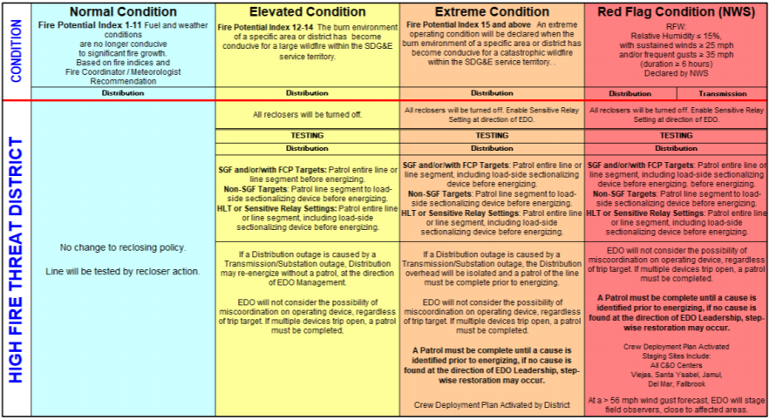
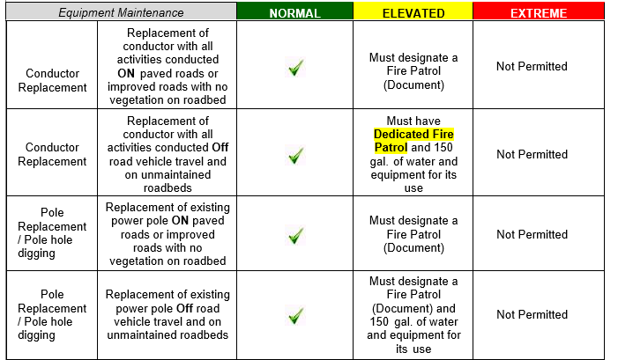
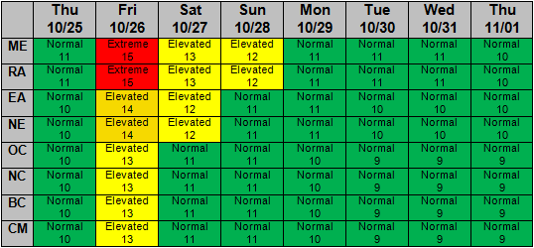
SDG&E’s Fire Potential Index (FPI)
The FPI is updated daily and is used to help determine the fire prevention / mitigation measures required to perform various work activities

