Slide 1
Lessons Learned in San Diego Caroline Winn - Chief Operating Officer, SDG&E
March 20, 2019

Slide 2
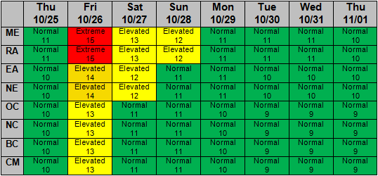
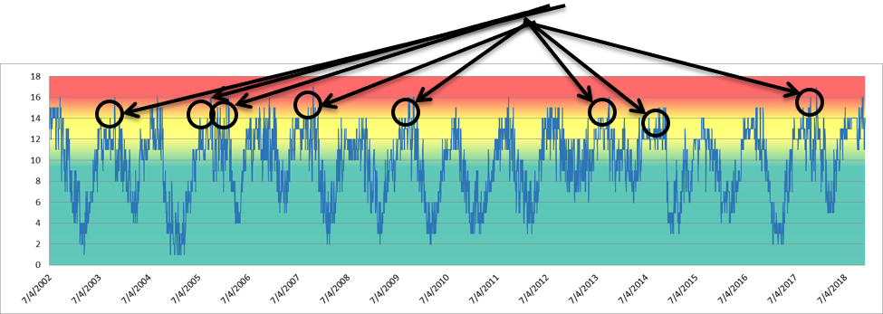
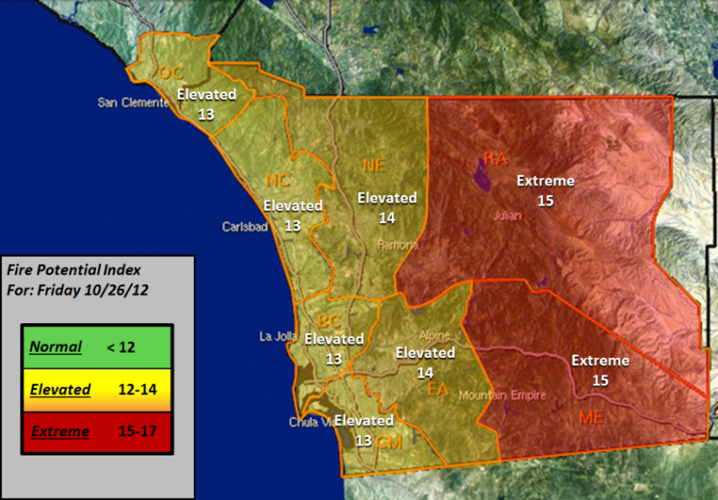
Lessons Learned in San Diego
SDGE’s Fire Potential Index
Planning + Decision Support Tool to Reduce Wildfire Risk
Situational Awareness + Weather Technology
Advanced situational awareness tools for modeling fire risk
Fire Potential Index
Santa Ana Wildfire Threat Index
Wildfire Risk Reduction Modeling
One of the largest utility-owned weather network in the nation
100+ High resolution camera network
Issued daily to inform operational decisions, work restrictions & resource allocation
Major Wildfires
Lessons Learned
Right people, priorities and culture
Set high expectations, be aspirational, challenge people to think beyond
Alignment is critical
It’s not going to be easy
Focus on customers and communities
Don’t do it alone
Shared broadly and relied upon by first responders throughout the region

Slide 3
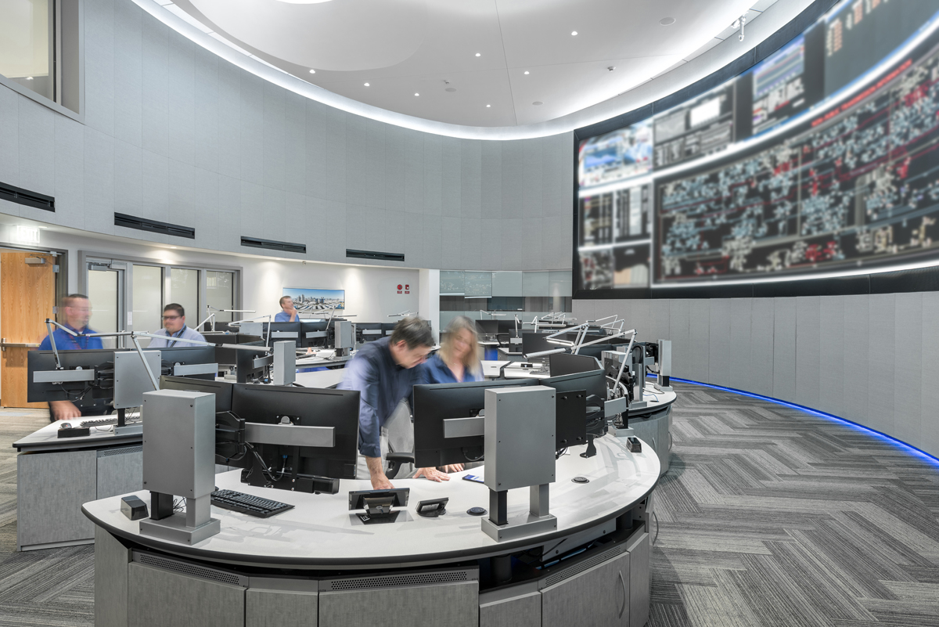
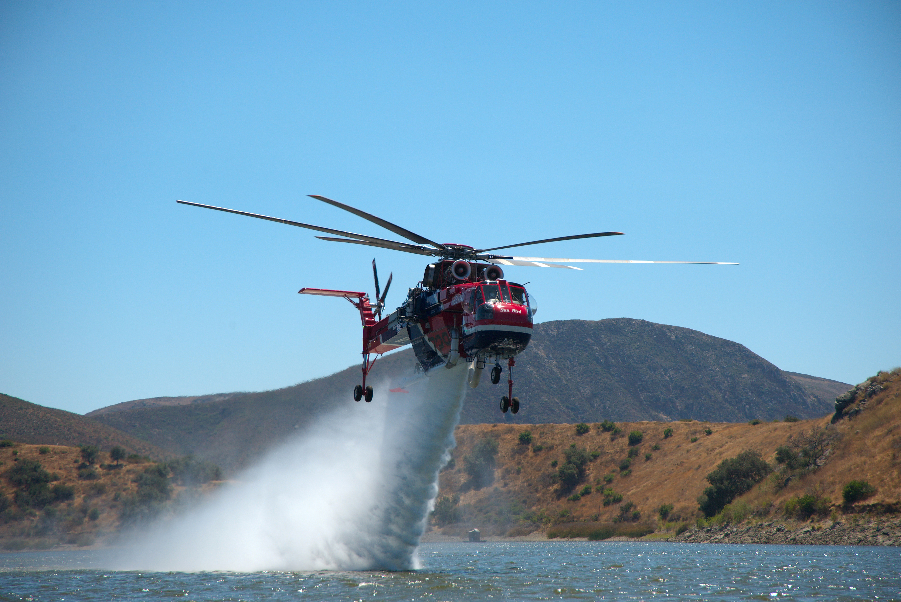
Vision for the Future
SDG&E | Future Enhancements
Strategic undergrounding
Install falling conductor algorithm on overhead lines
Redesign vegetation management program
Accelerate system hardening in the High Fire Threat District
Increase Situational Awareness
Replication of programs in other key areas
California | Climate Change Risk Mitigation
Enhance prevention and strong accountability
Objective and Reasonable Standard for cost recovery

