Slide 1
Technology Innovations to Reduce Wildfire Risk
David Erne, Energy Technology Systems Integration
California Energy Commission
March 21, 2019

Slide 2
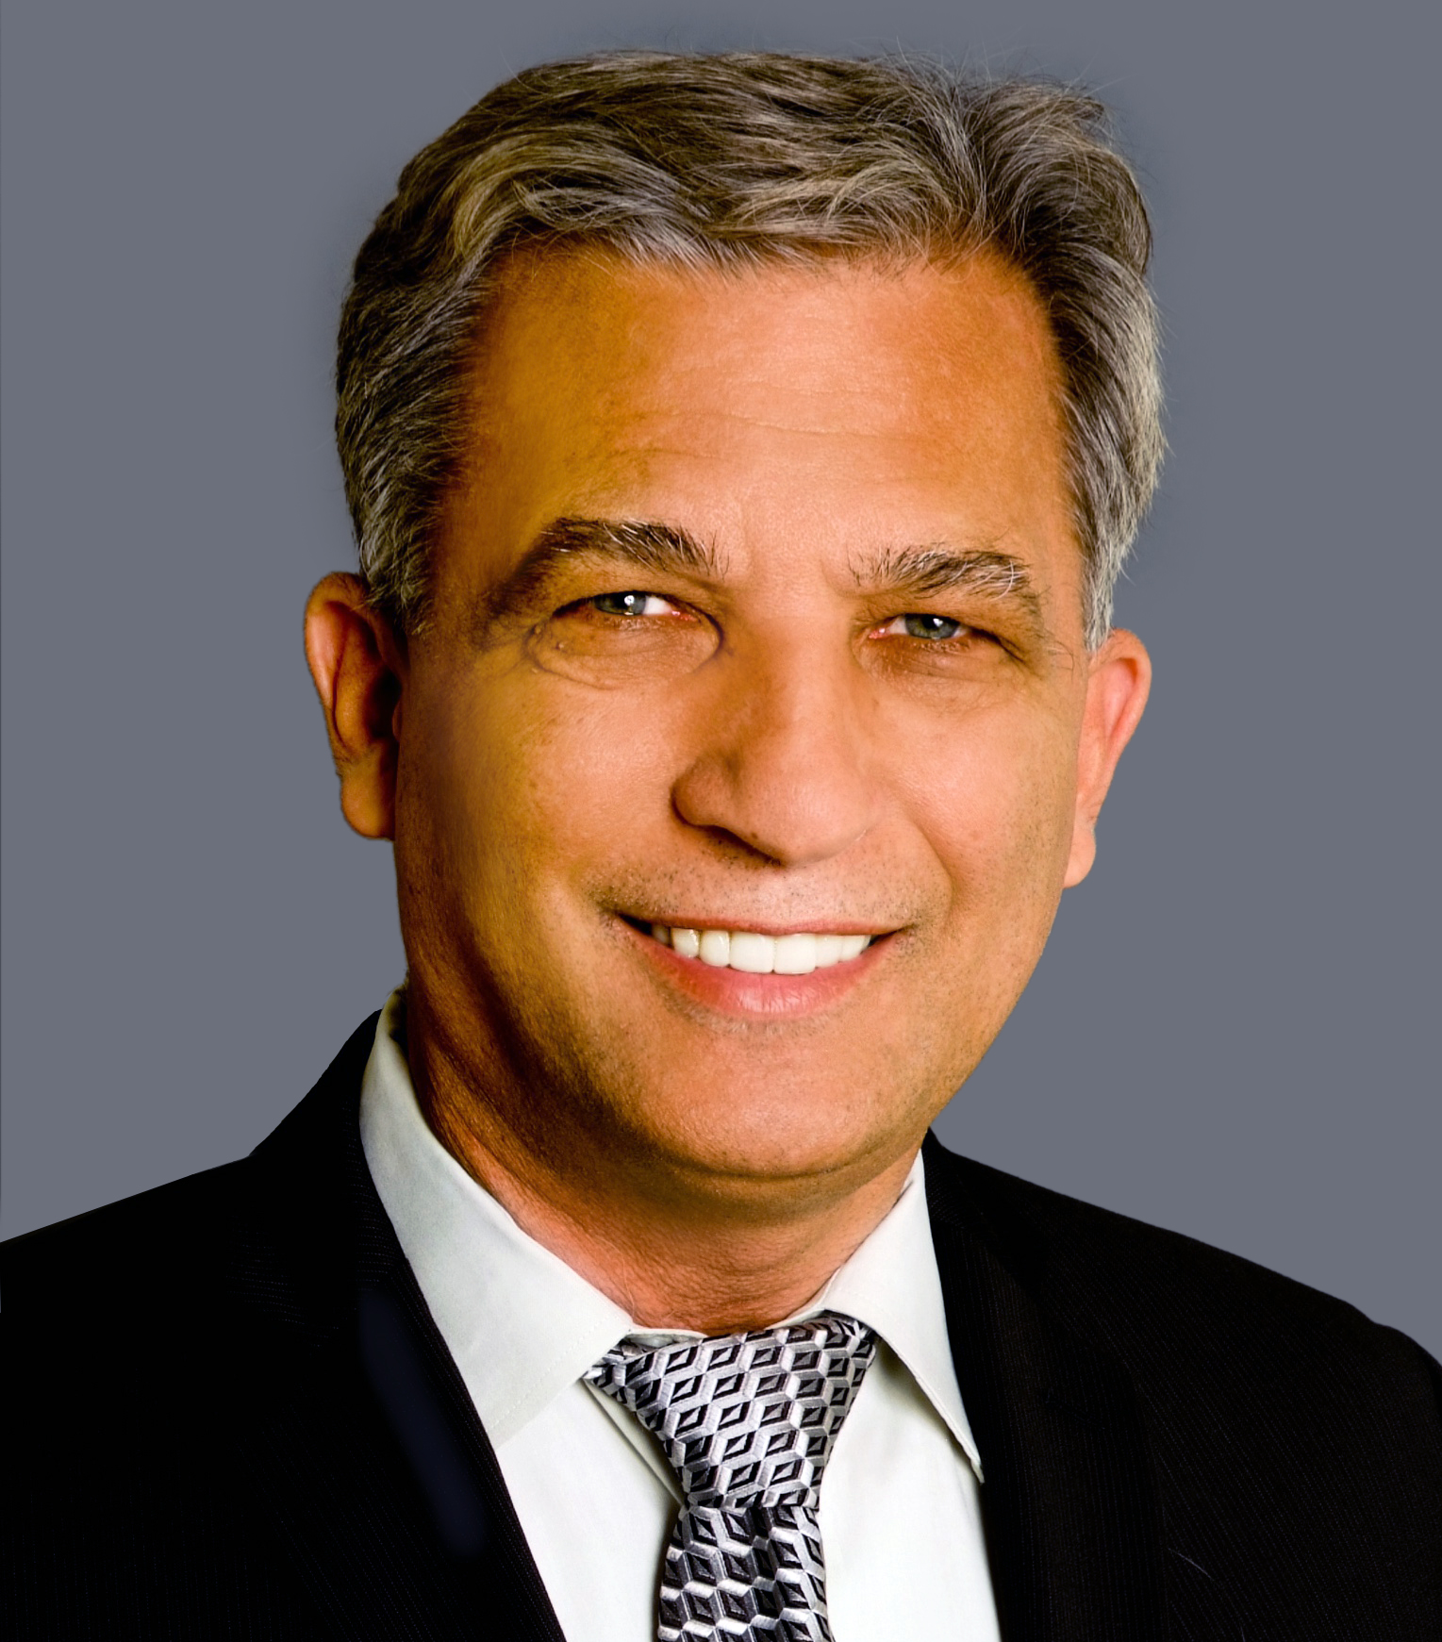
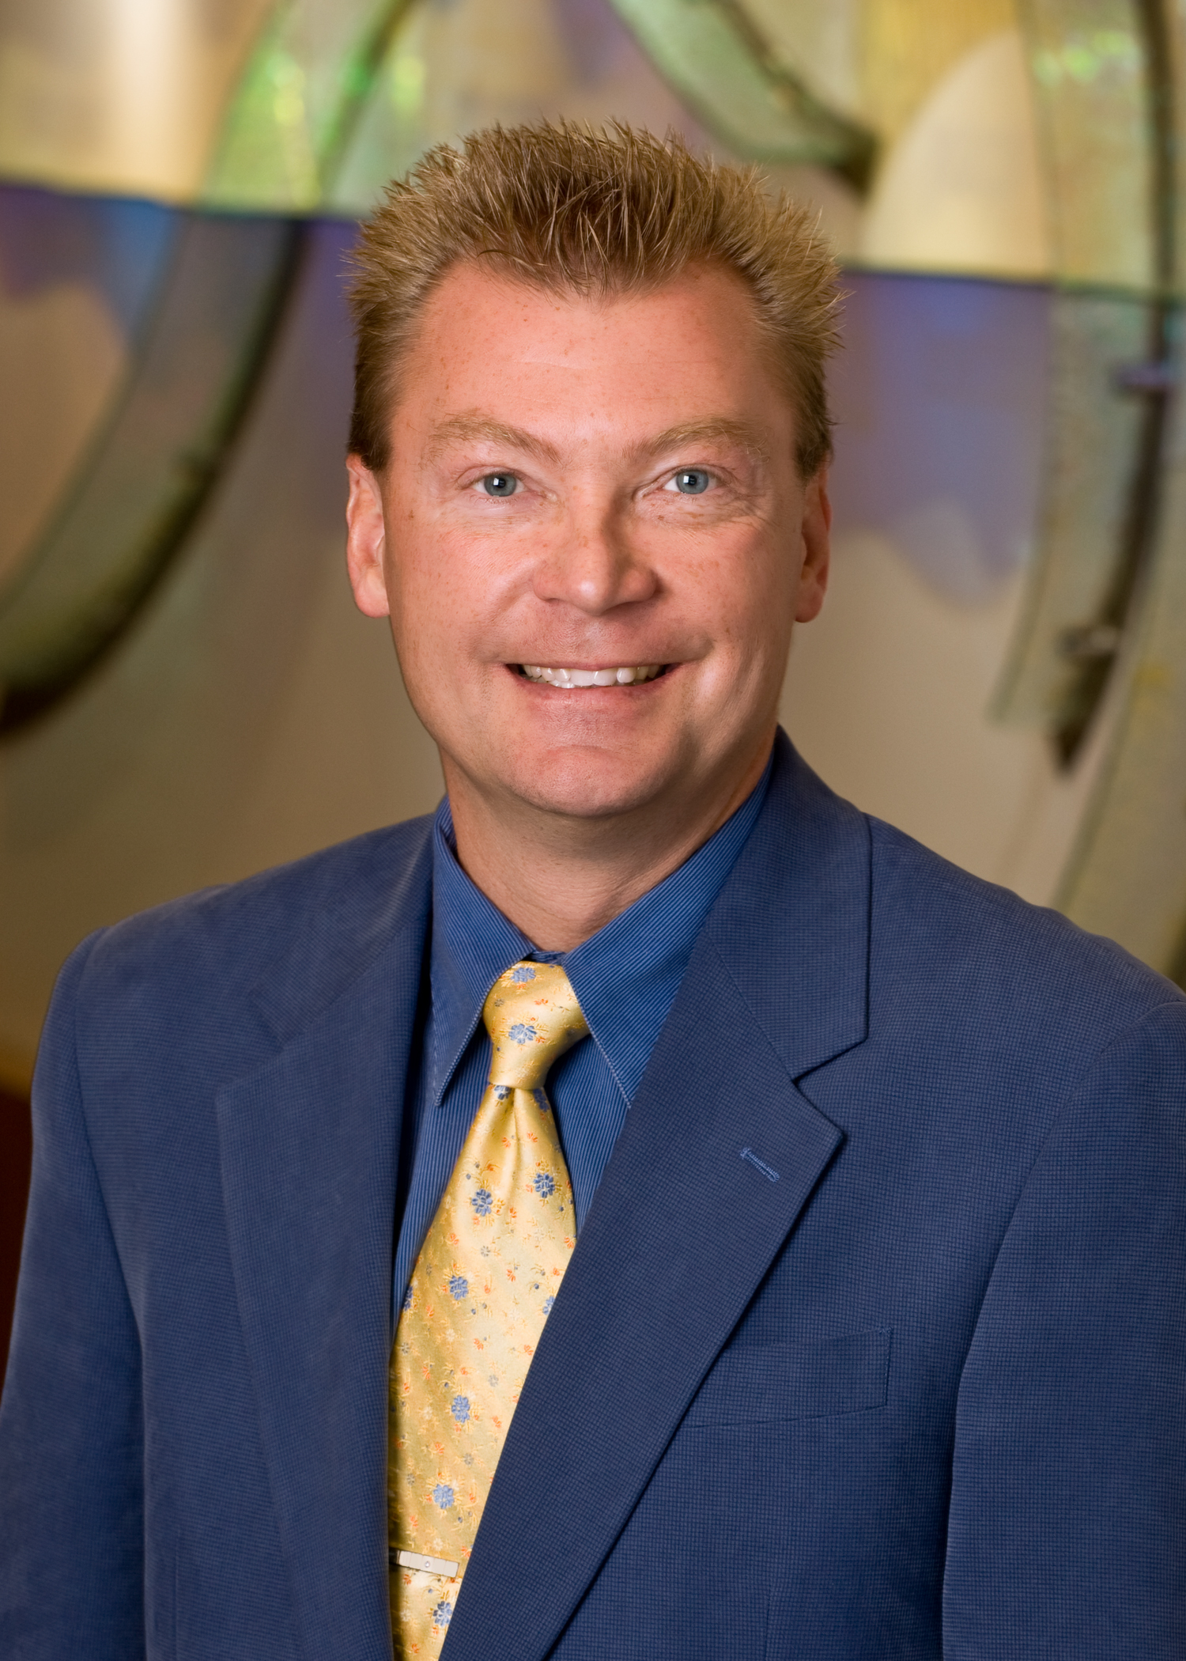
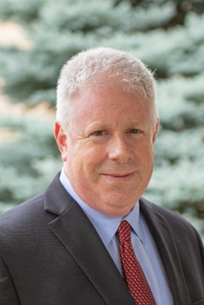
Panel
James Keener
Alan Wong
Tom Bialek
David Myers

Slide 3
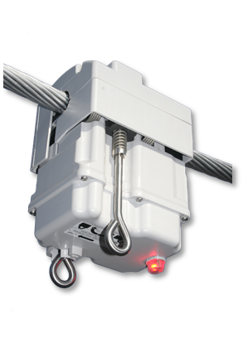
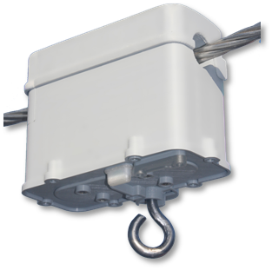
James Keener, CEO
MM3 for Feeders
ZM1 for Laterals
Conductor Sway Detection
Pre-Ignition Detection
Feeder Watchlist
Worst Performing Feeder Alerts

Slide 4
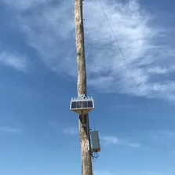
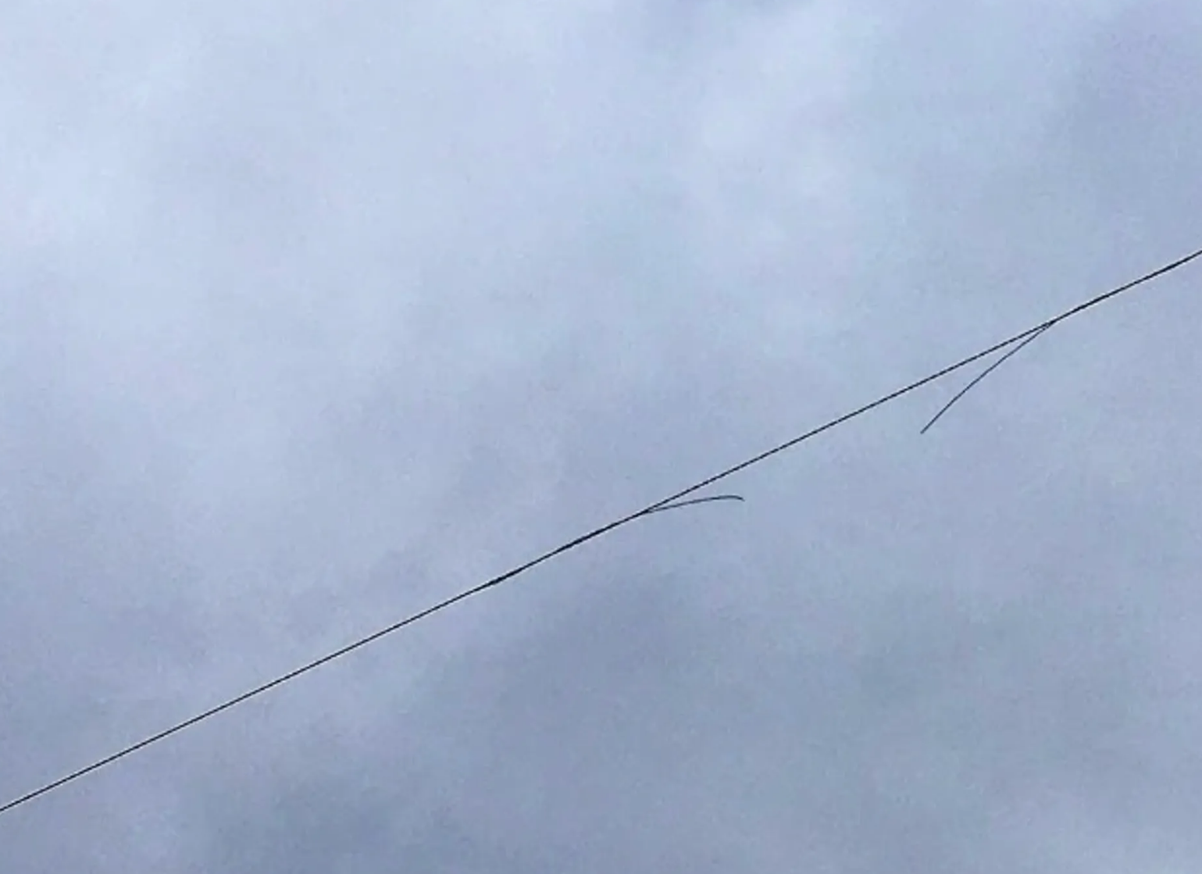
Alan Wong, CEO
Smart sensors along a typical 5km distance apart with 100+ assets, 24/365 early detection and location of fire risk faults

Slide 5
Dr. Tom Bialek, Chief Engineer
Ongoing Development
Working with IT on a cellular based communication system for reduced implementation cost and improved availability.
Expanding scope to include single phase branches in protection algorithm.
Circuit midpoint implementation

Slide 6
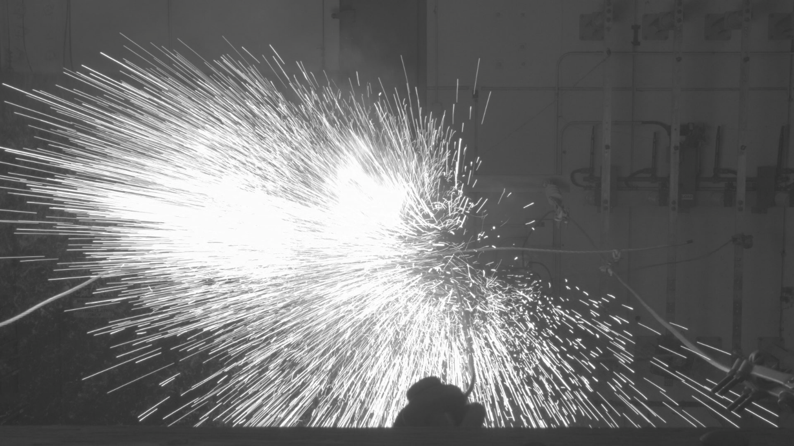
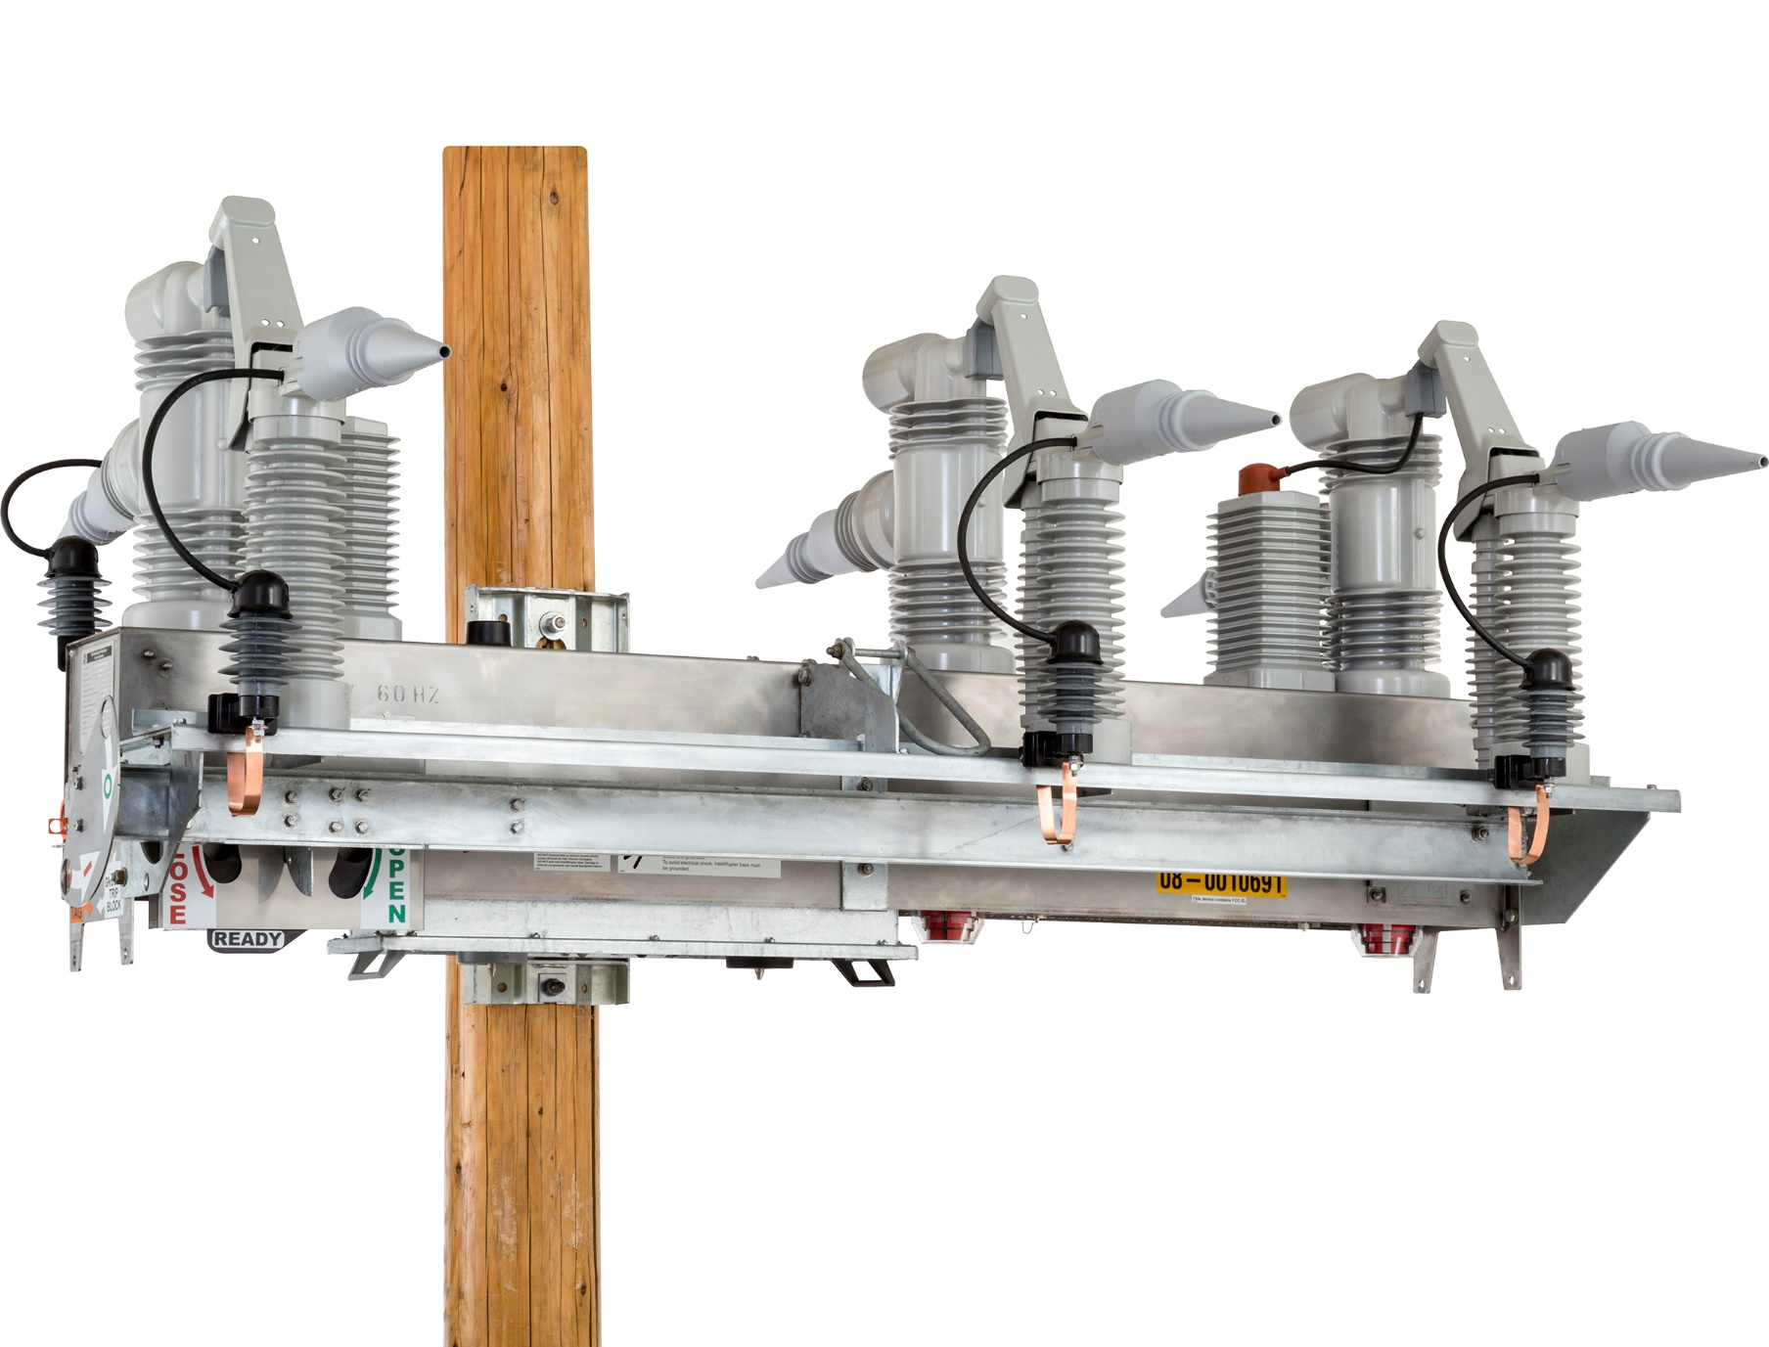
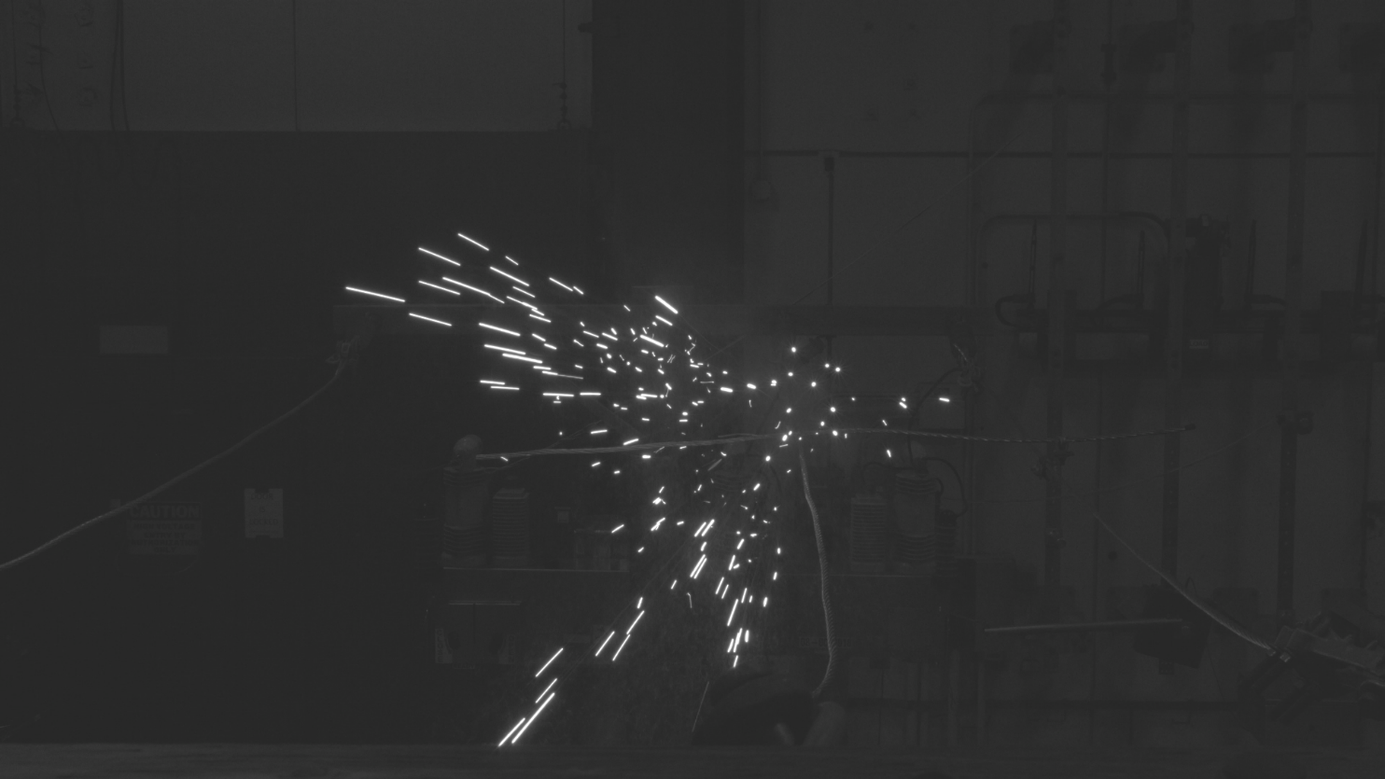
David Myers, VP Feeder Automation
IntelliRupter® PulseCloser®
Fault Interrupter
Conventional Reclosing
PulseClosing® Technology

Slide 7
Questions
Tom Bialek
James Keener
David Myers
Alan Wong

