Slide 1
Preventing Ignition from Utility Infrastructure
Using Smart Meter data and analytics to detect live wires down
March 21, 2019
Jim Cherrie

Slide 2
Reliability Operations Center
4_85
The Reliability Operations Center was established to enhance troubleshooting and support real-time operations through the use of situational awareness, remote diagnostics and data-driven decision making.
Analytics/Research & Development
High tech situational awareness environment leveraging a multi-faceted team of experts developing and deploying artificial intelligence (AI) solutions to improve public safety and grid reliability.
Real Time Situational Awareness
Analyze ~300 million daily data points from smart meters to identify equipment issues prior to customer or internal system notification.
Ability to visualize and pinpoint the location of grid events to aid first responders.
Predictive Analytics
Detecting potential equipment issues that may result in a public safety hazard.
Provides virtual troubleshooting support for field personnel.
Designing algorithms with a statistical approach to locate degrading assets otherwise undetectable by traditional methods
Notes:
This effort is a collaboration between many organizations…

Slide 3
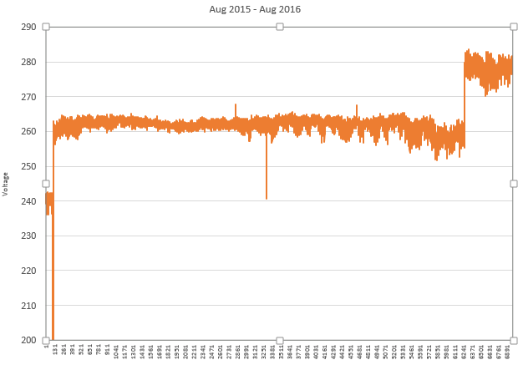
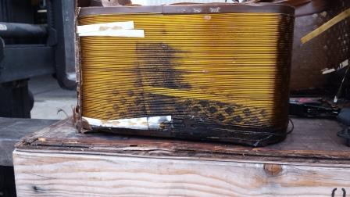
Early Damage Detection using Predictive Analytics
Lightning and stress can damage transformers.
This damage can lead to significant outages if left uncorrected.
With algorithms, we identify, locate, and replace damaged transformers.
Transformer sustained damage, and deteriorated

Slide 4
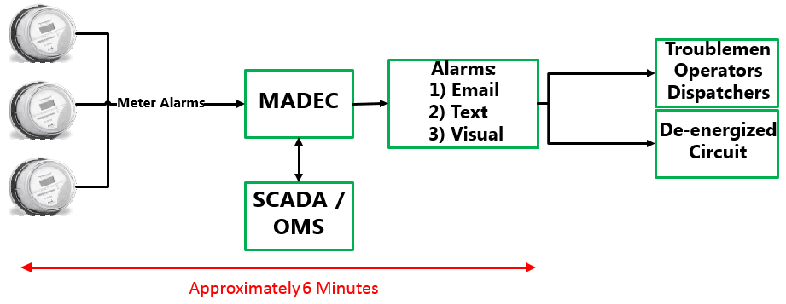
Detecting Live Wires Down with Smart Meters
The MADEC (Meter Alarming of Down Energized Conductors) application autonomously monitors SCE’s distribution circuits through it’s network of more than 5 million smart meters to identify live wire events.
The algorithm used for MADEC continues to improve in accuracy by learning from new data.

Slide 5
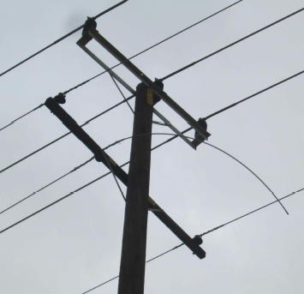
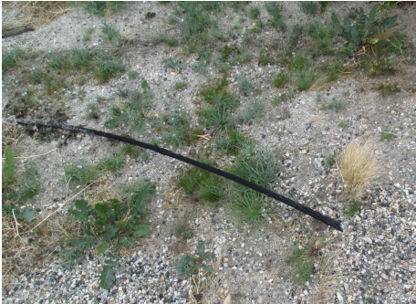
Live Wire Down detected by MADEC
Various factors can impact our ability to detect and isolate live wire down conditions.
Notes:
Hazard Reduction Time

Slide 6
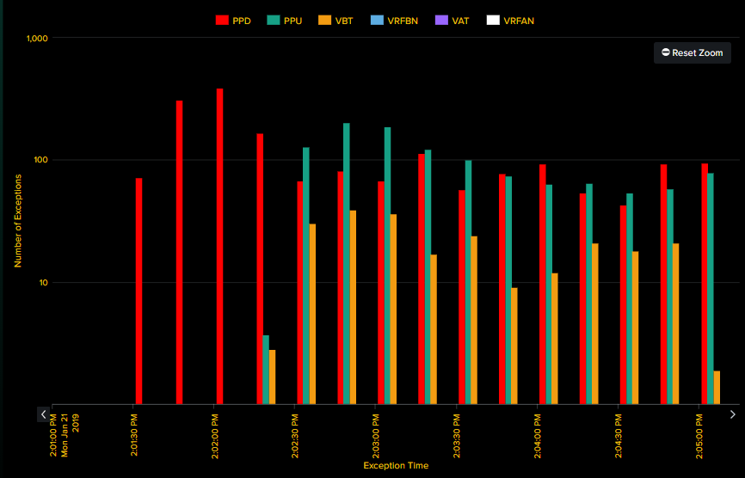
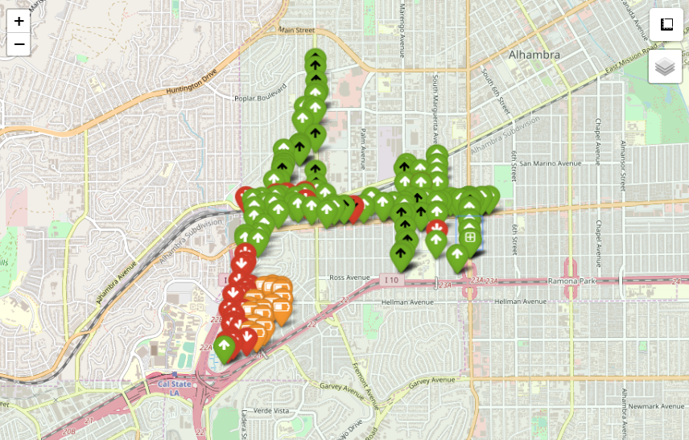
Real-Time Meter Alarms Enable Detection
Notes:
Hazard Reduction Time

Slide 7
Real-Time Meter Alarms Enable Detection
Notes:
Hazard Reduction Time

Slide 8
Technological Solutions in Development
Incorporating data points from additional intelligent devices including-
Distribution Digital Fault Recorders (DFR)
Substation Relays and Circuit Reclosers
Remote Fault Indicators (Overhead and Underground)
Value proposition-
Increased incident location accuracy
Increased detection speed through faster sampling rate
Improved sensitivity to detect more hazards
Overall objective-
Continually improve our capabilities to prevent, detect, and respond to any hazardous conditions.

