Slide 1
CONSUMER IMPACT OF INCREASED NATURAL GAS RESERVES AND HYDRAULIC FRACTURING
Bill Levis, Consumer Counsel
bill.levis@state.co.us
State of Colorado
June 19, 2013

Slide 3
Hydraulic Fracturing
Hydraulic fracturing (“fracking”) releases natural gas in shale by injecting high pressure fluids, usually over 99 percent water and sand, and chemicals.
Total volume of potentially toxic materials can be considerable.
High pressure of injected fluids cracks open shale, freeing trapped gas, which flows through horizontal bore into well casing to surface.
Fracking and horizontal drilling allow for recovering of shale gas economically to power electric plants for decades.

Slide 4
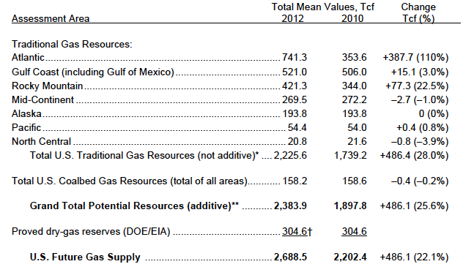
Colorado School of Mines 2013 Report on Natural Gas Reserves in Trillion Cubic Feet

Slide 5
Hydraulic Fracturing by State EPA Progress Report – December 2012

Slide 6
Impact in Colorado
Statewide vs. local (home rule city) control
Colorado Constitution, Article XX, §6, sets up home rule cities whose ordinances supersede generic state laws in conflict
That is, unless legislature (and courts) agree issue one of statewide concern
Governor position: hydraulic fracturing oversight issue of statewide concern
Cities and residents, including those in Longmont, Boulder and Greeley, view issue as one of local concern

Slide 7
Legal History in Colorado
Greeley's City Council enacted and electorate voted for ordinances in 1985 prohibiting oil and gas drilling.
In Voss vs. Lundvall Bros., 830 P.2d 1061 (Colo. 1992), Colorado Supreme Court rejected city’s ban, finding it blocked overriding statewide interest in oil and gas development.
Court found that Oil and Gas Conservation Act, §§34-60-101 to 126, C.R.S., preempts home rule city because of statewide interest in efficient development/production to prevent waste and protect rights of owners/producers.
Although drilling issue of local and statewide concern, state statute supersedes conflicting ordinances.

Slide 8
Not “living in harmony”
Re: “When big oil is made a villain, we all lose,” June 7, 2013 guest commentary in the Denver Post
“… As Greeley residents, we are faced with huge fracking sites within 350 feet of our homes. There are 16 wells approved one block from my home near schools, a recreation center and open areas. Two more fracking projects were approved in the city. One is … east of the University of Northern Colorado campus and another 60-plus wells in a residential area.”
“… Perhaps the people who have profited from the oil and gas industry are living in harmony. Residents, however, are forced to endure the impacts of fracking and drilling and the loss in home value.”

Slide 9
Result is Court Fight
Colorado Oil and Gas Conservation Commission (COGCC), not PUC, regulates natural gas production
COGCC, in Department of Natural Resources, sued City of Longmont in Boulder District Court July 2012
State Court of Appeals in Town of Milliken v. Kerr-McGee Oil & Gas Onshore LP., 2013 COA 72 (May 9, 2013), confirmed power vested in state COGCC, §38-60-101 to 129, C.R.S., to make rules
Point of interest: latest proposed federal rules, issued for comment in May, based on Colorado
Other communities, including Boulder and Greeley, considering rules to limiting fracking

Slide 10
Current Lawsuit
State attorneys using Voss precedent to sue Longmont for passing stricter local regulations on drilling.
Colorado Oil and Gas Association suing Longmont, challenging in-town drilling ban passed by 60% vote and may take legal action against Ft. Collins because council banned new wells.
Boulder just passed one year moratorium on drilling in city.
See Bowens/Edwards v. LaPlata County, 830 P.2d 1045 (CO 1992), (issued same time as Voss) finding not all local land use authority preempted relying on four prong test:
Need for state uniformity
Extraterritorial impact
Where traditionally governed
Whether State Constitution specifically comments on where regulation found

Slide 11
Other Issues in the Fight
Setback from residential areas
Currently 350 feet
COGCC increasing it to 500 feet August 1
What impact does setback have on residents and ability to drill?
Noise
Residents have complained per “in harmony” letter
Result seeks restriction on when/where to drill
Water
Concerns about pollution, unable to reuse
Look at amounts used compared to industry, especially in power plants

Slide 12
EPA Research Project
June 19, 2013
12

Slide 13
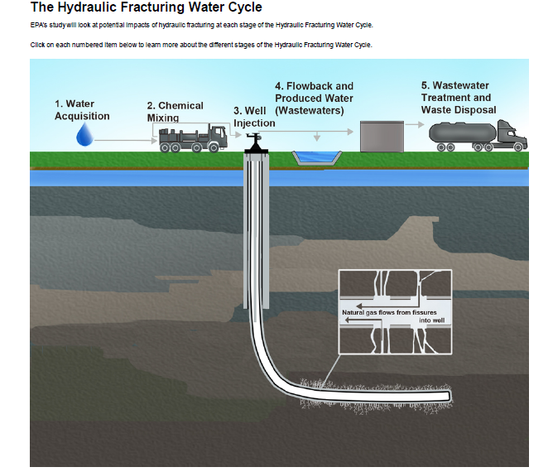

Slide 14
Water Issues
According to EPA December 2012 progress report, fracturing fluids up to 99 percent water
50,000 to 350,000 gallons may be required per well in coalbed formation
Two to five million gallons used to fracture well in shale formation
Waste water may be returned underground using injection well, discharged on surface after treatment or applied to land
Between 15-80 percent of fluids recovered
Some companies reuse fluids to conserve and recycle

Slide 15
Potential Water Risks
Risks to surface and underground water may occur at various stages of process
EPA research project evaluating issues – see December 2012 progress report
Contaminants to drinking water include fracturing fluid chemicals and degradation products and metals and other naturally occurring materials disturbed during fracturing process
Increasing farming and residential water prices

Slide 16
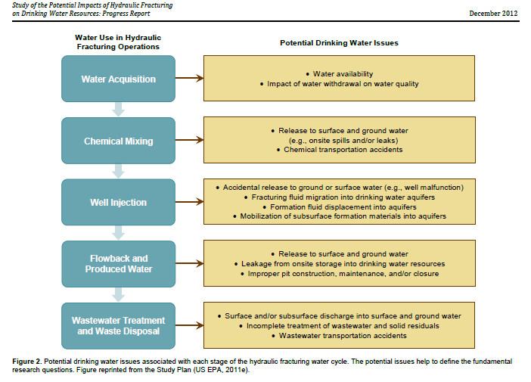
EPA Water Study

Slide 17
EPA Water Study

Slide 18
Additional Issues
Increased realization of who owns mineral rights
In newer subdivisions, mineral rights below ground belong to others
Possibility of earthquakes
Disagreement as to impact
EPA report footnotes indicate possible research
Gasland effect/impact
Gas/flames from faucets
Other environmental/health impacts

Slide 19
What does it all mean?
“Fracking” has negative connotation
Similar to issue of “smart grid” and fears that “smart meters” has engendered
Radio waves
Privacy
One reason for calling it “grid modernization”
Problem once again with fracking is forgetting whom this impacts: the consumer
Would it make any difference if called “below surface drilling?”

Slide 20
In the end, is it all similar to “Big Yellow Taxi” by Joni Mitchell?
“Don’t it always seem to go
That you don’t know what you’ve got
Till it’s gone
They paved paradise
And put up a parking lot”

Slide 21
Now for Something Completely Different - State Telecom Regulation
21 states have high cost funds separate from federal universal service fund
Some states phasing them down in part because of lifeline program
More than half the states have deregulated telecom, especially wireless and VOIP
Once deregulated legislatively, hard to go back

Slide 22
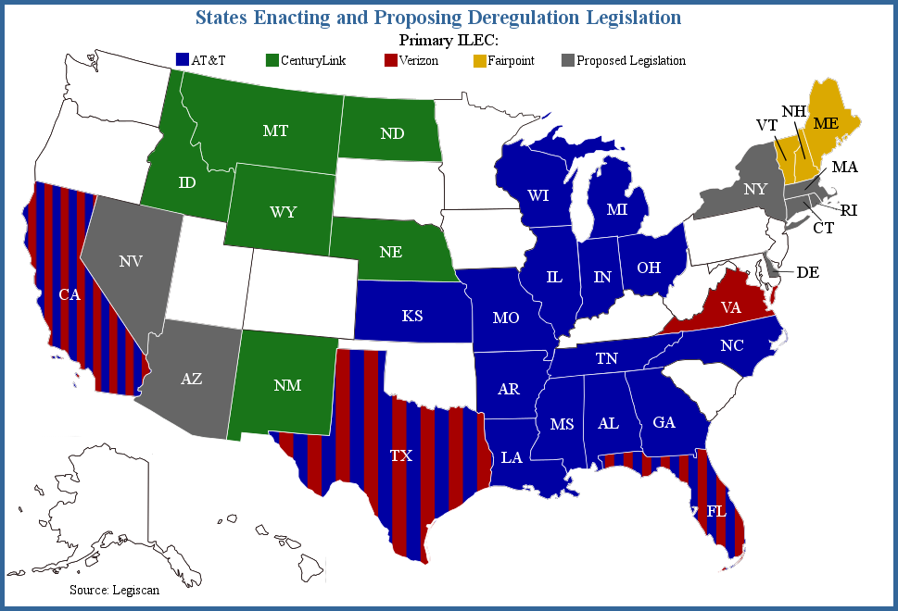
2013 State Legislative Update

Slide 23
Lots of Questions and Concerns
What is definition of basic service today?
Are we talking about voice or video?
How do we define broadband?
Already, 4 mbps down and 1 mbps up in Connect America Plan outdated – NTIA May 13 report
Speeds increasing over time for DSL, wireless, fiber and satellite
Schools and libraries access being updated
Should homes in rural areas receive same speeds?
If so, how?
How to define Lifeline?
Emergency service: Derecho, Hurricane Sandy, Western fires
Reason why Colorado bills failed
Notes:
23

Slide 24
Bottom Line to Telecom Regulation
Who will pay and for what?
Consumers
Providers
Issue of Competition vs. Monopolization
Among Technologies
Considering Satellite
Government Oversight and Public Interest
Emergency service, however defined
Complaint and service quality jurisdiction, regardless of technology
Rate regulation in areas with no competition
VoIP and Broadband where Telecom Service

