Slide 1
Solar Cost Sensitivity Modeling
CPUC Staff Analysis
February 21, 2020

Slide 2
Purpose & Outline
Purpose: CPUC staff analysis to support the resource-to-busbar mapping process in the 2019-2020 IRP cycle
Outline:
Background
Analytical approach
Results
Conclusion

Slide 3
Solar Sensitivity Modeling: Background
Throughout the course of IRP capacity expansion modeling, CPUC staff, consultants, and stakeholders have observed that the location of solar resources selected in IRP modeling can be sensitive to small cost and performance differences between solar resources
California has many areas of high solar resource quality
Other resource types, including wind and geothermal, have more distinct location-specific characteristics
Transmission constraints provided by CAISO help to guide the location of solar resources in IRP modeling, but many iterations of IRP modeling have suggested that solar resources typically “fill in” around other renewable resources (wind and geothermal)
Even though the RESOLVE model deploys all resources simultaneously, results have suggested that, at least conceptually, RESOLVE usually uses system-wide economic factors to determine the capacity of wind and geothermal resources, and then deploys the least cost solar resources “next” using any available transmission
The location-specific cost information available to IRP analysis is not as granular as that available to project developers and therefore may not accurately capture local cost differences

Slide 4
Solar Sensitivity Modeling: Analytical approach
This analysis tests the hypothesis that small cost differences can cause large shifts in the location of solar resources, but will result in minimal changes in the overall resource portfolio (solar vs. wind vs. battery, etc.) and accordingly, minimal differences in the expected cost, reliability, and emissions performance of the portfolio
Two sets of RESOLVE model runs were performed, in which solar costs were reduced by either 5% or 10% relative to base case assumptions
5% and 10% were chosen because they represent a small perturbation to the original solar capital cost, potentially on the order of magnitude of locational cost differences observed in the real world
Two model runs were performed for each CAISO solar resource. In these runs, the cost was reduced by either 5% or 10% for only one solar resource at a time
For example, the 5% Carrizo sensitivity reduces only the cost of Carrizo solar by 5% and leaves all other assumptions unchanged
Results for 2023 and 2030 were examined to detect potential differences between near and long-term effects
The analysis uses a Base Scenario that is similar to, but not aligned completely with, the Reference System Portfolio in the Proposed Decision
The inputs and assumptions are broadly consistent with the 2019 Reference System Portfolio, however the analytical approach focuses on changes relative to the Base Scenario
The applicability of the analytical approach to different portfolios (e.g., with 30 MMT by 2030 GHG target) is discussed
In general, the analysis confirms the hypothesis. This suggests that, for the purpose of providing inputs to the TPP, it may be appropriate to post-process RESOLVE solar location results to consider non-modeling factors (for example, alignment with commercial interest)

Slide 5
MW selected in solar sensitivities
Cost reductions applied for each solar resource one-by-one
Green = no change from base case
Red = increase in resource deployment resulting from solar cost decrease
The available transmission capacity of the existing transmission system is typically a more limiting factor for solar deployment in RESOLVE than the solar resource potential. Consequently, the MW values in the table above frequently “plateau” at the amount of transmission available to solar resource.

Slide 6
MW selected in solar sensitivities: explanations
Color scheme:
Cost reduction doesn’t result in more resource deployment because resource is already selected up to transmission limits in the base case
Small (5% cost reduction) results in most of the available resource being selected
Larger (10% cost reduction) results in most of the available resource being selected
Conclusion: Almost all CAISO solar resources are within 10% of cost-effective, and are therefore likely to be sensitive to local cost information

Slide 7
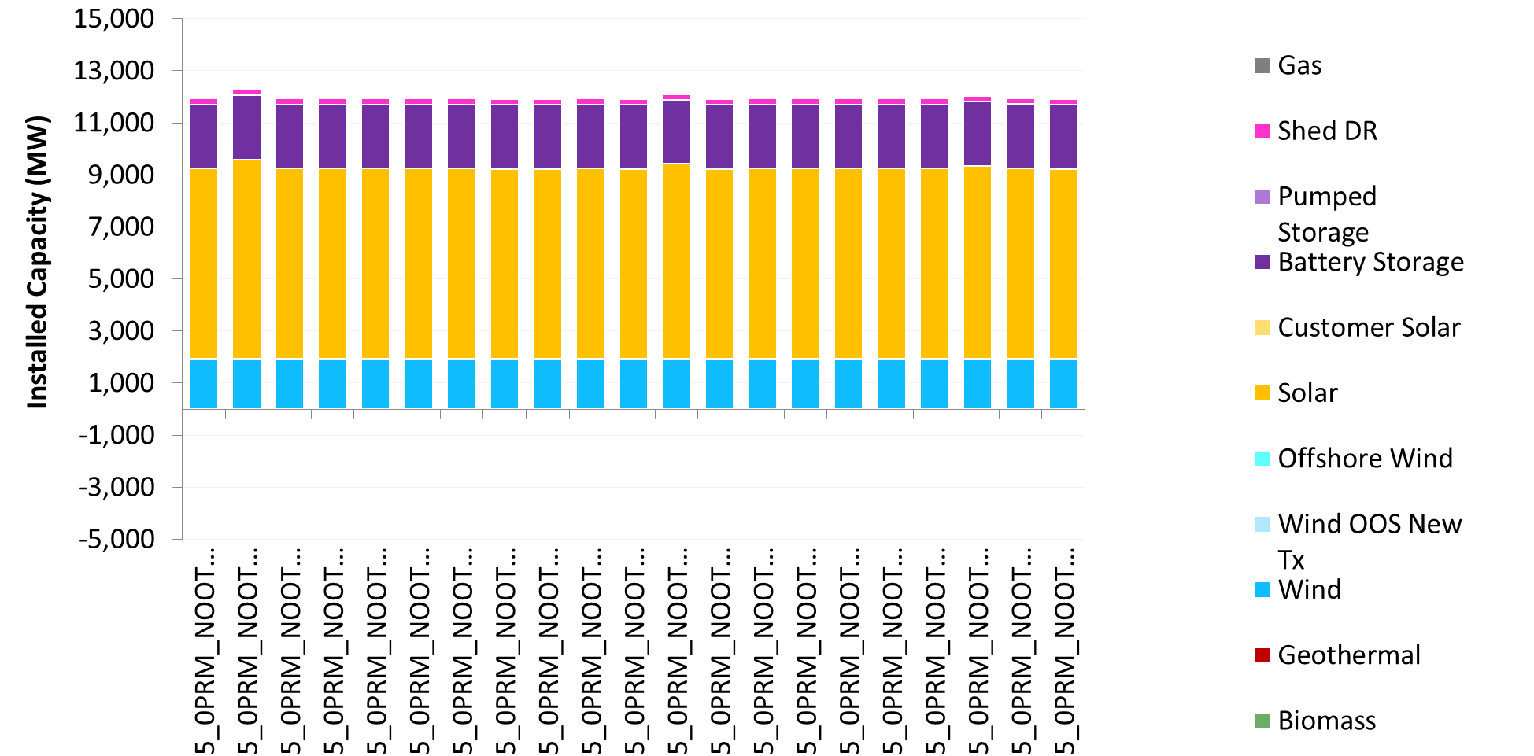
2023, 5% solar cost reduction
Lower costs for areas with significant available transmission can result in slightly more system-wide solar build than the base case.
AZ
Riverside East Palm Springs
Even though the solar resources change location in sensitivities, minimal differences in CAISO-wide resource portfolio are observed
Base Portfolio
Individual solar cost sensitivities (5% cost reduction)

Slide 8
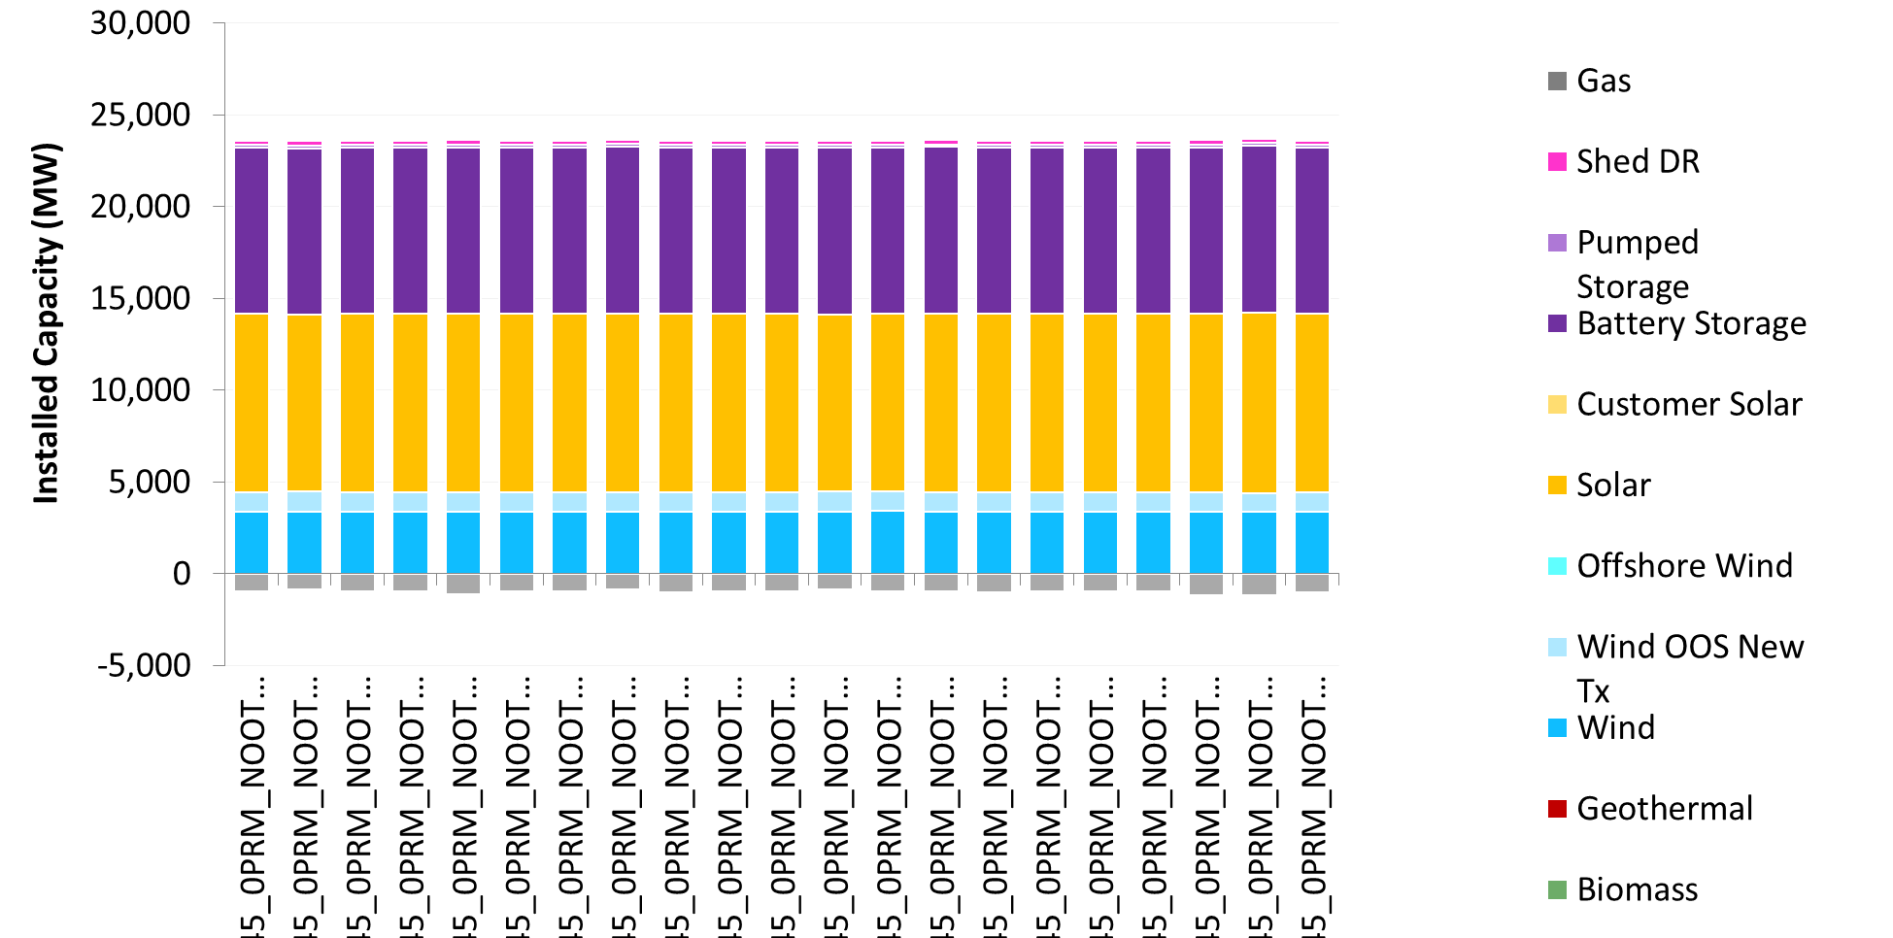
2030, 5% solar cost reduction
Even though the solar resources change location in sensitivities, minimal differences in CAISO-wide resource portfolio are observed
Base Portfolio
Individual solar cost sensitivities (5% cost reduction)

Slide 9
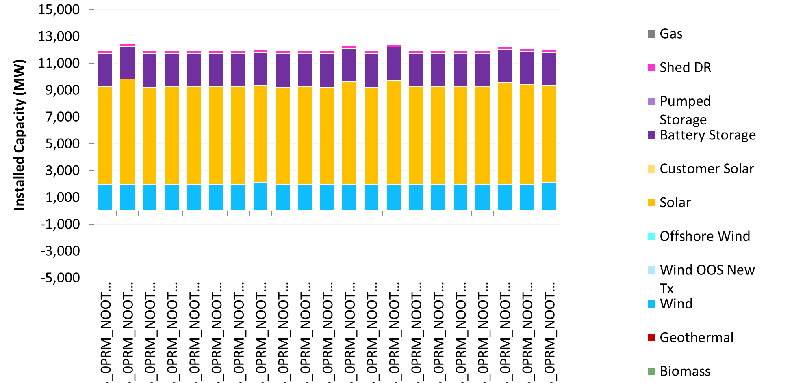
2023, 10% solar cost reduction
Lower costs for areas with significant available transmission can result in slightly more system-wide solar build than the base case.
Riverside East Palm Springs
AZ
SCADSNV
Even though the solar resources change location in sensitivities, minimal differences in CAISO-wide resource portfolio are observed
Base Portfolio
Individual solar cost sensitivities (10% cost reduction)

Slide 10
2030, 10% solar cost reduction
Even though solar resource changes location in sensitivities, minimal differences in CAISO-wide resource portfolio are observed
Base Portfolio
Individual solar cost sensitivities (10% cost reduction)

Slide 11
Conclusion
This analysis tests the hypothesis that small cost differences can cause large shifts in the location of solar resources, but will result in minimal changes in the overall resource portfolio (solar vs. wind vs. battery, etc.) and accordingly, minimal differences in the expected cost, reliability, and emissions performance of the portfolio
In general, the analysis confirms the hypothesis. This suggests that, for the purpose of providing inputs to the TPP, it may be appropriate to post-process RESOLVE solar location results to consider non-modeling factors (for example, alignment with commercial interest)
From experience analyzing numerous IRP scenarios, staff expect this conclusion to have broad relevance to a wide range of portfolios with a similar GHG target
Note that as the GHG target is reduced, the scale of new resources selected generally increases
Given the relatively homogenous nature of California’s solar potential, RESOLVE selects solar with a priority on not triggering new transmission
As the GHG target is reduced, there will be a point where solar is selected up to its limit in each transmission zone and accordingly the significance of this analysis recedes

