Slide 1
SDG&E SPP Non-residential TOU / TOU-CPP
Impact Summary
Prepared by:
Alana Lemarchand
Jonathan Cook
May 11, 2015

Slide 2
Time Varying Rates in SDG&E Territory
SDG&E is in the process of providing time-varying pricing options to most of its customers
1.2 million residential
116,000 small commercial
3,400 agricultural
This evaluation focused on Small commercial and Agricultural customers
Rates became available to select small commercial customers on an opt-in basis in 2014
The remainder of customers will be defaulted onto time-varying rates beginning in November 2015
Goal: Estimate the load impacts for customers who enrolled in 2014 and predict load impacts for the entire small commercial and agricultural population under default enrollment

Slide 3
SDG&E TOU / TOU-CPP rates analyzed
Customer Segment | Rate | Enrollment Policy | Start Date | Current Enrollment | Analysis
Small Commercial | TOU | Opt-in from non-time varying rate | June 18, 2014 | 1,028 | Ex post
 | TOU-CPP | Opt-in from non-time varying rate | July 1, 2014 | 1,132
 | TOU | Opt-in from default TOU-CPP | November 2015 | n/a | Ex ante
 | TOU-CPP | Default | November 2015 | n/a
Agricultural | TOU | Default | November 2015 | n/a
 | TOU-CPP | Opt-in from default TOU | November 2015 | n/a

Slide 4
SMB Ex Post TOU, TOU-CPP Impacts

Slide 5
Participants were structural winners, different from typical SMB; impacts estimated via matched control group & fixed effects regression
Ex Post Analysis
Participant characteristics
Methodology
Initial recruiting for opt-in TOU focused on structural winners
Participants were not representative of entire SMB population
Daily load shapes were predominantly flat or even u-shaped (compared with day-time peaking typical of most SMB customers
Higher than average representation of information and public administration (mostly services) accounts, including irrigation districts (e.g. lawns), water treatment and street lighting
Derived counterfactual using pre-treatment data and matched control group selected from non-participants with similar load shapes
Panel regression model with fixed effects used to estimate impacts
${avgpeakkwh}_{i,t}=β_{0}+β_{1}\left({posttreatment}_{t}∗{treatment}_{i}\right)+β_{2}{posttreatment}_{t}+β_{3}{mean17}_{i,t}+{β_{4}month}_{t}+ε_{i,t}+u_{i}$

Slide 6
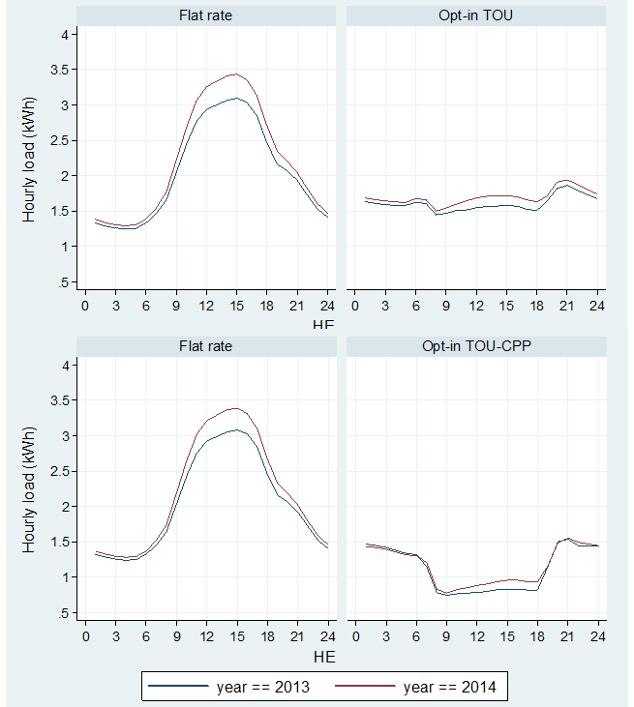
Load shapes for opt-in participants predominantly flat or u-shaped, making them structural winners for a TOU rate
Average Load Shapes for SPP & Non-SPP Customers
Load Shape Clusters by Rate (% of the Population)

Slide 7
Opt-in SMB TOU rate did not cause measureable load reductions for those who enrolled
Ex Post Analysis
Avg. Peak Summer Impacts, TOU (July-Oct 2014)
Observations
TOU impacts for all industries were small and statistically insignificant (p-values ranged 0.82-0.89)
Average monthly bills for most customers in each industry either decreased or remained essentially unchanged
Lack of significant impacts most likely driven by targeting structural winners
Industry | Ref. Load (kW) | Impact (kW) | Std. Error of Impact | P-value of Impact | % Reduction
Information (N=173) | 1.41 | 0.14 | 0.52 | 0.82 | 10%
Public Administration (N=191) | 0.85 | 0.05 | 0.31 | 0.89 | 5%
Other (N=89) | 3.74 | -0.13 | 0.95 | 0.89 | -4%
All Customers (N=493) | 1.63 | 0.05 | 0.30 | 0.87 | 3%
Results not statistically significant

Slide 8
Opt-in SMB TOU-CPP rate did not cause measureable load reductions on regular or event days for those who enrolled
Ex Post Analysis
Avg. Peak Summer Impacts, TOU-CPP (July-Oct 2014)
Observations
TOU-CPP impacts for all industries were small and statistically insignificant (p-values ranged 0.74-0.98)
Impacts for the two event days tested also not significant (Sept 15 & Sept 16, 2014)
Lack of significant impacts most likely driven by targeting of structural winners
Industry | Event day? | Ref. Load (kW) | Impact (kW) | Std. Error of Impact | P-value of Impact | % Reduction
Public Administra-tion (N=190) | No | 0.52 | -0.06 | 0.3 | 0.84 | -13%
 | Yes | 0.59 | 0.01 | 0.38 | 0.98 | 2%
Other (N=120) | No | 1.68 | 0.32 | 0.98 | 0.74 | 19%
 | Yes | 2.02 | -0.35 | 1.28 | 0.79 | -17%
All Customers (N=292) | No | 0.92 | 0.07 | 0.4 | 0.86 | 7%
 | Yes | 1.09 | -0.12 | 0.51 | 0.81 | -11%
Results not statistically significant

Slide 9
SMB and Agriculture Ex Ante TOU, TOU-CPP Impacts

Slide 10
Impact estimate assumptions drawn from outside of SDG&E
SDG&E Ex post impacts could not be used
Insignificant
Not representative
Variety of other issues with impact estimates from other studies
Wrong segment (e.g. residential or Med/Large C&I instead of SMB)
Small samples
Questionable research designs
PG&E Non-res TOU estimates were the best available (though not ideal)
Correct segment (SMB)
Sound design and sample size
Allowed estimation of impacts by industry

Slide 11
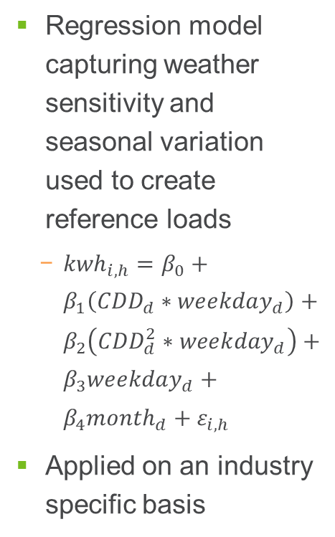
Methodology: Applied PG&E mandatory non-residential TOU impacts to reference loads derived using weather sensitivity model
Ex Ante Analysis
1: Reference loads
2: Assumptions
3: Impacts
Regression model capturing weather sensitivity and seasonal variation used to create reference loads
${kwh}_{i, h}=β_{0}+β_{1}\left({CDD}_{d}∗{weekday}_{d}\right)+β_{2}\left({CDD}_{d}^{2}∗{weekday}_{d}\right)+β_{3}{weekday}_{d}+{β_{4}month}_{d}+ε_{i,h}$
Applied on an industry specific basis
Used average percent impacts from evaluation of mandatory PG&E non-residential TOU
TOU: Applied PG&E impacts specific to
industry
rate block (e.g., peak, shoulder, etc.)
season
day of week
CPP: Assumed to be zero due to lack of empirical evidence

Slide 12
Aggregate TOU peak impacts of 11 to 12 MW in July 2016 for SMB and Agriculture rates
Ex Ante Analysis
Aggregate July 2016 Peak Day Impacts, MW
Observations
Aggregate peak day impacts of 10 to 11 MW for SMB, depending on weather conditions, and about 1.3 MW for Agriculture
Negative impacts for Mfg. sector reflect statistically significant results from PG&E mandatory TOU
All SMB
All Agriculture
All SMB
All Agriculture

Slide 13
Most SMB peak impacts range from 1% to 9%, highly differentiated by industry; Highest for Ag pumping, at 19% peak reduction
Ex Ante Analysis
Avg. July Peak Impacts, SDG&E 1-in-2 weather
Observations
Peak impacts are highly differentiated by industry, potentially reflective of relative load shifting ease:
Low for retail, services, schools, which all operate primarily during the day
High for agriculture, construction, utilities, institutions (includes services such as water treatment, irrigation)
All SMB
All Agriculture
All SMB
All Agriculture

Slide 14
Conclusions

Slide 15
Learnings and observations: Non-residential TOU impacts largely driven by differing economic incentive and ability to shift loads
Ex Post
Ex Ante
Initial recruiting for opt-in TOU focused on structural winners
Participants were very unlike average SMB customers (u-shaped or flat loads)
Analysis did not produce load impact estimates that were statistically different from zero
Aggregate July 2016 peak day impacts of 10 to 11 MW for SMB, depending on weather conditions, and about 1.3 MW for Agriculture
Peak impacts are highly differentiated by industry, which reflects diversity of end uses and willingness/ability to reduce peak load
Highest for Ag pumping
Small for retail, schools
Negative for manufacturing

Slide 16
For comments or questions, contact: Alana Lemarchand Consultant alemarchand@nexant.com
Jonathan Cook Senior Consultant jonathancook@nexant.com
Nexant, Inc. 101 Montgomery St., 15th Floor San Francisco, CA 94104 415-777-0707

