Slide 1
Load Impact Evaluations: Non-residential TOU Rates at PG&E and SCE
Dan Hansen
Marlies Patton
Christensen Associates Energy Consulting
DRMEC Spring Workshop
May 11, 2015

Slide 2
Non-residential TOU Rates
Background
Methodology
Ex-post load impacts (2014)
Ex-ante load impacts (2015 – 2025)

Slide 3
PG&E Program Description
Analyzed the load impacts of small and medium business (SMB) customers who were transitioned to mandatory TOU rates
A-1 (energy only C&I tariff) and A-10 (a demand + energy C&I tariff) customers
Do not estimate ex-post load impacts for agricultural customers because they were not transitioned in March 2014 as had been planned
Transitions have been occurring since 2012
225,000 SMB SAIDs in November 2012 and 18,000 Ag SAIDs in March 2013
104,000 SMB SAIDs in November 2013: these are the SAIDs we study here
Remaining transitions will occur in 2014, 2015, and 2016

Slide 4
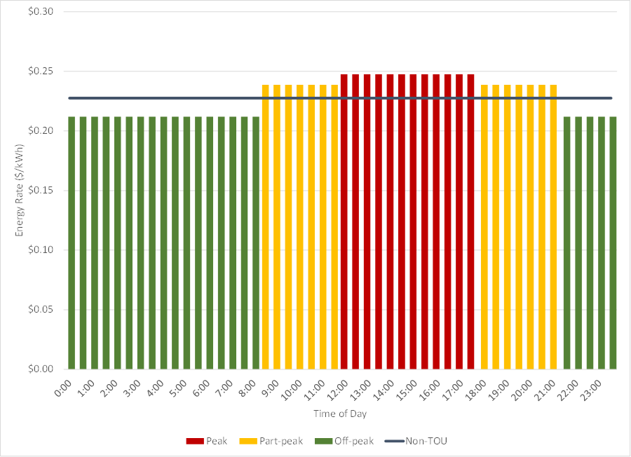
PG&E TOU Energy Rates: A-1

Slide 5
SCE Program Description
Analyzed the load impacts of small and medium business (SMB) customers and agricultural customers who were transitioned to mandatory TOU rates
GS-1 (energy only C&I tariff), GS-2 (a demand + energy C&I tariff), and PA (agricultural) customers
This is the first analysis of TOU transitions for SCE
393,000 SAIDs transitioned to TOU in 2014
SMB transitioned in January 2014
Agricultural accounts (~10,000) in February 2014
209,000 SAIDs expected to transition in 2015 (12,000 of which are agricultural)
98 percent of accounts expected to have bill impacts of less than $100 and 5 percent of the bill per year

Slide 6
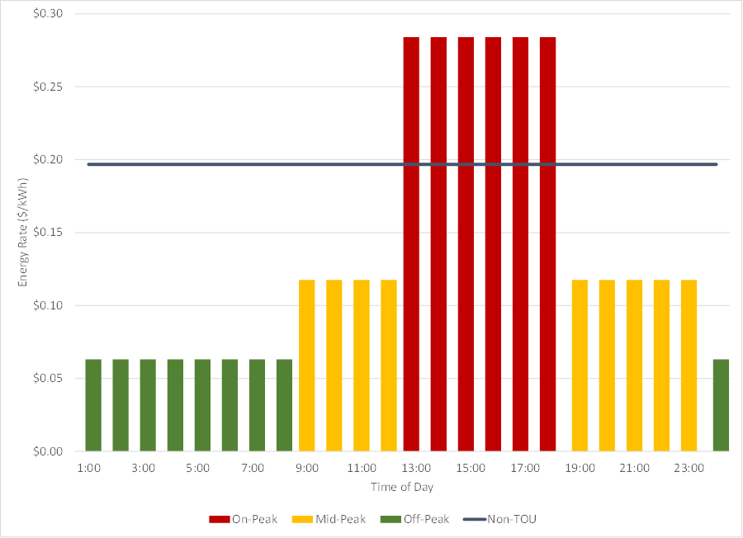
SCE TOU Energy Rates: TOU-GS-1

Slide 7
Methodology
Conduct a difference-in-differences methodology
Treatment versus matched control customers
Before and after TOU rates are implemented
Treatment customers are those transitioned to TOU rates in late 2013 or early 2014
Eligible pool of control-group customers consists of SAIDs yet to be transitioned to TOU rates
Each TOU customer is matched to a control-group customer using propensity score (PS) matching

Slide 8
Methodology (2)
In PS matching, customers are matched using the following characteristics:
Industry group
Weather station
A set of pre-TOU usage-based variables (e.g., average usage by season, weekday/weekend, and hour group)
The TOU and matched control-group customers are combined to estimate TOU load impacts
Fixed-effects model
Difference-in-differences structure helps control for usage differences across years that affect all customers (not just TOU customers), helping isolate the effect of TOU rates on customer load profiles
The following two slides compare treatment and control load profiles from the pre-TOU and TOU time periods

Slide 9
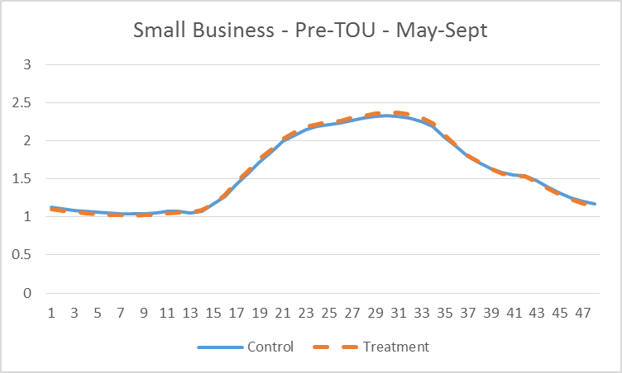
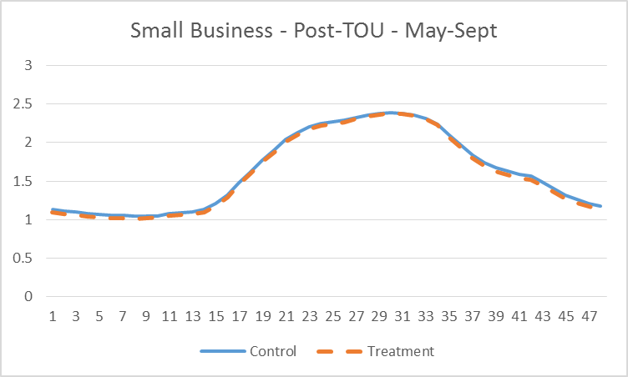
Comparison of TOU and Control Load Profiles: PG&E Small

Slide 10
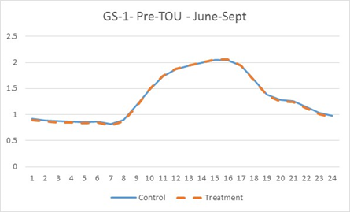
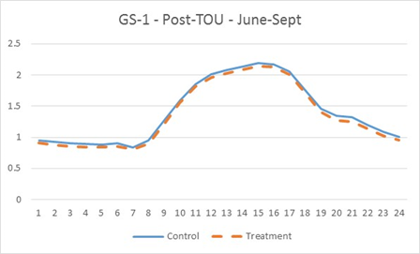
Comparison of TOU and Control Load Profiles: SCE GS-1

Slide 11
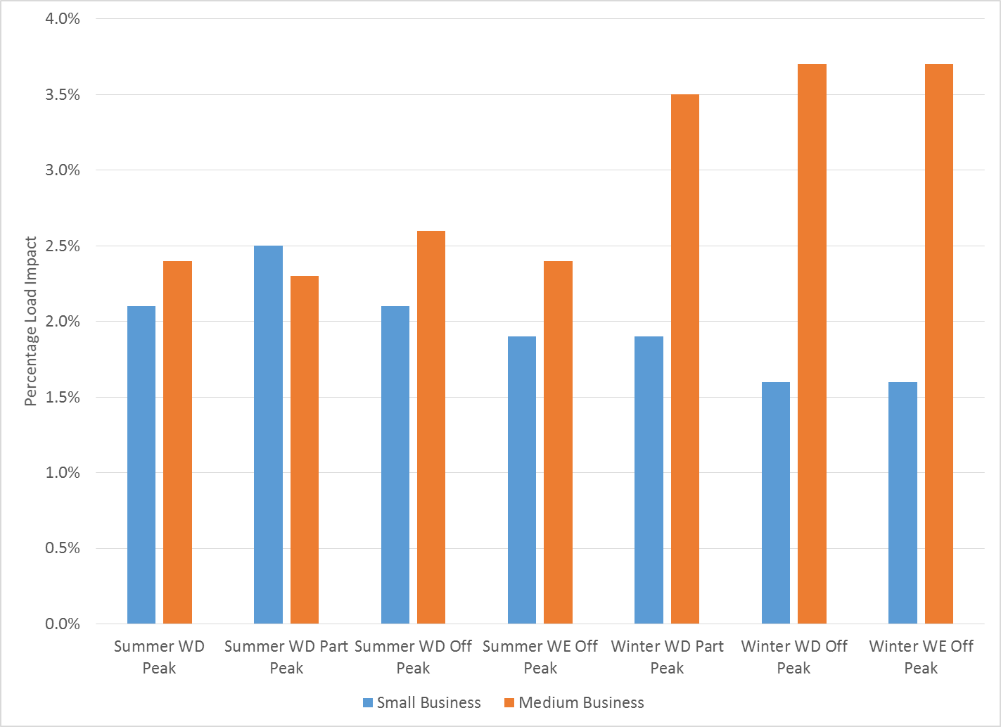
PG&E SMB TOU Load Impact Estimates: PY2014

Slide 12
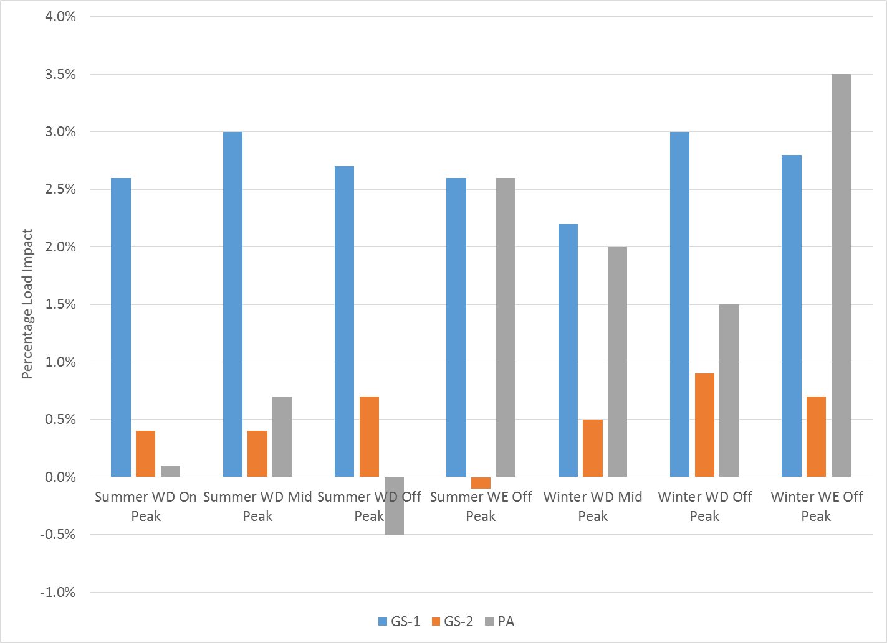
SCE Non-residential TOU Load Impact Estimates: PY2014

Slide 13
Comments on Ex Post Load Impact Estimates
PG&E medium business estimates were sensitive to the PS matching method
A reasonable alternative method resulted in estimated load increases in all pricing periods
Across all groups, the pattern of demand response looks more like conservation than TOU price response
Somewhat uniform percentage load decreases in all periods
Little to no change in on-peak to off-peak usage ratios
PY2013 PG&E study also estimated usage reductions in all TOU pricing periods
Suggests that TOU transition may have increased overall energy awareness rather than induced response to changing energy rates

Slide 14
Ex Ante Load Impacts
Ex ante incremental TOU load impacts are forecast for customers transitioned in 2015 and beyond
The reference loads and load impacts are based on the PY2014 data and ex post estimates
We estimate the weather sensitivity of TOU demand response and apply the estimates to the forecast weather conditions

Slide 15
Ex Ante Load Impacts (2)
Reference loads are simulated for every required group and scenario
Load impacts are based on PY2014, adjusted to forecast weather conditions
Enrollment is the expected number of SAIDs to be transitioned in each year

Slide 16
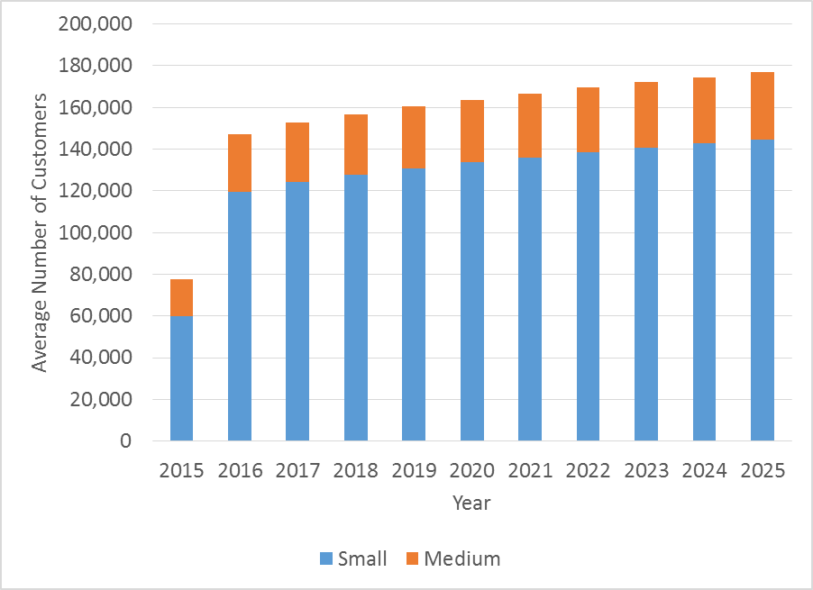
PG&E Ex Ante Incremental TOU Enrollment

Slide 17
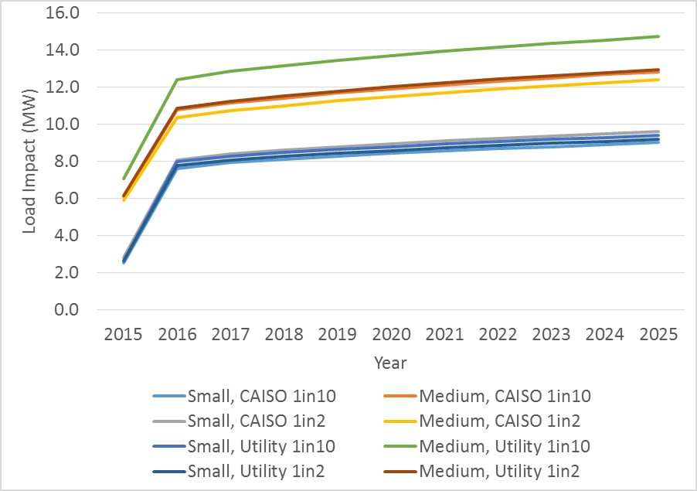
PG&E Ex Ante Incremental Load Impacts, August Peak Day

Slide 18
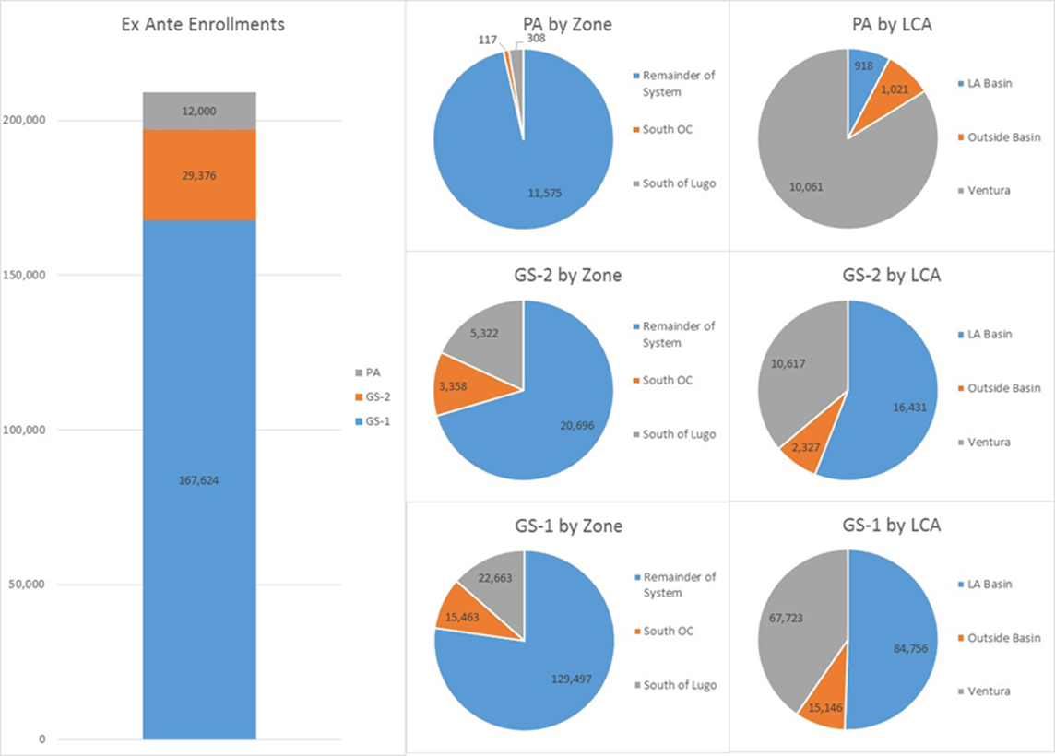
SCE Ex Ante Incremental TOU Enrollment

Slide 19
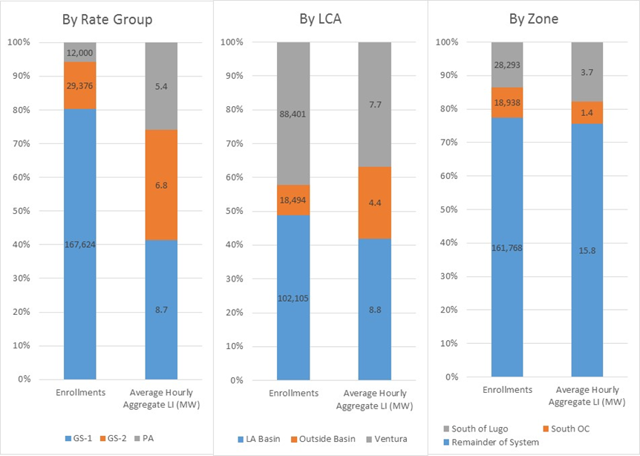
SCE Ex Ante Incremental Load Impacts, August Peak Day

Slide 20
Questions?
Contact – Dan Hansen, Christensen Associates Energy Consulting Madison, Wisconsin
Danh@CAEnergy.com
608-231-2266

