Slide 1
PG&E’s 2014 SmartRate Program Evaluation
Prepared by:
Dr. Stephen George
May 11, 2015

Slide 2
Program Overview

Slide 3
Overview of PG&E’s SmartRate Program
Voluntary, critical peak pricing (CPP) rate that is an overlay on residential customers’ existing rate schedules
High price period from 2 PM to 7 PM on up to 15 event days per summer
Peak price adder is $0.60/kWh
Credits apply to non-peak usage from June through September
Program enrollment at the end of 2014 was roughly 130,000
Increase of about 10,000 customers (8%) since end of 2013
But there were roughly 27,000 new customers enrolled (due to churn)
Customers may participate in both SmartRate and SmartAC, and can have as their underlying tariff PG&E’s standard E-1 tariff or one of two TOU tariffs (E-6 or E-7)
Roughly 31% (40,000) SmartRate customers are also enrolled in SmartAC and have their air conditioners cycled during SmartRate events
Roughly 5,000 SmartRate customers have either E-6 or E-7 as their underlying tariff

Slide 4
Ex Post Methodology and Results

Slide 5
SmartRate Ex Post Methodology
There were 12 event days in 2014, with the first one on May 14 and the last one on September 12
Impacts were estimated by first developing a control group consisting of non-participating customers with loads and other characteristics similar to SmartRate customers and then using a difference-in-differences regression analysis to estimate load impacts
The analysis was conducted separately for SmartRate only and dually enrolled customers
Matching was done by first segmenting customers by LCA, usage quartile, and CARE status
Within each segment, statistical matching was done based on average hourly usage for each hour from 8 AM to 10 PM on the 9 hottest non-event days in 2014

Slide 6
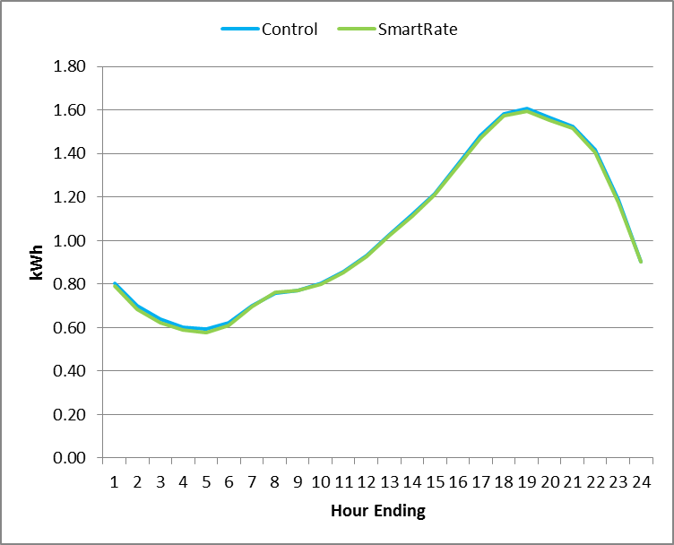
SmartRate Participants vs. Matched Control Group
SmartRate and Matched Control Group Usage on Hot, Non-event Days

Slide 7
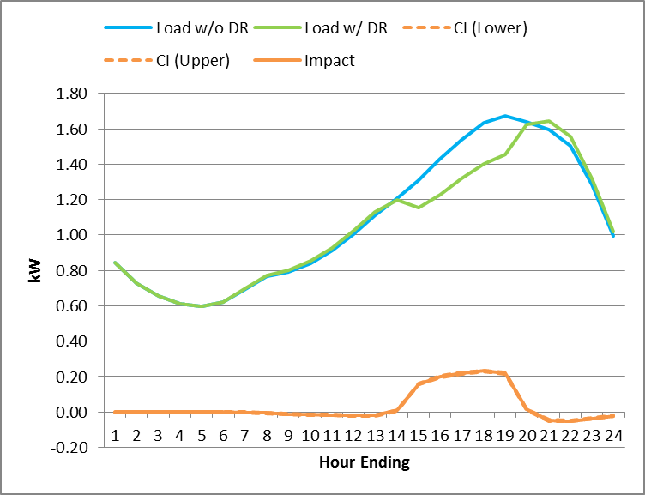
Ex Post Impacts – SmartRate Only
Average hourly impact of 0.21 kW across 12 event days in 2014
This represents about 14% of whole-house load
Impacts ranged from 0.15 kW to 0.27 kW
In percentage terms, impacts ranged from 12% to 16%

Slide 8
Ex Post Impacts by Event – SmartRate Only
Date | Enrolled participants | Avg. Reference Load (kW) | Avg. Load Reduction (kW) | Percent Load Reduction (%) | Aggregate Load Reduction (MW) | Daily Maximum Temp (°F)
14-May | 84,532 | 1.19 | 0.15 | 13% | 13 | 93
9-Jun | 88,694 | 1.77 | 0.27 | 15% | 24.2 | 91
30-Jun | 89,748 | 1.71 | 0.27 | 16% | 24.3 | 90
1-Jul | 89,653 | 1.5 | 0.19 | 13% | 17.2 | 83
7-Jul | 89,487 | 1.33 | 0.16 | 12% | 14 | 83
14-Jul | 89,478 | 1.6 | 0.22 | 14% | 19.8 | 87
25-Jul | 89,583 | 1.63 | 0.24 | 15% | 21.9 | 94
28-Jul | 89,552 | 1.47 | 0.19 | 13% | 17.1 | 85
29-Jul | 89,517 | 1.58 | 0.21 | 13% | 18.8 | 88
31-Jul | 89,504 | 1.67 | 0.21 | 13% | 19.1 | 88
11-Sep | 89,488 | 1.35 | 0.17 | 13% | 15.3 | 89
12-Sep | 89,493 | 1.42 | 0.17 | 12% | 15.2 | 89
Average Event Day | 89,061 | 1.52 | 0.21 | 14% | 18.3 | 88

Slide 9
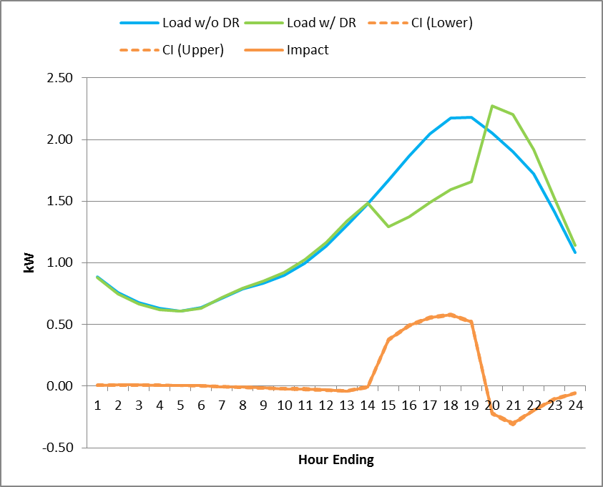
Ex Post Impacts – Dually Enrolled
Impacts for dually enrolled customers were between 2 and 3 times larger than for SmartRate only customers
Average hourly impact of 0.51 kW across 12 event days in 2014
This represents about 25% of whole-house load
Impacts ranged from 0.33 kW to 0.71 kW, or from 21% to 30% of whole house load

Slide 10
Ex Post Impacts by Event – Dually Enrolled
Date | Enrolled participants | Avg. Reference Load (kW) | Avg. Load Reduction (kW) | Percent Load Reduction (%) | Aggregate Load Reduction (MW) | Daily Maximum Temp (°F)
14-May | 37,713 | 1.46 | 0.37 | 25% | 14 | 94
9-Jun | 40,107 | 2.44 | 0.7 | 29% | 28.2 | 99
30-Jun | 40,536 | 2.35 | 0.71 | 30% | 28.8 | 98
1-Jul | 40,528 | 1.88 | 0.43 | 23% | 17.6 | 89
7-Jul | 40,523 | 1.58 | 0.33 | 21% | 13.3 | 89
14-Jul | 40,541 | 2.17 | 0.58 | 27% | 23.5 | 95
25-Jul | 40,573 | 2.18 | 0.58 | 27% | 23.5 | 99
28-Jul | 40,570 | 1.87 | 0.41 | 22% | 16.6 | 91
29-Jul | 40,572 | 2.09 | 0.51 | 24% | 20.6 | 95
31-Jul | 40,560 | 2.24 | 0.55 | 25% | 22.4 | 96
11-Sep | 40,570 | 1.72 | 0.43 | 25% | 17.6 | 95
12-Sep | 40,551 | 1.85 | 0.46 | 25% | 18.7 | 96
Average Event Day | 40,279 | 1.99 | 0.51 | 25% | 20.4 | 94

Slide 11
2014 Impacts Were Lower Than 2013 Impacts
Average impacts declined from 2013 to 2014 by about 20% in spite of event day temperatures being very similar
Average impact for SmartRate only customers in 2013 was 0.26 kW (16%), while the impact in 2014 was 0.21 kW (14%)
Average impact for dually enrolled customers in 2013 was 0.63 kW (29%), while the impact in 2014 was 0.51 kW (25%)
There are three potential explanations for this difference
Differences in load shapes or demand response for the 27,000 new participants compared with prior participants
Lack of persistence in price response among participants
Spillover impacts on non-event days which, given the matching methodology, would produce a downward bias in the impact estimates because matching is based on non-event day loads
Further analysis indicated that
The difference was not due to new participants who actually had higher loads and load impacts than prior participants
Spillover effects might explain as much as 25% of the difference for SmartRate only participants and as much as 40% for dually enrolled participants
The rest may be due to a drop off in price responsiveness for multi-year participants

Slide 12
Ex Post Impacts by Local Capacity Area
The Bay Area contains roughly 44% of SmartRate customers but produces only about 33% of the programs impacts
Dually enrolled customer account for only 30% of participants but account for more than half of the aggregate demand reductions
Local Capacity Area | Dually Enrolled Customers |  | SmartRate Only |  | All Customers
 | # of Participants | Aggregate Load Reduction (MW) | # of Participants | Aggregate Load Reduction (MW) | # of Participants | Aggregate Load Reduction (MW)
Greater Bay Area | 15,010 | 5.9 | 43,357 | 6.1 | 58,367 | 12.0
Greater Fresno Area | 4,020 | 2.5 | 6,064 | 2.0 | 10,084 | 4.5
Humboldt | 214 | 0.1 | 1,191 | 0.2 | 1,405 | 0.3
Kern | 2,030 | 1.4 | 6,783 | 1.8 | 8,813 | 3.2
North Coast and North Bay | 2,201 | 0.6 | 3,746 | 0.4 | 5,947 | 1.0
Other | 7,878 | 4.2 | 16,644 | 3.7 | 24,522 | 7.9
Sierra | 4,778 | 3.4 | 5,624 | 2.6 | 10,402 | 6.0
Stockton | 4,149 | 2.3 | 5,653 | 1.5 | 9,802 | 3.8
All | 40,279 | 20.4 | 89,061 | 18.3 | 129,340 | 38.7

Slide 13
Ex Post Load Impacts by CARE Status
Impacts for SmartRate only CARE customers were roughly 1/3 as large as for non-CARE customers but impacts were much more similar between dually CARE and Non-CARE enrolled customers
CARE Status |  | # of Accounts | Average Reference Load (kW) | Average Estimated Load with DR (kW) | Average Load Reduction (kW) | % Load Reduction | Average Maximum Event Temperature (°F)
SMR-Only | Non-CARE | 68,491 | 1.43 | 1.19 | 0.24 | 17% | 86
 | CARE | 20,570 | 1.81 | 1.71 | 0.10 | 6% | 94
Dually enrolled | Non-CARE | 32,115 | 1.91 | 1.39 | 0.52 | 27% | 94
 | CARE | 8,164 | 2.30 | 1.83 | 0.47 | 20% | 97

Slide 14
Ex Ante Analysis

Slide 15
Ex Ante Methodology
Average load impacts per customer were estimated using a regression model relating ex post load impacts from 2013 and 2014 events to weather conditions
Separate models were estimated for each hour (a deviation from the method used in prior years)
Separate models were estimated for each LCA and for SmartRate only and dually enrolled customers
Ex ante weather conditions were used as input to estimate ex ante load impacts for the 1-in-2 and 1-in-10 year weather conditions under two different weather scenarios
PG&E driven peak weather conditions versus CAISO driven peak weather conditions – PG&E peak weather conditions are hotter than CAISO conditions
Aggregate impacts equal the average impact per customer times the forecasted number of participants
PG&E forecasted only very modest changes in program enrollment

Slide 16
Example: Ex Post Impacts versus Mean17
SmartRate Only
Dually Enrolled

Slide 17
2015 SmartRate Ex Ante Load Impact Estimates (PG&E)
Aggregate impacts vary significantly across months and weather year conditions
1-in-10 year annual peak impacts are almost 30% higher than 1-in-2 year annual peak impacts
Weather Year | Day Type | Mean Hourly Per Customer Impact (SmartRate- only) (kW) | Mean Hourly Per Customer Impact (Dually Enrolled) (kW) | Aggregate Mean Hourly Impact (SmartRate- only) (MW) | Aggregate Mean Hourly Impact (Dually Enrolled) (MW) | Aggregate Mean Hourly Impact (Full Program) (MW)
1-in-2 | Typical Event Day | 0.19 | 0.49 | 17.7 | 21.1 | 38.8
 | May Monthly Peak | 0.13 | 0.27 | 11.4 | 11.5 | 22.9
 | Jun Monthly Peak | 0.20 | 0.51 | 17.8 | 21.8 | 39.6
 | Jul Monthly Peak | 0.20 | 0.51 | 17.9 | 22.0 | 39.9
 | Aug Monthly Peak | 0.20 | 0.49 | 18.1 | 21.5 | 39.6
 | Sep Monthly Peak | 0.19 | 0.44 | 17.2 | 19.6 | 36.8
 | Oct Monthly Peak | 0.11 | 0.16 | 10.2 | 7.3 | 17.5
1-in-10 | Typical Event Day | 0.24 | 0.58 | 21.7 | 25.3 | 46.9
 | May Monthly Peak | 0.23 | 0.53 | 20.7 | 22.5 | 43.2
 | Jun Monthly Peak | 0.25 | 0.59 | 22.8 | 25.1 | 47.8
 | Jul Monthly Peak | 0.25 | 0.66 | 22.8 | 28.5 | 51.3
 | Aug Monthly Peak | 0.23 | 0.60 | 21.6 | 26.5 | 48.0
 | Sep Monthly Peak | 0.21 | 0.48 | 19.7 | 21.5 | 41.2
 | Oct Monthly Peak | 0.18 | 0.36 | 16.7 | 16.2 | 32.9

Slide 18
2015 SmartRate Ex Ante Load Impact Estimates (CAISO)
There are significant differences in aggregate load impacts between PG&E peak weather and CAISO peak weather, especially for selected months
Impacts for the August 1-in-2 year peak are 30% less under CAISO weather conditions compared with PG&E weather conditions
Weather Year | Day Type | Mean Hourly Per Customer Impact (SmartRate- only) (kW) | Mean Hourly Per Customer Impact (Dually Enrolled) (kW) | Aggregate Mean Hourly Impact (SmartRate- only) (MW) | Aggregate Mean Hourly Impact (Dually Enrolled) (MW) | Aggregate Mean Hourly Impact (Full Program) (MW)
1-in-2 | Typical Event Day | 0.17 | 0.39 | 15.4 | 16.9 | 32.3
 | May Monthly Peak | 0.11 | 0.24 | 10.1 | 10.4 | 20.4
 | Jun Monthly Peak | 0.19 | 0.48 | 17.7 | 20.5 | 38.2
 | Jul Monthly Peak | 0.18 | 0.45 | 16.4 | 19.7 | 36.1
 | Aug Monthly Peak | 0.15 | 0.33 | 14.0 | 14.4 | 28.5
 | Sep Monthly Peak | 0.15 | 0.30 | 13.5 | 13.1 | 26.6
 | Oct Monthly Peak | 0.11 | 0.16 | 10.1 | 7.2 | 17.3
1-in-10 | Typical Event Day | 0.20 | 0.50 | 18.5 | 21.7 | 40.2
 | May Monthly Peak | 0.16 | 0.36 | 14.5 | 15.4 | 29.9
 | Jun Monthly Peak | 0.19 | 0.46 | 17.7 | 19.7 | 37.4
 | Jul Monthly Peak | 0.23 | 0.60 | 21.1 | 26.0 | 47.2
 | Aug Monthly Peak | 0.21 | 0.54 | 19.3 | 23.8 | 43.2
 | Sep Monthly Peak | 0.17 | 0.40 | 16.0 | 17.6 | 33.6
 | Oct Monthly Peak | 0.15 | 0.30 | 13.6 | 13.5 | 27.1

Slide 19
Relationship Between Ex Post and Ex Ante Estimates (SmartRate Only Plus Dually Enrolled)
Factor | Aggregate Load Impact (MW) | Explanation
Ex-Post Impact | 38.7 | Combined SmartRate only & dually enrolled
Ex-Post Impact with Ex-Ante Enrollment | 40.8 | Enrollment is projected to increase slightly
Ex Ante Model Ex Post Weather and Event Window | 43.0 | Impacts from 2013, when impacts were higher, were used together with impacts from 2014 to estimate the ex ante model
Ex Ante Model Ex Post Weather RA Event Window | 34.0 | The event window includes an hour that is not in the RA window – reduces impacts by 20%
CAISO 1-in-2 | 32.3 | Ex post mean17 = 76.5 CAISO mean 17 = 75.7
PG&E 1-in-2 | 38.8 | Ex post mean17 = 76.5 PG&E mean 17 = 78.4
CAISO 1-in-10 | 40.2 | Ex post mean17 = 76.5 CAISO mean 17 = 79.0
PG&E 1-in-10 | 47.0 | Ex post mean17 = 76.5 PG&E mean 17 = 81.9

Slide 20
For comments or questions, contact: Dr. Stephen George Senior Vice President, Utility Services sgeorge@nexant.com
415 948-2328
Nexant, Inc. 101 Montgomery St., 15th Floor San Francisco, CA 94104 415-777-0707

