Slide 1
2014 Load Impact Evaluation of Southern California Edison’s Peak Time Rebate Program
Prepared by:
Dr. Eric Bell
May, 2015

Slide 2
Presentation overview
Program Overview
Evaluation Objectives
Ex Post Methodology
Ex Post Results
Ex Ante Methodology
Ex Ante Results

Slide 3
Program Overview

Slide 4
SCE Save Power Days (SPD) program overview
Program Overview
SCE may call PTR events on a day-ahead basis year-round on non-holiday weekdays.
Event hours: 2:00 p.m. through 6:00 p.m.
Notification types: voice, text, or email alerts
Customers signed up for notification receive phone, text message or email alerts that PTR credits are in effect from 2 to 6 PM the following day
Most customers earn a rebate of $0.75 per kWh reduced
Customers with approved enabling technology, such as programmable communicating thermostats (PCT), are eligible to earn an additional $0.50 per kWh reduced, for a total incentive of $1.25 per kWh
Bill credit is calculated based on 2 to 6 PM load reduction below customer-specific reference level (CSRL)
The CSRL is defined as the average 2:00 p.m. through 6:00 p.m. usage for the highest three (3) of five (5) previous weekdays, excluding PTR event days and holidays. Customers with event period usage below their CSRL receive PTR credits.
8 Events in 2014
7/14, 8/4, 9/2, 9/8, 9/11, 9/15, 9/17, 10/3

Slide 5
Brief history of SPD (PTR) program eligibility
Program Overview
In 2012 and 2013, PTR was the default rate option for residential customers with a smart meter (nearly everyone was eligible for a rebate)
Additionally, SCE encouraged residential customers to directly enroll in notifications of PTR events by email, text message and/or phone
My Account customers were defaulted onto email PTR notifications
Default notification customers were ultimately contacted and asked if they would like to opt-in for PTR notifications, dropping non-responsive and declining customers from the program
Starting in 2014, SCE requires that residential customers directly enroll in the SPD program to receive notification in order to receive PTR credits

Slide 6
Opt-in PTR enrollment by customer category- year end 2014
Program Overview
Customer Category |  | N | %
LCA | LA Basin | 337,139 | 83.24 %
 | Outside LA Basin | 30,068 | 7.42 %
 | Ventura | 37,801 | 9.33 %
SONGS Region | South of Lugo | 122,485 | 30.24 %
 | South Orange County | 45,440 | 11.22 %
 | Neither | 237,096 | 58.54 %
Non-SDP / SDP | Non-SDP | 310,702 | 76.71 %
 | SDP | 94,319 | 23.29 %
Non-Care / Care | Non-CARE | 264,240 | 65.24 %
 | CARE | 140,781 | 34.76 %
Size | Avg. kW Less than 1 kW | 285,560 | 70.5 %
 | Avg. kW More than 1 kW | 119,461 | 29.5 %
Alert Type | Text Only | 274,197 | 69.7 %
 | Phone Only | 36,764 | 9.35 %
 | Email Only | 82,438 | 20.96 %
All Customers |  | 405,008 | -
As of year end 2014, there were 405,008 active opt-in alert PTR participants
28% of current participants enrolled in 2013 prior years
Newer enrollees are more likely to receive notification of PTR events through text message, which may improve awareness of PTR events
Text only notification increased from 29% in 2013 to 70% in 2014
Email only notification dropped from 54% in 2013 to 21% in 2014
For comparison, there were approximately 600,000 default alert customers (My Account) in 2013

Slide 7
Evaluation Objectives

Slide 8
Scope of evaluation
Evaluation Objectives
The 2014 SCE PTR load impact evaluation focused on the following three customer segments:
Opt-in alert PTR customers (opt-in): Customers that voluntarily enrolled in PTR event notification by phone, text message, or email (approximately 405,000 customers);
Customers with in-home displays (IHD): Customers who received IHDs (approximately 770 customers); and
Third-party PCT customers: Customers that have a programmable communicating thermostat (PCT) and participated in the third-party PCT study, which enabled demand response during 2014 PTR events (approximately 3,200 customers).

Slide 9
Evaluation objectives
Evaluation Objectives
For each of the three participant groups, the objectives of the load impact evaluation were to:
Estimate hourly ex post load reductions on the eight 2014 PTR event days (aggregate and per-customer level)
Estimate ex post load reductions for each SCE local capacity area (LCA) and for areas affected by the SONGS closure (South of Lugo and Southern Orange County)
For the Opt-in PTR and PCT customers, additional objectives include:
Forecast 2015–2025 PTR hourly ex ante load impacts for a 1-in-2 and 1-in-10 weather year by month, coincident with SCE’s monthly system peak (aggregate and per-customer level)
Estimate ex ante load reductions for each LCA and for areas affected by the SONGS closure
Significant changes for 2014
Forecast 2015–2025 PTR hourly ex ante load impacts for a 1-in-2 and 1-in-10 weather year by month, coincident with the CAISO system peaking conditions (aggregate and per-customer level)
No default PTR enrollment, opt-in PTR only

Slide 10
Ex Post Methodology

Slide 11
Overview of ex post analysis methodology
Ex Post Methodology
Reference loads for the PTR impact estimates were calculated using a matched control group drawn from the non-participant population
Non-participant customers have not provided load impacts in the past (and are no longer eligible for rebates), so they serve as good candidates for the control group
Control group was selected using a propensity score match to find non-participant customers who had similar load shapes to the PTR customers on proxy event days (within the same weather station area and average daily energy use quartile)
Matching variables: Average Daily kWh, Hourly kWh: 11 AM to 9 PM,
Each customer in the participant population was matched with a customer in the non-participant population with the closest propensity score
The analysis included the entire population of PTR customers, and was not based on a sample
The entire SCE residential non-participant population was used as a pool for matching (approximately 3.8M customers)
Load impact estimates were based on the difference in loads for the participant and control group customers on the event day minus the difference in load between the two groups on similar, nonevent days (what is referred to as a difference-in-differences analysis)

Slide 12
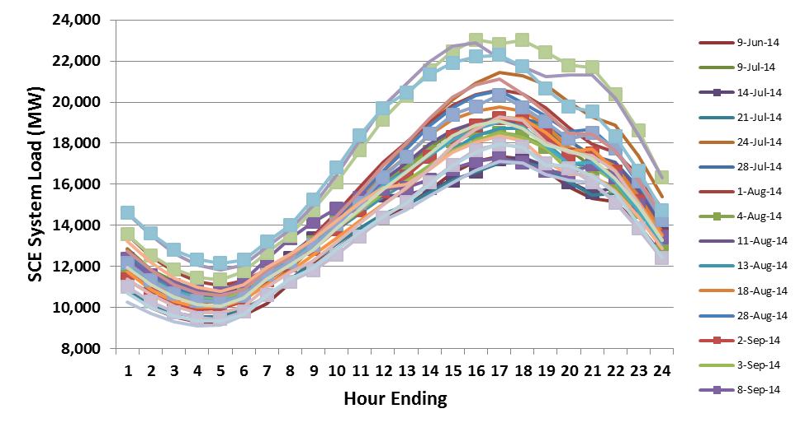
Matched control group
Ex Post Methodology
There were many non-event weekdays with similar load as event days, which is ideal for developing a matched control group
*PTR event days are marked by squares

Slide 13
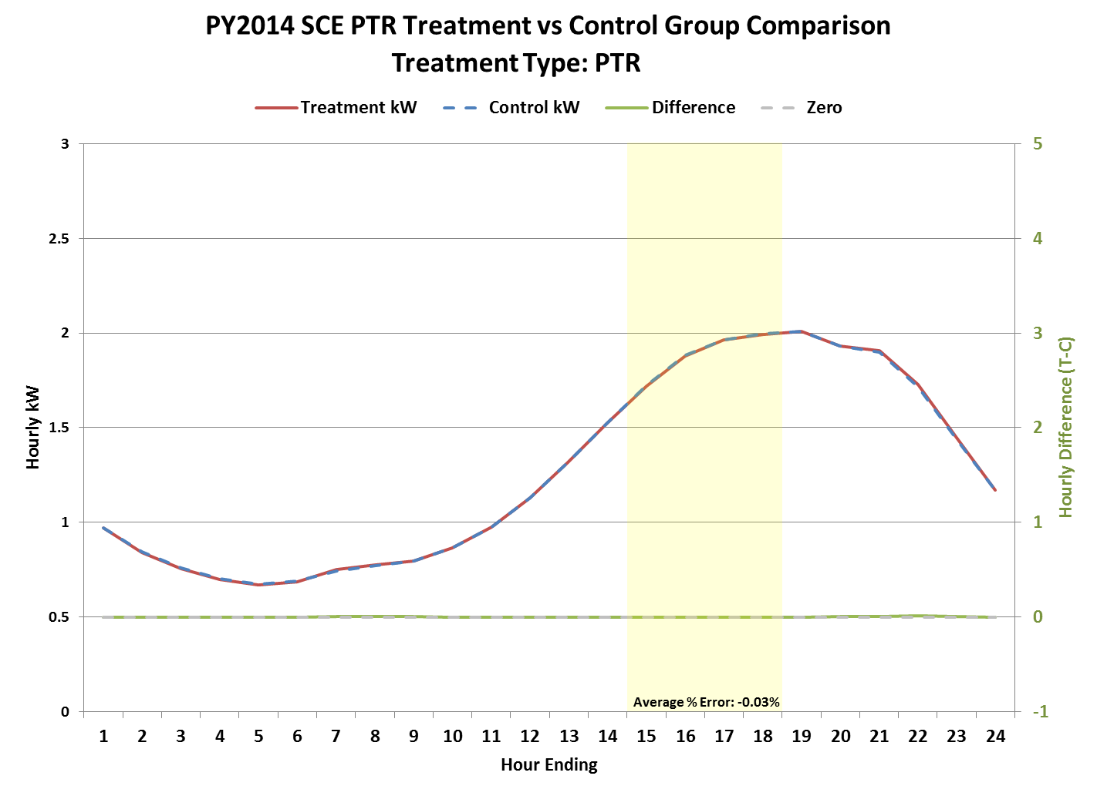
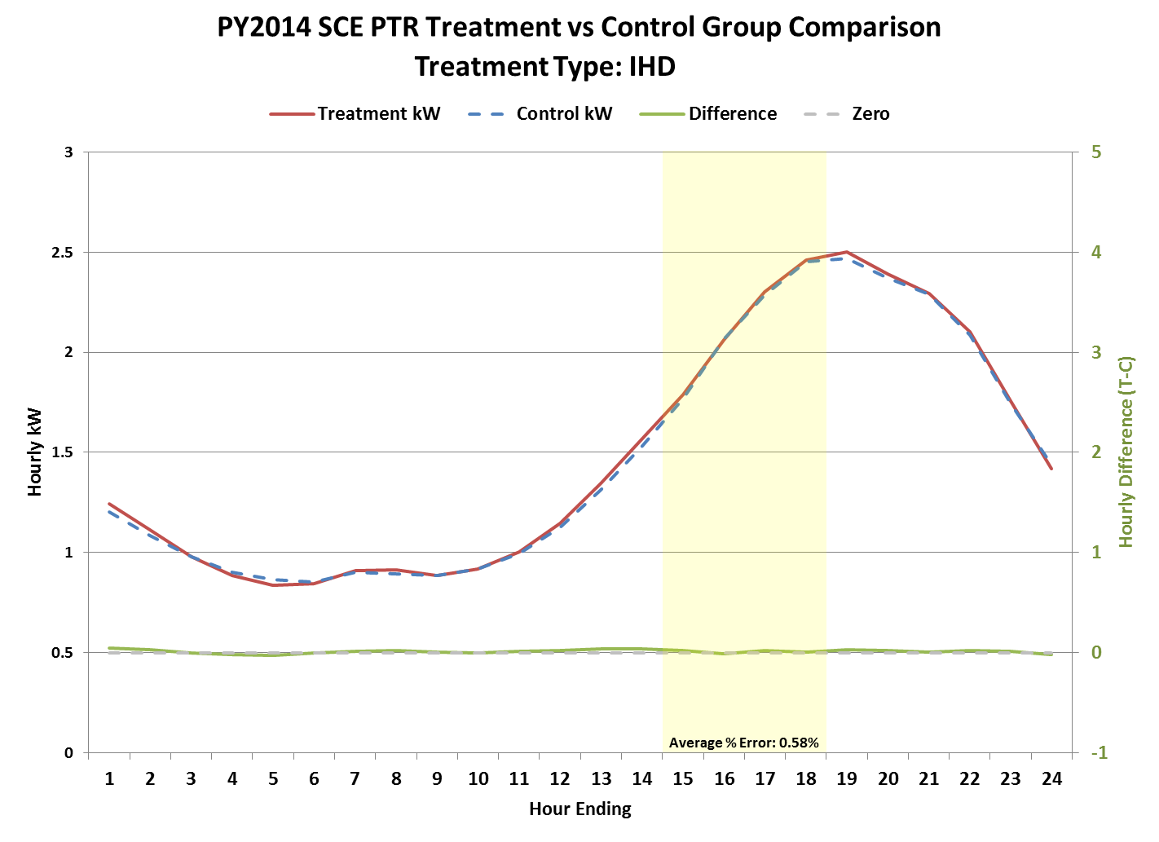
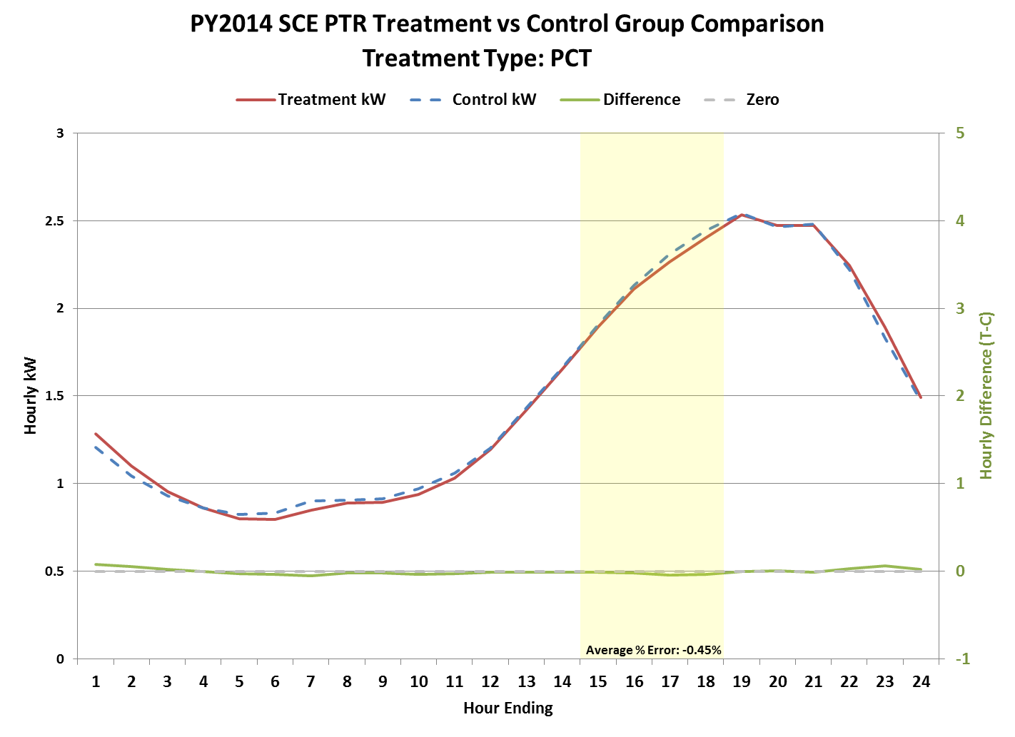
Matching results
Ex Post Methodology
Report includes many validations to show that the model produced accurate estimates
Difference-in-differences was used to calculate impacts, but the magnitude of the adjustment was small
13

Slide 14
Ex Post Results

Slide 15
Average Event Ex Post Load Impact Estimates (2-6 PM)
Ex Post Results
Participant Group | Number of Customers¹ | Avg. Reference Load (kW) | Avg. Load w/ DR (kW) | Avg. Load Impact (kW) | % Load Impact | Aggregate Load Impact (MW) | Heat Buildup (Avg. °F, 12 AM to 5 PM)
Opt-in PTR | 362,938 | 1.77 | 1.69 | 0.08 | 4.4% | 28.07 | 77.4
IHD | 668 | 2.30 | 2.25 | 0.05 | 2.0% | 0.03 | 77.2
PCT | 2,650 | 2.25 | 1.64 | 0.60 | 26.9% | 1.6 | 77.8
Opt-in PTR load impacts were similar to the 2013 impacts
PCT average load impacts per customer decreased by 20% compared to 2013
Reference loads decreased by 10% in 2014 compared to 2013
Existing customers provided a similar percentage load impact between 2013 and 2014
Newly recruited customers exhibited a smaller load impact in both kW and percentage terms
Note: For each event day, if a PTR participant was also activated for SDP – SCE’s AC cycling program – that participant was removed from the ex post load impact estimates for PTR in order to avoid overestimating PTR impacts

Slide 16
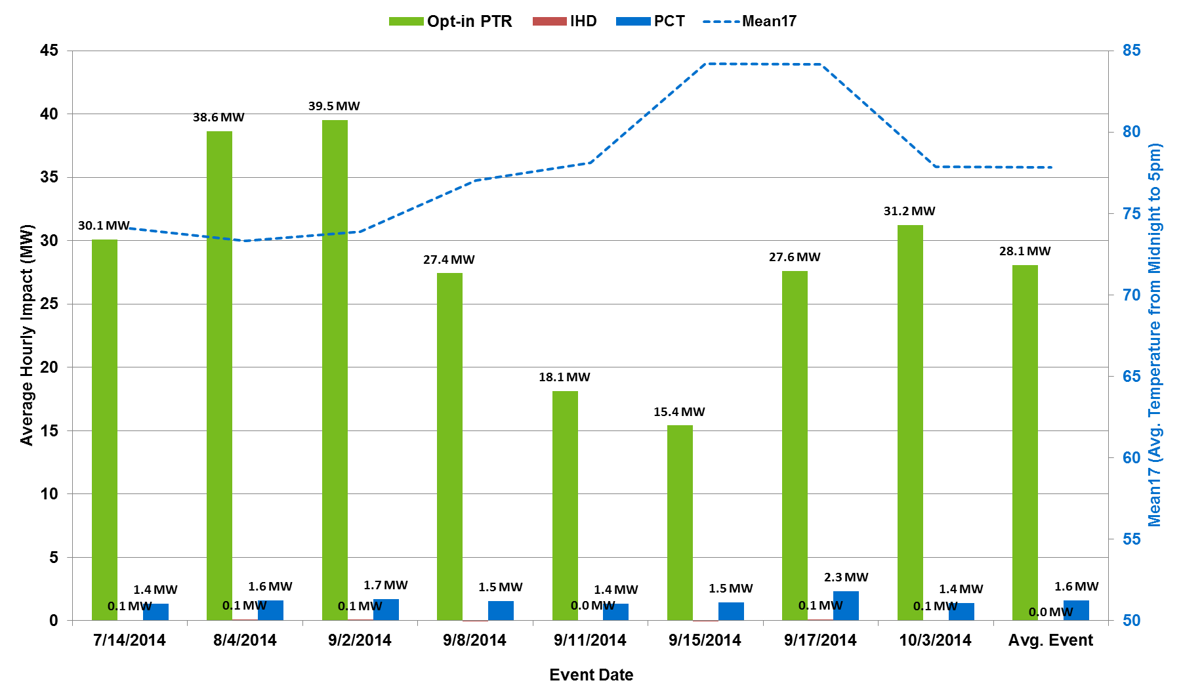
Aggregate Load Reductions (MW) by Event Day and Group
Ex Post Methodology
16

Slide 17
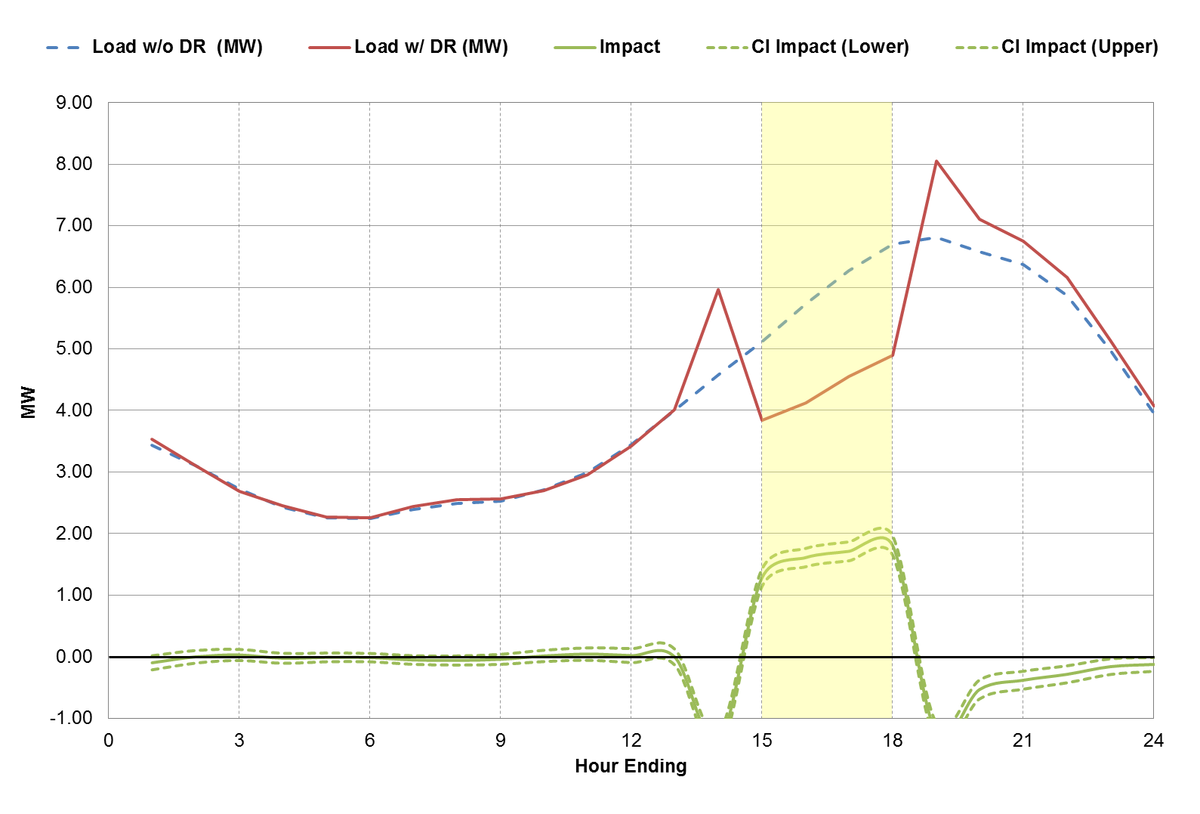
Average ex post event results for PCT customers
Ex Post Results
PCTs delivered substantial pre-cooling before the event period
In the hour before the event, the load impact was negative 30% (-1.39 MW), which means that there was a large increase in cooling load before the event began (intended to mitigate discomfort during the event period)
The event start time of 2 PM results in the precooling occurring during the hour starting at 1 PM, which is inside the Resource Adequacy (RA) window of 1 PM to 6 PM
Similarly, the load impact was negative 18% (-1.24 MW) during the first hour after the event to make up for the increase in temperature during the event period
Overall energy use throughout the day was 2% lower
Avg. Load Reduction for Event Window (MW): 1.60
% Load Reduction for Event Window: 26.9%
17

Slide 18
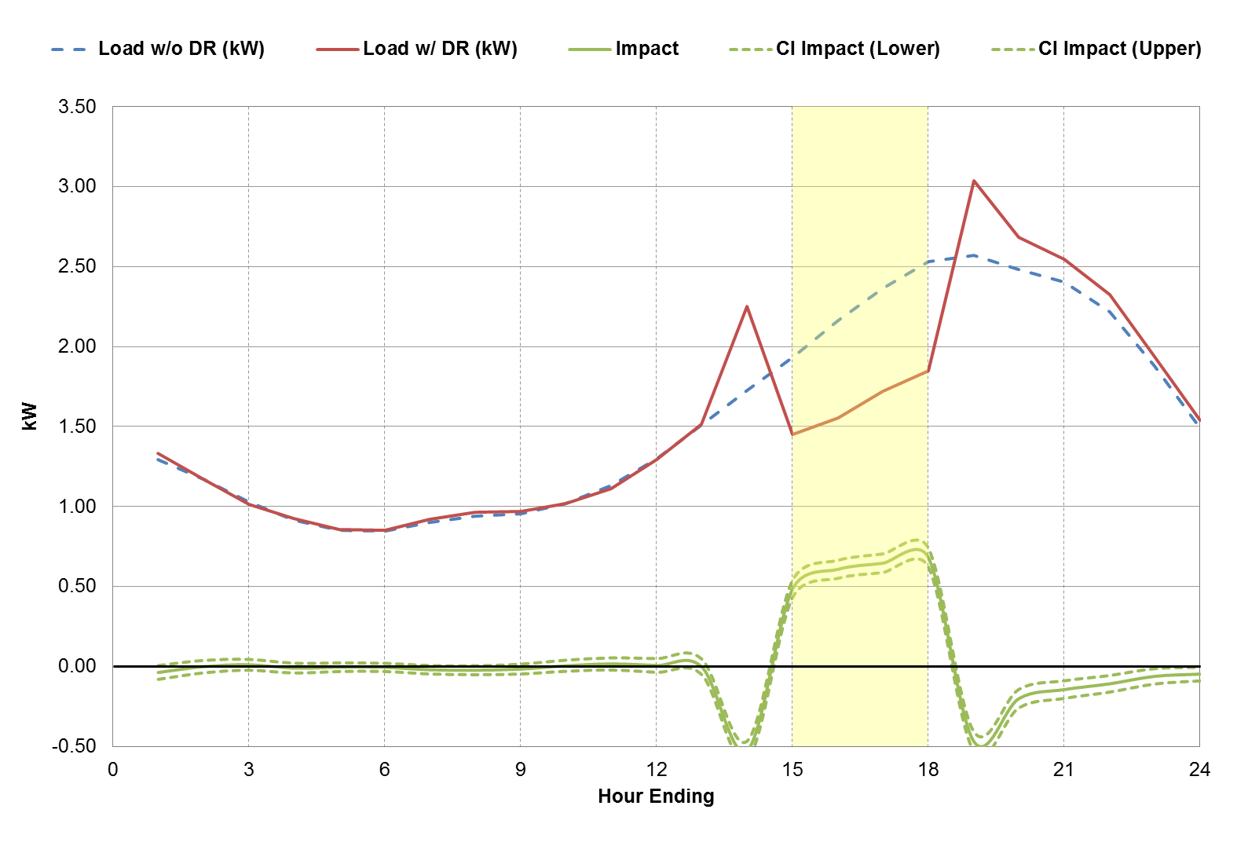
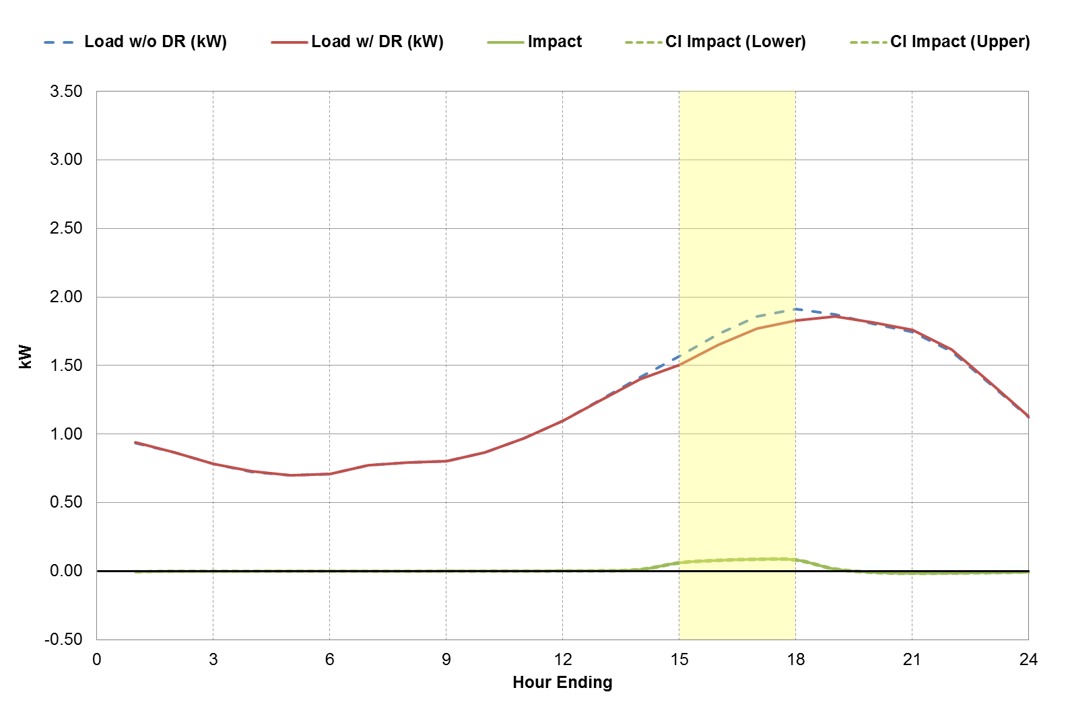
Comparing PCT vs Opt-in PTR load impacts
Ex Post Results
PCT | Opt-in PTR
Avg. Load Reduction for Event Window (kW): 0.60 % Load Reduction for Event Window: 26.9% | Avg. Load Reduction for Event Window (kW): 0.08 % Load Reduction for Event Window: 4.4%
0.66 kW
There is a significant difference in reference loads between PCT and Opt-in PTR customers
PCT customers exhibit a 0.66kW higher on-peak reference load

Slide 19
Ex Ante Methodology

Slide 20
Overview of Ex Ante Methodology: Opt-in PTR
Ex Ante Methodology
At a high level, the modeling steps consist of the following:
Ex post estimates were developed for opt-in PTR customers by weather station
Ex ante regression model was developed to explain average ex post impacts from 2 to 6 PM as a function of temperatures that day
Ex ante impact estimates were converted to hourly impacts from 2 PM to midnight (including the post-event period) using a scaling factor based on the average ratio between impacts at different hours (based usage pattern for average 2014 event)
Finally, hourly whole-house reference loads were predicted for each set of ex ante weather conditions based on loads observed in 2014, using a simple regression model that related hourly usage to temperature, time of year and day of week for each customer segment
Each step was performed separately for opt-in PTR-only customers and for customers dually-enrolled in SDP

Slide 21
Ex Post Impacts versus Mean17 for Opt-in PTR Customers
Ex Ante Methodology
Population Weighted Ex Post Impacts versus Mean17 for Opt-in PTR Only Customers
Population Weighted Ex Post Impacts versus Mean17 for Customers Dually Enrolled with SDP

Slide 22
Overview of Ex Ante Methodology: PCT
Ex Ante Methodology
At a high level, the modeling steps consist of the following:
Ex post estimates were developed for PCT customers by LCA
A regression model was developed to explain hourly ex post impacts from 2 PM to 6 PM as a function of temperatures.
This model estimated separate load impacts for each hour.
The model was then used to predict average hourly impacts from 2 PM to 6 PM based on the set of ex ante weather conditions;
Finally, hourly whole-house reference loads were predicted for each set of ex ante weather conditions based on loads observed in 2014.
These reference loads are needed to comply with the load impact protocols, but were not necessary for ex ante load impact estimation, as impacts were estimated directly from ex post impact values.
Reference load shapes were estimated by running a simple regression model on 2014 participant load for 6 segments (combinations of two enrollment groups and three regional groups). The regression model related hourly usage to temperature, time of year and day of week.
Each step was performed separately for PCT-only customers and for customers dually-enrolled in SDP

Slide 23
Enrollment Forecasts
Ex Ante Methodology
SCE expects that the Opt-in PTR program will enroll 20,000 new customers each year, and lose 10% of existing customers to attrition. These assumptions result in a net decrease in enrollment over time.
SCE expects significant growth in the PCT customer segment over the planning horizon as customer adoption of PCT technology is expected to increase significantly in coming years. By the year 2025, SCE expects to have more than 110,000 PCT customers on the program.
Year | Year- Beginning Enrollment | New Enrollment | Attrition | Year- Ending Enrollment
2015 | 384,296 | 20,000 | 39,296 | 365,000
2016 | 365,000 | 20,000 | 36,500 | 348,500
… | … | … | … | …
2024 | 271,027 | 20,000 | 27,103 | 263,924
2025 | 263,924 | 20,000 | 26,392 | 257,532
Year | Year-Beginning Enrollment | Net Incremental Enrollment | Year-Ending Enrollment
2015 | 2,000 | 4,000 | 6,000
2016 | 6,000 | 3,000 | 9,000
2017 | 9,000 | 6,000 | 15,000
2018 | 15,000 | 10,000 | 25,000
2019 | 25,000 | 10,000 | 35,000
2020 | 35,000 | 13,000 | 48,000
2021 | 48,000 | 15,000 | 63,000
2022 | 63,000 | 15,000 | 78,000
2023 | 78,000 | 15,000 | 93,000
2024 | 93,000 | 10,000 | 103,000
2025 | 103,000 | 10,000 | 113,000

Slide 24
Ex Ante Results

Slide 25
Opt-in PTR Ex Ante Load Impact Estimates (2015 & 2015)
Ex Ante Results
Peak Type | Weather Year | Month | 2015 |  |  | 2025
 |  |  | Opt-in PTR-only | Dually-enrolled | Total | Opt-in PTR-only | Dually-enrolled | Total
SCE Specific | 1-in-2 | May | 13.9 | 10.9 | 24.8 | 9.7 | 7.6 | 17.2
 |  | Jun | 14.1 | 11.1 | 25.2 | 9.7 | 7.6 | 17.2
 |  | Jul | 14.2 | 11.2 | 25.5 | 9.7 | 7.6 | 17.3
 |  | Aug | 14.2 | 11.2 | 25.4 | 9.7 | 7.7 | 17.4
 |  | Sep | 13.9 | 11.0 | 24.9 | 9.6 | 7.6 | 17.2
 |  | Oct | 13.8 | 10.8 | 24.6 | 9.6 | 7.5 | 17.1
 | 1-in-10 | May | 14.1 | 11.1 | 25.3 | 9.8 | 7.7 | 17.5
 |  | Jun | 14.3 | 11.2 | 25.5 | 9.7 | 7.7 | 17.4
 |  | Jul | 14.3 | 11.4 | 25.7 | 9.8 | 7.7 | 17.5
 |  | Aug | 14.2 | 11.3 | 25.5 | 9.7 | 7.7 | 17.5
 |  | Sep | 14.1 | 11.2 | 25.3 | 9.7 | 7.7 | 17.4
 |  | Oct | 13.9 | 10.9 | 24.8 | 9.6 | 7.6 | 17.2
CAISO Specific | 1-in-2 | May | 13.9 | 10.9 | 24.7 | 9.6 | 7.5 | 17.1
 |  | Jun | 14.2 | 11.1 | 25.2 | 9.7 | 7.6 | 17.2
 |  | Jul | 14.3 | 11.3 | 25.5 | 9.7 | 7.7 | 17.4
 |  | Aug | 14.2 | 11.2 | 25.3 | 9.7 | 7.7 | 17.3
 |  | Sep | 14.0 | 11.0 | 24.9 | 9.6 | 7.6 | 17.2
 |  | Oct | 13.7 | 10.7 | 24.3 | 9.5 | 7.4 | 16.9
 | 1-in-10 | May | 14.1 | 11.1 | 25.1 | 9.8 | 7.7 | 17.4
 |  | Jun | 14.3 | 11.3 | 25.4 | 9.7 | 7.7 | 17.4
 |  | Jul | 14.3 | 11.3 | 25.5 | 9.7 | 7.7 | 17.4
 |  | Aug | 14.2 | 11.3 | 25.4 | 9.7 | 7.7 | 17.4
 |  | Sep | 14.1 | 11.2 | 25.2 | 9.7 | 7.7 | 17.3
 |  | Oct | 13.9 | 10.9 | 24.7 | 9.6 | 7.6 | 17.1

Slide 26
PCT Ex Ante Load Impact Estimates (2015 & 2015)
Ex Ante Results
Peak Type | Weather Year | Month | 2015 |  |  | 2025
 |  |  | Opt-in PTR-only | Dually-enrolled | Total | Opt-in PTR-only | Dually-enrolled | Total
SCE Specific | 1-in-2 | May | 0.8 | 0.2 | 1.0 | 26.1 | 7.1 | 33.2
 |  | Jun | 1.0 | 0.4 | 1.4 | 26.8 | 10.0 | 36.8
 |  | Jul | 1.2 | 0.5 | 1.7 | 28.3 | 12.7 | 41.1
 |  | Aug | 1.4 | 0.7 | 2.2 | 30.1 | 15.5 | 45.6
 |  | Sep | 1.6 | 0.7 | 2.2 | 29.3 | 12.9 | 42.2
 |  | Oct | 1.6 | 0.5 | 2.1 | 29.4 | 10.2 | 39.6
 | 1-in-10 | May | 0.9 | 0.4 | 1.3 | 28.7 | 12.3 | 41.0
 |  | Jun | 1.0 | 0.5 | 1.5 | 28.3 | 13.5 | 41.7
 |  | Jul | 1.3 | 0.7 | 1.9 | 29.8 | 16.0 | 45.7
 |  | Aug | 1.5 | 0.8 | 2.3 | 30.8 | 17.6 | 48.5
 |  | Sep | 1.7 | 0.9 | 2.6 | 31.5 | 17.5 | 49.0
 |  | Oct | 1.6 | 0.7 | 2.3 | 30.2 | 12.4 | 42.6
CAISO Specific | 1-in-2 | May | 0.8 | 0.2 | 1.0 | 25.6 | 6.2 | 31.8
 |  | Jun | 1.0 | 0.4 | 1.4 | 27.0 | 10.7 | 37.7
 |  | Jul | 1.3 | 0.6 | 1.9 | 29.4 | 15.1 | 44.5
 |  | Aug | 1.4 | 0.7 | 2.2 | 29.8 | 15.2 | 45.1
 |  | Sep | 1.6 | 0.8 | 2.4 | 30.0 | 14.6 | 44.6
 |  | Oct | 1.5 | 0.4 | 1.9 | 28.1 | 7.7 | 35.8
 | 1-in-10 | May | 0.9 | 0.4 | 1.2 | 28.2 | 11.5 | 39.7
 |  | Jun | 1.1 | 0.5 | 1.6 | 28.4 | 13.6 | 42.0
 |  | Jul | 1.3 | 0.7 | 1.9 | 29.5 | 15.4 | 45.0
 |  | Aug | 1.5 | 0.8 | 2.3 | 30.6 | 17.1 | 47.7
 |  | Sep | 1.7 | 1.0 | 2.6 | 31.6 | 17.9 | 49.6
 |  | Oct | 1.6 | 0.7 | 2.3 | 30.2 | 12.4 | 42.7

Slide 27
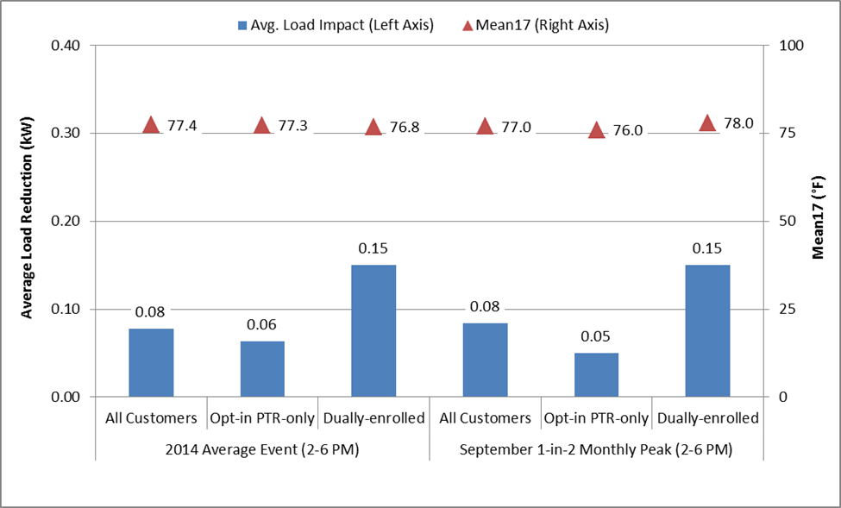
Comparison of Ex Post and Ex Ante Estimates of Opt-in PTR Average 2 to 6 PM Load Impact (kW)
Ex Ante Results
Average event temperatures in 2014 are most similar to the temperatures for the Sept. peak day under 1‑in-2 weather conditions – for this day, the average 2-6 PM impacts are very similar

Slide 28
For comments or questions, contact: Dr. Eric Bell Senior Consultant EBell@nexant.com
Nexant, Inc. 101 Montgomery St., 15th Floor San Francisco, CA 94104 415-777-0707

