Slide 1

2014 SDG&E PTR/SCTD Evaluation
Dave Hanna
May 11th, 2015
Customer Category | Mean Active Participants | Mean Reference Load (kW) | Mean Observed Load (kW) | Mean Impact (kW) | % Load Reduction | Aggregate Load Reduction (MW) | Mean °F
All | 56,270 | 1.52 | 1.42 | 0.11 | 6.9% | 5.92 | 88.0
Large | 24,200 | 2.41 | 2.20 | 0.21 | 8.7% | 5.10 | 88.3
Medium | 19,765 | 1.07 | 1.01 | 0.06 | 5.6% | 1.20 | 87.9
Small | 11,435 | 0.45 | 0.45 | 0.00 | 1.1% | 0.05 | 87.5
Coastal | 30,599 | 1.38 | 1.29 | 0.10 | 7.0% | 2.95 | 86.5
Inland | 24,801 | 1.70 | 1.58 | 0.12 | 6.8% | 2.88 | 89.8
No SCTD | 54,757 | 1.51 | 1.41 | 0.11 | 7.2% | 5.95 | 88.0
No Load Control (SCTD or Summer Saver) | 51,855 | 1.50 | 1.40 | 0.10 | 6.7% | 5.14 | 88.0
Summer Saver – 50% Cycling | 871 | 2.29 | 2.11 | 0.18 | 7.3% | 0.16 | 87.3
Summer Saver – 100% Cycling | 2,028 | 2.02 | 1.43 | 0.59 | 28.1% | 1.20 | 87.0
Low Income | 16,199 | 1.35 | 1.31 | 0.04 | 2.8% | 0.60 | 87.8
Non-Low Income | 35,656 | 1.55 | 1.44 | 0.11 | 7.1% | 3.85 | 88.1
Enroll. Year – 2012 | 24,224 | 1.53 | 1.40 | 0.13 | 8.4% | 3.08 | 88.5
Enroll. Year – 2013 | 8,086 | 1.51 | 1.39 | 0.12 | 8.0% | 0.96 | 88.5
Enroll. Year – 2014 | 19,545 | 1.47 | 1.40 | 0.07 | 4.5% | 1.30 | 87.0
Notification – Email | 35,765 | 1.52 | 1.41 | 0.10 | 7.0% | 3.74 | 88.0
Notification – Text | 8,049 | 1.40 | 1.34 | 0.06 | 4.4% | 0.49 | 88.0
Notification – Both | 7,251 | 1.54 | 1.41 | 0.13 | 8.7% | 0.96 | 88.1
Summer Billing Tier 1 | 20,499 | 1.45 | 1.35 | 0.10 | 6.8% | 2.01 | 87.7
Summer Billing Tier 2 | 4,673 | 1.42 | 1.35 | 0.07 | 5.0% | 0.32 | 87.5
Summer Billing Tier 3 | 9,391 | 1.49 | 1.38 | 0.10 | 7.0% | 0.97 | 87.8
Summer Billing Tier 4 | 8,700 | 1.53 | 1.47 | 0.06 | 4.1% | 0.53 | 88.3
Summer Billing Tier 5 | 8,542 | 1.64 | 1.51 | 0.12 | 7.6% | 1.05 | 88.6
Net Energy Metered | 2,864 | 0.57 | 0.14 | 0.43 | -21.3% | 1.23 | 88.4
Customer Category | Mean Active Participants | Mean Reference Load (kW) | Mean Observed Load (kW) | Mean Impact (kW) | % Load Reduction | Aggregate Load Reduction (MW) | Mean °F
All | 1,887 | 2.70 | 2.09 | 0.61 | 22.9% | 1.16 | 87.0
4 Degree Setback | 923 | 2.58 | 1.93 | 0.65 | 25.6% | 0.60 | 86.2
50% Cycling | 964 | 2.80 | 2.21 | 0.58 | 20.9% | 0.56 | 87.7
PTR | 1,162 | 2.66 | 2.00 | 0.66 | 24.9% | 0.77 | 87.1
PTR – 4 Deg. Setback | 556 | 2.55 | 1.83 | 0.72 | 28.3% | 0.40 | 86.1
PTR – 50% Cycling | 606 | 2.76 | 2.14 | 0.62 | 22.5% | 0.37 | 87.8
SCTD Only | 725 | 2.76 | 2.22 | 0.55 | 20.0% | 0.40 | 87.0
SCTD Only – 4 Degree Setback | 366 | 2.64 | 2.07 | 0.57 | 21.8% | 0.21 | 86.3
SCTD Only – 50% Cycling | 359 | 2.87 | 2.34 | 0.53 | 18.6% | 0.19 | 87.5

Slide 2
Introduction
Program Overviews
Methods
Ex-post Results
Ex-Ante Estimates

Slide 3
Peak Time Rebate (Reduce Your Use) Program
Notification on a day-ahead basis for events
  11 a.m. – 6 p.m.
Two-level incentive program
  Basic ($0.75/kWh)
  Premium ($1.25/kWh)
Bill credit based on reduction in electric usage below customer reference level (CRL)
Opt-in to receive credit, beginning in 2013
  Was default, with opt-in for notification

Slide 4
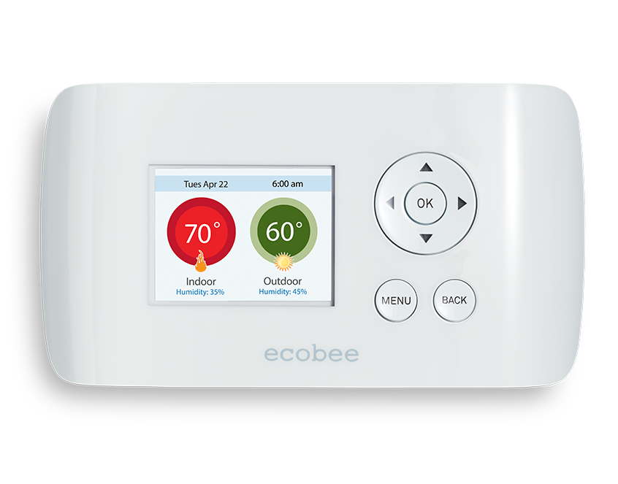
Small Customer Technology Deployment (SCTD) Program
Free programmable communicating thermostats (PCTs) with DR-enabling technology
Two DR methods – randomly assigned
  50% air conditioning cycling
  4 degree thermostat setback
2 p.m. – 6 p.m.

Slide 5
Methods
Multiple Segment Aggregated Regression models
  PTR only –
  Load Control –
Compared participant and reference hourly residential loads
  Reference loads calculated from matched control groups of non-program participants
Control groups selected via Stratified Propensity Score Matching
  Logistic regression model to estimate probability of participation

Slide 6
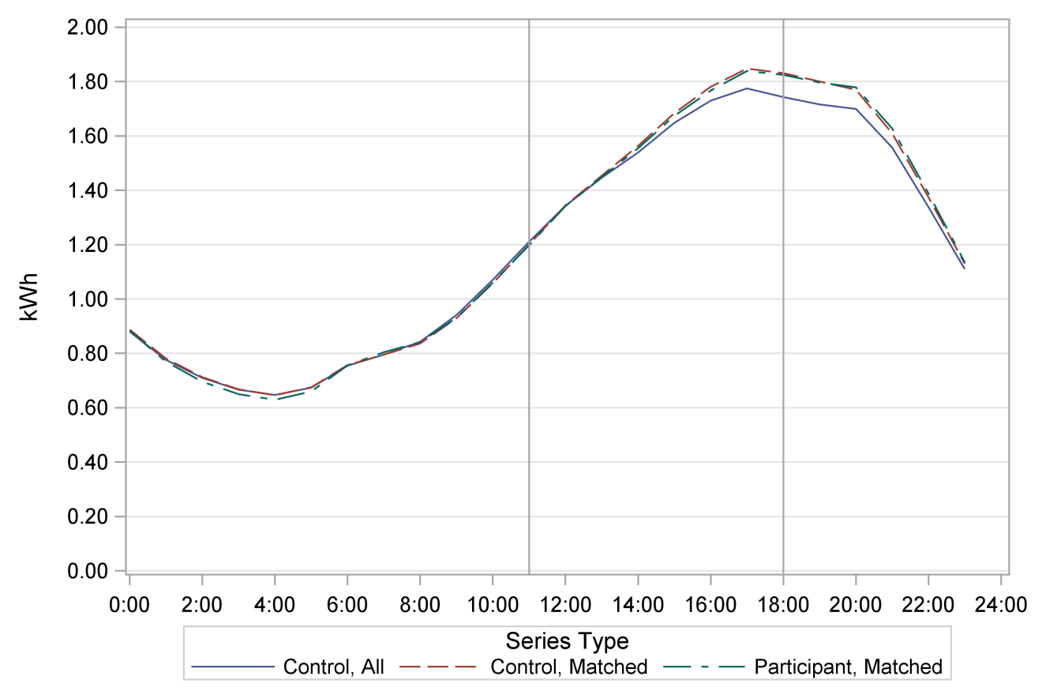
Methods - PSM
Two stages of Propensity Score Matching
  Stage I – Monthly Billing Data, 5-to-1 matches
  Stage II – Interval Data, 1-to-1 matches

Slide 7
Methods – Ex-Post Impacts
Impact models based on aggregate hourly residential loads for opt-in alert groups and matched controls
Final model specifications included variables for hour, day of the week, month, cooling degree hours (CDH65), event indicators, and opt-in status

Slide 8
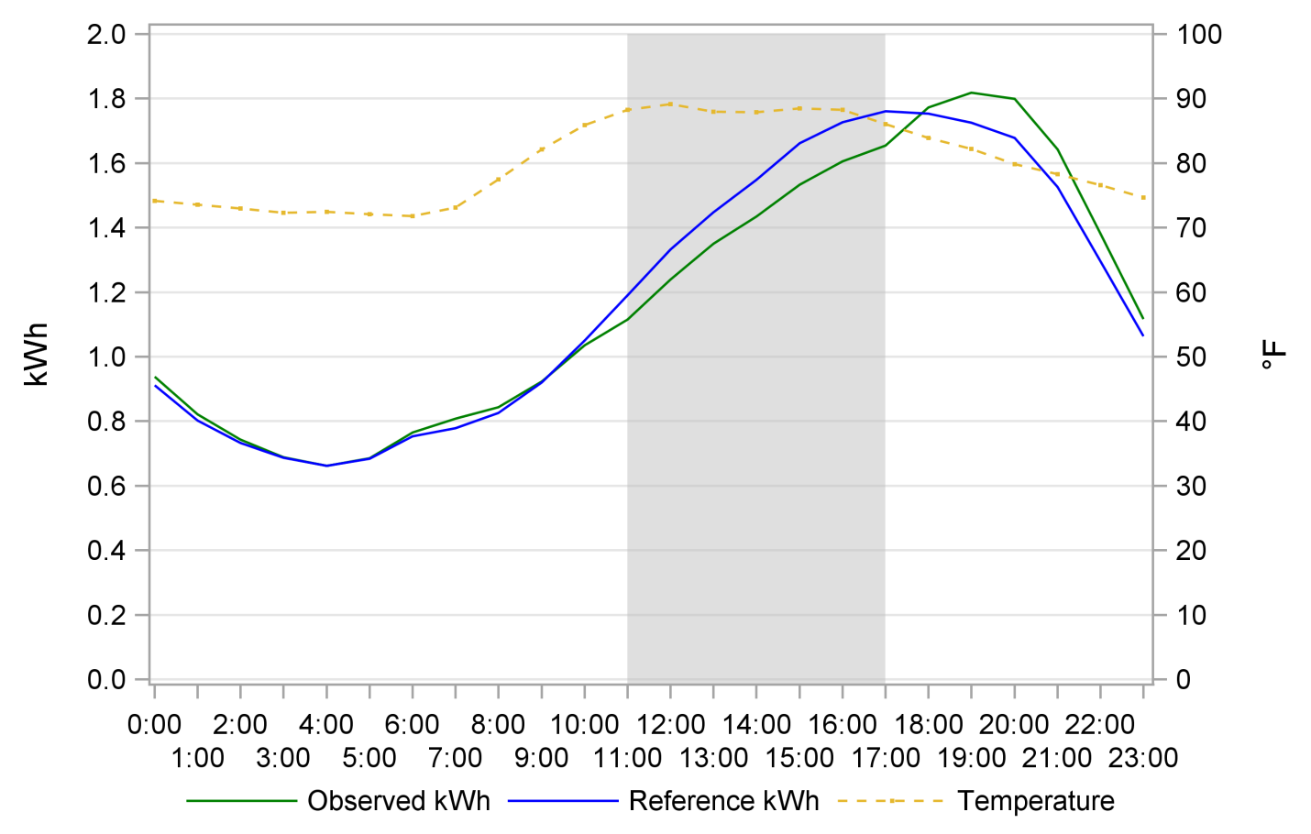
Results - PTR
Average Participant Event Hour Load Reduction : 0.11 kW
Average Aggregate Event Hour Load Reduction : 5.92 MW (6.9%)
Average Temperature : 88.0°F; Average Active Participants : 56,270

Slide 9
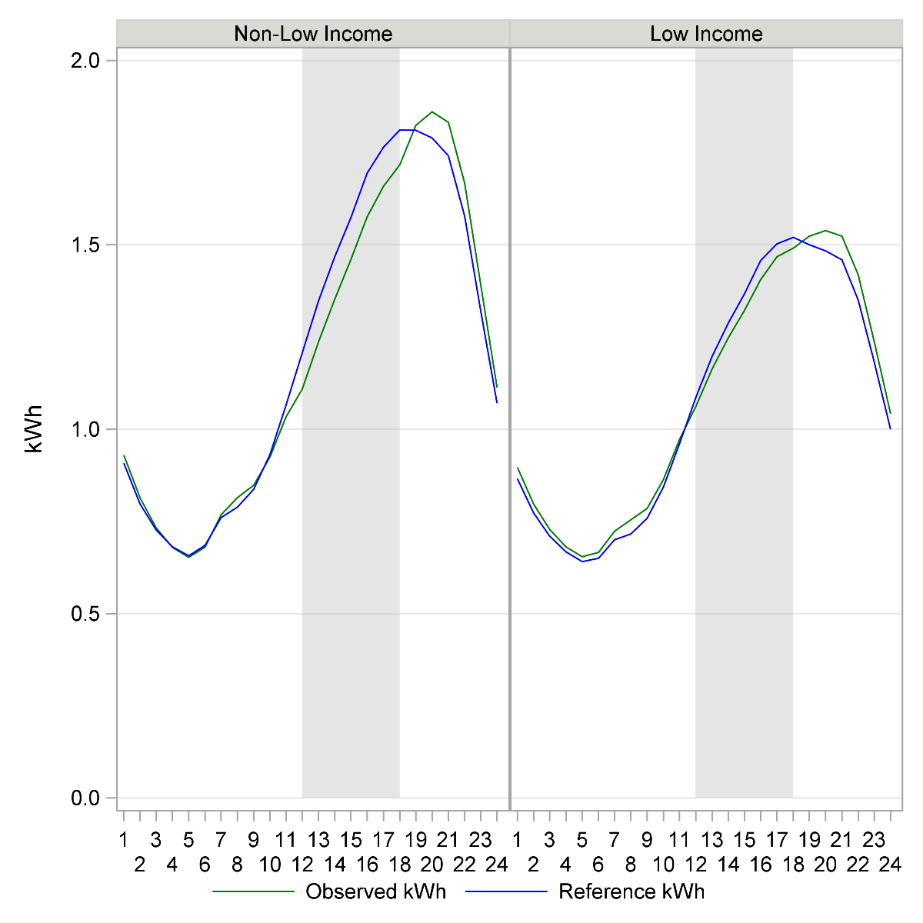
Results – PTR – Low Income
Average Participant Event Hour Usage
  Non-L.I. : 1.44 kW
  L.I. : 1.31 kW
Average Participant Event Hour Load Reduction
  Non-L.I. : 0.11 kW (7.1%)
  L.I. : 0.04 kW (2.8%)
Average Active Participants
  Non-L.I. : 35,656
  L.I. : 16,199

Slide 10
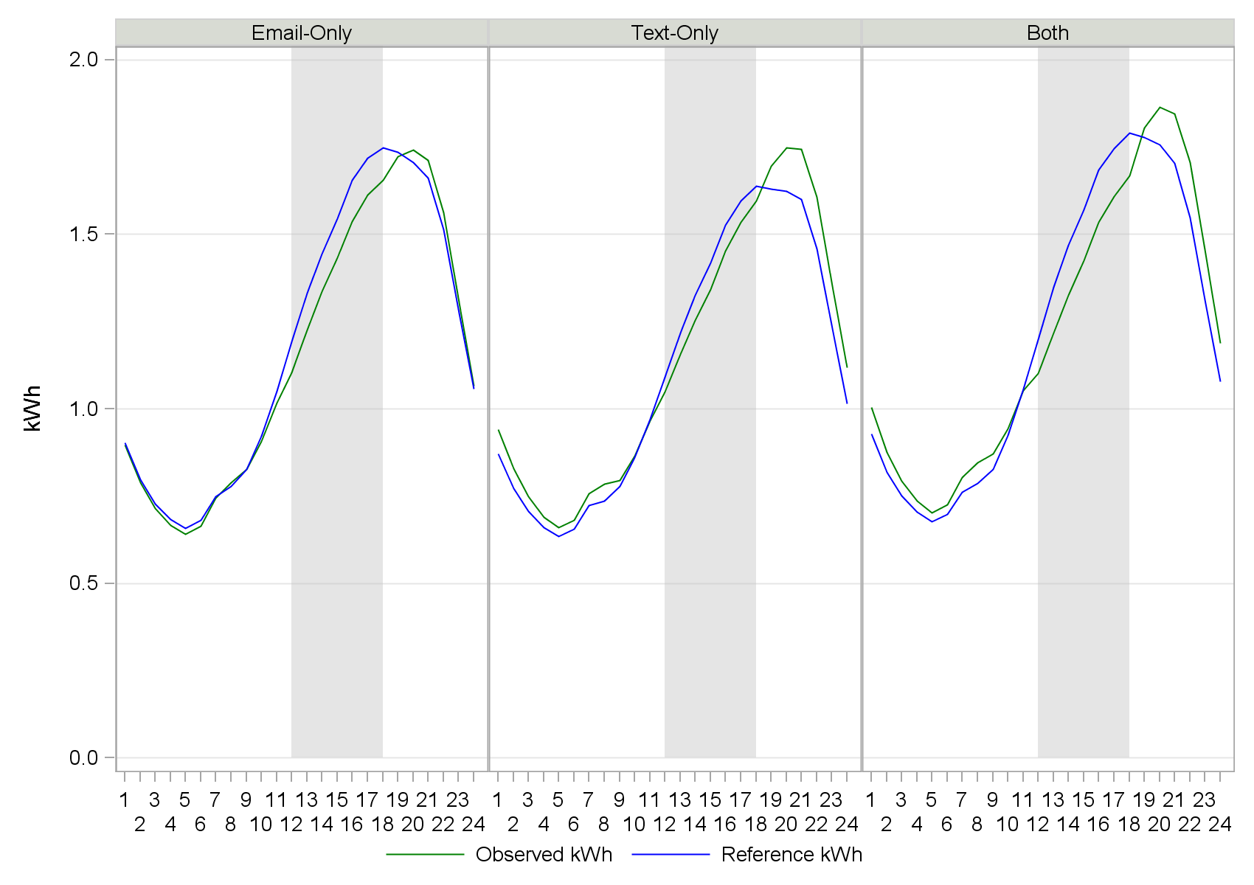
Results – PTR – Notification Type
Average Participant Event Hour Load Reduction
  Email-Only: 0.10 kW (7.0%)
  Text-Only: 0.06 kW (4.4%)
  Both: 0.13 kW (8.7%)
Average Aggregate Event Hour Load Reduction
  Email-Only: 3.74 MW
  Text-Only: 0.49 MW
  Both: 0.96 MW
Average Active Participants
  Email-Only: 35,765
  Text-Only: 8,049
  Both: 7,251

Slide 11
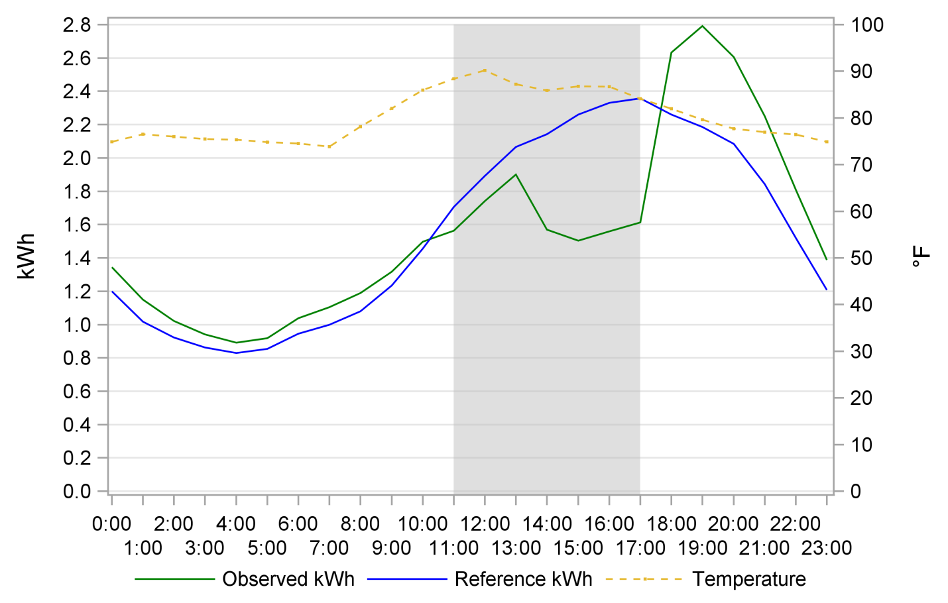
Results - SCTD
Average Participant Event Hour Load Reduction : 0.61 kW
Average Aggregate Event Hour Load Reduction : 1.16 MW (22.9%)
Average Active Participants : 1,887

Slide 12
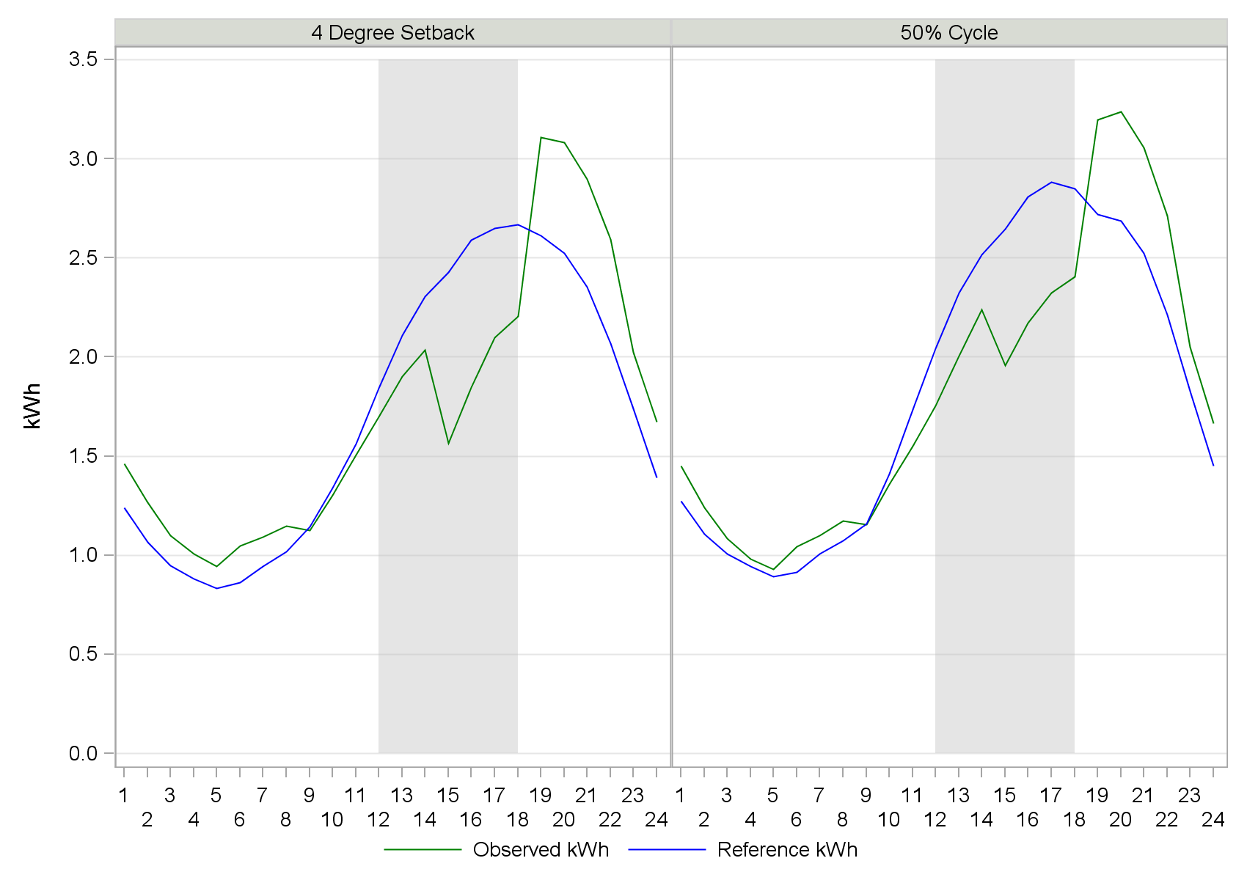
Results – SCTD – Cycling Strategy
Average Participant Event Hour Load Reduction
  4 degree : 0.65 kW
  50% cycling: 0.58 kW
Average Aggregate Event Hour Load Reduction
  4 degree : 0.60 MW (25.6%)
  50% cycling: 0.56 MW (20.9%)
Average Active Participants
  4 degree : 923
  50% cycling : 964

Slide 13
SCTD – Energy Savings
Energy conservation effects estimated using panel time-series regression analysis
  May through October for 2013 and 2014
  Treatment and control group
  Pre and post installation data
Estimated monthly, daily, and hourly models
Daily Model:
  Average program impact per weekday = 0.32 kWh (1.3%), statistically significant

Slide 14
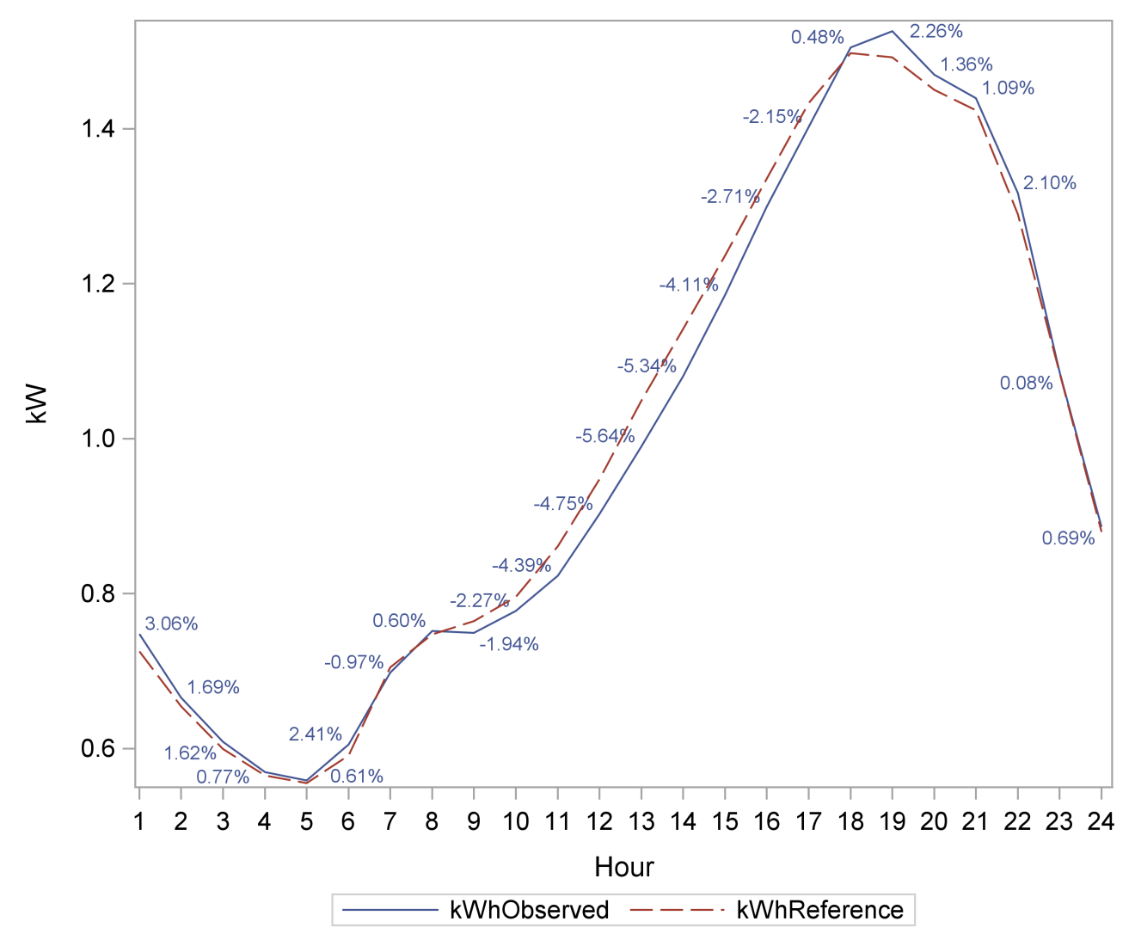
SCTD – Energy Savings – Weekday Hours

Slide 15
SCTD – Overrides
Participants can override DR signal during events
  Thermostat runtime reports show manual AC usage
About 20% of participants overrode at all during events, averaging 55-65% of event duration
About 15% of participants overrode for the majority of event, averaging 80-85% of event duration

Slide 16
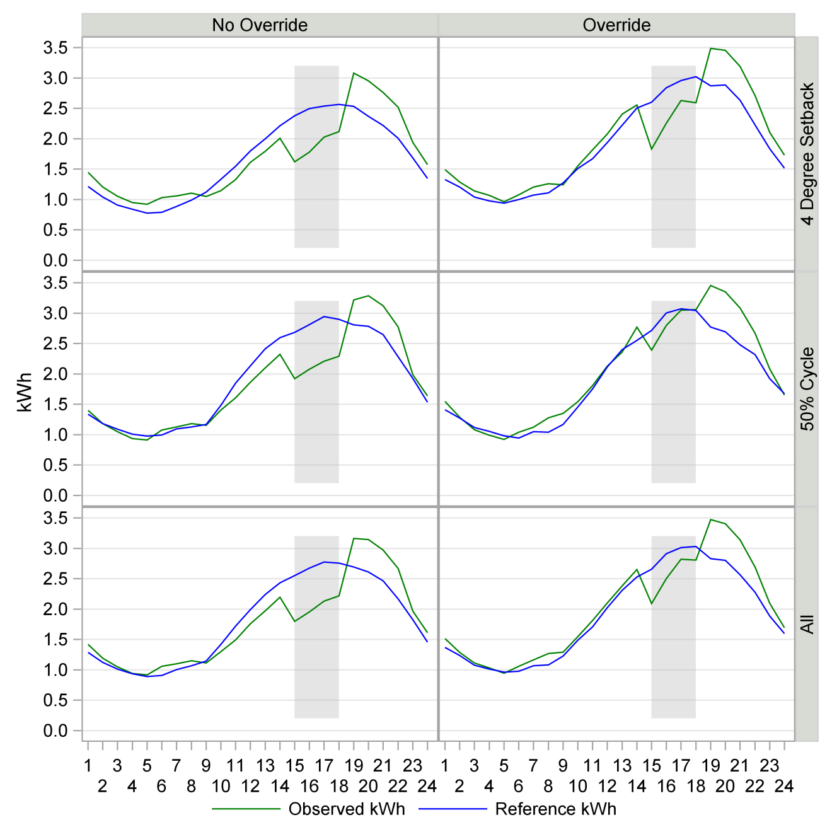
SCTD – Overrides

Slide 17
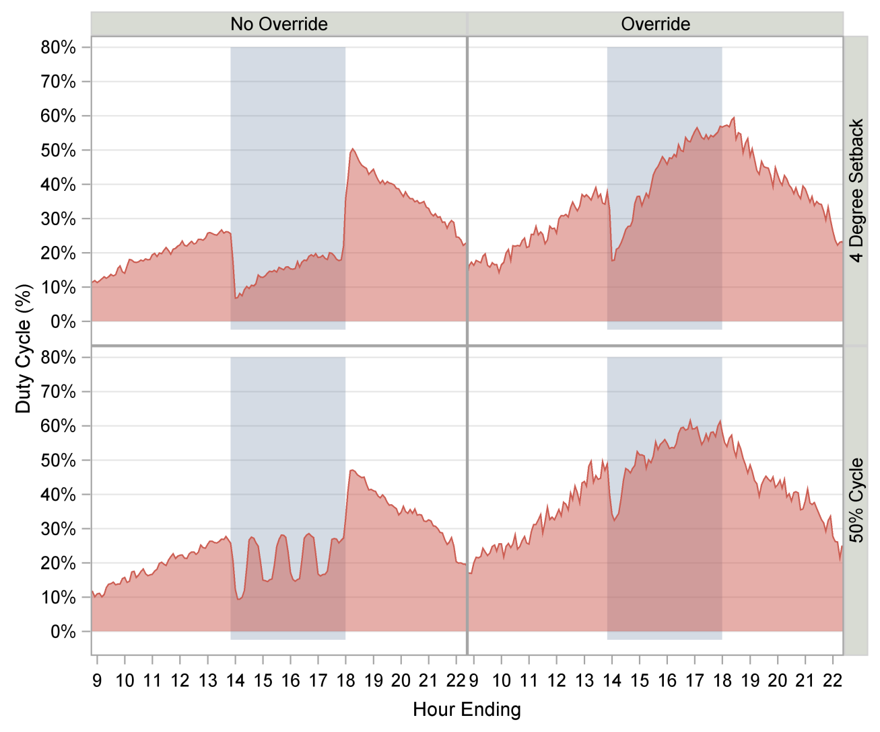
SCTD Overrides in Thermostat Data

Slide 18
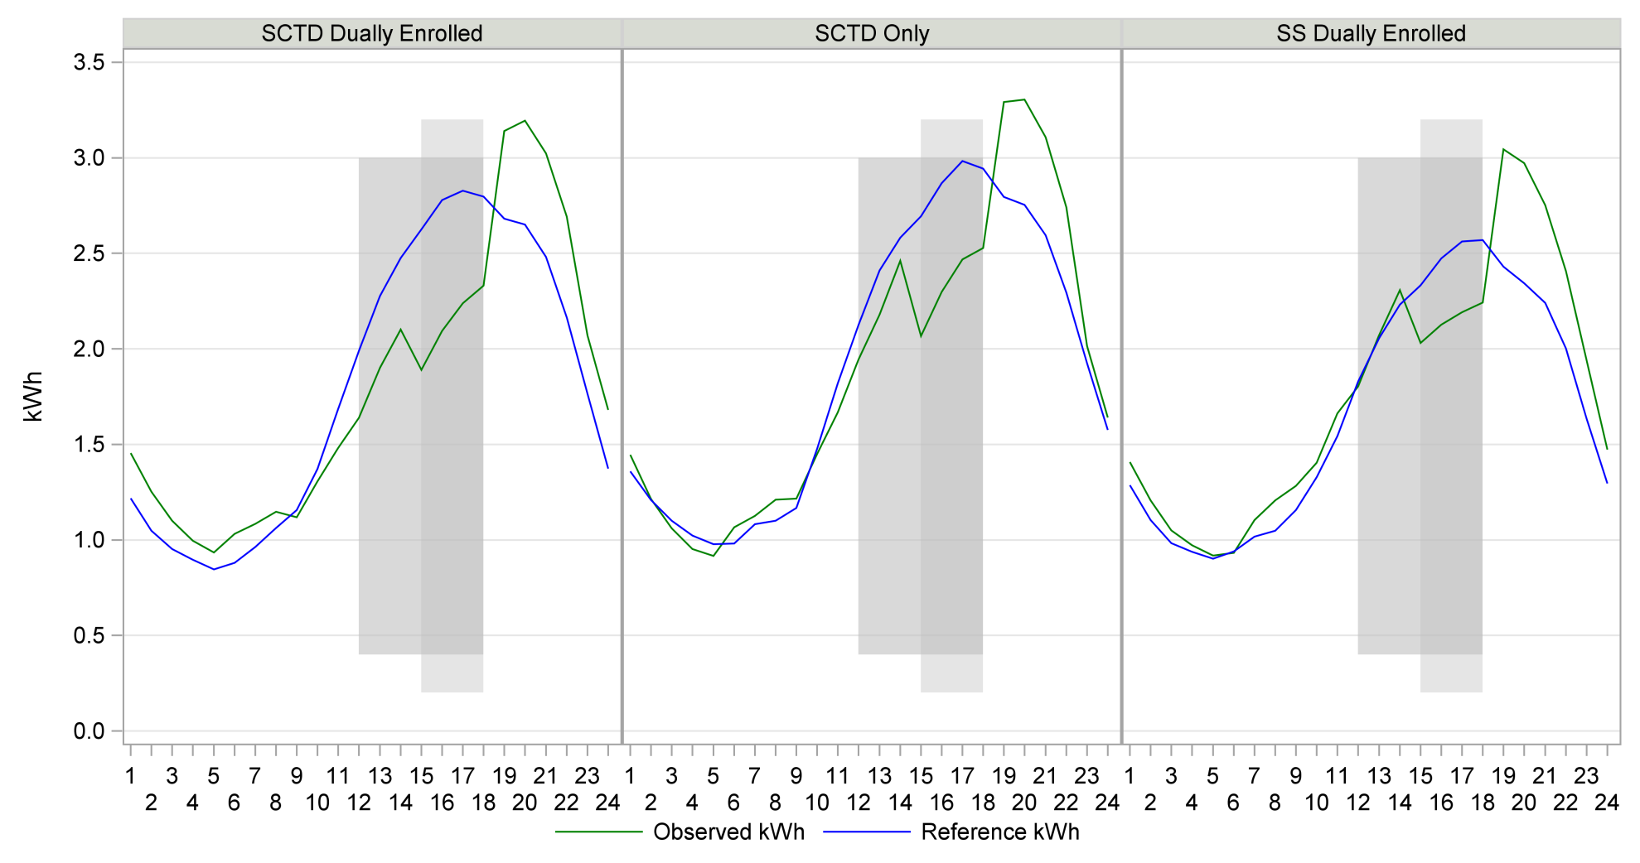
SCTD vs. Summer Saver – 50% Cycle

Slide 19
SCTD vs. Summer Saver – 50% Cycle
Program Segment | Hours | Average Hourly Impact | Average Percent Load Reduction | Average Significant Hourly Impact | Average Significant Percent Load Reduction
SCTD Dually Enrolled | Entire Day | 0.003 | 0.2% | 0.027 | 1.5%
 | PTR Only Hours | 0.366 | 16.3% | 0.366 | 16.3%
 | PTR and SCTD/SS Hours | 0.619 | 22.5% | 0.619 | 22.5%
SCTD Only | Entire Day | 0.019 | 1.0% | 0.005 | 0.3%
 | PTR Only Hours | 0.177 | 7.5% | 0.000 | 0.0%
 | PTR and SCTD/SS Hours | 0.532 | 18.5% | 0.532 | 18.5%
SS Dually Enrolled | Entire Day | -0.094 | -5.6% | -0.047 | -2.8%
 | PTR Only Hours | -0.022 | -1.1% | 0.000 | 0.0%
 | PTR and SCTD/SS Hours | 0.336 | 13.5% | 0.336 | 13.5%

Slide 20
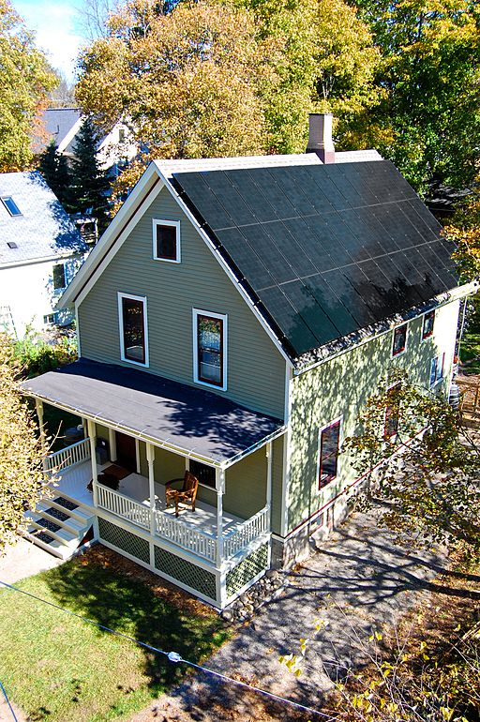
Net Energy Metering
PTR participants with photovoltaic (PV) generation
Able to export excess PV energy back to grid
PSM matching done on both import and export channels of interval data
Ex-post results based on net impact of NEM customers’ consumption minus exported PV delivered to the grid

Slide 21
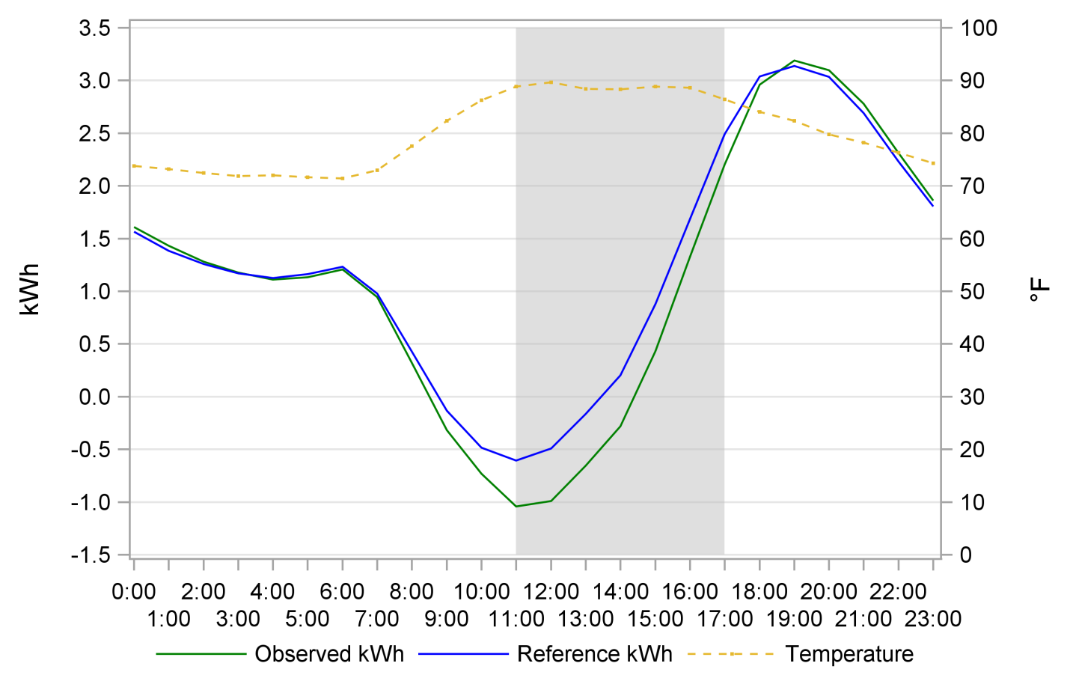
Results – Net Energy Metering
Average Participant Event Hour Load Reduction : 0.43 kW
Average Aggregate Event Hour Load Reduction : 1.23 MW (-21.3%)
Average Active Participants : 2,864

Slide 22
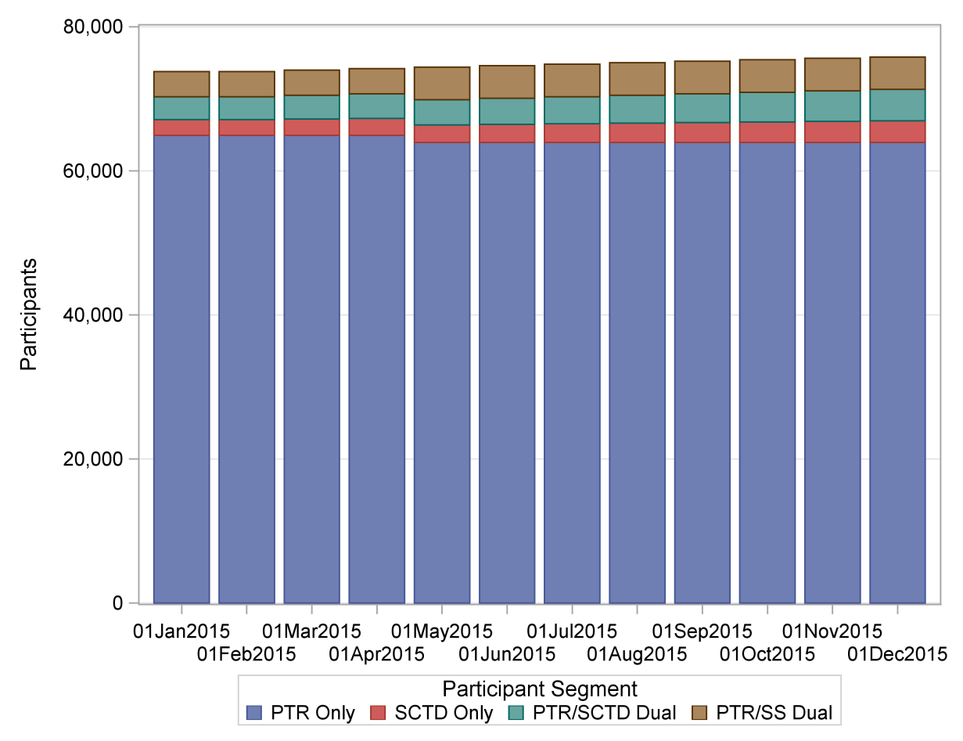
Ex Ante Forecast
Combine ex post results with:
  Alternative weather scenarios (year and day type)
  Forecast of participation
PTR participant forecast flat after 2015
Small increase in share of PTR/SS Dual
Two sources for weather scenarios:
  SDG&E
  CAISO

Slide 23
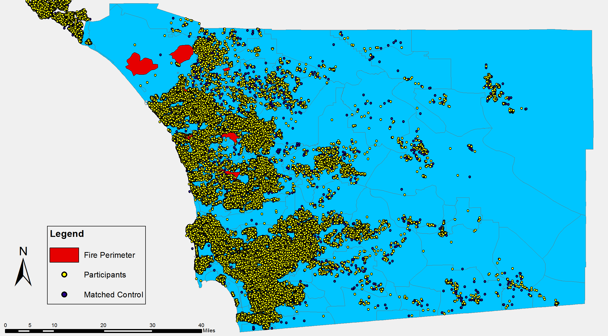
Ex-Ante Estimates - Wildfires
Weather in 2014 was particularly hot
  Swarm of wildfires in May 2014
  Overlapped with several PTR, SCTD, and SS events

Slide 24
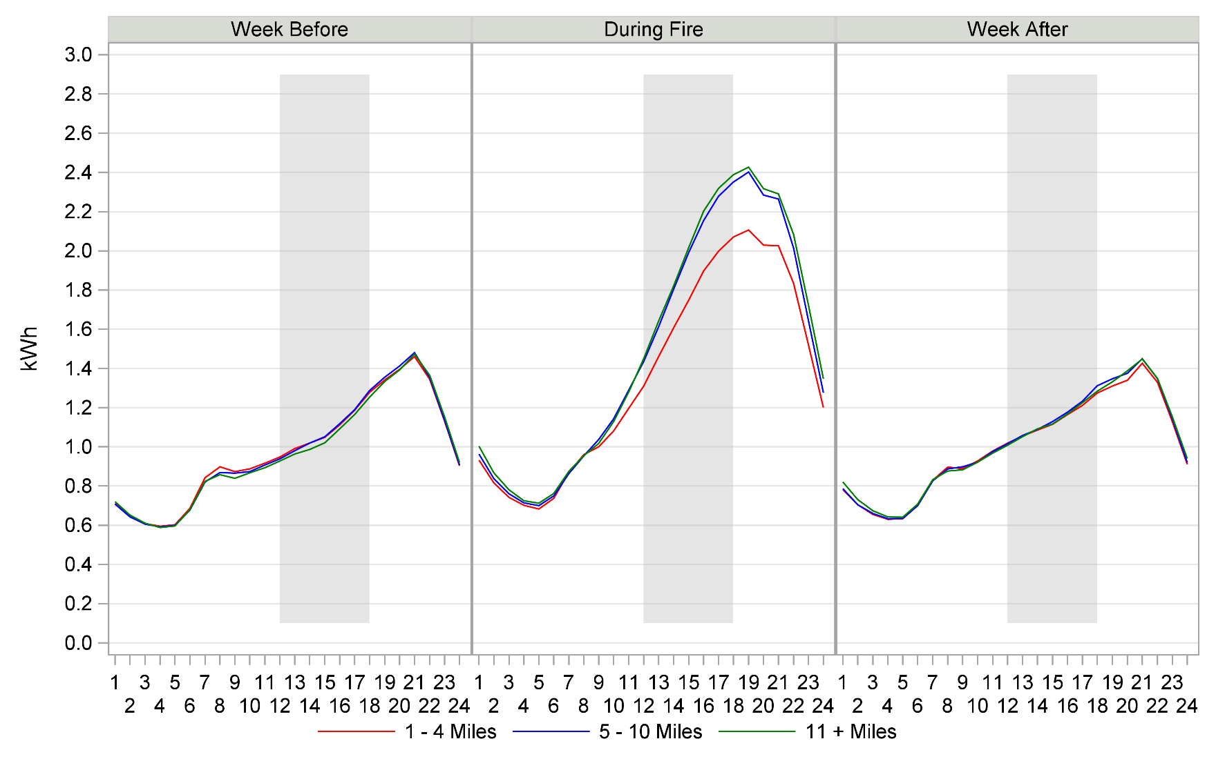
Ex-Ante Estimates - Wildfires
Participant Usage Before, During, and After, by Distance to Fire

Slide 25
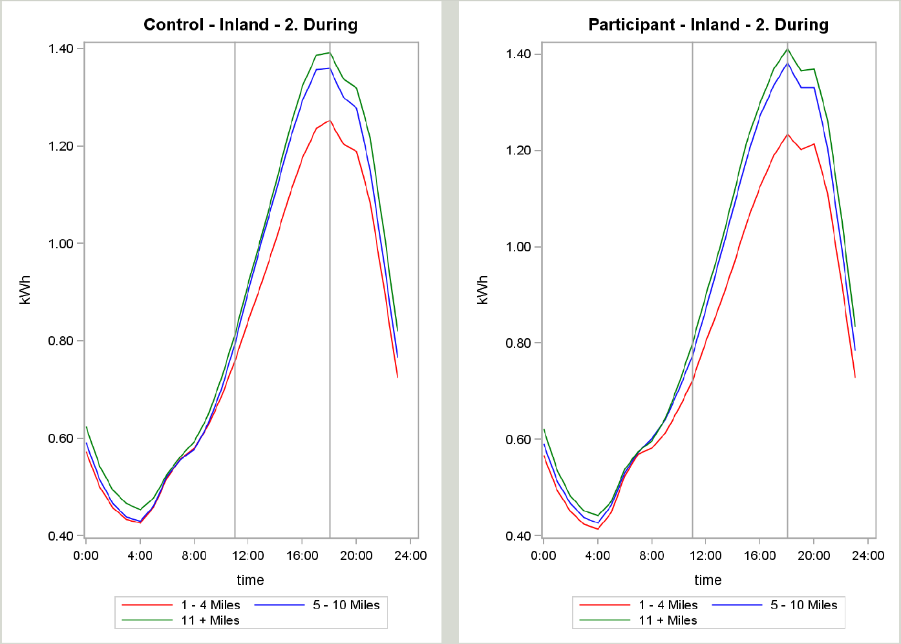
Ex-Ante Estimates - Wildfires
Comparison of Control and Participants by Distance to Fire

Slide 26
Ex-Ante Estimates
Weather in 2014 was particularly hot
Ex-post results align with 1-in-10 ex-ante weather
Program Segment and Weather Scenario |  |  | Mean Reference Load (kW) | Mean Observed Load (kW) | Mean Impact (kW) | % Load Reduction | Mean Temp. °F
PTR Only | Overall | 1-in-10 | 1.57 | 1.48 | 0.09 | 5.8% | 86.52
 |  | 1-in-2 | 1.37 | 1.30 | 0.07 | 4.8% | 80.55
PTR/SCTD | 4 Degree Setback | 1-in-10 | 2.60 | 1.92 | 0.68 | 26.2% | 87.44
 |  | 1-in-2 | 2.03 | 1.54 | 0.49 | 24.2% | 81.07
 | 50% Cycle | 1-in-10 | 2.63 | 2.07 | 0.55 | 21.0% | 87.26
 |  | 1-in-2 | 2.05 | 1.65 | 0.40 | 19.4% | 80.97
 | Overall | 1-in-10 | 2.62 | 2.01 | 0.60 | 23.1% | 87.35
 |  | 1-in-2 | 2.04 | 1.60 | 0.43 | 21.3% | 81.02

Slide 27

Questions?

