Slide 1
2014 Load Impact Evaluation Aggregator Managed Portfolio (AMP)
Steve Braithwait, Dan Hansen, and Dave Armstrong
Christensen Associates Energy Consulting
DRMEC Spring Workshop
May 11, 2015

Slide 2
AMP Programs
Program features
Model validation
Ex-post load impacts (2014)
Deriving ex-ante from ex-post
Key changes affecting ex-ante load impacts

Slide 3
AMP Features
Bilateral contracts between aggregators and PG&E/SCE
Nominated monthly capacity commitments made at beginning of season
Product-type options
Day-ahead (DA) or Day-of (DO) notice
Event window (e.g., 1-4; 1-6)
Local or System (PG&E)
PG&E called a number of local events for specific Sub-LAPs (SCE called one localized event)

Slide 4
Nominated Customer Service Accounts by Utility, Year and Notice
DA not shown; confidentiality
No DA contracts

Slide 5
Ex-Post Model Validation
Model performance on non-event days
Select event-like non-event days
Estimate regression models with those days withheld from the data series (one at a time)
Examine performance of model predictions on those days (MAPE, MPE, R Sq)
Model variations – 18 different combinations of weather variables

Slide 6
Model Validation (2)
Estimate “synthetic” event-day models
Treat event-like days as if they were true events
Test significance of “load impact” coefficients for synthetic event days
Coefficients that are not statistically significant indicate that models do not falsely estimate load impacts on non-event days
Examine sensitivity of estimated hourly load impacts on actual event days across 18 alternative specifications
Select preferred specification

Slide 7
Findings from Model Validation
Models predict well on event-like days
Synthetic event-day tests do not find significant “false” load impact estimates
Relatively little sensitivity of estimated load impacts for true events across the tested specifications

Slide 8
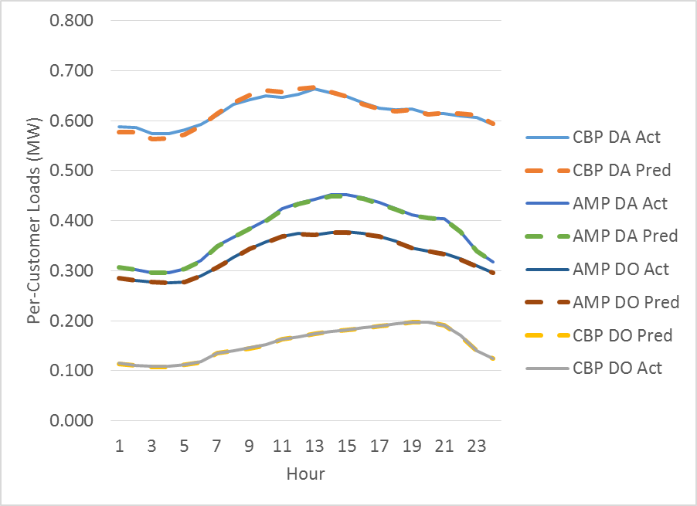
Actual and Predicted Loads – Average Event-Like Non-Event Day (PG&E)
AMP

Slide 9
Ex-Post Load Impacts (2012 – 14) Typical Event – Average Event-Hour (MW)

Slide 10
Ex-Ante Load Impact Simulation Process
Re-estimate customer-level regressions for reference loads
1-in-2 and 1-in-10 weather conditions
Simulate hourly reference loads, by scenario
Calculate % load impacts (Based on up to 3 years of estimated ex-post LI, for nom. Serv. Accnt)
Enrollment forecasts, by group
Per-customer ex-ante % load impacts, by group
Aggregate ex-ante load impacts

Slide 11
Previous Ex-Ante (for 2014); Ex-Post for 2014; and Ex-Ante for 2015

Slide 12
Key Factors in Ex-Ante Changes
PG&E bases enrollment forecast on assumed contract capacity divided by forecasts of per-customer ex-ante load impacts; these can change if enrollments are assumed to shift from some LCAs to others, because load impacts reflect observed ex-post values in the relevant LCAs.
SCE experienced transfers of DA and DO contracts from AMP to CBP

Slide 13
Questions?
Contact – Steve Braithwait or Dan Hansen, Christensen Associates Energy Consulting Madison, Wisconsin
Steve@CAEnergy.com
Danh@CAEnergy.com
608-231-2266

Slide 14
Appendix
Ex-Post Regression Models

Slide 15
Ex-Post Regression Model (Individual Customer Service Account Level)
Dependent variable = kWh/hour
Independent variables:
To estimate hourly event-day load impacts --
Indicator variables for each hour of every event day
To control for weather conditions --
CDH65_3MA and 24MA
To establish typical hourly load profile --
Separate hourly indicator variables for Monday, Tuesday - Thursday, and Friday
To control for typical load level --
Day-of-week indicator variables
Month-of-year indicator variables

Slide 16
Ex-Post Regression Model (2)
Independent variables (continued):
Event-hour indicators for events of other DR programs in which the customer is enrolled
Summer pricing season differences
Summer defined according to tariff season definitions
Separate summer load level and hourly load profile
Day-of, morning-load adjustment to improve accuracy
Average hourly load from hour-ending 1 through 10

