Slide 1
2014 SDG&E Summer Saver Load Impact Evaluation
DRMEC Spring 2015 Load Impacts Evaluation Workshop
San Francisco, California
May 11, 2015

Slide 2
Agenda
Summer Saver program overview
Ex post methodology and results
Ex ante methodology and results
Relationship between ex post and ex ante

Slide 3
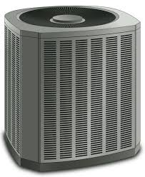
Load Control Demand Response at SDG&E
Summer Saver is a local demand response program offered by SDG&E to residential and small commercial customers
Summer Saver has been offered by SDG&E for nearly 10 years – since 2006
Central air conditioners (CACs) are only end uses currently enrolled in Summer Saver
Summer Saver uses direct load control (DLC) switches with 1-way paging communication

Slide 4
DLC devices cycle the cooling function of enrolled CACs on and off
When a demand response event is called, the DLC device limits the amount of time CAC cools air according to the cycling strategy
Participants have a choice of cycling strategy:
Customer Type | Cycling Strategy | % of CACs Enrolled
Residential | 50% | 52%
 | 100% | 48%
Commercial | 30% | 32%
 | 50% | 68%
Participation is incented with an annual bill credit based on cycling strategy and tonnage of enrolled CAC unit(s)
Residential - $11.50 per ton for 50% cycling, $38 per ton for 100% cycling
Commercial - $ 9 per ton for 30% cycling, $15 per ton for 50% cycling

Slide 5
Nearly 40,000 CAC units are enrolled in Summer Saver
About 70% of enrolled CAC units are residential:
Customer Type | Enrolled CACs
Residential | 27,629
Commercial | 11,322
While the SDG&E service territory is comprised of a single LCA, it has four climate zones:
Customer Type | Coastal | Mountain | Desert | Inland
Residential | 15% | 2% | 0% | 83%
Commercial | 49% | 0% | 0% | 50%
Summer Saver enrollment has been stable over time:
 | 2011 | 2012 | 2013 | 2014
Enrolled CACs | 42,082 | 39,310 | 39,993 | 38,951

Slide 6
Summer Saver is used to reduce SDG&E system demand under peaking conditions
Summer Saver is a local resource that is dispatched as either local or CAISO system conditions warrant.
While Summer Saver can be called any day of the week, event dispatch is subject to a number of limitations:
May through October only
Event duration no less than two hours, no more than four hours
No events on holidays
No more than three event days per week
Placeholder – Group shot? Or possibly just another image

Slide 7
Eight Summer Saver Events Called in 2014
SDG&E typically calls 6-8 Summer Saver events each summer:
 | 2011 | 2012 | 2013 | 2014
Number of Events | 6 | 8 | 6 | 8
Placeholder – Group shot? Or possibly just another image
The 2014 Summer Saver season was notable events called in response to wildfires and Santa Ana conditions in May:
Date | Avg. Temperature during Event (°F)
Wednesday, May 14 | 85
Thursday, May 15 | 87
Friday, May 16 | 93
Tuesday, July 29 | 80
Wednesday, August 27 | 85
Monday, September 15 | 88
Tuesday, September 16 | 89
Wednesday, September 17 | 83

Slide 8
Ex Post Load Impacts Methodology
Ex post load impacts are estimated using hourly interval data available through SDG&E’s smart meters
Participants’ load with demand response can be directly observed on event days, but what would have been if the event were not called?
Nexant has estimated reference loads for Summer Saver using a randomized control trial (RCT) since 2012
The key feature of an RCT is random assignment to treatment and control conditions:
A random sample of participants is selected each year prior to the start of the control season. Half of the sample is randomly assigned to group A and half of the sample is assigned to group B.
Group A and group B alternate treatment and control status event-to-event

Slide 9
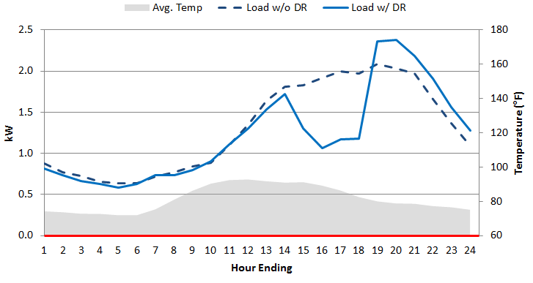
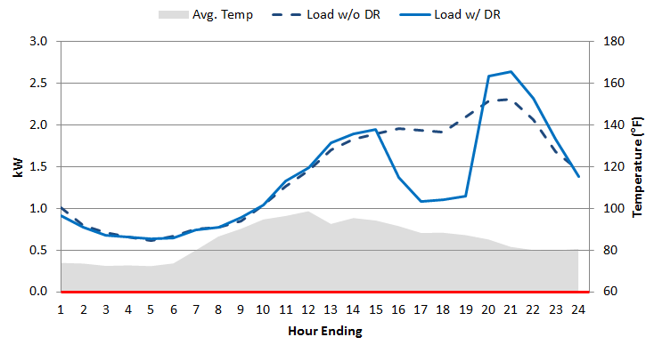
Load Impacts Using an RCT
Average hourly loads (kW) for Group A and Group B
September 15 and September 16 – Res. 100% Cycling
On 9/15 Group A was Treated, and Group B was Control…
… and on 9/16 Group B was Treated, and Group A was Control.
Key benefits to using an RCT:
Reference load is not modeled – estimate is not subject to modeling error (particularly an issue when event days are much hotter than non-event days)
Selection bias is avoided – Reference load reflects what actual program participants would have done in the absence of the event

Slide 10
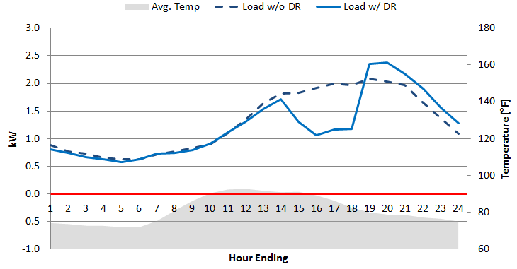
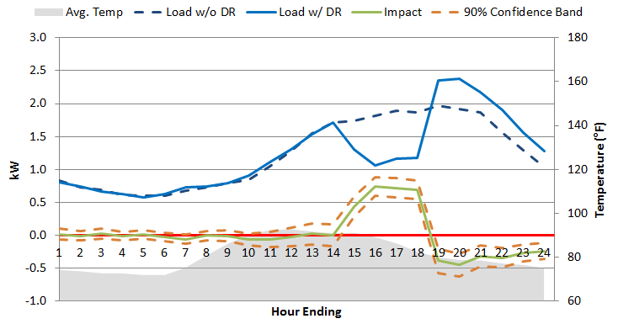
RCTs enable straightforward calculation of load impacts
Average hourly loads (kW) for Group A and Group B
September 15 – Res. 100% Cycling – Adjusted and Unadjusted
Unadjusted…
… adjusted
Differences in magnitude between Treatment and Control groups are controlled for with a same-day adjustment:
Control group load is adjusted by the ratio of treatment group load divided by control group load as observed the hour prior to the event
Hourly load impacts are the calculated as the simple differences between hourly adjusted control loads and treatment loads

Slide 11
Load Impacts for May Events
The May Summer Saver events were called prior to implementing the 2014 experimental design
As a result, no Summer Saver participants were held back from experiencing the events as a control group during those events
The May 2014 ex post load impacts were estimated using a statistically matched control group selected from the SDG&E residential and commercial non-participant population

Slide 12
Residential Ex Post Load Impacts
Date | Load Impact per CAC (kW) | Aggregate Load Impact (MW) | Event Time | Avg. Temp. during Event (°F)
5/14/2014 | 0.26 | 7 | 4 – 8 PM | 85
5/15/2014 | 0.41 | 11 | 4 – 8 PM | 87
5/16/2014 | 0.22 | 6 | 12 – 4 PM | 93
7/29/2014 | 0.45 | 12 | 3 – 7 PM | 80
8/27/2014 | 0.23 | 6 | 2 – 6 PM | 85
9/15/2014 | 0.68 | 18 | 2 – 6 PM | 88
9/16/2014 | 0.78 | 20 | 3 – 7 PM | 89
9/17/2014 | 0.53 | 14 | 2 – 6 PM | 83
Events in May occurred under unusual circumstances
Events in September show the highest load impacts, typical for Summer Saver

Slide 13
Commercial Ex Post Load Impacts
Date | Load Impact per CAC (kW) | Aggregate Load Impact (MW) | Event Time | Avg. Temp. during Event (°F)
5/14/2014 | 0.16 | 2 | 4 – 8 PM | 85
5/15/2014 | 0.25 | 3 | 4 – 8 PM | 86
5/16/2014 | 0.33 | 4 | 12 – 4 PM | 91
7/29/2014 | 0.04 | 1 | 3 – 7 PM | 78
8/27/2014 | 0.31 | 4 | 2 – 6 PM | 84
9/15/2014 | 0.24 | 3 | 2 – 6 PM | 86
9/16/2014 | 0.36 | 4 | 3 – 7 PM | 89
9/17/2014 | 0.32 | 4 | 2 – 6 PM | 82
Commercial ex post load impacts also peaked in September.
July event load impacts are notably low, but are also accompanied by notably low temperatures

Slide 14
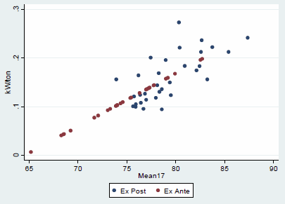
Ex Ante Methodology
Load impacts between 2 and 5 PM for all events in 2011 through 2014 were regressed against the average temperature from midnight to 5 pm (mean17)
$${impact}_{d}=b_{0}+b_{1}{∙mean17}_{d }+ε_{d}$$
The regression model parameters were used to predict load impacts under ex ante weather conditions for 2 to 5 PM
Load impacts are estimated for a set of SDG&E-peaking weather conditions as well as for a set of CAISO-peaking weather conditions
Impacts for other hours were based on the ratio of impacts from 2 to 5 PM to impacts in those hours for 2014 events
Average Ex Post Load Impacts and Ex Ante Predictions from 2 to 5 PM for Residential 100% Cycling Participants

Slide 15
The largest ex ante aggregate impacts for Summer Saver are predicted to occur in September under both 1-in-2 and 1-in-10 year weather conditions
Weather Year | Day Type | Hour of Day |  |  |  |  | Average
 |  | 1 to 2 PM | 2 to 3 PM | 3 to 4 PM | 4 to 5 PM | 5 to 6 PM
1-in-2 | Typical Event Day | 11.0 | 12.5 | 13.9 | 14.5 | 12.5 | 12.9
 | May Monthly Peak | 2.9 | 3.2 | 3.4 | 3.5 | 2.8 | 3.1
 | June Monthly Peak | 6.6 | 7.5 | 8.2 | 8.5 | 7.2 | 7.6
 | July Monthly Peak | 9.2 | 10.5 | 11.5 | 12.1 | 10.3 | 10.7
 | August Monthly Peak | 13.7 | 15.7 | 17.5 | 18.3 | 15.8 | 16.2
 | September Monthly Peak | 14.4 | 16.5 | 18.3 | 19.2 | 16.6 | 17.0
 | October Monthly Peak | 5.7 | 6.5 | 7.1 | 7.3 | 6.2 | 6.6
1-in-10 | Typical Event Day | 13.9 | 15.9 | 17.7 | 18.5 | 15.9 | 16.4
 | May Monthly Peak | 10.9 | 12.5 | 13.8 | 14.5 | 12.4 | 12.8
 | June Monthly Peak | 10.8 | 12.4 | 13.7 | 14.3 | 12.3 | 12.7
 | July Monthly Peak | 11.5 | 13.1 | 14.5 | 15.2 | 13.1 | 13.5
 | August Monthly Peak | 14.3 | 16.4 | 18.3 | 19.2 | 16.5 | 16.9
 | September Monthly Peak | 18.9 | 21.7 | 24.2 | 25.4 | 21.9 | 22.4
 | October Monthly Peak | 12.3 | 14.0 | 15.6 | 16.3 | 14.0 | 14.4

Slide 16
Relationship Between Ex Post and Ex Ante Estimates - Residential
Date | 2014 Ex Post |  |  |  | 2014 Ex Ante Model
 | Event Window | Mean17 (°F ) | Ex-Post Aggregate Impacts (MW) | Mean17 using KSAN KNKX Only (°F) | Ex-Ante Impact with Ex-Post Event Window and Weather (MW) | Ex-Ante Impact (1pm-6pm) using Ex Post Weather (MW) | Ex-Ante Impact SDG&E 1-in-2 (MW) | Ex-Ante Impact SDG&E 1-in-10 (MW) | Ex-Ante Impact CAISO 1-in-2 (MW) | Ex-Ante Impact CAISO 1-in-10 (MW)
A | B | C | D | E | F | G | H | I | J | K
5/14/2014 | 4-8 pm | 82 | 2.2 | 82 | 9 | 8.6 | 3.0 (69°F) | 6.6 (77°F) | 1.6 (65°F) | 5.3 (74°F)
5/15/2014 | 4-8 pm | 84 | 4.8 | 86 | 10.5 | 10.1
5/16/2014 | 12-4 pm | 82 | 1.5 | 83 | 8.7 | 8.9
7/29/2014 | 3-7 pm | 80 | 6.3 | 78 | 7.3 | 6.9 | 5.0 (74°F) | 7.5 (79°F) | 5.3 (74°F) | 6.7 (78°F)
8/27/2014 | 2-6 pm | 79 | 1.3 | 79 | 7.5 | 7.2
9/15/2014 | 2-6 pm | 84 | 10 | 82 | 9 | 8.7 | 6.3 (77°F) | 9.1 (83°F) | 7.0 (78°F) | 9.1 (83°F)
9/16/2014 | 3-7 pm | 86 | 8.1 | 86 | 10.7 | 10.1
9/17/2014 | 2-6 pm | 86 | 7.4 | 84 | 9.6 | 9.2
Residential
50% Cycling
100% Cycling
Date | 2014 Ex Post |  |  |  | 2014 Ex Ante Model
 | Event Window | Mean17 (°F ) | Ex-Post Aggregate Impacts (MW) | Mean17 using KSAN KNKX Only (°F) | Ex-Ante Impact with Ex-Post Event Window and Weather (MW) | Ex-Ante Impact (1pm-6pm) using Ex Post Weather (MW) | Ex-Ante Impact SDG&E 1-in-2 (MW) | Ex-Ante Impact SDG&E 1-in-10 (MW) | Ex-Ante Impact CAISO 1-in-2 (MW) | Ex-Ante Impact CAISO 1-in-10 (MW)
A | B | C | D | E | F | G | H | I | J | K
5/14/2014 | 4-8 pm | 82 | 4.8 | 82 | 9.9 | 8.6 | 2.0 (69°F) | 6.1 (77°F) | 0.3 (65°F) | 4.7 (74°F)
5/15/2014 | 4-8 pm | 84 | 6.1 | 85 | 11.8 | 10.3
5/16/2014 | 12-4 pm | 82 | 4.5 | 83 | 8.1 | 8.9
7/29/2014 | 3-7 pm | 79 | 5.9 | 78 | 7.4 | 6.6 | 4.3 (73°F) | 7.1 (79°F) | 4.7 (74°F) | 6.3 (77°F)
8/27/2014 | 2-6 pm | 79 | 4.6 | 79 | 7.4 | 6.9
9/15/2014 | 2-6 pm | 83 | 8.5 | 82 | 9.3 | 8.7 | 5.8 (76°F) | 8.9 (83°F) | 6.5 (78°F) | 9.0 (83°F)
9/16/2014 | 3-7 pm | 85 | 11.2 | 85 | 11.6 | 10.3
9/17/2014 | 2-6 pm | 85 | 7.3 | 83 | 9.8 | 9.2

Slide 17
Relationship Between Ex Post and Ex Ante Estimates - Commercial
Date | 2014 Ex Post |  |  |  | 2014 Ex Ante Model
 | Event Window | Mean17 (°F ) | Ex-Post Aggregate Impacts (MW) | Mean17 using KSAN KNKX Only (°F) | Ex-Ante Impact with Ex-Post Event Window and Weather (MW) | Ex-Ante Impact (1pm-6pm) using Ex Post Weather (MW) | Ex-Ante Impact SDG&E 1-in-2 (MW) | Ex-Ante Impact SDG&E 1-in-10 (MW) | Ex-Ante Impact CAISO 1-in-2 (MW) | Ex-Ante Impact CAISO 1-in-10 (MW)
A | B | C | D | E | F | G | H | I | J | K
5/14/2014 | 4-8 pm | 82 | 0.1 | 82 | 0.9 | 1 | 0.7 (69°F) | 0.9 (77°F) | 0.6 (65°F) | 0.8 (74°F)
5/15/2014 | 4-8 pm | 84 | 0.4 | 85 | 1 | 1.1
5/16/2014 | 12-4 pm | 81 | 0.9 | 82 | 1.1 | 1
7/29/2014 | 3-7 pm | 79 | 0.1 | 78 | 0.9 | 0.9 | 0.8 (74°F) | 0.9 (79°F) | 0.8 (74°F) | 0.9 (78°F)
8/27/2014 | 2-6 pm | 78 | 0.7 | 78 | 0.9 | 0.9
9/15/2014 | 2-6 pm | 82 | 0.6 | 82 | 1 | 1 | 0.9 (77°F) | 1.0 (83°F) | 0.9 (78°F) | 1.0 (83°F)
9/16/2014 | 3-7 pm | 85 | 1.5 | 85 | 1 | 1.1
9/17/2014 | 2-6 pm | 84 | 0.3 | 83 | 1 | 1
Commercial
30% Cycling
50% Cycling
Date | 2014 Ex Post |  |  |  | 2014 Ex Ante Model
 | Event Window | Mean17 (°F ) | Ex-Post Aggregate Impacts (MW) | Mean17 using KSAN KNKX Only (°F) | Ex-Ante Impact with Ex-Post Event Window and Weather (MW) | Ex-Ante Impact (1pm-6pm) using Ex Post Weather (MW) | Ex-Ante Impact SDG&E 1-in-2 (MW) | Ex-Ante Impact SDG&E 1-in-10 (MW) | Ex-Ante Impact CAISO 1-in-2 (MW) | Ex-Ante Impact CAISO 1-in-10 (MW)
A | B | C | D | E | F | G | H | I | J | K
5/14/2014 | 4-8 pm | 82 | 1.6 | 82 | 3.1 | 3.3 | 1.1 (69°F) | 2.5 (77°F) | 0.6 (65°F) | 2.0 (74°F)
5/15/2014 | 4-8 pm | 84 | 2.4 | 85 | 3.5 | 3.9
5/16/2014 | 12-4 pm | 81 | 2.8 | 82 | 3.5 | 3.3
7/29/2014 | 3-7 pm | 78 | 0.4 | 78 | 2.6 | 2.7 | 1.9 (73°F) | 2.7 (79°F) | 2.0 (74°F) | 2.5 (77°F)
8/27/2014 | 2-6 pm | 78 | 2.8 | 78 | 2.7 | 2.7
9/15/2014 | 2-6 pm | 82 | 2.1 | 81 | 3.3 | 3.3 | 2.3 (76°F) | 3.2 (83°F) | 2.5 (78°F) | 3.3 (83°F)
9/16/2014 | 3-7 pm | 84 | 2.4 | 85 | 3.7 | 3.8
9/17/2014 | 2-6 pm | 83 | 3.3 | 82 | 3.4 | 3.4

Slide 18
Contact Us
Candice Churchwell Senior Consultant, Utility Services CChurchwell@nexant.com
(415) 777-0707

