Slide 1
PG&E’s SmartAC Program
Prepared by:
Dr. Jonathan Cook
Dr. Stephen George
May 11, 2015

Slide 2
Program Overview

Slide 3
Overview of PG&E’s SmartAC Program
AC load control through installation of control devices that limit the duty cycles of AC units
Two types of devices: Switches and PCTs
Residential and small/medium businesses (SMB)
Events can be called for several reasons:
For testing purposes; or
To provide demand reductions during emergency conditions; or
Events occur between May 1st and October 31st, for up to 6 hours or less in each event and for a maximum of 100 hours per season
149,678 residential accounts and 5,009 SMB accounts at end of summer 2014

Slide 4
Ex Post Analysis

Slide 5
SmartAC Ex Post Methodology
Basic strategy for estimating ex post SmartAC load impacts is to compare usage of treatment and control groups during event hours
SmartAC population is randomly divided into 10 groups based on last digit of the device serial number
For each event, only some groups are called (treatment) and the groups that are not called serve as a control group
Estimation uses SmartMeter interval data
Impacts were calculated by comparing the average event day usage in the control group to the average event day usage in the treated group
Dually enrolled customers were dropped from the analysis on some event days (6/30 and 9/11) due to overlap with SmartRate event days
No SMB events were called in 2014

Slide 6
2014 Event Characteristics
Event Date | Event Hours | Groups Called | SmartRate Event Day
June 30 | 3 to 6 PM | 1 & 2 | Yes
July 30 | 10 AM to 8 PM | 1–9 (staggered) | No
August 1 | 3 to 6 PM | 1 & 2 | No
September 11 | 3 to 6 PM | 2–10 | Yes

Slide 7
Loads of Randomized Groups on August 1 Event Day

Slide 8
SmartAC 2014 Residential Ex Post Impacts for 3-6 PM
Event Date | Event Hours | Average Whole-Building Reference Load (kW) | Average Event Impact (kW) | Percent Impact | Aggregate Impact (MW) | Average Temperature 3 to 6 PM (°F)
6/30 | 3 to 6 PM | 2.73 | 0.62 | 22.6% | 13.6 | 98
7/30 | 3 to 6 PM | 2.43 | 0.50 | 20.7% | 15.1 | 95
8/1 | 3 to 6 PM | 2.70 | 0.62 | 22.8% | 18.5 | 98
9/11 | 3 to 6 PM | 1.94 | 0.32 | 16.5% | 31.6 | 95
Average | 3 to 6 PM | 2.45 | 0.52 | 20.7% | 19.7 | 97

Slide 9
Dual-enrolled SmartAC/SmartRate Customers
Date | Hour Ending | Impact (kW) |  | Impact (%)
 |  | SmartAC-only | Dually-enrolled | SmartAC-only | Dually-enrolled
30-Jul-14 | 11 | 0.07 | 0.04 | 7% | 4%
 | 12 | 0.13 | 0.09 | 11% | 8%
 | 13 | 0.19 | 0.13 | 13% | 10%
 | 14 | 0.22 | 0.18 | 13% | 11%
 | 15 | 0.34 | 0.23 | 17% | 13%
 | 16 | 0.45 | 0.33 | 20% | 17%
 | 17 | 0.55 | 0.41 | 22% | 19%
 | 18 | 0.60 | 0.48 | 22% | 21%
 | 19 | 0.52 | 0.44 | 19% | 19%
 | 20 | 0.45 | 0.36 | 17% | 16%
1-Aug-14 | 16 | 0.58 | 0.41 | 22% | 18%
 | 17 | 0.68 | 0.51 | 24% | 21%
 | 18 | 0.72 | 0.56 | 24% | 22%
Average | 16 | 0.52 | 0.37 | 21% | 18%
 | 17 | 0.62 | 0.46 | 23% | 20%
 | 18 | 0.66 | 0.52 | 23% | 22%
Approximately 40,000 (37%) of SmartAC customers are also enrolled in SmartRate
Can compare impacts for Dual-enrolled and SmartAC-only customers on non-SmartRate Days
Dual-enrolled customers have approximately the same % impacts as SmartAC-only customers, but have lower absolute impacts

Slide 10
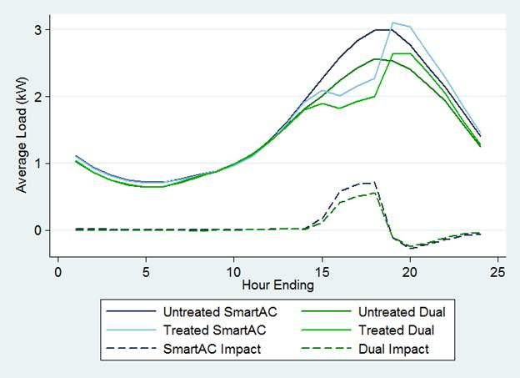
Dual-Enrolled Customers Have Lower Impacts Because of Lower Loads

Slide 11
Distribution of Impacts by Geography and Usage Level
Local Capacity Area | Average Temperature during Event Window (°F) | Average per Customer Impact from 3 to 6 PM (kW) | Average % Impact from 3 to 6 PM
Greater Bay Area | 91 | 0.42 | 21.1%
Greater Fresno | 103 | 0.56 | 19.1%
Kern | 103 | 0.70 | 21.9%
Northern Coast | 88 | 0.30 | 20.0%
Other | 100 | 0.54 | 20.5%
Sierra | 99 | 0.61 | 21.9%
Stockton | 99 | 0.63 | 22.3%
All | 96 | 0.52 | 21.2%
Usage Decile | Average Peak Period Load (kW) | Average per Customer Impact from 3 to 6 PM (kW) | Average % Impact from 3 to 6 PM
1 | 0.71 | 0.17 | 24.1%
2 | 1.25 | 0.27 | 21.6%
3 | 1.64 | 0.32 | 19.5%
4 | 1.97 | 0.40 | 20.3%
5 | 2.32 | 0.48 | 20.7%
6 | 2.67 | 0.56 | 21.0%
7 | 2.99 | 0.64 | 21.4%
8 | 3.35 | 0.73 | 21.8%
9 | 3.77 | 0.80 | 21.2%
10 | 4.74 | 1.01 | 21.3%

Slide 12
SmartAC Impacts for Solar Customers on August 1 Event
Hour Ending | Impact (kW) | Aggregate Impact (MW) | Average Temperature (°F)
16 | 0.58 | 1.01 | 98
17 | 0.67 | 1.17 | 98
18 | 0.79 | 1.38 | 97
Avg. | 0.68 | 1.19 | 98

Slide 13
Ex Ante Analysis

Slide 14
Ex Ante Methodology
Evaluation is required to produce forecasts of load impacts under specified weather conditions
Two sets of weather conditions in this year’s analysis
PG&E peaking conditions
CAISO peaking conditions
Our method is to use ex post impacts as inputs into a model describing relationship between impacts and temperature
Similar method used for both residential and SMB
Ex post impacts for SMB were taken from 2011 events

Slide 15
Getting from Ex Post to Ex Ante
Model relationship between ex post impacts and temperature for 4-5 PM at LCA level (pool all LCAs into single dataset)
Use estimated parameters from regression model to predict impacts for 4-5 PM under ex ante weather conditions
Predict impacts for other hours (1-4 PM, 5-6 PM) based on observed ratios between impact at 4-5 PM and impact at each other hour (ratios are LCA-specific and vary with temperature)
Commercial model is essentially the same, but makes concessions for smaller sample sizes

Slide 16
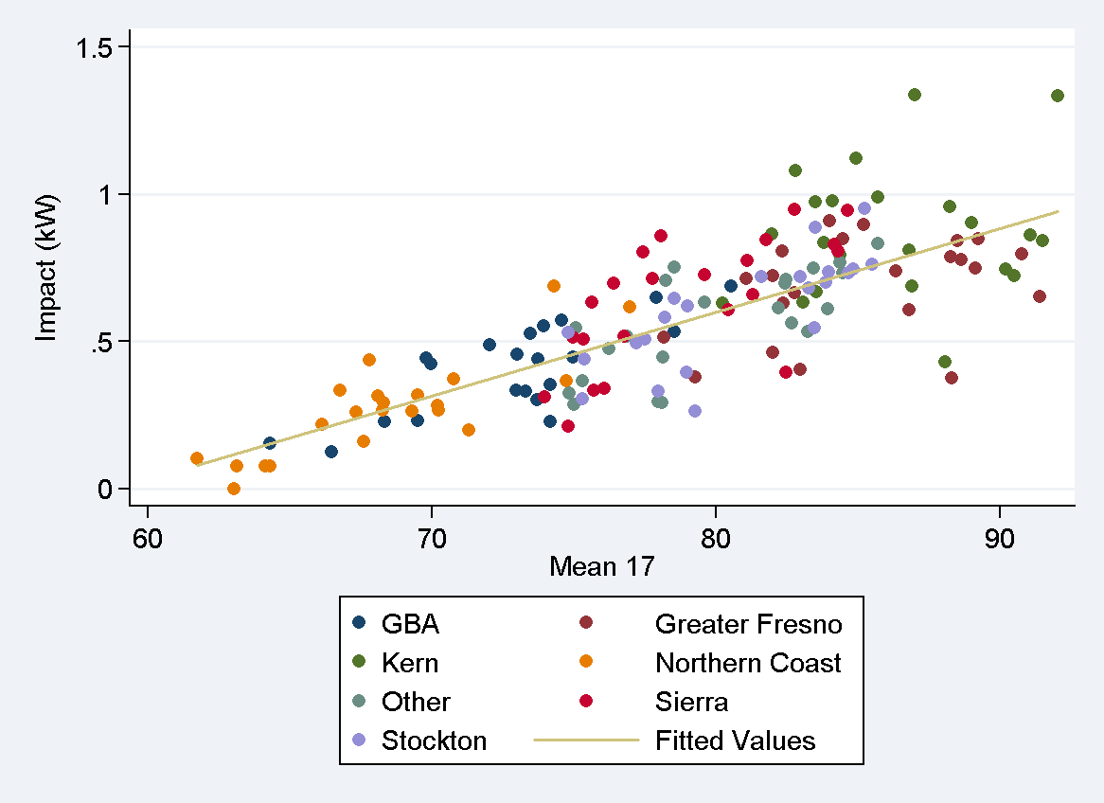
Steps 1 & 2: Model Relationship between Impact & Temperature for 4-5 PM

Slide 17
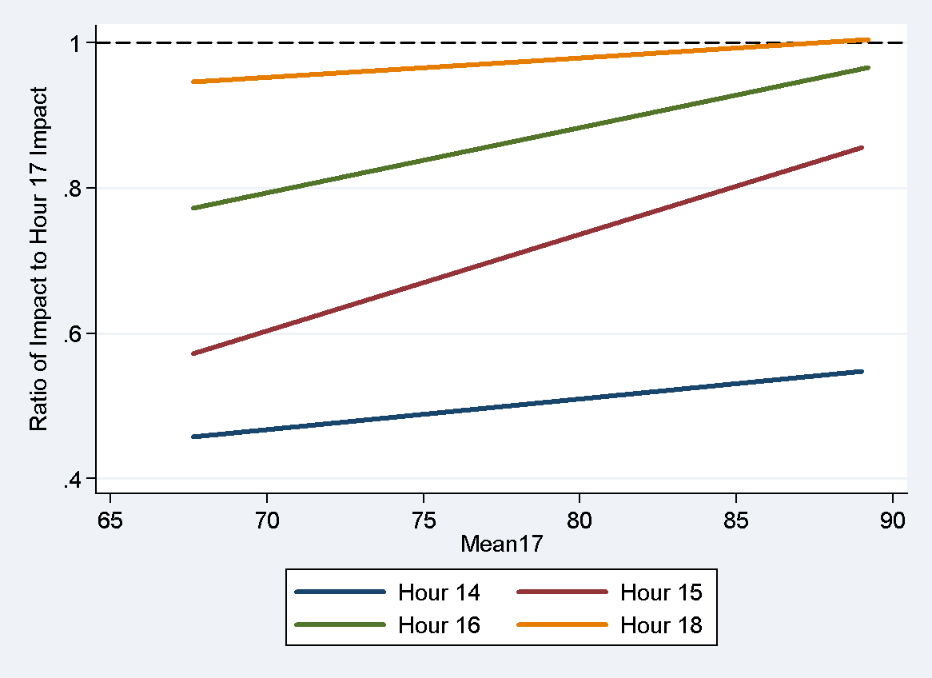
Step 3: Predict Ratios of Impacts for Other Hours Relative to 4-5 PM

Slide 18
Adjustments to Ex Ante Model
As mentioned previously, dually enrolled customers provide smaller impacts
Ex post impacts were adjusted to include dually enrolled customers based on results from non-SmartRate days
Reference loads must be scaled to account for ex ante weather
Load increases after event ends (snapback) must be modeled separately

Slide 19
End Result is Estimated Treatment and Control Loads for Each Combination of LCA, Weather, and Month

Slide 20
SmartAC 2014 Residential Ex Ante Impacts
Weather Conditions | Month with Largest Impact | Maximum Aggregate Impact (MW) | Typical Event Day Impacts
 |  |  | Avg. Per Customer Impact for 1-6 PM (kW) | Avg. Aggregate Impact for 1-6 PM (MW)
PG&E 1-in-2 | June/July | 99 | 0.52 | 83
PG&E 1-in-10 | July | 125 | 0.60 | 104
CAISO 1-in-2 | June | 95 | 0.44 | 79
CAISO 1-in-10 | July | 114 | 0.53 | 96
Larger impacts for hotter weather conditions
Impacts for CAISO peaking conditions are lower than for PG&E peaking conditions
Indicates that PG&E peak does not overlap perfectly with CAISO system peak

Slide 21
SmartAC 2014 SMB Ex Ante Impacts
Weather Conditions | Month with Largest Impact | Maximum Aggregate Impact (MW) | Typical Event Day Impacts
 |  |  | Avg. Per Customer Impact for 1-6 PM (kW) | Avg. Aggregate Impact for 1-6 PM (MW)
PG&E 1-in-2 | June/July | 3.7 | 0.67 | 3.1
PG&E 1-in-10 | July | 4.3 | 0.73 | 3.4
CAISO 1-in-2 | June | 3.5 | 0.55 | 2.6
CAISO 1-in-10 | July | 4.2 | 0.68 | 3.2
Similar patterns as residential impacts

Slide 22
Comparing Ex Post and Ex Ante Impacts
(A) Date | 2014 Ex Post Aggregate Estimates |  |  |  |  |  | Aggregate Estimates Based on Ex Ante Model
 | (B) Event Window | (C) Mean17 | (D) % of Resources Dispatched | (E) Aggregate Reduction of SmartAC-only (MW) | (F) Scaled to Entire SmartAC-only Population | (G) Scaled Up to include Dually Enrolled | (H) Historical Window, Weather & Enrollment | Standardized Event Window
 |  |  |  |  |  |  |  | (I) Historical Weather & Enrollment | (J) Historical Weather, Forecast Enrollment | (K) PG&E 1-in-2 Year Weather, Forecast Enrollment | (L) PG&E 1-in-10 Year Weather, Forecast Enrollment
30-Jun-14 | 3-6 pm | 81.8 | 20% | 13.7 | 68.9 | 94.1 | 94.6 | 87.9 | 89.5 | 80.2 | 92.7
30-Jul-14 | 3-6 pm | 79.3 | 20% | 11.8 | 58.8 | 75.7 | 83.0 | 76.3 | 77.8
1-Aug-14 | 3-6 pm | 81.2 | 20% | 14.4 | 72.8 | 93.4 | 91.1 | 84.5 | 86.7
11-Sep-14 | 3-6 pm | 76.8 | 90% | 31.6 | 35.2 | 48.1 | 71.3 | 64.7 | 66.5
Average | N/A | 79.8 | 37.5% | 17.9 | 55.1 | 75.2 | 85.0 | 78.4 | 80.1

Slide 23
Change in Ex Ante Estimates from Last Year
Several differences between the two years
Enrollment
Model
Weather
Impact of change in enrollment is negligible
2014 weather is cooler than 2013 weather (lower impacts)
2014 ex post impacts were below average of 2011-2013 impacts, lowering predictions from ex ante model
 | 2013 Weather, 2013 Enrollment, 2013 Model | 2014 Weather, 2013 Enrollment, 2013 Model | 2014 Weather, 2014 Enrollment, 2013 Model | 2014 Weather, 2014 Enrollment, 2014 Model
Average per customer impact in Hour 17 (kW) | 0.70 | 0.68 | 0.68 | 0.65
Aggregate Hour 17 Impact (MW) | 108 | 105 | 105 | 99
Change in Aggregate Impact (MW) | N/A | -3 | 0 | -6
Average Aggregate Impact During Hours 14 to 18 (MW) | 92 | 89 | 89 | 83
Change | N/A | -3 | 0 | -6

Slide 24
Conclusions

Slide 25
Conclusions
2014 test events were called in a way that enhanced the evaluation
2 events that were not on SmartRate days
1 event that occurred outside typical event hours
SmartAC reduces peak load for participants by approximately 20% on hot days when system load is very high
Impacts increase with temperature
Going forward, SmartAC is expected to be able to provide significant peak load reductions on a typical event day
80-93 MW for PG&E peaking conditions
67-82 MW for CAISO peaking conditions
Load reductions will be smaller if SmartAC is called on days when the CAISO system is peaking because PG&E and CAISO peaks are not perfectly correlated

Slide 26
For comments or questions, contact: Jonathan Cook Senior Consultant jonathancook@nexant.com
Nexant, Inc. 101 Montgomery St., 15th Floor San Francisco, CA 94104 415-777-0707

