Slide 1
2011 Aggregator Programs Accuracy of Baseline Estimates Josh Bode, M.P.P. DRMEC Load Impact Workshop San Francisco, CA July 25-26, 2012
Notes:
Housekeeping
Introduce EPRI and FSC
Recording session, etc.
Welcome, have everyone introduce themselves to see who is there
Want to focus on your comments questions… please ask questions throughout

Slide 2
Presentation Overview
Introduction and objectives of the study
How baselines work
Changes in baseline rules tested
Results
Key findings

Slide 3
Baselines are a tool to estimate demand reductions
Measuring demand reductions is an entirely different task than measuring power production
Power production is metered and thus is measured directly.
Demand reductions cannot be metered. They must be estimated by indirect approaches.
In principle, the reduction is simply the difference between electricity use with and without the load curtailment
However, it is not possible to directly observe or meter what electricity use would have been in the absence of the curtailment – the counterfactual.
Instead, the counterfactual must be estimated.

Slide 4
We addressed three study objectives using controlled tests and real world comparisons
Aggregation
Does calculating the baselines and adjustments in aggregate (versus individually) affect the accuracy of the estimates?
Does it reduce the magnitude of same-day adjustments?
Universal application of same day adjustments
Does accuracy improve or deteriorate if same-day adjustments are applied universally?
How does changing the adjustment cap affect accuracy?
How often are different cap levels exceeded
Adjustment caps

Slide 5
Controlled tests can be very useful
Ability to introduce specific changes in a controlled fashion
Ability to isolate the effects those changes
Valid causal conclusions
Ability to limit factors, such as behavior, that may otherwise be confounded with baseline changes

Slide 6
But they do not always replicate all the factors in the real world…

Slide 7
How baselines work
Select a set of days
Average the hourly load for those days to produce a unadjusted baseline
Apply same day adjustments
Compare unadjusted baseline to actual load during the pre-event period
Calculate the adjustment
Apply the adjustment to the baseline
Calculate impacts as the difference between the adjusted baseline and the actual loads during the event
The process assumes usage in prior days provide information about the electricity customers would have used in the absence of curtailment

Slide 8
Which comes first, aggregation or calculation?
Calculate first, then aggregate
Calculate baselines individually
Apply adjustments and caps individually
Aggregate to settlement portfolio
Aggregate first, then calculate
Aggregate customer loads in portfolio
Calculate baselines using aggregated load
Apply adjustments and caps
Does aggregating loads first affect the accuracy of the estimates?
Does it reduce the magnitude of same-day adjustments?

Slide 9
An applied example of same day adjustments
Baselines can be adjusted up or down based on electricity use patterns during the hours leading up to an event
Same-day adjustments implicitly assume that differences between the unadjusted baseline and actual loads during hours leading up to an event are due to predictive error and not due to customer behavior

Slide 10
Customer and aggregator behavior can affect the accuracy of baseline estimates
The customers are nearly identical, but the estimation error differ because of they reduce ad different amount of demand
Metric | Customer A | Customer B
Baseline Estimate | 294 kW | 294 kW
True Reference load | 300 kW | 300 kW
Load with DR | 270 kW | 225 kW
Demand reduction estimate | 24 kW (294-270) | 69 kW (294-225)
True demand reduction | 30 kW (10%) | 75 kW (25%)
% Error | -20% | -8%

Slide 11
The current baseline calculations are applied individually
Current Baseline Rules
Last 10 of 10 eligible days
Aggregators can elect whether or not to apply same day adjustment in advance, but must do so proactively
Adjustment is calculated based on the first three of the four hours immediately before an event
Adjustments are capped at ± 20%
Baselines are calculated individually, adjustments are applied individually and then aggregated to the settlement portfolio

Slide 12
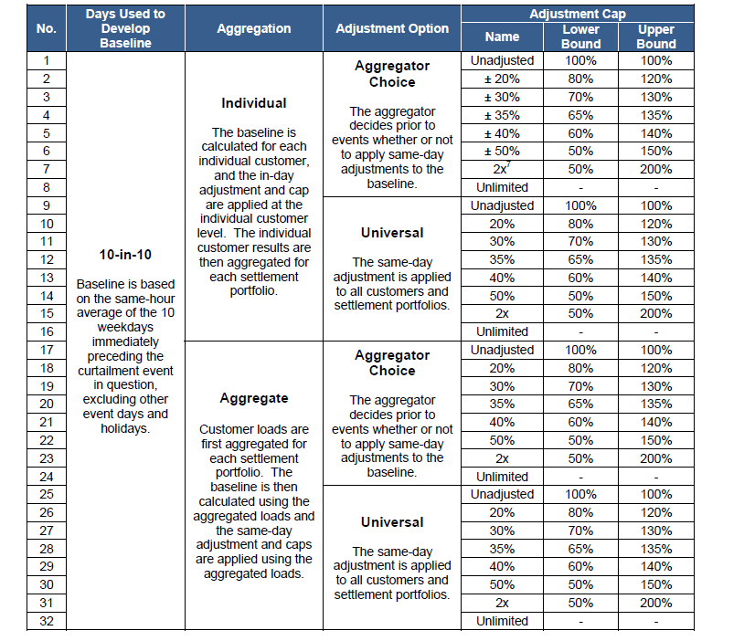
In total 32 different baseline rules were tested for each program option at each utility
The report has a much richer set of results
CBP day-of and day-Ahead by utility
AMP day-of and day-ahead for PG&E
DRRC day-of and day-ahead for SCE

Slide 13
The “real world” comparison compares one estimate – regression results – to other estimates – baseline results
CPUC decision ordered comparison of actual event days
Comparing results from actual event days is useful because:
The comparison is made for real event conditions
It reflects customer behavior that are difficult to replicate in a controlled setting – such as shifting of load to some pre-event hours, or early demand reductions – that can affect same day adjustments
However, to assess accuracy, it is necessary to know the correct answer

Slide 14
In some cases, baseline estimates matched evaluation results; in other cases, they did not
Utility | Program | Advance Notification | Average Event Comparison |  |  |  | Baseline Bias (simulation results)
 |  |  | Event Hours | Evaluation Load Reduction (MW) | Baseline Load Reduction (MW) | % of Evaluation Results
PG&E | CBP | Day Ahead | 15 | 13.6 | 15.2 | 112.0% | -22.3%
 |  | Day-of | 3 | 14.2 | 12.5 | 87.7% | -9.7%
 | AMP | Day Ahead | 4 | 52.8 | 43.3 | 82.1% | -22.8%
 |  | Day-of | 4 | 111.2 | 104.5 | 94.0% | -5.1%
SCE | CBP | Day Ahead | 48 | 4.0 | 3.2 | 80.0% | -15.0%
 |  | Day-of | 10 | 15.2 | 13.6 | 89.5% | -11.3%
 | DRRC | Day Ahead | 4 | 17.4 | 17.0 | 97.7% | -3.3%
 |  | Day-of | 8 | 81.4 | 81.8 | 100.5% | -2.8%
SDG&E | CBP | Day Ahead | 19 | 11.0 | 8.6 | 78.2% | -12.5%
 |  | Day-of | 21 | 11.4 | 9.9 | 86.8% | -18.0%
The bias results for the controlled tests explain much of the difference, but some of those differences are due to changes in customer load during hours that affect the same-day adjustment

Slide 15
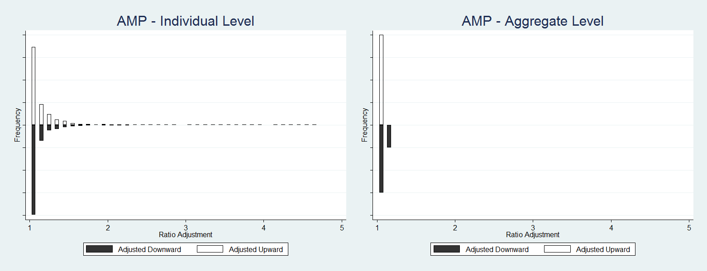
The baseline adjustments are much smaller when loads are aggregated before baselines are calculated
The results are similar for all utilities, programs and program options
Few individual accounts require very large adjustments

Slide 16
Another look at the same issue for aggregator contracts
Program | Adjustment Level | Adjustment Direction | Adjustment Cap
 |  |  | ± 20% | ± 30% | ± 40% | ± 50%
PG&E AMP | Aggregate | Upward | 0.00% | 0.00% | 0.00% | 0.00%
 |  | Downward | 0.00% | 0.00% | 0.00% | 0.00%
 |  | TOTAL | 0.00% | 0.00% | 0.00% | 0.00%
 | Individual | Upward | 12.60% | 7.90% | 5.70% | 4.00%
 |  | Downward | 7.60% | 5.00% | 3.80% | 3.20%
 |  | TOTAL | 20.20% | 12.90% | 9.40% | 7.20%
SCE's DRRC | Aggregate | Upward | 0.00% | 0.00% | 0.00% | 0.00%
 |  | Downward | 0.00% | 0.00% | 0.00% | 0.00%
 |  | TOTAL | 0.00% | 0.00% | 0.00% | 0.00%
 | Individual | Upward | 14.20% | 8.90% | 6.90% | 5.20%
 |  | Downward | 10.70% | 9.00% | 7.80% | 6.70%
 |  | TOTAL | 24.90% | 17.90% | 14.80% | 11.90%

Slide 17
For CBP, large adjustments are more common even when results are aggregated
Utility | Adjustment Level | Adjustment Direction | Adjustment Cap
 |  |  | ± 20% | ± 30% | ± 40% | ± 50%
PG&E | Aggregate | Upward | 7.90% | 3.10% | 1.60% | 1.60%
 |  | Downward | 15.70% | 3.90% | 3.90% | 3.90%
 |  | TOTAL | 23.60% | 7.10% | 5.50% | 5.50%
 | Individual | Upward | 16.50% | 11.40% | 9.20% | 7.30%
 |  | Downward | 19.30% | 18.30% | 17.30% | 16.30%
 |  | TOTAL | 35.80% | 29.70% | 26.60% | 23.70%
SCE | Aggregate | Upward | 19.80% | 14.40% | 9.00% | 5.40%
 |  | Downward | 0.00% | 0.00% | 0.00% | 0.00%
 |  | TOTAL | 19.80% | 14.40% | 9.00% | 5.40%
 | Individual | Upward | 10.00% | 3.70% | 2.20% | 1.60%
 |  | Downward | 1.10% | 0.70% | 0.60% | 0.40%
 |  | TOTAL | 11.10% | 4.40% | 2.80% | 2.00%
SDG&E | Aggregate | Upward | 22.80% | 3.50% | 3.50% | 3.50%
 |  | Downward | 3.50% | 3.50% | 3.50% | 3.50%
 |  | TOTAL | 26.30% | 7.00% | 7.00% | 7.00%
 | Individual | Upward | 20.30% | 9.10% | 4.80% | 2.10%
 |  | Downward | 2.20% | 1.20% | 0.70% | 0.60%
 |  | TOTAL | 22.50% | 10.30% | 5.50% | 2.70%

Slide 18
The results from the “real world” test varied by program and option
Arrows indicate if the results get closer to the evaluation estimates
The results are affected by customer behavior during the same hours used to calculate the adjustment

Slide 19
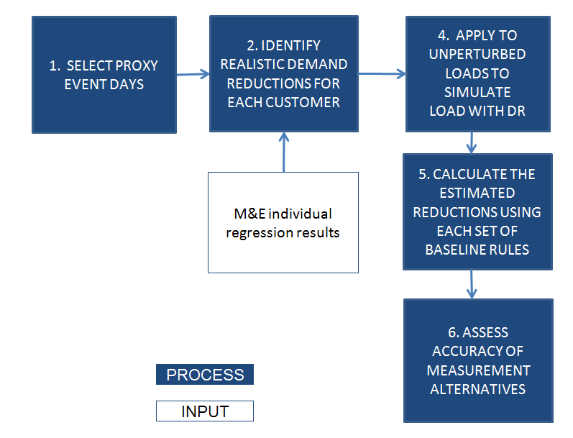
The controlled test relies on comparing baseline estimates to known demand reductions introduced on event-like days
To assess accuracy, one needs to know the correct values. Because the demand reductions values are artificially introduced and known, we can determine the accuracy of each set of baseline rules

Slide 20
The detailed results include information about accuracy for each event day
Application of Baselines |  | Adjustment Option | Adjustment Cap | Impact (MW) by Proxy Event Day |  |  |  |  |  |  |  |  | Avg | Bias | Goodness-of-Fit
 |  |  |  | 1 | 2 | 3 | 4 | 5 | 6 | 7 | 8 | 9 |  | MPE | MAPE | CV RMSE
Simulated Impact |  |  |  | 44.3 |  |  |  |  |  |  |  |  | - | - | - | -
Individual | Aggregator Choice |  | Unadjusted | 50.6 | 48.9 | 34.8 | 28.6 | 22.9 | 17.9 | 27.3 | 32.8 | 39.5 | 33.7 | -23.9% | 29.4% | 0.336
 |  |  | 20% | 50.4 | 48.8 | 34.7 | 28.9 | 23.4 | 18.8 | 28.5 | 34.8 | 39.5 | 34.2 | -22.8% | 28.1% | 0.322
 |  |  | 30% | 50.3 | 48.7 | 34.7 | 29.0 | 23.6 | 19.3 | 29.1 | 34.8 | 39.5 | 34.3 | -22.5% | 27.7% | 0.317
 |  |  | 35% | 50.2 | 48.6 | 34.7 | 29.1 | 23.7 | 19.5 | 29.4 | 34.8 | 39.5 | 34.4 | -22.3% | 27.5% | 0.315
 |  |  | 40% | 50.2 | 48.6 | 34.6 | 29.1 | 23.8 | 19.7 | 29.8 | 34.8 | 39.5 | 34.5 | -22.2% | 27.3% | 0.312
 |  |  | 50% | 50.1 | 48.5 | 34.6 | 29.3 | 24.1 | 20.2 | 30.4 | 34.9 | 39.5 | 34.6 | -21.8% | 26.9% | 0.307
 |  |  | 2x | 50.1 | 48.5 | 34.6 | 30.3 | 25.3 | 22.5 | 31.0 | 34.9 | 39.5 | 35.2 | -20.6% | 25.6% | 0.288
 |  |  | Unlimited | 49.6 | 48.2 | 34.5 | 32.1 | 26.0 | 23.1 | 30.9 | 34.9 | 39.5 | 35.4 | -20.0% | 24.6% | 0.278
 | Universal |  | Unadjusted | 50.6 | 48.9 | 34.8 | 28.6 | 22.9 | 17.9 | 27.3 | 32.8 | 39.5 | 33.7 | -23.9% | 29.4% | 0.336
 |  |  | 20% | 49.2 | 49.8 | 44.0 | 36.5 | 28.4 | 22.0 | 34.8 | 40.6 | 39.2 | 38.3 | -13.6% | 18.8% | 0.237
 |  |  | 30% | 48.3 | 49.5 | 44.7 | 38.3 | 29.7 | 23.5 | 36.8 | 41.5 | 39.3 | 39.1 | -11.8% | 16.7% | 0.215
 |  |  | 35% | 48.0 | 49.1 | 44.9 | 38.7 | 30.1 | 24.3 | 37.7 | 41.6 | 39.3 | 39.3 | -11.2% | 15.9% | 0.206
 |  |  | 40% | 47.8 | 48.7 | 45.0 | 39.0 | 30.5 | 25.0 | 38.7 | 41.8 | 39.3 | 39.5 | -10.7% | 15.1% | 0.197
 |  |  | 50% | 47.4 | 48.0 | 44.9 | 39.7 | 31.1 | 26.4 | 40.4 | 42.0 | 39.3 | 39.9 | -9.8% | 13.6% | 0.181
 |  |  | 2x | 47.7 | 48.0 | 45.0 | 42.4 | 34.1 | 32.4 | 43.8 | 42.5 | 39.6 | 41.7 | -5.8% | 9.7% | 0.130
 |  |  | Unlimited | 46.1 | 46.4 | 44.7 | 46.1 | 35.7 | 34.0 | 43.9 | 42.8 | 40.0 | 42.2 | -4.7% | 7.8% | 0.110

Slide 21
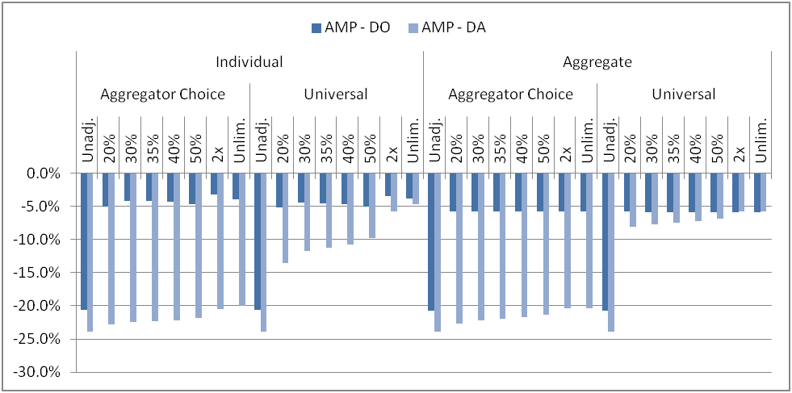
A visual example of detailed results

Slide 22
The results from the controlled test varied by program and option
Arrows indicate if the results get more accurate – that is, closer to the true demand reduction
The controlled test assumes that customer behavior does not affect the hours used to calculate adjustments

Slide 23
The more aggregation that takes place, the more accurate the baseline estimates become
Individual settlement portfolio errors are larger than program errors
Individual day errors are larger than average day errors
Most baseline accuracy summaries show aggregate findings and don’t focus on the error of the demand reduction estimates
* Based on aggregated baseline calculation, with same day adjustment universally applied and no cap. Includes all settlement portfolios across all three utilities.

Slide 24
Baseline estimates are more accurate when percent demand reductions are larger
Individual settlement portfolio errors are larger than program errors
Individual day errors are larger than average day errors
* Based on aggregated baseline calculation, with same day adjustment universally applied and no cap. Includes all settlement portfolios across all three utilities.

Slide 25
Key findings
Applying same-day adjustments universally almost always increases accuracy.
Calculating adjustments at the settlement portfolio level generally does not noticeably decrease or increase bias in the impact estimate, but it does reduce the magnitude of same-day adjustments.
The effect of increasing the adjustment cap varies by program and option. When it does change results, accuracy generally improves but only slightly.
Few customer need large adjustments.
Errors in the baseline estimates are smaller with more aggregation and larger percent demand reductions.

Slide 26
Recommendations
Make same day adjustments the default option for settlement baselines
If needed, increase the adjustment cap to ±30%
We advise against removing the adjustment cap altogether it can cause extreme adjustments for some customers that are large enough to affect the overall program results.
We do not recommend higher adjustment caps of ±40% or ±50% for two reasons: relatively few accounts require large adjustments; and customers that require large adjustments are less predictable and instead should be encouraged to enroll in DR programs that do not rely on baselines for settlement.

Slide 27
For any questions, feel free to contact
Josh Bode, M.P.P.
Freeman, Sullivan & Co.
101 Montgomery Street 15th Floor, San Francisco, CA 94104
joshbode@fscgroup.com
415.777.0707

