Slide 1
2012 California Statewide
Critical Peak Pricing
Evaluation
Josh L. Bode
Candice A. Churchwell
DRMEC Spring 2013 Load Impacts Evaluation Workshop
San Francisco, California
June 3, 2013

Slide 2
Presentation overview
Introduction and comparison of rates
Evaluation methodology and validation
Ex post results
Ex ante results
Recommendations

Slide 3
California is the only state with default Critical Peak Pricing (CPP) rates
CPP is a rate in which the utility charges a higher price for consumption of electricity during peak hours on critical days
in exchange for a reduction in non-peak energy charges, demand charges or both.
Approximately 15,000 customers have been defaulted onto CPP and about 5,200 remain on the rate. Most of them are large customers (over 200 kW of maximum demand).
All large customers defaulted onto CPP from TOU rates that already provided them an incentive to reduce or shift consumption from peak hours

Slide 4
Although conceptually similar, many rate & deployment details vary across the utilities
CPP Characteristic | Utility
 | PG&E | SDG&E | SCE
Date of First CPP Default | May-10 | May-08 | Oct-09
Demand Criterion for CPP Default | >200 kW | >20 kW | >200 kW
Number of Months Demand Must Exceed Threshold | 3 out of 12 | 12 out of 12 | NA
Opt-out Period | Rolling | Once Annually | Rolling
Event Period Hours | 2 pm-6 pm | 11 am-6 pm | 2 pm-6 pm
Event Season | Year-round | Year-round | Summer M-F
Number of Events | 9 (Min) -15 (Max) | Maximum 18 | 9 (Min) -15 (Max)
Summer TOU Peak Hours | 12 pm-6 pm, M-F | 11 am-6 pm, M-F | 12 pm-6 pm, M-F
Winter TOU Peak Hours | NA | 5pm-8pm, M-F | NA
Summer Season | May-Oct | May-Sep | Jun-Sep
Winter Season | Nov-Apr | Oct-Apr | Oct-May
Capacity Reservation Default Level | 50%* | 50%* | NA
First Year Bill Stabilization | Yes | Yes | Yes
*Capacity reservation default level of 50% refers to 50% of the customer's peak demand during the previous summer

Slide 5
CPP rates include two main changes…
… A CPP adder on event day during event hours
… and a discounted on-peak demand charge on non-event days
Load impacts estimated here only account for the incremental effect of event day prices on peak period demand relative to that of non-CPP days

Slide 6
Ex post load impacts were calculated using difference-in-differences
A transparent methodology for estimating load impacts:
  No need to model loads
  Results do not depend on modeling but on quality of control group and control days
  Impacts can be replicated with hand calculations
  The regression simply guarantees correct calculation of standard errors
  .
Difference-in-difference uses on both information from a control group and information for hot non-event days
  Hourly loads for a well-matched control group nearly mirror the loads of the CPP population on event-like days.
  These small differences are subtracted from the difference between control and CPP population loads on actual event days – the difference in differences.

Slide 7
The non-event control days were selected to closely match event conditions
We matched non-event days to historical events based on system loads, temperature, day of week and program year
Comparable proxy days are not available for some days with very extreme weather

Slide 8
The validation tests show that the differences-in-differences out performs other alternatives
We replicate the process for event like days where we knew the CPP response was zero:
  Same control group
  Select control days
  Calculated difference-in-differences
If the methods works, impacts should be zero, since CPP high prices were not in effect

Slide 9
Ex post impact estimates from a different estimation method produce similar results
Individual customer regressions were estimated for all CPP participants as a secondary estimation method
  Individual customer regressions have been the primary load impact estimation method for prior load impact evaluations
  The same model selection, testing and validation procedures and checks were employed as had been in previous evaluations
The estimated load impacts from the difference-in-difference method (using a matched control group) are quite similar to those obtained from individual customer regressions
  Individual customer regressions, on an event-by-event basis, produced noisier estimates than those obtained by the differences-in-differences method

Slide 10
Event days are different across the three utilities
PG&E called 9 events
SCE called 12 events
SDG&E called 7 events
Each utility calls event
days based on their
system conditions
SDG&E’s events last from
11 AM to 6 PM while PG&E
and SCE’s last from 2 to 6 PM
System load patterns across utilities are not always coincident, particularly for Northern and Southern California
Comparisons in impacts between the utilities should be made
with caution
The only event day common to all utilities was August 9.

Slide 11
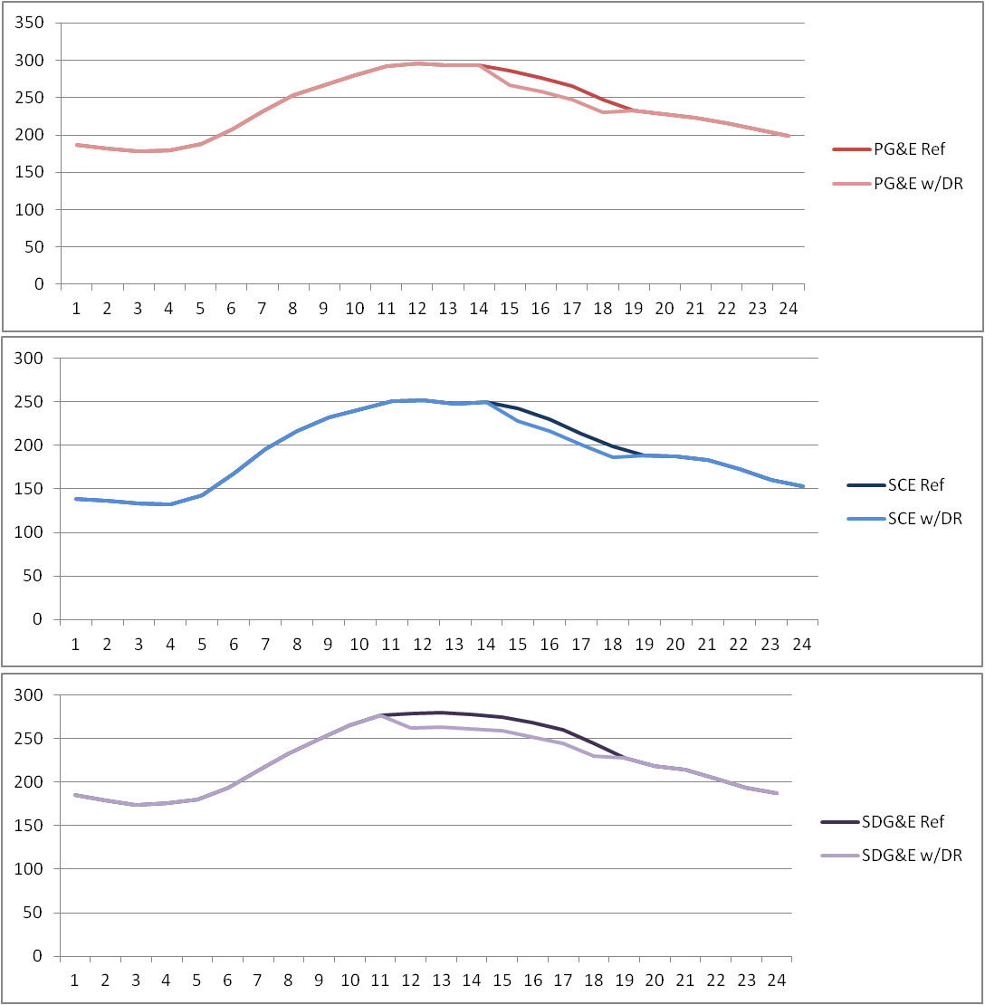
Average impacts by utility were similar
PG&E’s average load reduction was 6.9% (30.2 MW)
SCE’s average load reduction was 6.0% (32.9 MW)
SDGE’s average load reduction was 6.0% (18.1 MW)

Slide 12
PG&E’s average load reduction was 6.9%, or 30.2 MW, across the 9 events in 2012

Slide 13
PG&E detailed event load impacts
Event Date | Day of Week | Accounts | Avg. Customer Reference Load | Avg. Customer Load w/ DR | Impact | Aggregate Impact | % Reduction | Avg. Temp. | Daily Maximum Temp.
 |  |  | (kW) | (kW) | (kW) | (MW) | % | °F | °F
7/9/2012 | Mon | 1,623 | 255.0 | 232.8 | 22.2 | 36.0 | 8.7% | 81.4 | 96.3
7/10/2012 | Tue | 1,623 | 271.1 | 245.8 | 25.4 | 41.2 | 9.4% | 88.6 | 99.9
7/11/2012 | Wed | 1,623 | 268.9 | 250.7 | 18.2 | 29.5 | 6.8% | 90.2 | 103.0
7/12/2012 | Thu | 1,623 | 265.1 | 249.0 | 16.1 | 26.1 | 6.1% | 86.0 | 102.3
8/2/2012 | Thu | 1,629 | 260.6 | 247.7 | 12.9 | 21.0 | 4.9% | 85.7 | 99.8
8/8/2012 | Wed | 1,630 | 276.2 | 257.2 | 18.9 | 30.9 | 6.9% | 87.9 | 98.8
8/9/2012 | Thu | 1,630 | 271.8 | 258.9 | 12.9 | 21.0 | 4.7% | 90.2 | 101.8
8/10/2012 | Fri | 1,630 | 261.7 | 248.7 | 13.0 | 21.2 | 5.0% | 88.5 | 104.3
8/13/2012 | Mon | 1,630 | 281.2 | 261.6 | 19.6 | 31.9 | 7.0% | 89.7 | 103.9
Avg. Event |  | 1,627 | 268.8 | 250.3 | 18.5 | 30.2 | 6.9% | 86.5 | 102.8

Slide 14
PG&E’s demand reductions were concentrated in two industries
Manufacturing and Wholesale & Transport accounted for 34% of the load and 74% of impacts
While the Offices, Hotels, Finance, Services sector had the most load, 36%, it accounted for only 10% of program impacts

Slide 15
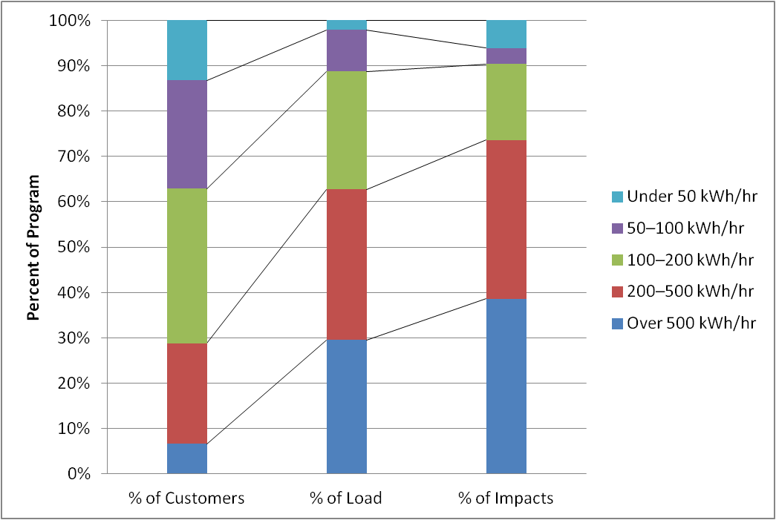
Not surprisingly, the largest customers account for a large share of the demand reductions
Customers with average demand over 500 kW make up 7% of accounts, 30% of reference load and 39% of impacts

Slide 16
SCE’s average load reduction was 6.0%, or 32.9 MW, across the 12 event days in 2012

Slide 17
SCE detailed event load impacts
Event Date | Day of Week | Accts | Avg. Customer Reference Load (kW) | Avg. Customer Load w/ DR (kW) | Impact (kW) | Aggregate Impact (MW) | Reduction % | Event Period Temp. °F | Daily Maximum Temp. °F
6/29/2012 | Mon | 2,464 | 194.1 | 182.7 | 11.4 | 28.2 | 5.9% | 82.5 | 86.7
7/12/2012 | Tue | 2,458 | 213.0 | 194.5 | 18.5 | 45.6 | 8.7% | 80.3 | 90.9
7/23/2012 | Wed | 2,456 | 207.0 | 193.5 | 13.6 | 33.3 | 6.5% | 80.3 | 90.6
8/7/2012 | Thu | 2,473 | 227.8 | 210.7 | 17.0 | 42.1 | 7.5% | 89.9 | 96.5
8/9/2012 | Thu | 2,474 | 228.8 | 213.6 | 15.2 | 37.7 | 6.7% | 90.5 | 97.5
8/13/2012 | Wed | 2,469 | 232.7 | 218.2 | 14.5 | 35.8 | 6.2% | 90.9 | 99.5
8/20/2012 | Thu | 2,475 | 230.1 | 216.4 | 13.7 | 33.9 | 6.0% | 87.3 | 93.0
8/27/2012 | Fri | 2,476 | 218.8 | 208.1 | 10.7 | 26.5 | 4.9% | 89.4 | 93.0
8/29/2012 | Mon | 2,477 | 238.1 | 225.3 | 12.7 | 31.6 | 5.4% | 89.2 | 94.0
9/10/2012 | Mon | 2,468 | 231.5 | 220.1 | 11.4 | 28.1 | 4.9% | 84.4 | 88.6
9/20/2012 | Thu | 2,474 | 232.0 | 220.9 | 11.2 | 27.7 | 4.8% | 89.0 | 93.4
9/28/2012 | Fri | 2,474 | 208.2 | 199.0 | 9.1 | 22.6 | 4.4% | 84.3 | 90.3
Avg. Event |  | 2,470 | 221.9 | 208.6 | 13.3 | 32.9 | 6.0% | 87.3 | 95.8

Slide 18
Two industry groups account for 87% of the demand reductions
Manufacturing accounts for roughly 29% of customers and load but provides 60% of the reductions
Wholesale
and transport accounts for 16% of the customers and load but provides 27% of the reductions

Slide 19
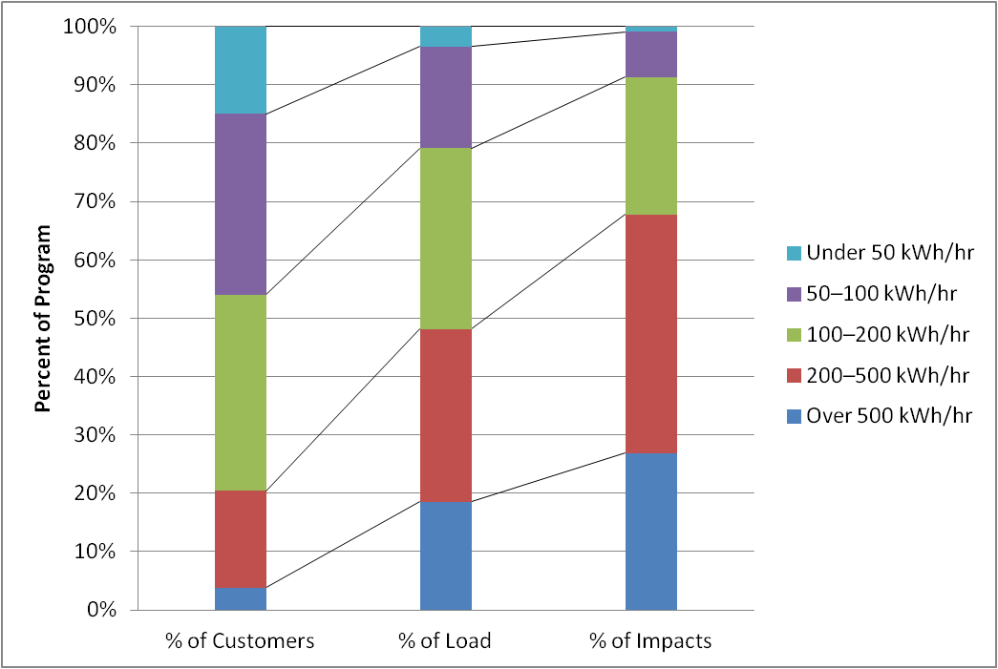
At SCE, larger customers not only have more load but they reduce a larger share
Customers with average demand over 500 kW make up 4% of the accounts, 19% of the reference load, and 27% of the impacts

Slide 20
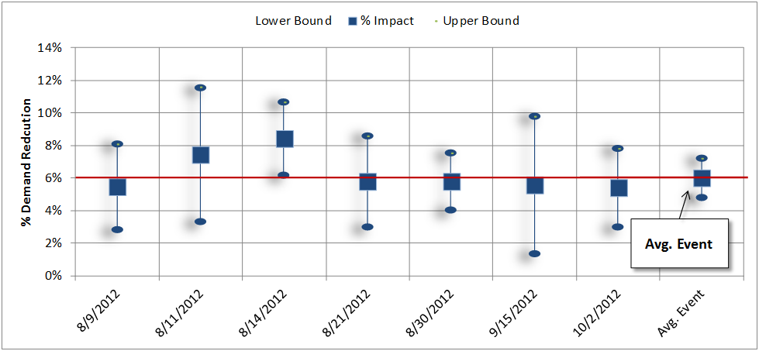
SDG&E’s average weekday load impact was 6.0%, 18.1 MW

Slide 21
SDG&E detailed event load impacts
Event Date | Day of Week | Accounts | Avg. Customer Reference Load (kW) | Avg. Customer Load w/ DR (kW) | Impact (kW) | Aggregate Impact (MW) | Reduction % | Avg. Temp. °F | Daily Maximum Temp. °F
8/9/2012 | Thu | 1,103 | 263.4 | 249.0 | 14.4 | 15.9 | 5.5% | 79.8 | 81.5
8/11/2012 | Sat | 1,135 | 217.3 | 201.0 | 16.2 | 18.4 | 7.5% | 82.1 | 84.1
8/14/2012 | Tue | 1,103 | 278.0 | 254.6 | 23.5 | 25.9 | 8.4% | 80.9 | 83.2
8/21/2012 | Tue | 1,135 | 262.0 | 246.8 | 15.2 | 17.2 | 5.8% | 75.7 | 78.3
8/30/2012 | Thu | 1,135 | 270.7 | 255.0 | 15.7 | 17.8 | 5.8% | 80.6 | 82.7
9/15/2012 | Sat | 1,138 | 226.9 | 214.2 | 12.7 | 14.5 | 5.6% | 95.1 | 100.0
10/2/2012 | Tue | 1,109 | 273.8 | 259.0 | 14.9 | 16.5 | 5.4% | 84.5 | 90.5
Avg. Weekday Event |  | 1,117 | 269.1 | 252.9 | 16.2 | 18.1 | 6.0% | 80.4 | 82.9
Avg. Weekend Event |  | 1,137 | 221.5 | 207.6 | 13.9 | 15.8 | 6.3% | 87.1 | 90.3
Note that the August 11 and September 15 event were called on Saturdays and can’t be directly compared to the other weekday event or most of SDG&E’s CPP events from prior years
The Saturday event on September 15 was accompanied by extremely high temperatures

Slide 22
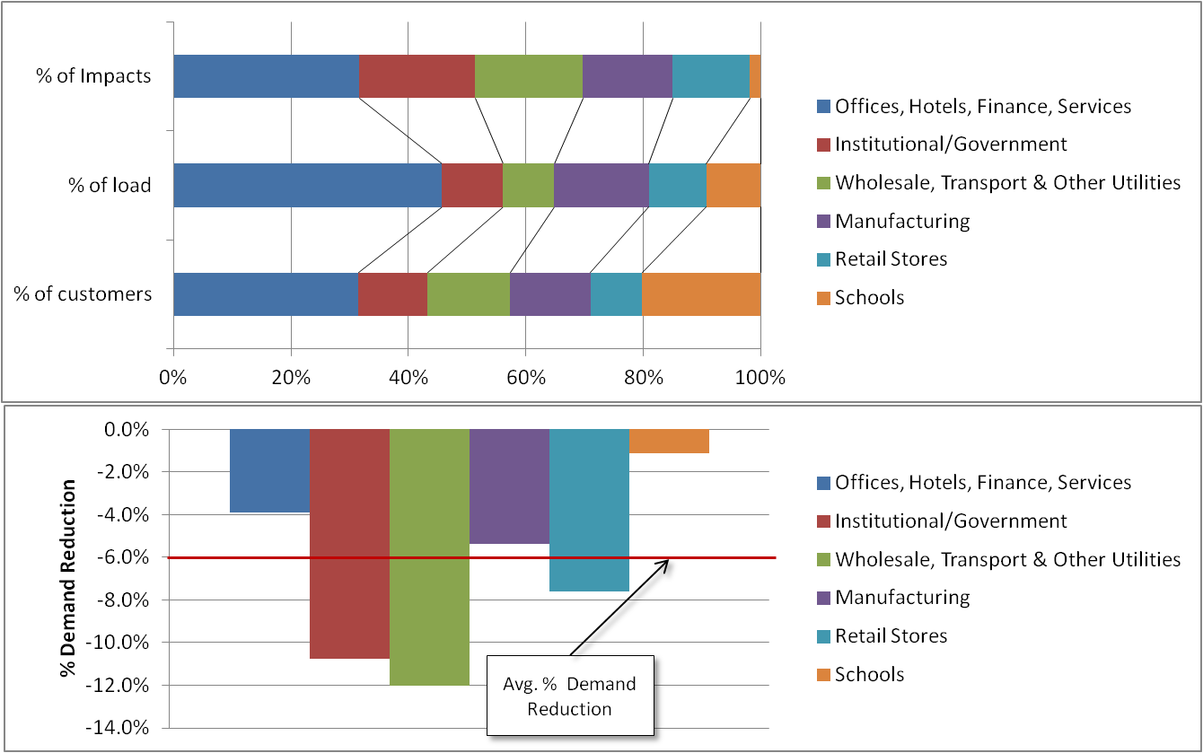
SDG&E had more customers and load in the offices sector
Offices made up 46% of the load at SDG&E (versus 36% and 22% at PG&E and SCE). They
also reduced demand more.
Institutional and Wholesale & Transport segments still performed the best and accounted for a substantial share of impacts.

Slide 23
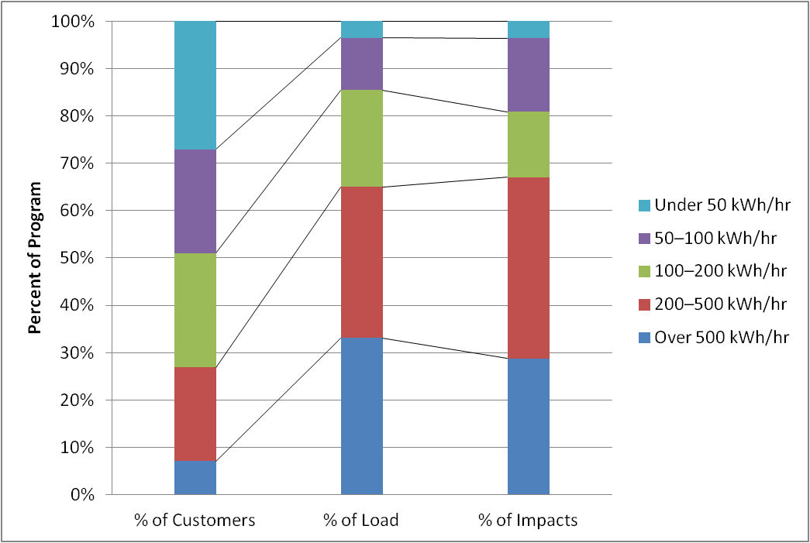
At SDG&E, larger customers also accounted for a large amount of the demand reductions
Customers with average demand over 500 kW make up 7% of the accounts, 33% of the reference load, and 29% of the impacts

Slide 24
2012 MW reductions were similar to 2011, but fewer MW of reference load were enrolled
^{[1}
Utility | Year | Number of Events Called | Approximate Customer Count | Temperature (°F) | Reference Load (MW) | Load Impact (MW) | Percent Impact (%)
PG&E | 2010 | 9 | 1,650 | 90.2 | 592 | 23 | 3.90%
 | 2011 | 9 | 1,750 | 88.1 | 473 | 28 | 5.90%
 | 2012 | 9 | 1,627 | 86.5 | 437 | 30 | 6.90%
SCE | 2010 | 12 | 4,100 | 84.7 | 1,077 | 31 | 2.90%
 | 2011 | 12 | 3,000 | 84.7 | 615 | 35 | 5.70%
 | 2012 | 12 | 2,508 | 87.3 | 554 | 33 | 5.90%
SDG&E | 2010 | 4 | 1,350 | 81.3 | 357 | 19 | 5.30%
 | 2011 | 2 | 1,300 | 86.2 | 359 | 19 | 5.20%
 | 2012 | 7 | 1,117 | 80.4 | 268 | 16 | 6.00%
Notes:
SDG&E values reflect average weekday load impacts

Slide 25
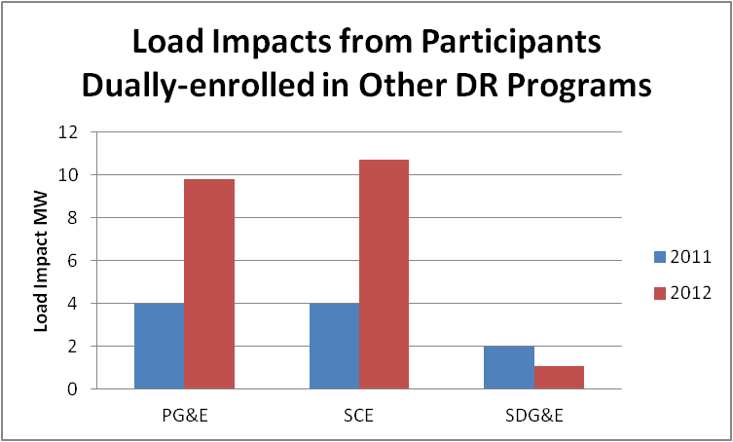
Dually-enrolled load impacts are on the rise at PG&E and SCE
Load impacts from dually-enrolled customers nearly tripled in 2012 over 2011
Dually-enrolled impacts represent a third of all CPP load impacts at PG&E and SCE

Slide 26
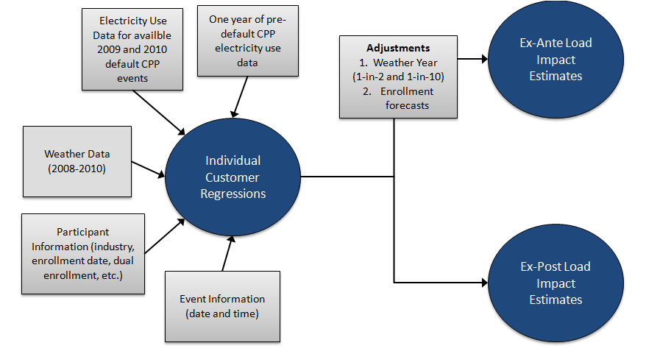
Ex ante impacts are based on historical data and performance
Ex ante impacts reflect the load reduction capability under a standard set of weather conditions that align with those that drive system planning

Slide 27
The uncertainty for ex ante impacts varies by customer size category
For large customers
we know:
  how many of these customers tried out default CPP;
  how much load reduction they provide during events;
  what type of customers are more responsive;
  how many remained on
  CPP after 1st bill protection
  expired; and
  persistence of impacts.
For medium customers, we have far less
empirical data
  A small number of medium customers were defaulted (most are close to large)
  Customers right above the official large/medium cutoff
  are similar
For small customers, we lack empirical data of response to default CPP

Slide 28
Key enrollment and ex ante assumptions
Both PG&E and SCE will implement a new event window, 1 PM – 6 PM, beginning in 2013
PG&E will default medium customers in 2014, after two years of experience on TOU rates is complete
SCE enrollment forecasts assume future enrollments similar to that of 2012, but with modest enrollment increases in years 2013-2015 due to increased retention associated with rollout of a CRL option
SDG&E’s large customer enrollment forecast changes are minimal, medium customer enrollments are forecast to begin in 2014. Lower awareness rates among these customers are assumed because many medium customers do not have assigned account representatives

Slide 29
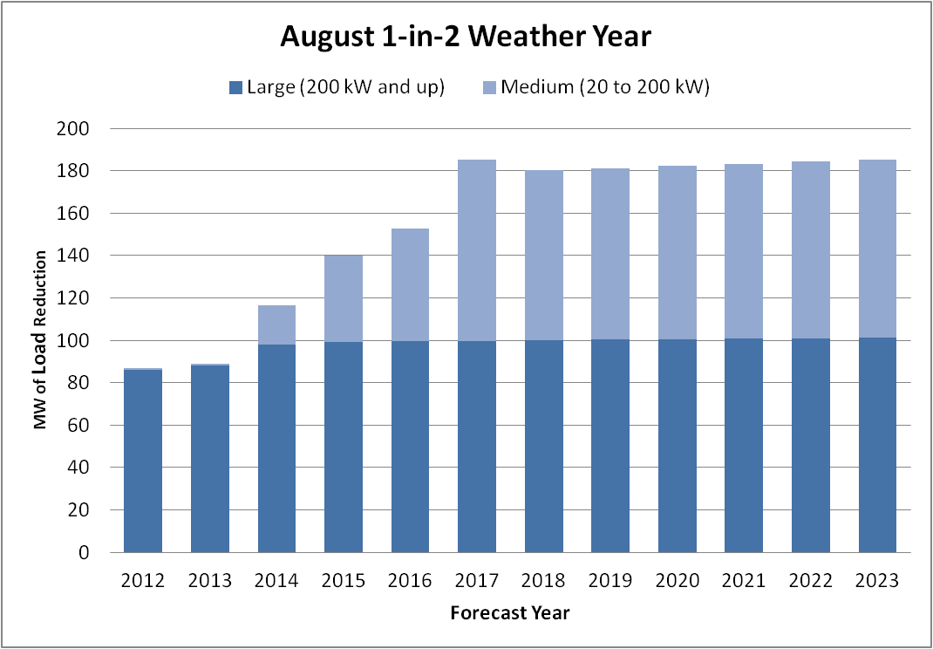
Statewide, ex ante impacts are projected to grow with the scheduled introduction of default CPP for medium customers

Slide 30
Recommendations
Conduct an early test of default CPP for medium customers
Evaluate demand reductions closer to event days by using a control group with a difference-in-differences calculation
Estimate the effect of program changes through research design rather than after-the-fact analysis
These recommendations are the opinion of FSC only and do not represent the positions of the IOUs or the DRMEC. The recommendations are based solely upon the data gathered in conducting the evaluation and do not include other important policy or operational considerations that should be weighed when making final program change recommendations.
Notes:
1. If CPP will be implemented on a default basis for these customer segments, we recommend a multi-stage deployment process, where utilities test the default CPP process with a smaller, random sub-set of customers prior to full implementation; 3. Calling additional events will help SDG&E better understand the relationship between weather conditions and the magnitude of demand reductions

Slide 31
Contact us with questions
Josh L. Bode, M.P.P.
Candice A. Churchwell, M.S.
Freeman, Sullivan & Co.
101 Montgomery Street 15th Floor, San Francisco, CA 94104
joshbode@fscgroup.com
candicechurchwell@fscgroup.com
415.777.0707

