Slide 1
PG&E’s SmartAC Program July 26, 2012 Michael Perry Freeman, Sullivan & Co.

Slide 2
Overview of PG&E’s SmartAC Program
AC load control through installation of control devices that limit the duty cycles of AC units
Residential and small/medium businesses (SMB)
Two types of devices: switches and PCTs
Events called for testing purposes or under emergency or in anticipation of emergency conditions between May 1st and October 31st, up to 6 hours or less in each event, for a maximum of 100 hours per season
147,600 residential accounts and 6,200 SMB accounts at end of summer 2011

Slide 3
SmartAC Ex Post Methodology
Basic analytical requirement for SmartAC impact evaluation is the estimation of a reference load during event periods
2011 evaluation was based on the use of control groups for every test event
Residential estimates were based on the use of SmartMeter interval data with very large treatment and control groups (e.g. 15,000 customers/event)
SMB estimates were based on AC logger data for a sample of customers
Ex post impacts were calculated by comparing the average event day usage in the control group to the average event day usage in the treated group

Slide 4
SmartAC 2011 Residential Ex Post Impacts
Event Date | Event Hours | Average Reference Load² (kW) | Average Event Impact (kW) | Percent Impact | Average Temperature 4–6 PM (°F)
6/15/2011 | 4-6 PM | 1.97 | 0.34 | 17% | 92
6/21/2011 | 4-6 PM | 2.95 | 0.77 | 26% | 99
6/22/2011 | 4-6 PM | 2.66 | 0.57 | 21% | 92
8/24/2011 | 4-6 PM | 2.34 | 0.59 | 25% | 92
9/6/2011 | 4-6 PM | 1.99 | 0.39 | 19% | 94
9/7/2011 | 4-6 PM | 2.18 | 0.48 | 22% | 95
9/8/2011 | 4-6 PM | 1.98 | 0.39 | 20% | 90
Average | 4-6 PM | 2.30 | 0.50 | 22% | 94
^{[1]} Impacts are a percentage of whole-building load for residential customers. This must be kept in mind when comparing percent impacts to those in previous evaluations, which were calculated as a percentage of CAC load.
^{[2]} Excludes about 10,000 customers called for a substation test event. Results for those customers have been reported in a separate document.

Slide 5
Two-Hour Versus Five-Hour Event
One group had an event from 1 PM to 6 PM
Another group had an event from 4 PM to 6 PM

Slide 6
Simple Cycling Versus Algorithmic Cycling
Standard 50% cycling allows AC to run, at most, half the time
True Cycle II uses a baseline methodology to restrict the AC to run no more than half as much as baseline
No modeling or weather uncertainty in this result

Slide 7
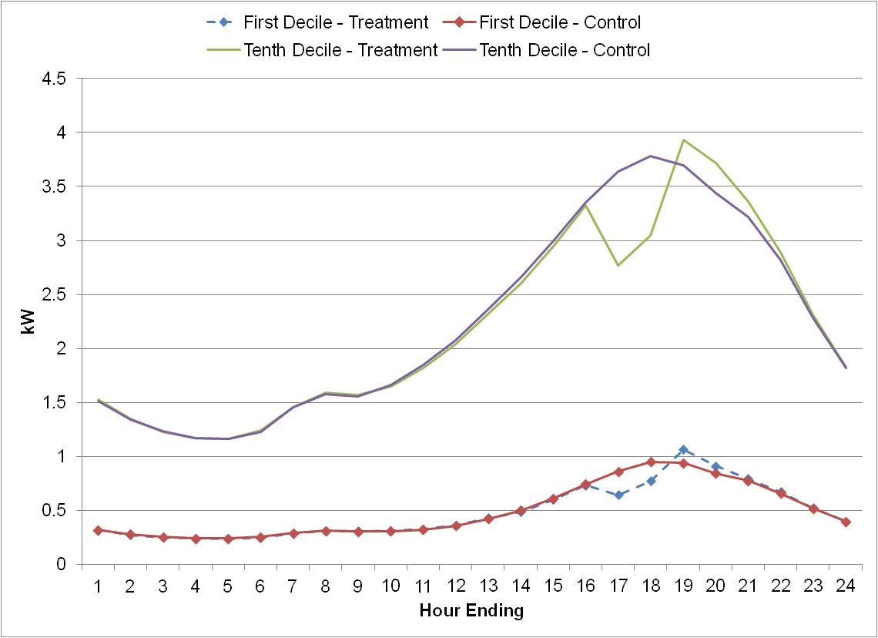
Distribution of Event Impacts Across Customers
Deciles divide sorted data into equal parts so that each part represents 1/10 of the sample population
Customers were divided into deciles based on average monthly usage in June 2011
Customers in the lowest decile had an average monthly usage of 184 kW compared to 1,286 kW for customers in the highest decile of usage
Customers in the greatest decile of usage provided impacts over four times greater than customers in the lowest decile of usage

Slide 8
Dually-enrolled SmartAC/SmartRate Customers
About 4,700 customers are enrolled on both SmartAC and SmartRate
5 of 15 SmartRate days were also SmartAC test event days
SmartRate provides a modest incremental impact to SmartAC
SmartAC provides much greater incremental impact to SmartRate
Date | Program Called | Event Hours | Avg. Hourly Impacts
 |  |  | SmartAC Customers | SmartRate Customers | Dually-Enrolled Customers
6/21/2011 | SMR/SMAC | 4-6 PM | 0.65 | 0.54 | 0.93
6/22/2011 | SMR/SMAC | 4-6 PM | 0.71 | 0.43 | 0.86
9/6/2011 | SMR/SMAC | 4-6 PM | 0.47 | 0.24 | 0.53
9/7/2011 | SMR/SMAC | 4-6 PM | 0.58 | 0.22 | 0.56
9/8/2011 | SMR/SMAC | 4-6 PM | 0.47 | 0.23 | 0.53
Average Impact when All Groups Called |  |  | 0.58 | 0.33 | 0.68

Slide 9
SmartAC 2011 SMB Ex Post Impacts
Event Date | Event Hours | Average Reference Load (kW) | Average Event Impact (kW) | Percent of CAC Load | Average Temperature (°F)
6/21/2011 | 3-5 PM | 2.06 | 0.27 | 14% | 96
6/22/2011 | 3-5 PM | 1.92 | 0.44 | 23% | 89
6/23/2011 | 3-5 PM | 1.41 | 0.20 | 14% | 83
8/24/2011 | 3-5 PM | 1.60 | 0.23 | 14% | 89
9/6/2011 | 3-5 PM | 1.67 | 0.25 | 15% | 90
9/7/2011 | 3-5 PM | 1.69 | 0.28 | 16% | 94
9/8/2011 | 3-5 PM | 1.44 | 0.20 | 14% | 87
9/20/2011 | 3-5 PM | 1.87 | 0.43 | 23% | 94
9/21/2011 | 3-5 PM | 1.72 | 0.34 | 19% | 92
Average | 3-5 PM | 1.71 | 0.29 | 17% | 90

Slide 10
Ex Ante Methodology
Evaluation is required to produce forecasts of load impacts under specified weather conditions
Our method is to use ex post impacts as inputs into a model describing relationship between impacts and temperature
Model is a simple regression line relating average impact during observed events to average temperature from midnight-5 PM on the event day
Similar method used for both residential and SMB

Slide 11
Ex Ante Methodology (example)
Average Event Impacts Versus Mean17 by LCA

Slide 12
SmartAC 2012 Residential Ex Ante Impacts
1-in-2 weather year, highest aggregate mean impact from 1-6 PM is on the July peak day, with an impact of 101 MW
Highest individual hourly impact during a 1-in-2 year is also the July value – 126 MW
The July peak day also shows the highest impacts for the 1-in-10 weather year. The largest aggregate impact over the five-hour event is 128 MW and highest individual hour provides an estimated impact of 160 MW

Slide 13
SmartAC 2012 SMB Ex Ante Impacts
1-in-2 weather year, highest aggregate mean impact from 1-6 PM is on the July peak day, with an impact of 4.2 MW
Highest individual hourly impact during a 1-in-2 year is also the July value – 4.9 MW
July peak day also shows the highest impacts for the 1-in-10 weather year—average 1-6 PM impact of 4.8 MW and peak hourly impact of 5.6 MW

Slide 14
Questions?
Contact Information
Michael Perry
Freeman, Sullivan & Company
michaelperry@fscgroup.com
415-777-0707

