Slide 1
PG&E’s SmartRate Program July 26, 2012 Liz Hartmann Freeman, Sullivan & Co.

Slide 2
Agenda
PG&E’s SmartRate Program
Overview of Program
Ex Post Methodology
2011 Ex Post & Ex Ante Results
Discussion of Results
Conclusions

Slide 3
Overview of PG&E’s SmartRate Program
Voluntary, critical peak pricing (CPP) rate that is an overlay on residential customers’ existing rate schedules
High price period from 2 PM to 7 PM on up to 15 event days per summer
Peak price adder is $0.60/kWh
Credits apply to non-peak usage from June through September
About 23,000 accounts at the end of the summer of 2011
There are around 47,000 active and pending accounts as of July 1, 2012

Slide 4
SmartRate Ex Post Methodology
SmartRate is an opt-in program
Customers who are enrolled are not a representative slice of the population
Because of this selection bias, a control group from the population not on SmartRate must be selected
Propensity score matching used to match all SmartRate customers to comparable control group
Match based on geographic location and load shape variables
Control customers can be matched to more than one SMR customers
Smart Meter data from treatment and control groups used to calculate impacts on event days

Slide 5
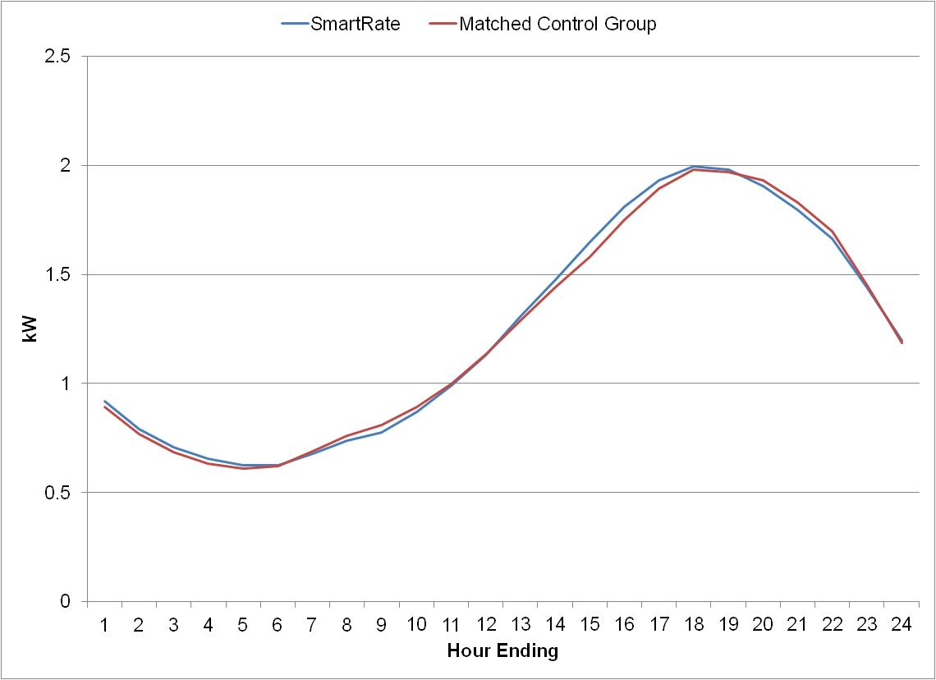
SmartRate Ex Post Methodology (cont’d)
SmartRate and Matched Control Group Usage on Hot, Non-Event Days
Notes:
*shows usage of SMR and matched control customers on 9 hot, non-event days

Slide 6
SmartRate Ex Post Methodology (cont’d)
The matched control group was extremely similar to the SmartRate population not only based on usage, but also based on CARE status and geographical location.
Characteristic | SmartRate Population | Matched Control Group
Greater Bay Area | 27% | 27%
Greater Fresno | 16% | 16%
Kern | 27% | 27%
Sierra | 14% | 14%
Stockton | 6% | 6%
Other | 9% | 10%
June 2011 kWh | 539 | 563
July 2011 kWh | 809 | 836
Non-CARE | 53% | 51%
CARE | 47% | 49%

Slide 7
SmartRate 2011 Ex Post Impacts
Date | Enrolled participants | Avg. Reference Load | Avg. Estimated Load with DR | Avg. Load Reduction | Percent Load Reduction | Aggregate Load Reduction | Daily Maximum Temp
 |  | (kW) | (kW) | (kW) | (%) | (MW) | (°F)
21-Jun-11 | 23,175 | 2.05 | 1.74 | 0.32 | 15% | 7.3 | 99
22-Jun-11 | 23,174 | 2.09 | 1.79 | 0.29 | 14% | 6.8 | 95
5-Jul-11 | 23,072 | 2.11 | 1.82 | 0.30 | 14% | 6.8 | 96
6-Jul-11 | 23,051 | 2.15 | 1.89 | 0.27 | 12% | 6.1 | 96
28-Jul-11 | 23,022 | 1.83 | 1.58 | 0.25 | 14% | 5.7 | 92
29-Jul-11 | 23,021 | 1.82 | 1.59 | 0.23 | 13% | 5.4 | 90
17-Aug-11 | 22,997 | 1.63 | 1.41 | 0.22 | 14% | 5.2 | 89
18-Aug-11 | 22,991 | 1.65 | 1.46 | 0.20 | 12% | 4.5 | 89
23-Aug-11 | 22,991 | 1.71 | 1.48 | 0.23 | 13% | 5.3 | 94
29-Aug-11 | 22,978 | 1.82 | 1.60 | 0.22 | 12% | 5.0 | 90
2-Sep-11 | 22,972 | 1.70 | 1.47 | 0.23 | 13% | 5.2 | 92
6-Sep-11 | 22,972 | 1.63 | 1.43 | 0.20 | 12% | 4.5 | 92
7-Sep-11 | 22,969 | 1.76 | 1.53 | 0.23 | 13% | 5.4 | 95
8-Sep-11 | 22,958 | 1.64 | 1.44 | 0.21 | 13% | 4.7 | 89
20-Sep-11 | 22,939 | 1.68 | 1.44 | 0.24 | 14% | 5.6 | 94
Total | 23,019 | 1.82 | 1.58 | 0.24 | 13% | 5.6 | 93

Slide 8
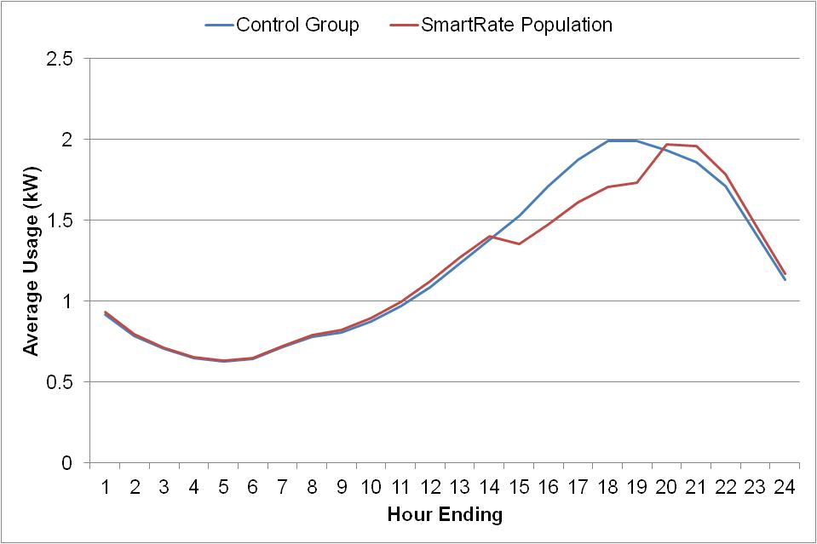
SmartRate 2011 Average Event Day
Average hourly impact of 0.24 kW for 2011 event days
This represents about 13% of whole-house load

Slide 9
SmartRate 2011 Ex Ante Impacts
A model of average hourly ex post impacts was created based on the average temperature from midnight until 5 PM on each event day
This simple regression was applied to ex ante weather condition to calculate ex ante impacts for 1-in-2 and 1-in-10 weather years
For the typical event day in a 1-in-10 weather year, it is predicted that average per customer impacts will be 0.34 kW
On the same day type for the 1-in-2 weather year, the average impact is predicted at 0.26 kW

Slide 10
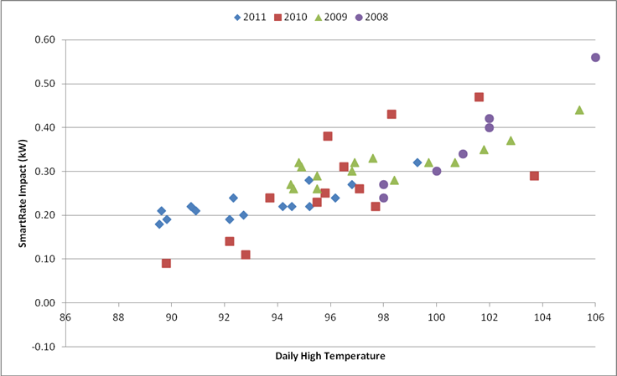
SmartRate Impacts from 2008 - 2011

Slide 11
High Responder Analysis
Conducted an analysis to determine if different categories of customers provided greater kWh load impacts than others
Customers in the top decile of usage are more than twice as likely to be high responders than the average customer
Customers who have a higher likelihood of AC ownership and those who are also enrolled in SmartAC provide greater impacts than customers with lower AC ownership likelihoods

Slide 12
2011 Bill Impacts
Over the four month summer period, SmartRate customers saved an average of $27, or 8% of their total bill
Nearly 80% of all SmartRate customers saw bill savings compared to what they would have paid under the otherwise applicable tariff (OAT)
Month | Average SMR Bill | Savings | % Savings | % Winners
June thru September | $385 | $27 | 8% | 79%
June | $61 | $9 | 17% | 90%
July | $106 | $7 | 7% | 79%
August | $101 | $9 | 10% | 87%
September | $117 | $2 | 2% | 63%

Slide 13
Marketing Campaign
In 2012, PG&E made a push to market SmartRate
The first wave of marketing was targeted at customers who were already enrolled in SmartAC
At the end of the summer of 2011, there were about 23,000 SmartRate customers
By July 1, 2012, there were 47,000 active and pending customers
This marketing campaign is important as ex ante results will be greatly affected
With program size forecasted to more than double by the end of 2012 and with a greater proportion of dually-enrolled customers, impacts in the 2012 and 2013 seasons may be greater than in the past

Slide 14
Conclusions
On average, customers reduced load by 0.24 kW (13% of whole-house usage) during event hours
The ex ante analysis predicted impacts of 0.26 kW on the typical event day for a 1-in-2 weather year
For summer 2012, the SmartRate population has greatly increased and the share of dually-enrolled SmartAC participants had grown
These changes may lead to significantly higher aggregate load impacts as well as greater average individual load impacts

Slide 15
Questions?
Contact Information
Liz Hartmann
Freeman, Sullivan & Company
lizhartmann@fscgroup.com
415-777-0707

