Slide 1
PG&E’s 2012 SmartRate Program Evaluation June 3, 2013 Aimee Savage and Michael Perry Freeman, Sullivan & Co.

Slide 2
Agenda
PG&E’s SmartRate Program
Overview of Program
Ex Post Methodology
Overview of 2012 Ex Post & Ex Ante Results
Discussion of Results

Slide 3
Overview of PG&E’s SmartRate Program
Voluntary, critical peak pricing (CPP) rate that is an overlay on residential customers’ existing rate schedules
High price period from 2 PM to 7 PM on up to 15 event days per summer
Peak price adder is $0.60/kWh
Credits apply to non-peak usage from June through September
About 86,000 accounts as of April, 2013
32,000 of these customers are also enrolled in PG&E’s SmartAC program

Slide 4
SmartRate Ex Post Methodology
SmartRate is an opt-in program
Customers who are enrolled are not a representative slice of the population
Because of the rapidly growing SmartRate population, a series of control groups must be selected
A separate control group was selected for each of three snapshots in time of the SmartRate population
Additionally, a separate but parallel analysis was performed for the group of SmartRate customers also enrolled in SmartAC

Slide 5
SmartRate Ex Post Methodology
Propensity score matching used to match all SmartRate customers to a comparable control group
Match based on geographic location and load shape variables
Control customers can be matched to more than one SMR customer
Smart Meter data from treatment and control groups used to calculate impacts on event days

Slide 6
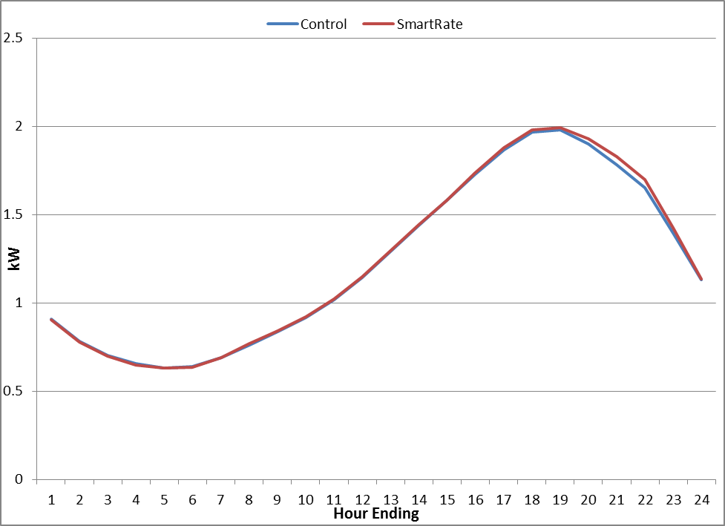
SmartRate Ex Post Methodology (cont’d)
SmartRate and Matched Control Group Usage on Hot, Non-event Days

Slide 7
SmartRate Ex Post Methodology (cont’d)
The matched control group was extremely similar to the SmartRate population not only based on usage, but also based on CARE status and geographical location.
Characteristic | SmartRate Population | Matched Control Group
Greater Bay Area | 37% | 37%
Greater Fresno | 12% | 12%
Kern | 21% | 21%
Northern Coast | 2% | 2%
Other | 14% | 14%
Sierra | 6% | 6%
Stockton | 7% | 7%
June 2012 kWh | 672 | 686
July 2012 kWh | 750 | 762
Non-CARE | 60% | 67%
CARE | 40% | 33%

Slide 8
SmartRate 2012 Ex Post Impacts
Date | Enrolled participants | Avg. Reference Load (kW) | Avg. Load Reduction (kW) | Percent Load Reduction (%) | Aggregate Load Reduction (MW) | Daily Maximum Temp (°F)
9-Jul-12 | 37,108 | 1.61 | 0.34 | 21% | 12.6 | 88
10-Jul-12 | 38,428 | 1.78 | 0.35 | 20% | 13.4 | 95
11-Jul-12 | 40,082 | 2.00 | 0.41 | 20% | 16.3 | 97
4-Sep-12 | 49,253 | 1.65 | 0.31 | 19% | 15.1 | 88
13-Sep-12 | 66,540 | 1.38 | 0.26 | 18% | 16.9 | 87
14-Sep-12 | 71,402 | 1.41 | 0.25 | 17% | 17.4 | 88
23-Jul-12 | 71,935 | 1.41 | 0.22 | 16% | 16.2 | 86
1-Oct-12 | 77,480 | 1.46 | 0.31 | 21% | 23.4 | 96
2-Oct-12 | 77,760 | 1.51 | 0.29 | 19% | 22.2 | 97
3-Oct-12 | 77,999 | 1.38 | 0.22 | 16% | 17.6 | 90
Total | 60,799 | 1.52 | 0.29 | 19% | 17.1 | 91

Slide 9
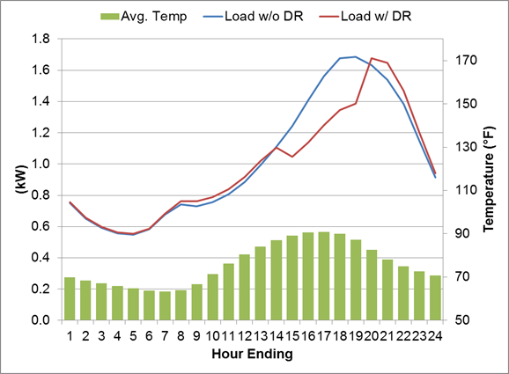
SmartRate 2012 Average Event Day
Average hourly impact of 0.28 kW for 2012 event days
This represents about 18% of whole-house load

Slide 10
SmartRate 2012 Ex Ante Impacts
A two-stage matching process was used to find a suitable control group for the Ex Ante analysis
First, a group of customers in the program since 2011 that matches the population at the end of 2012 was found
Then, a control group was matched to this representative sample
A model of average hourly ex post impacts was created using this sample and control group
The model is based on the average temperature from midnight until 5 PM on each event day
This simple regression was applied to ex ante weather conditions to calculate ex ante impacts for 1-in-2 and 1-in-10 weather years

Slide 11
SmartRate 2012 Ex Ante Impacts
For the typical event day in a 1-in-10 weather year, it is predicted that average per customer impacts will be 0.34 kW
On the same day type for the 1-in-2 weather year, the average impact is predicted at 0.26 kW

Slide 12
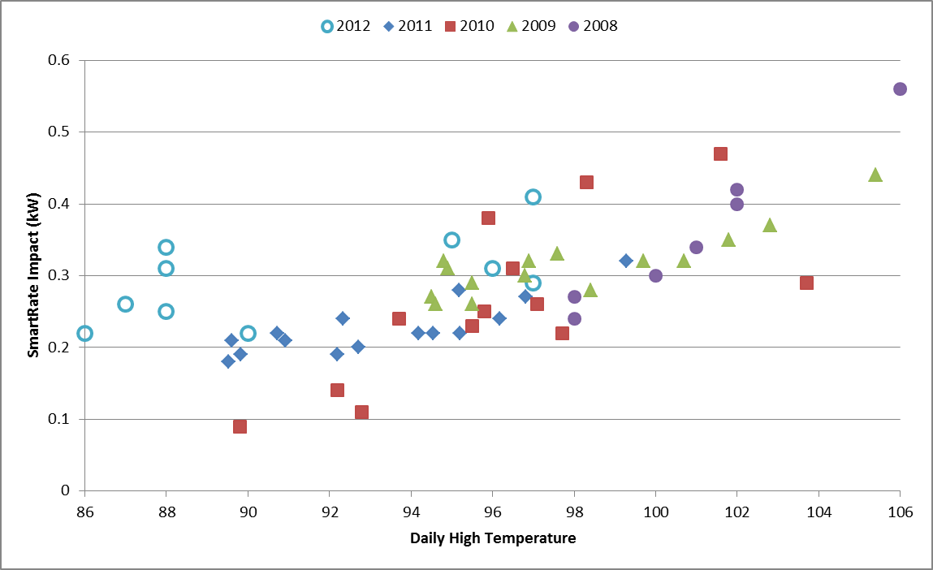
SmartRate Impacts from 2008 - 2012

Slide 13
High Responder Analysis
Conducted an analysis to determine if different categories of customers provided greater kWh load impacts than others
Customers in the top decile of usage are more than twice as likely to be high responders than the average customer
Customers who have a higher likelihood of AC ownership and those who are also enrolled in SmartAC provide greater impacts than customers with lower AC ownership likelihoods

Slide 14
2012 Bill Impacts
Over the five month summer period, SmartRate customers saved an average of $74, or 13% of their total bill
Nearly 95% of all SmartRate customers saw bill savings compared to what they would have paid under the otherwise applicable tariff (OAT)
Month | Average SMR Bill | Savings | % Savings | % Winners
June thru October | $493 | $74 | 13% | 94%
June | $80 | $22 | 22% | 100%
July | $123 | $8 | 6% | 82%
August | $116 | $27 | 19% | 100%
September | $95 | $10 | 10% | 94%
October | $79 | $6 | 8% | 83%

Slide 15
Questions?
Contact Information
Aimee Savage
Freeman, Sullivan & Company
aimeesavage@fscgroup.com
Michael Perry
Freeman, Sullivan & Company
michaelperry@fscgroup.com
415-777-0707

