Slide 1
Load in Wholesale Markets
DR Workshop (R. 13-09-011)
October 16, 2013
Eric Cutter

Slide 2
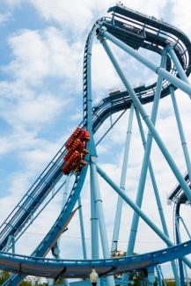
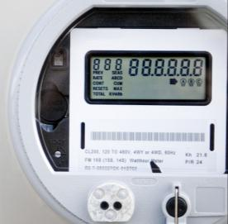
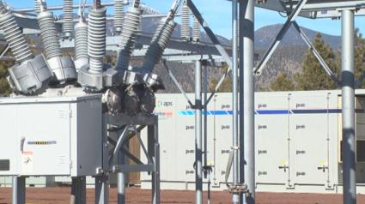
Which needs do DERs fill best?
What the grid needs
What DERs do best
?
What grid resources do best

Slide 3
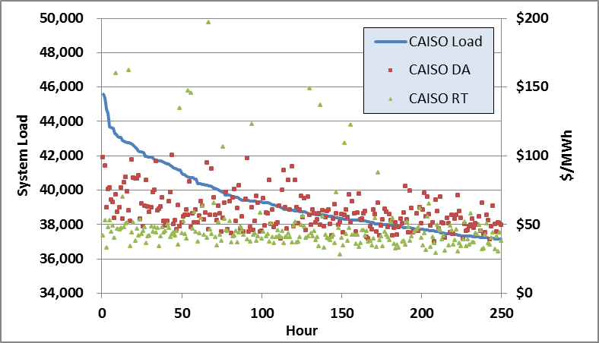
Can prices drive the needed response?
Don’t chase ISO markets just because we can
Look ahead to services we need going forward

Slide 4
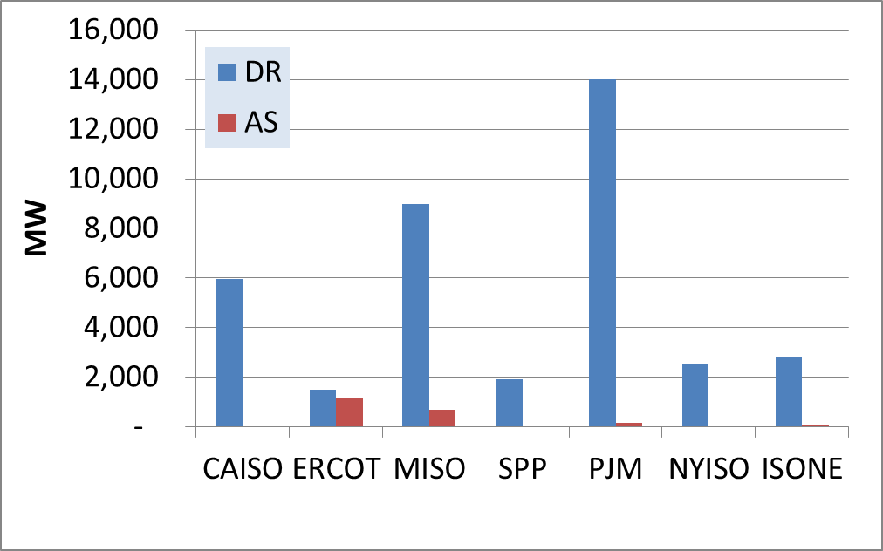
How can load be a flexible resource?
Not just removing barriers
Clearly more changes are needed

Slide 5
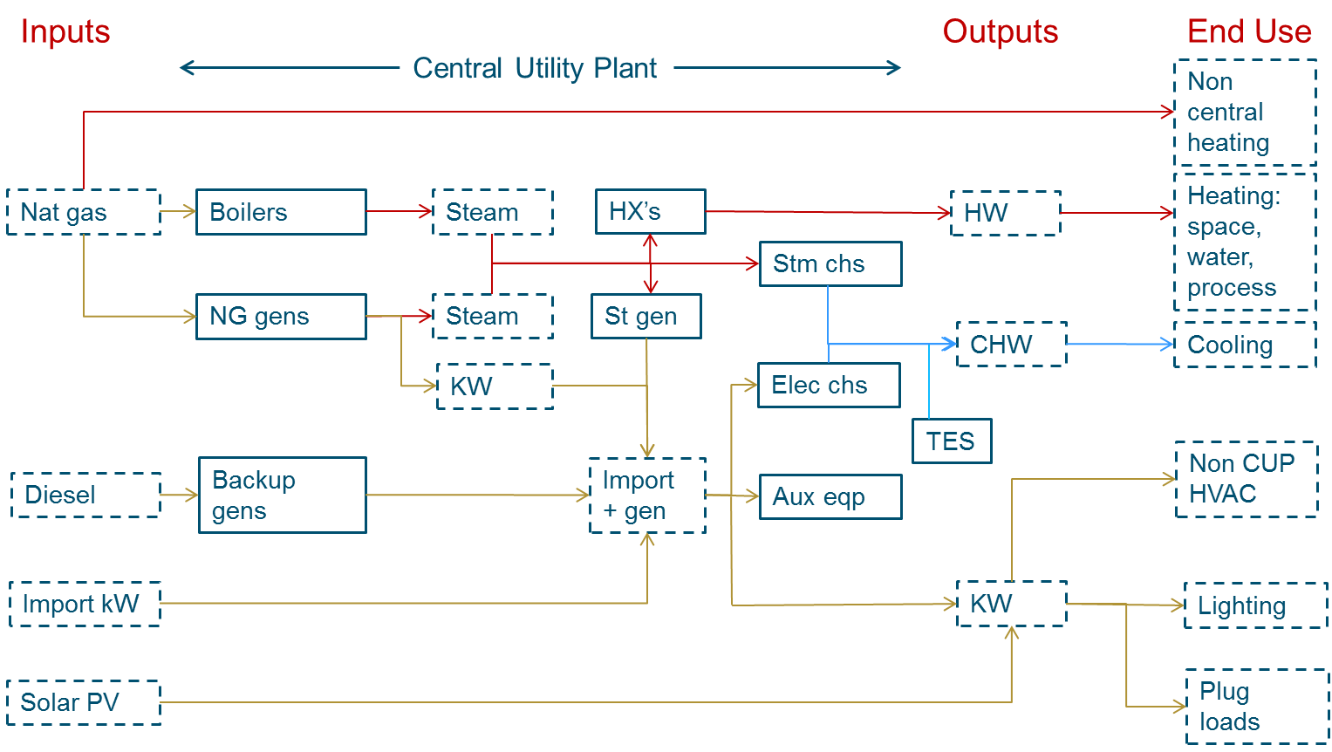
Will load participate?
UCSD Example
can provide frequency regulation for a net profit
But only ~ 1-2% of total energy costs
Incentives for local benefits?

