Slide 1


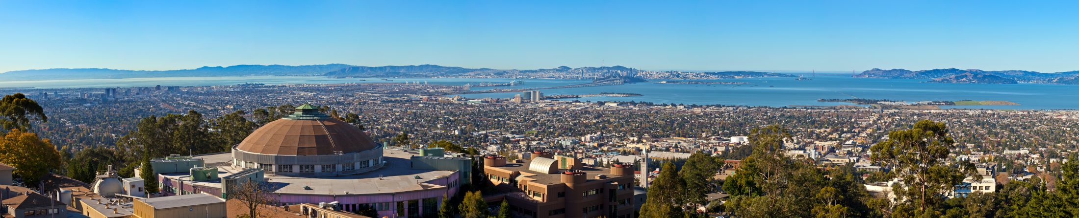
Update on Automated DR Technology
Mary Ann Piette
CPUC Demand Response Rulemaking (R.13-09-011)
Stakeholder Workshop 2 – Load Modifying Demand Response
Lawrence Berkeley National Laboratory

Slide 2
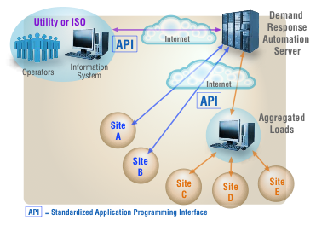
Update on Automated Demand Response
Automated DR Technology and OpenADR in development in California for over 10 years
  Original motivation was to support dynamic pricing
  Used by all 3 IOUs and at least 3 MUNIs in California
  Used in over 8 countries around the world
  OpenADR demonstrated in all sectors,historical emphasis was commercial and industrial facilities
  Advanced OpenADR pilots for ancillary services
  New requirements for automated DR in Title 24
OpenADR 2.0 - national standard with formal compliance and certification through OpenADR Alliance
Need to educate customer on automation options, critical need to better understand tariffs, DR programs and value
Need to integrate efficiency and DR programs and technologies
  SMUD requires OpenADR capability when customers receive incentives for control system retrofits
  Need to link retro-commissioning with DR automation install

Slide 3

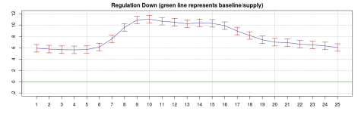
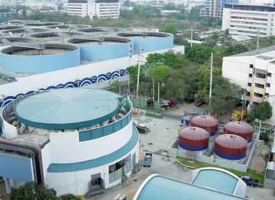
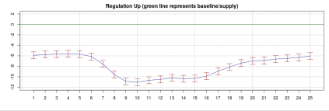
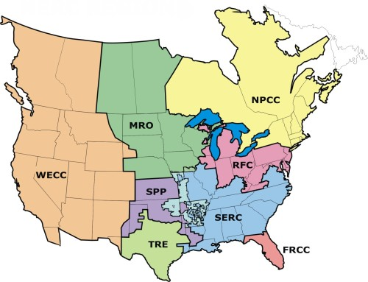
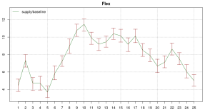

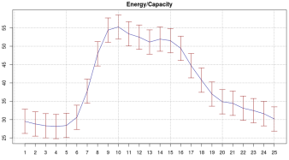
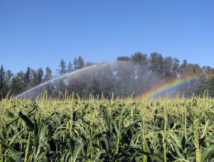
New DOE Project – Western Tech Potential of Demand Response
LOADS
FLEXIBILITY FILTER
ANCILLARY SERVICES
PRODUCTS
Response Parameters
Flexibility range (reg up, reg down, both)
Speed of Response
Store, Shift or Shed
Load response to products
Size of Response
Controllable
Sizing of Resource
Min and max daily consumption requirements
Cycling Rate Impacts (wear/tear)
Impacts on Overall Response
Rebound/Recovery Issues
Charge/Discharge
Independence
How to Predict
Predictable or Variable (daily, seasonal, geographic)
Time or Operational dependence
How it Participates
Individual or Aggregated
Residential
MODELS
Municipal
Commercial
Agricultural

