Slide 1
Overview of California’s GHG Goals and Related Aspirational Goals and Targets
California Public Utilities Commission Staff
Energy Division
Integrated Demand Side Management Learning Session #2
February 20, 2015

Slide 2
Overview of California’s GHG and Related Goals
Cap-and-Trade
Low Carbon Fuel Standard
Electric Vehicles
Storage
Distributed Generation
Energy Efficiency
Demand Response
ZNE Buildings
Smart Meter

Slide 3
Cap-and-trade
Global Warming Solutions Act (AB32)

Slide 4
California Cap-and-Trade Program
Statewide cap on GHG emissions declines each year to 2020
Large emitters, including utilities, covered under Cap-and-Trade
Started in 2013 for electric utilities and large industrial facilities
Started in 2015 for transportation, natural gas, and other fuels
Covered entities buy allowances to account for their emissions
ARB holds quarterly allowance auctions
Entities can buy, sell, trade allowances
CPUC oversees electric and gas IOU participation in program
Utilities receive free allowances but must sell them at auction and separately purchase allowances to cover emissions

Slide 5
Cap-and-Trade Implementation
CPUC D. 12-12-033 determined how utilities use allowance revenue
Offset costs in rates for residential customers (until rate reform)
Provide transition assistance for small businesses
Provide assistance to “Emission-Intensive, Trade-Exposed” Industries
Remainder is provided to utility customers as an on-bill “California Climate Credit,” twice per year (roughly $35)
SB 1018: PUC must ensure customer awareness of GHG revenue
Climate Credit is currently marketed with Energy Upgrade California and used to promote energy awareness and conservation
Forthcoming workshop and Decision will consider refinement of customer outreach and budgets

Slide 6
Low carbon fuel standard
Global Warming Solutions Act (AB32)

Slide 7
Low-Carbon Fuel Standard
Adopted by ARB pursuant to AB 32 to address carbon emissions in transportation fuels.
Requires 10% reduction in carbon intensity of transportation fuels below 2010 levels by 2020
Providers of low-carbon transportation fuels generation credits that can be sold to providers of fuels that exceed the threshold
Electric and natural gas utilities generate LCFS credits when they provide fuel for Electric or natural gas vehicles
The LCFS regulation requires the utilities to sell those credits and return the revenue to the drivers who generated them

Slide 8
Low-Carbon Fuel Standard
In 2014, the CPUC required the utilities to file implementation plans for selling credits and returning LCFS revenue to drivers
Advice Letters with implementation plans are due on March 18
Utilities may opt for one of two means of returning revenue
Up-front rebate at the time a customer purchases an EV or natural-gas vehicle, which could also be provided retroactively
Annual credit based on the actual amount (or an estimate) of electricity or natural gas used to fuel a vehicle
Utilities are required to conduct marketing and outreach to ensure that customers are aware of the program

Slide 9
Zero-emission vehicles
Additional GHG-Related Goals

Slide 10
Imperatives for Plug-In Electric Vehicles
Senate Bill 626 (2009) & P.U. Code 740.2
Adopt rules “to develop infrastructure sufficient to overcome any barriers to the widespread adoption and use of plug-in hybrid and electric vehicles…”
1.5 Million Zero Emission Vehicles by 2025
80% Reduction in Transportation GHG by 2050
Changing California’s transportation sector to one dominated by zero emission vehicles, powered by electricity and hydrogen, is essential to meeting federal air quality standards and long-term climate goals.
Gov. Brown’s Executive Order B-16-2012
Air Resources Board’s 2014 Scoping Plan

Slide 11
Promotion of Zero-Emission Vehicles (ZEVs)
E.O. B-16-2012 sets a target of 1.5 million ZEVs on California roads by 2025, displacing 1.5 billion gallons of petroleum fuel annually
B-16-2012 requires CPUC to work with ARB and CEC to ensure:
Major metropolitan areas can accommodate ZEVs
The state has enough infrastructure to support 1 million ZEVs by 2020
Californians have easy access to ZEV infrastructure
Electric Vehicle Charging is integrated into the electric grid
There is widespread use of ZEVs for public transit and freight

Slide 12
Promotion of Zero-Emission Vehicles (ZEVs)
CPUC Rulemaking R. 13-11-007 addresses ZEV issues
Vehicle-grid integration (VGI)
Municipal and Commercial EV rates
Education and outreach
Utility applications to deploy EV charging infrastructure
PG&E: $654 million; SCE: $355 million; SDG&E: $103 million
CPUC currently considering all three applications
Other activities
VGI pilot projects
Submetering pilots

Slide 13
Storage
Additional GHG-related Goals

Slide 14
Energy Storage
AB 2514 (Skinner, 2010) directed CPUC to open a proceeding to adopt storage procurement targets, if appropriate, by 2015 and 2020
D. 13-10-040 established procurement targets and policies
IOU targets: 1,325 MW of storage by 2020 in 4 solicitations
PG&E and SCE: 580 MW; SDG&E 165 MW
Targets divided into three “grid domains”
Transmission-connected: 700 MW
Distribution-level: 425 MW
Customer-side of meter: 200 MW

Slide 15
Energy Storage
First Energy Storage solicitations issued in December 2014
Utilities are currently accepting solicitations
SCE also procured energy storage to meet the local capacity need created by the closure of the SONGs nuclear plant
260 total MW of Energy Storage
160 MW behind-the-meter storage, including 135 MW of batteries and 25 MW thermal energy
TOU rates can assist in reaching the CPUC’s goal of 200 MW of customer-owned storage:
Customers on flat rates have little incentive to invest in storage

Slide 16
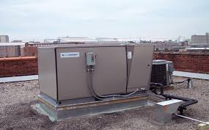
Thermal Energy Storage: Shifting Cooling Peak

Slide 17
Distributed generation
Additional GHG-related Goals

Slide 18
Distributed Generation Programs and Goals
Authorization | Program | Goals
SB 1 (2006) | Go Solar California | 3,000 MW of solar energy systems installed in 10 years (2008-2018) California Solar Initiative (CSI) Program Goal (CPUC run): Install 1,940 MW by 2016 (R. 12-11-005) New Solar Homes Partnership (NSHP) Goal (CEC run): Install 360 MW by 2016 Publicly Owned Utilities (POU) Goa: 700 MW by 2016
AB 1470 (2007) | CSI-Thermal (solar thermal technologies) | Install 200,000 residential systems by 2017 Displace 585 million therms of natural gas
Established by AB 970 (2000), modified by SB 412 (2009), SB 861 (2013), and others | Self Generation Incentive Program (SGIP) (non-solar DG and storage) | Reduce peak demand Reduce GHG emissions
Established by AB 656 (1996), AB 327 (2013) authorized successor tariff | Net Energy Metering (NEM) | Facilitate the deployment of customer-side renewable DG

Slide 19
Implementation
CSI Program has installed 1,844 MW of 1,900 MW goal with two years remaining in program.
CSI-Thermal Program recently adjusted incentive levels to encourage participation amid low adoption rates.
SGIP has installed more than 300 MW of non-solar DG and storage.
CPUC is in the process of developing a successor tariff to the current NEM tariff by the end of 2015.
Progress on NSHP goal but insufficient funds for program through 2016

Slide 20
Demand response
Additional GHG-Related Goals

Slide 21
Demand Response Goals
PUC Sec 454.5 (AB 57, Wright 2002) requires that IOUs’ procurement plans “meet unmet resource needs with all available EE and demand reduction [DR] that is cost-effective, reliable, and feasible.”
D.14-12-024 sets an interim statewide goal for DR, which is 5% of the sum of the peak demands of SCE, PG&E and SDG&E.
This interim goal would be eventually replaced with future goals set by the Commission following the completion of a DR potential study.
2015 DR goal is 2,324 MWs
D.14-12-024 also determined that by 2018, demand response programs will be bifurcated into two categories of DR:
supply resources and load-modifying resources. Supply resources are DR resources that are bid into CAISO markets, while load-modifying resources are those that reduce the demand curve.

Slide 22
Demand Response Implementation Activities
Complete DR potential study that will determine future goals for DR.
Implement recommendations from working groups that ease CAISO’s requirements for DR participation in wholesale markets
Revise the DR cost-effectiveness protocol so that both supply resources and load modifying resources are accurately valued.
Launch the Demand Response Auction Mechanism pilots for deliveries in 2016.
Establish policy guidance for the next generation of DR programs starting in 2018.

Slide 23
Energy efficiency
Additional GHG-Related Goals

Slide 24
IOUs Must Procure “All Cost Effective EE”
PUC Sec 454.5 requires that electric IOUs’ procurement plans “meet unmet resource needs with all available EE and demand reduction that is cost-effective, reliable, and feasible.”
PUC Sec 454.55 / 454.56 requires CPUC to establish targets for the IOUs to achieve all cost-effective electric and natural gas EE.

Slide 25
2015 Adopted Energy Efficiency Goals D. 14-10-046
IOU Service Territory | 2015 Electricity Savings (GWh/year) | 2015 Peak Savings (MW) | 2015 Natural Gas Savings (MMT/year)
PG&E | 980.5 | 154.4 | 15.4
SCE | 983.0 | 160.1
SDG&E | 239.7 | 39.6 | 2.5
SCG |  |  | 25.3
Total | 2,203.2 | 354.1 | 40.9

Slide 26
Zero net energy buildings
Additional GHG-Related Goals

Slide 27
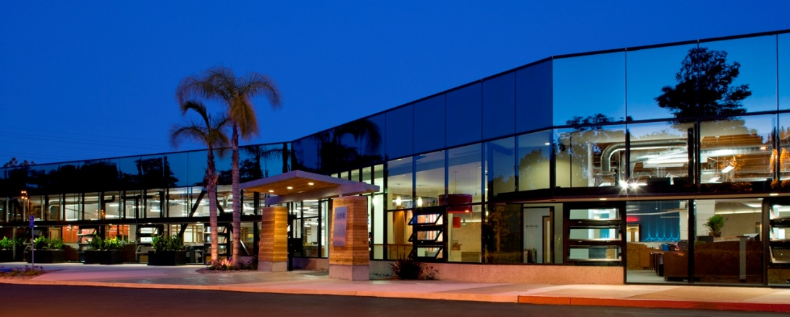
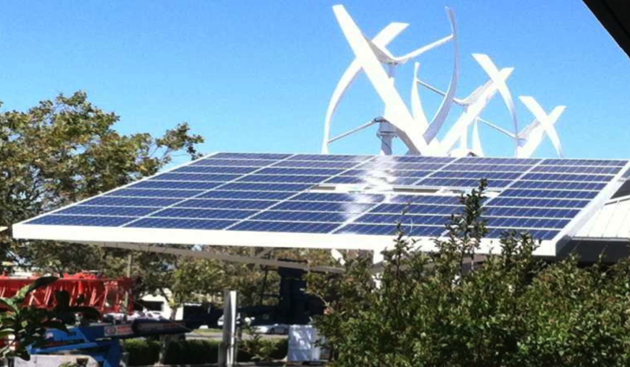
California’s ZNE Building Aspirational Goals
All new residential construction and all new commercial construction in California will be zero net energy by 2020 and 2030, respectively
50% of existing commercial buildings will be retrofit to ZNE by 2030
All new state buildings and major renovations shall be ZNE (2025)
50% of existing state-owned building area by 2025 shall be ZNE
IOUs shall launch and ramp a ZNE K-12 Schools and Community
College Pilot Program (Prop 39) in 2015-18
IBEW Zero Net
(D.07-10-032;
CEC’s 2007, 2013 IEPR)
D.08-09-040
Ex Order B. 18-12
D. 14-10-046
DPR Construction San Diego Corporate Office , Chip Fox, DG&E, renovation
IBEW ZNE Center, San Leandro, renovation
Notes:
A quarter of all ZNE buildings to date are renovations.

Slide 28
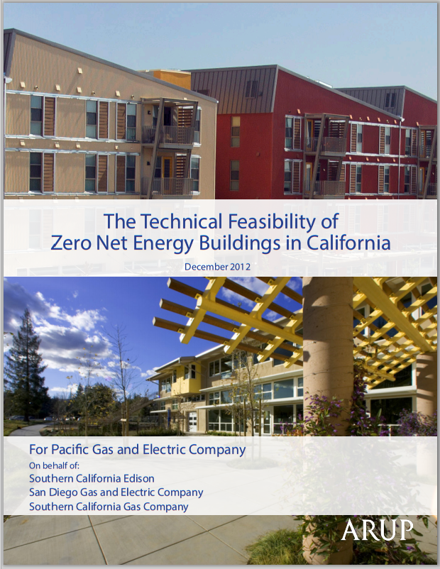
PG&E / Arup 2012 study:
“The study’s central finding is that ZNE buildings will be technically feasible for much of California’s new construction market in 2020.”
IOU programs to advance ZNE goals:
Codes and Standards
ZNE and Sustainable Communities Pilots
Emerging Technologies
New Construction Programs (CAHP and Savings by Design)

Slide 29
Smart meter capabilities
Additional GHG-Related Goals

Slide 30
Smart Grid is Here
California a leader in Smart Grid investments
$5.5 B in AMI/HAN
21 M Smart Meters (12 M electric + 9M gas)
Other on-going investments in Smart Grid
Many $$$ millions of assumed DR/EE conservation benefits
Applications (EE, DR, DG, ES, RE, …)
New Grid capabilities
Two-way communication
Sensors/monitoring
Timely/granular actionable data / analytics
Control/automation
Smart Infrastructure
Electrical Infrastructure (poles, circuits, transformers…)

Slide 31
Show Me the Data!
Green Button Access by Third Parties
(next day, hourly)
IOU My Account
(next day, hourly
HAN Gateway with Service Provider
(real time,5 seconds)

Slide 32
Leveraging Smart Grid / Smart Meters
Grid interactivity & monetization of services/value
Automated load management,
Smart Inverters, Wholesale Markets
Flexible rate options (time-based, energy, power, limits)
Sub-metering specific end use and rates (e.g. EVs)
Smooth, firm, green power
Leverage data/analytics in all DSM & rate programs/design
Segmentation and customization
Targeted rebates
Incentivize adoption of Data tools (e.g., HAN, Analytics)
Virtual/remote home audits
More tools for program EM&V
…

Slide 33
Recap
Many GHG and related goals, but not all are binding
Cost effectiveness limits on many – e.g.:
ZNE buildings must be found cost effective by Energy Commission to require under Title 24 Building Standards (Part 6)
“all cost-effective EE and DR”
Unifying approaches to cost effectiveness is key to optimizing progress on goals

