Slide 1
SC-REN Public Agency Program
Objective
Affordable, widespread and typical Energy Efficiency Expertise in Local Governments
(CA Energy Efficiency Strategic Plan, Local Government chapter, Goal #5)

Slide 2
SC-REN Public Agency Program
Budget
$19M over 3 year cycle energy efficiency only
Accomplishments
48 enrolled agencies
Launched expedited group procurement product
130 qualified and viable new energy efficiency projects (50M KWh)
LCR awardees and MOU LGs recognize value of this infrastructure

Slide 3
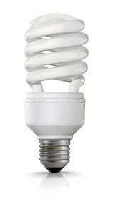
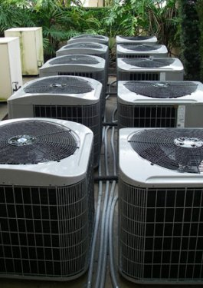
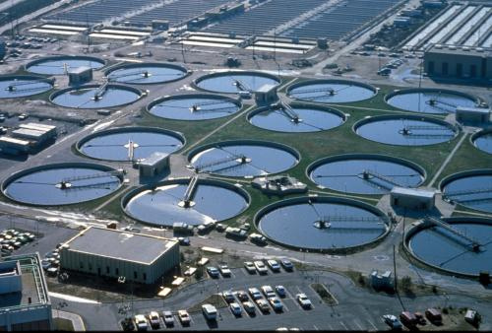
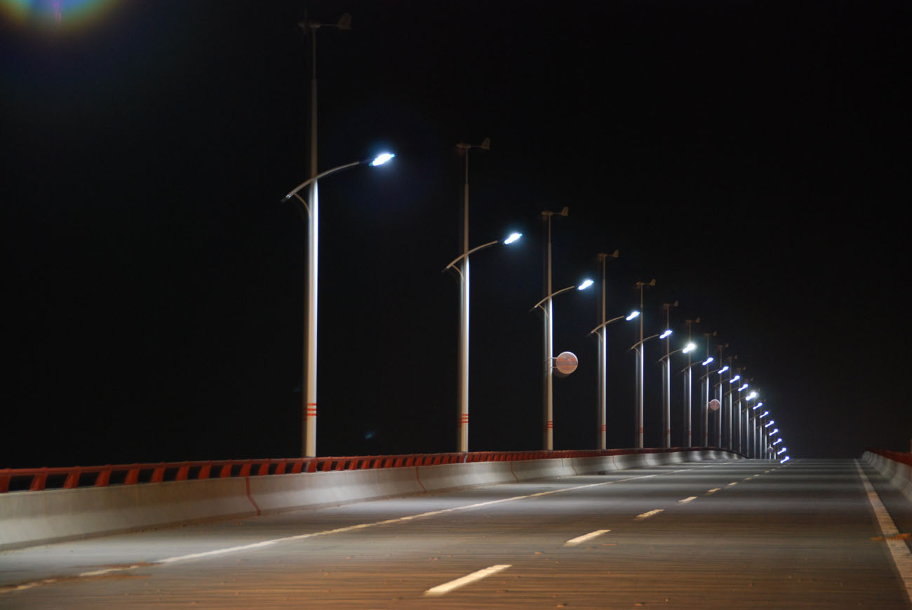
Accomplishments
52 Public Agencies Enrolled
Total 130 Projects
175 Facilities
20,000 Streetlights
Services Type
Project Types
71
55
45
Turnkey
Lighting
Mechanical
59
15
15
Customized
Water/Wastewater
Street Lighting
Notes:
September marked the one year anniversary of this program’s launch
Turnkey: leveraging NJPA

Slide 4
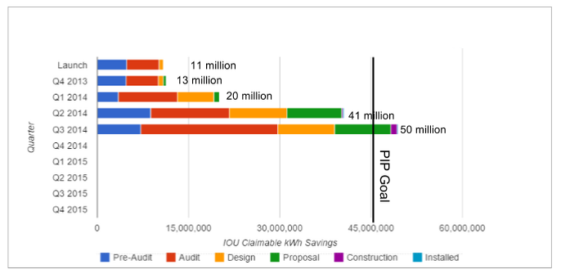
Program Pipeline Savings

Slide 5
SC-REN Public Agency Program
Lessons Learned
Silos harms customer engagement and satisfaction
SC-REN filed for a small amount of DR funding to offer integrated services – rejected by Commission
Retail Energy Markets (exponential) vs. command and control approaches (incremental)
Data
Net Zero projects require IDSM, LA County and City of Huntington Beach have made efforts to integrate DSM despite obstacles but fell outside of IDSM PCG survey parameters

