Slide 1
CPUC Learning Workshop: Targeted Demand Side Management – Past, Present, and Future
February 20, 2015
Michael Harrington
Section Manager,
Energy Efficiency and Demand Management
Con Edison

Slide 2
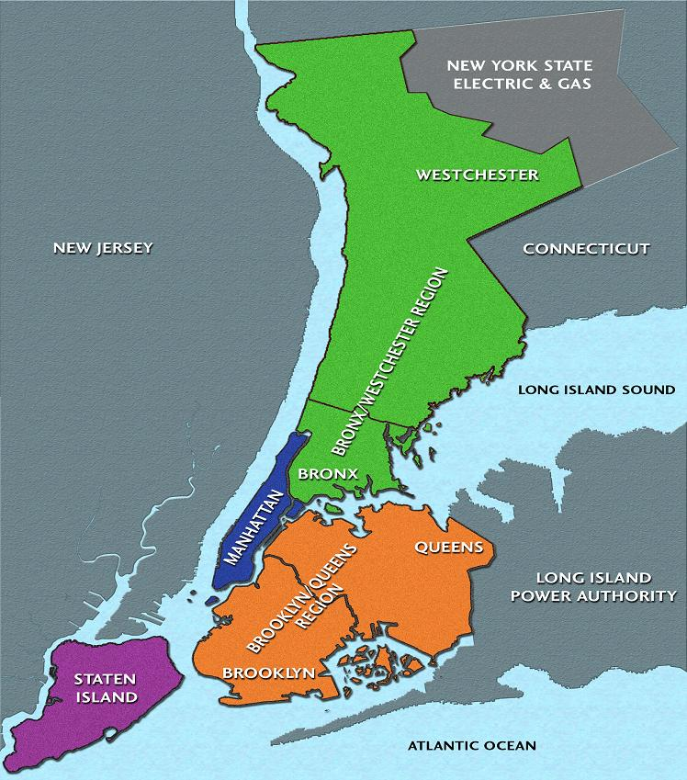
Con Edison provides electricity to New York City and Westchester
660 square mile service territory
3.33 million electric customers; 9.3 million resident population
2.47 million customers are in network distribution grids
System is 87% underground and 13% overhead
>13,000 MW system peak
Energy density: 20MW/sq mi; >200 MW/sq mi in parts of NYC
Deliver 62.6 million MWhs/year
$12.3b revenues; $35b in assets
Notes:
660 sq. mile service territory
133,000 miles of T&D cable (over 96,000 miles are underground)
>14000 people/sq. mile
20 MW/sq. mile overall.
3.3 million electric customers – 2.86m residential, 488k commercial and industrial, 6344 “other” (NYPA?)
1.1 million gas, and 1,700 steam accounts;
Serve a resident population of 9.3 million people
Over 650,000,000 sq. ft. of office space
462,000 businesses
900,000 residential buildings
63 billion kWh of electric consumption
Average residential customer usage - ~400kWh per month

Slide 3
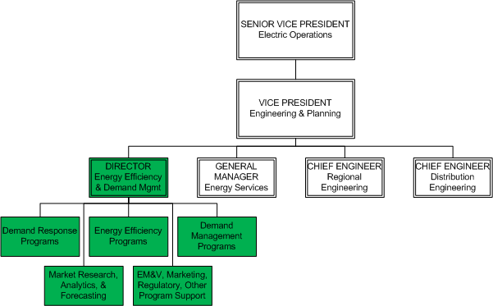
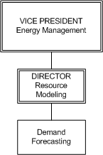
DSM is integrated into Engineering & Planning
Hands-on support starts here
Notes:
In

Slide 4
DSM has a measurable impact on demand per CECONY Five-Year Electric Peak Demand Forecast
5-Yr CAGR:
w/o DSM: 14,575 1.4%
w/ DSM: 14,250 0.9%
MW
Including DSM in the forecast reduces peak demand growth by 35% over next 5 years
Notes:
In
Peak Forecast Process:
Actual Peak Input ➔ Weather Adjustment of Actuals ➔ Top-Down & Bottom-Up Growth Analysis ➔ Demand Growth/Decline Output ➔ DSM and other Adjustments to Forecast (EV, DG) ➔ Final Peak Demand Forecast
For more info on our forecasting work
“Planning for Efficiency”, Public Utilities Fortnightly, August 2011
http://www.fortnightly.com/fortnightly/2011/08/planning-efficiency

Slide 5
Infrastructure build deferrals via system-wide programs and targeted DSM
System-wide DSM
Targeted DSM
Original build needed for 2016
Build deferred to 2020 with add’l Targeted DSM
Build deferred to 2018 with DSM in forecasts
In this illustrative example, accounting for DSM in the forecast defers build two years. Add’l targeted DSM pushes build two more years.
Notes:
DSM has proven to be a viable load relief option for system planning
Contributed to capital investment deferrals and reductions
Improvements in the accuracy of forecasts has enhanced the way engineers view DSM
Increasing DSM awareness has increased its importance in system planning
Positively impacted customer bills
For more info on our original TDSM program:
“Planning for Efficiency”, Public Utilities Fortnightly, August 2011
http://www.fortnightly.com/uploads/08012011_PlanforEff.pdf
“Con Edison’s Targeted Demand Side Management Program: Replacing Distribution Infrastructure with Load Reduction”, ACEEE 2010 http://eec.ucdavis.edu/ACEEE/2010/data/papers/2059.pdf

Slide 6
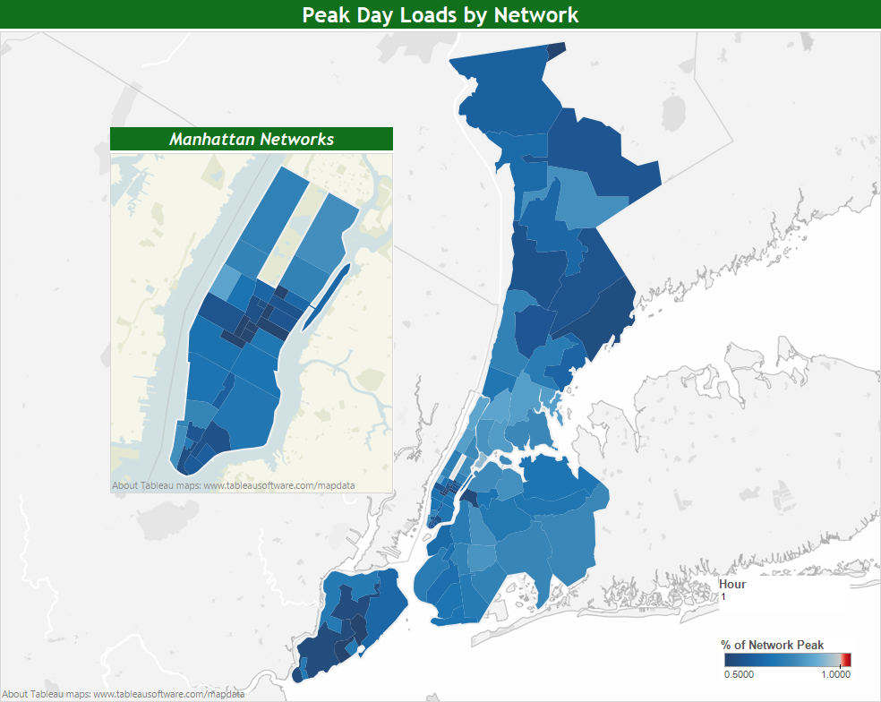
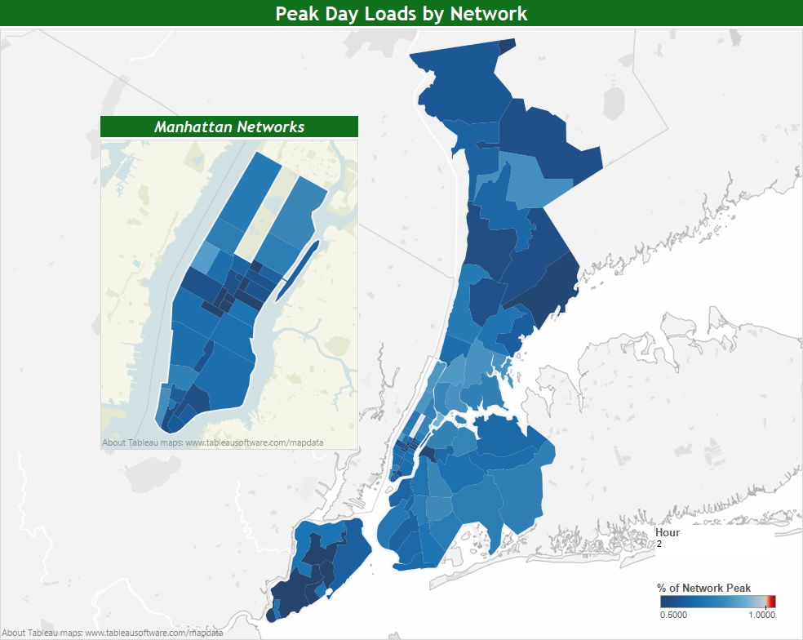
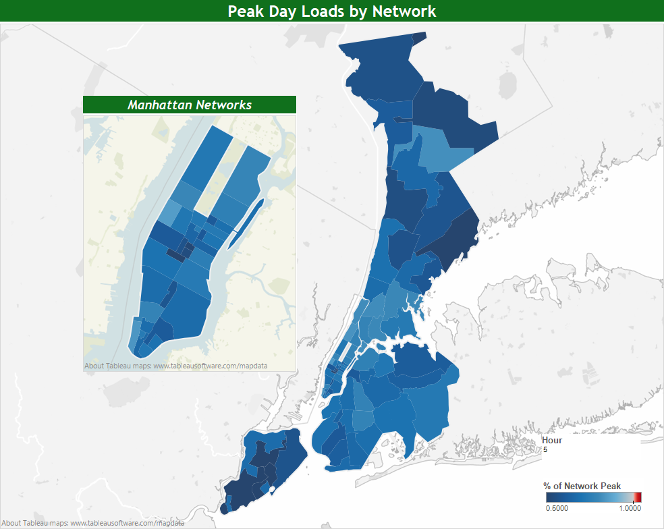
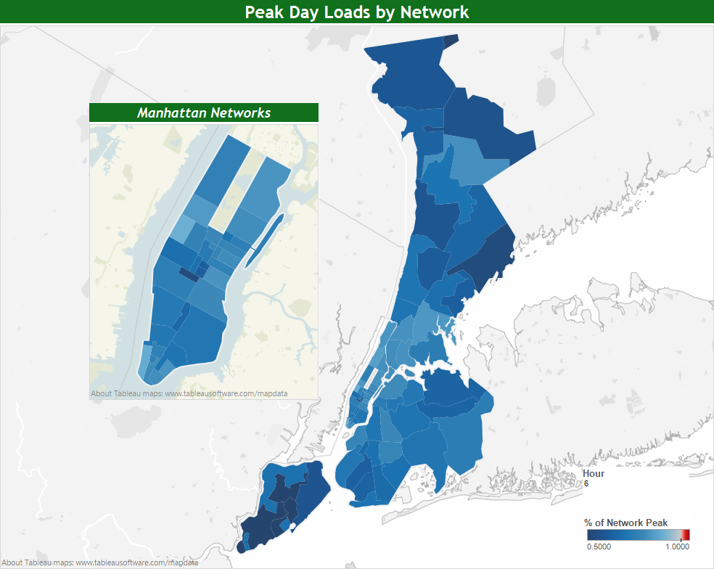
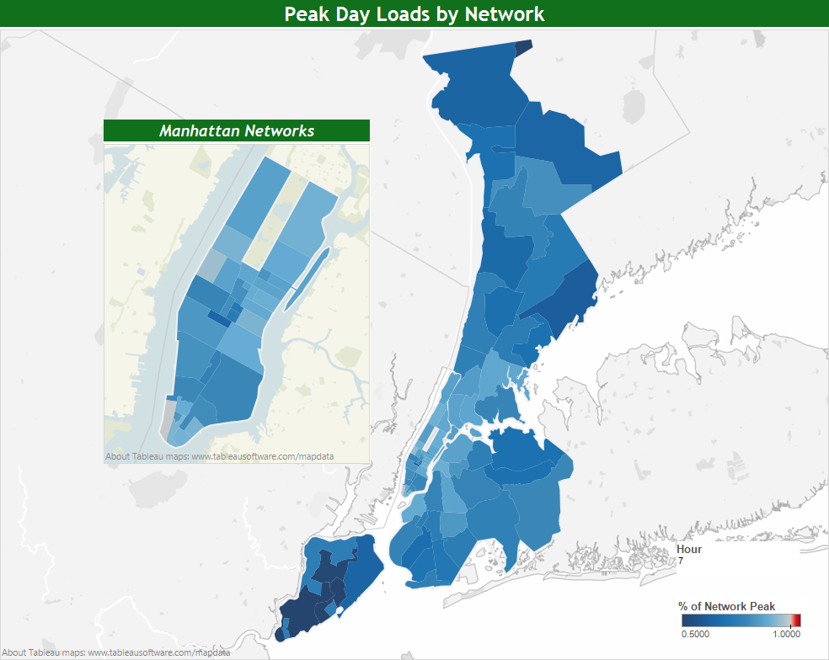
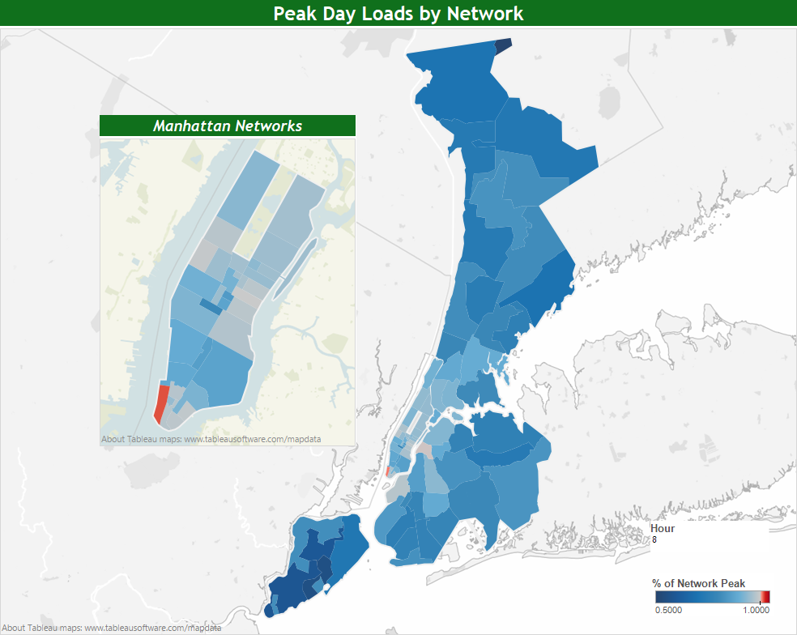
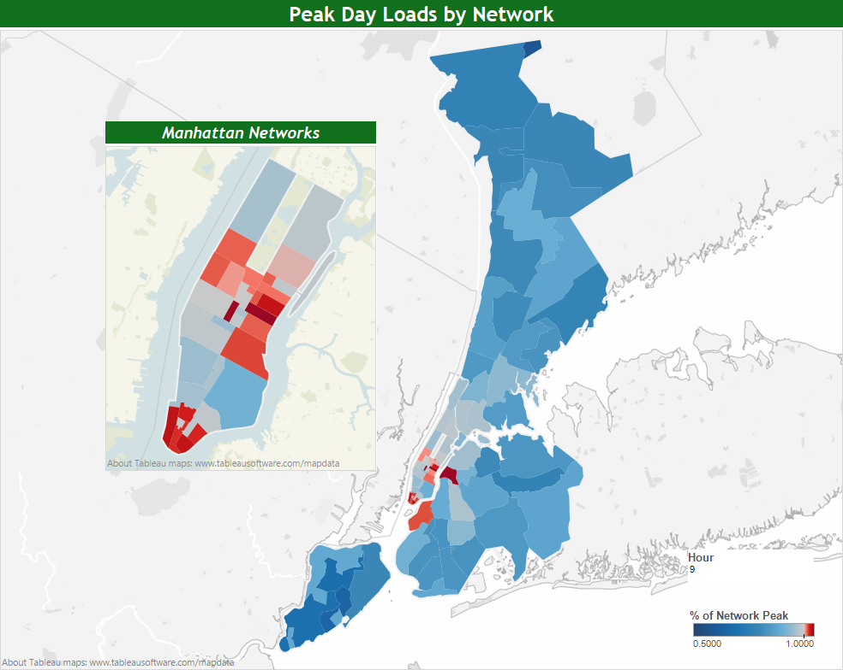
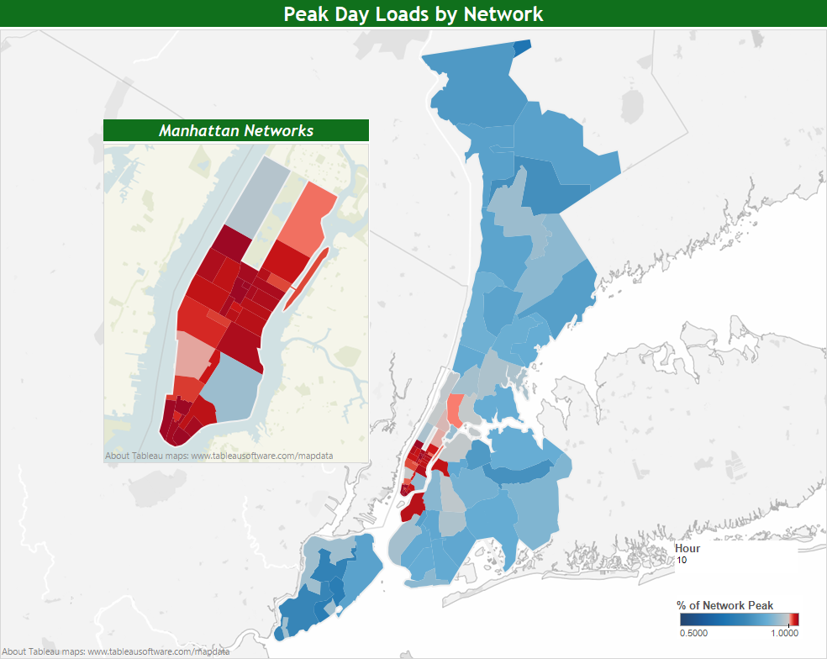
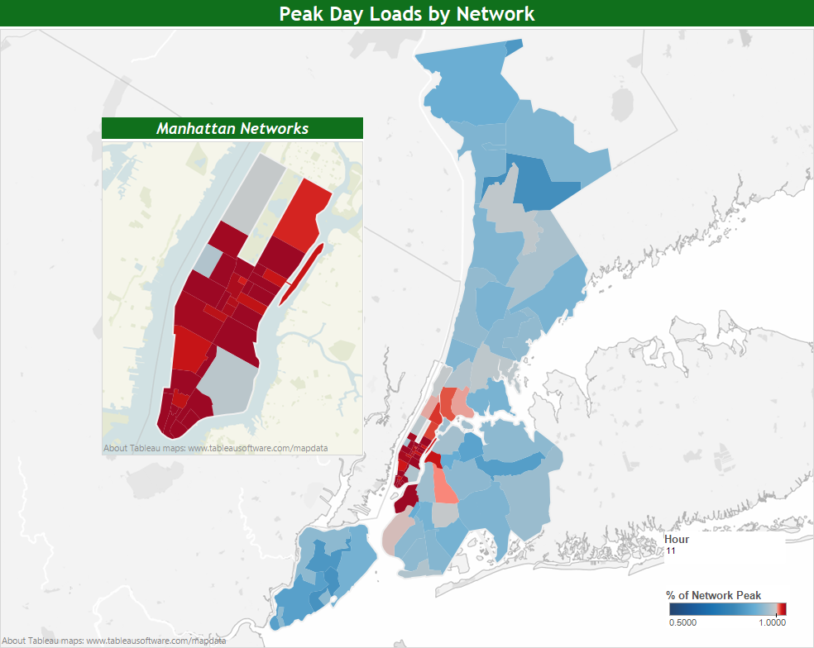
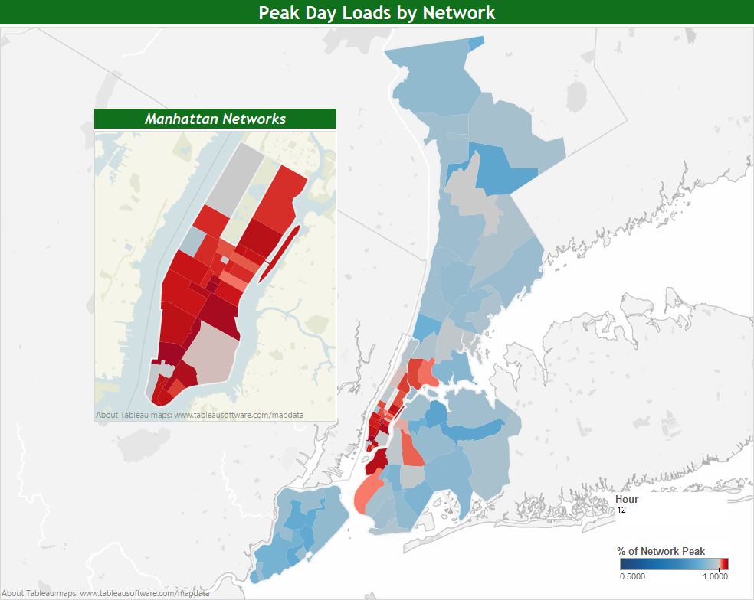
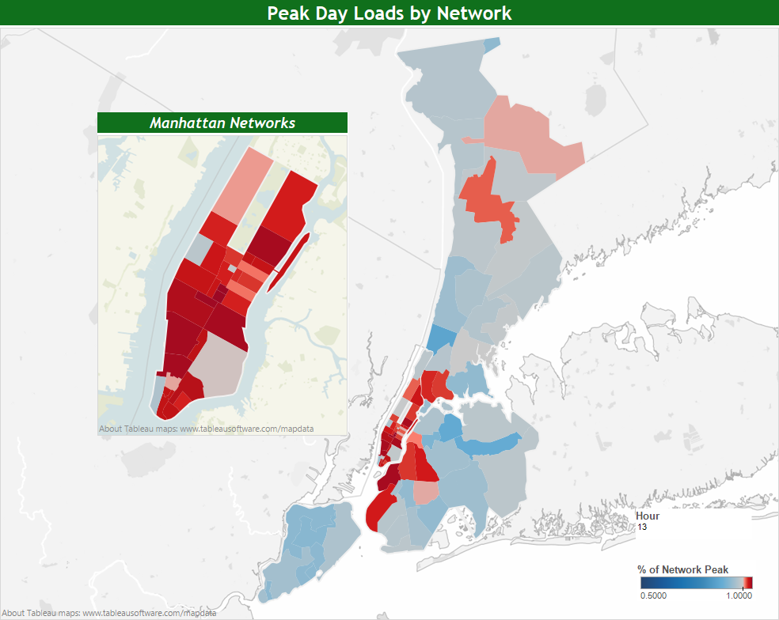
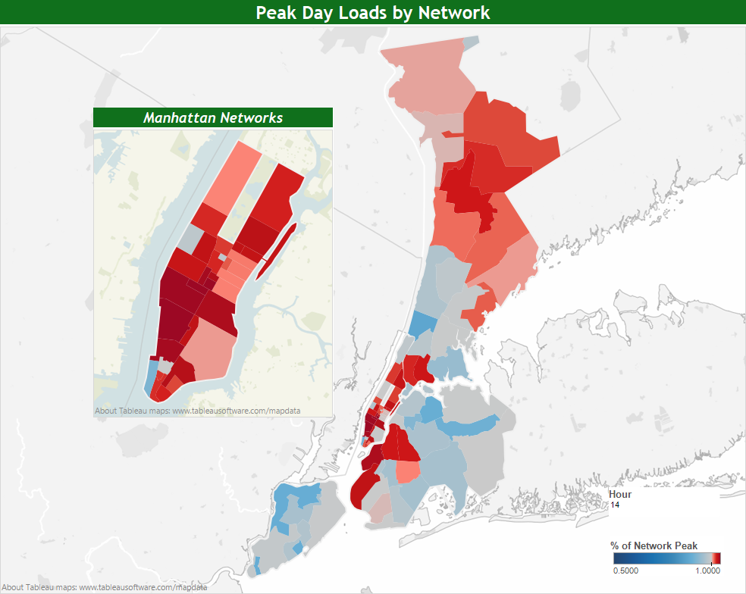
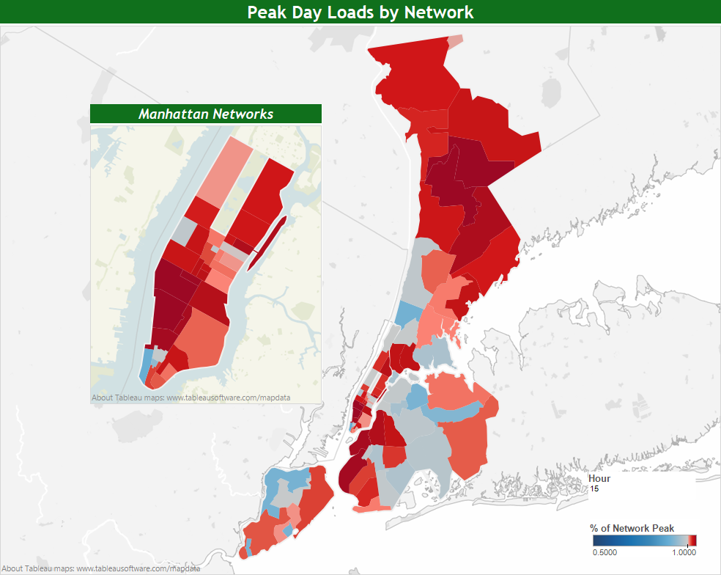
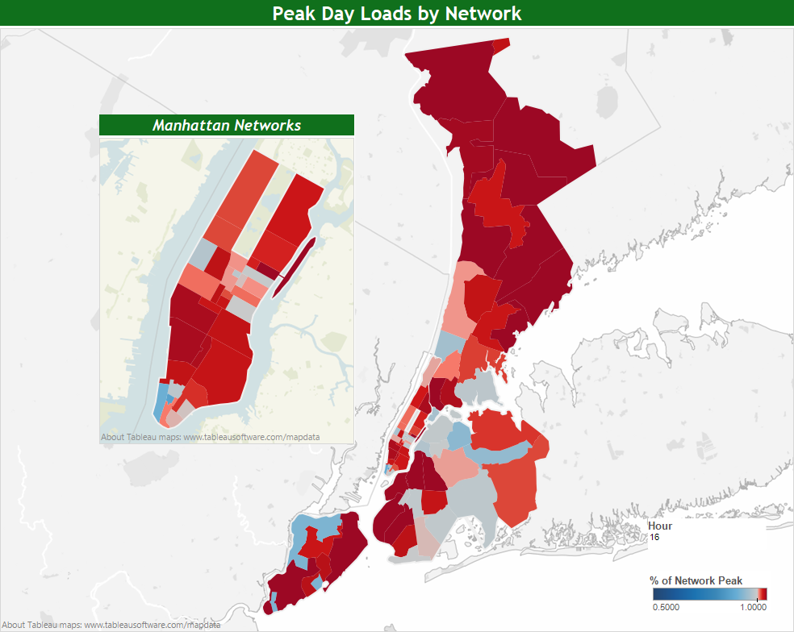
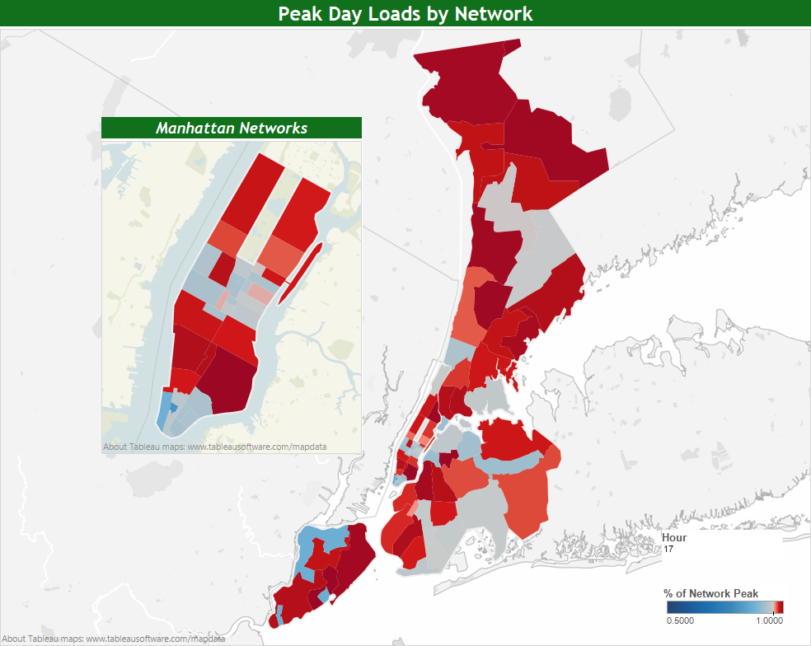
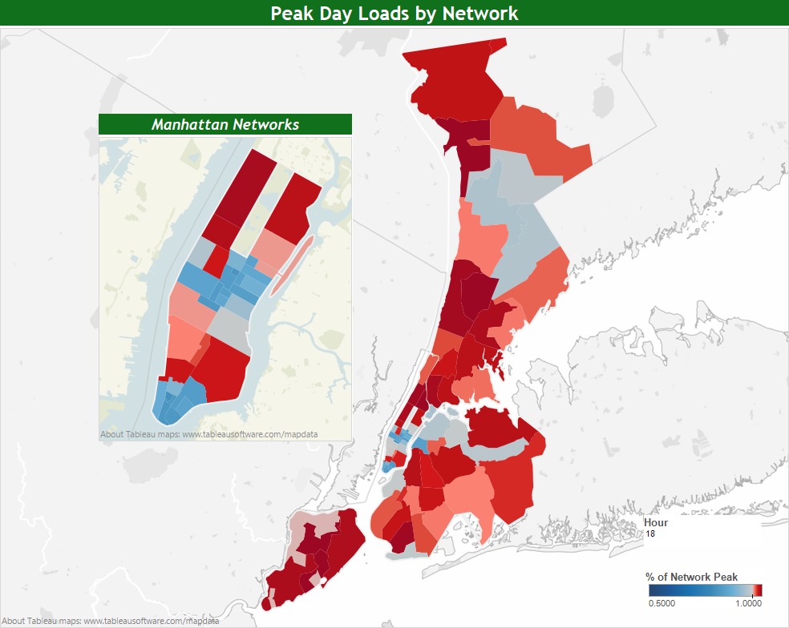
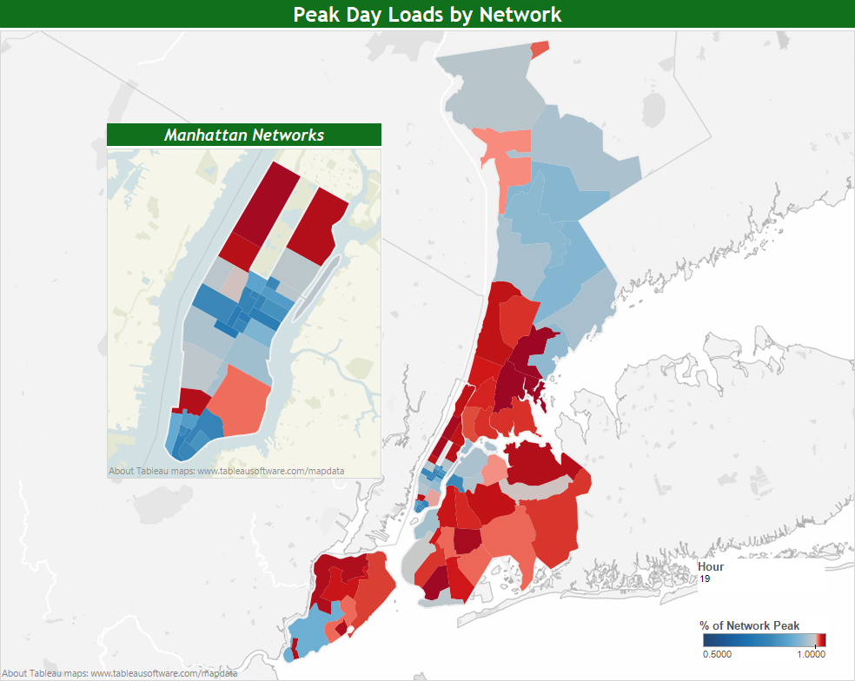
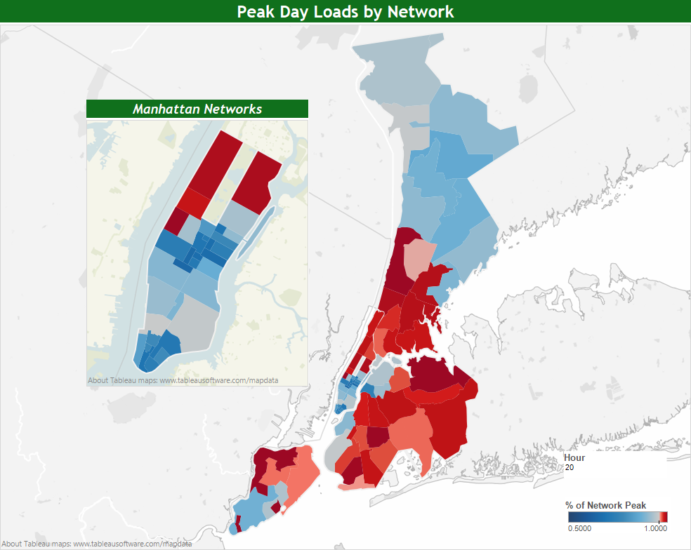
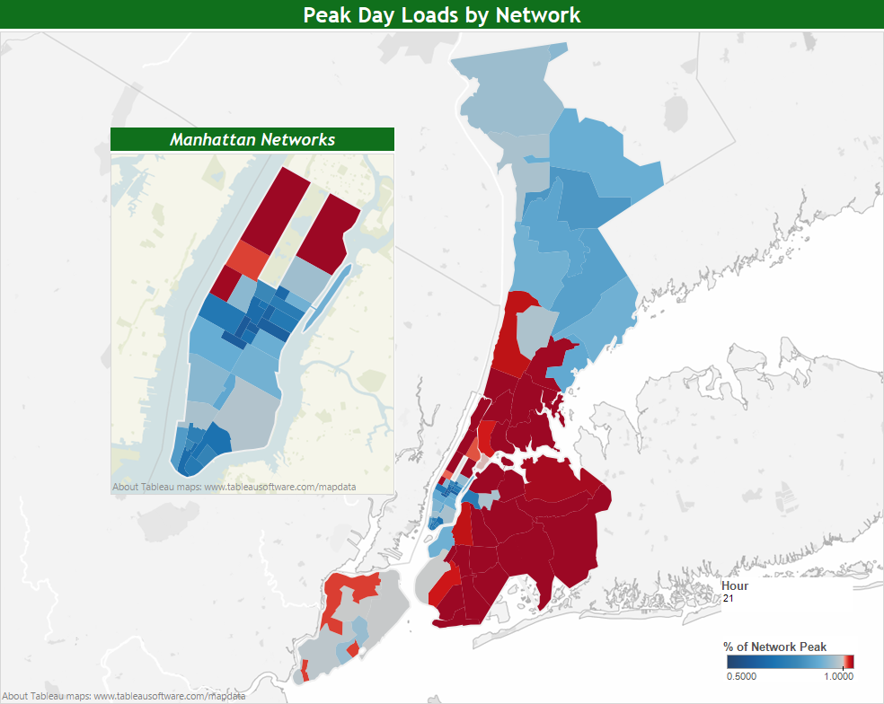
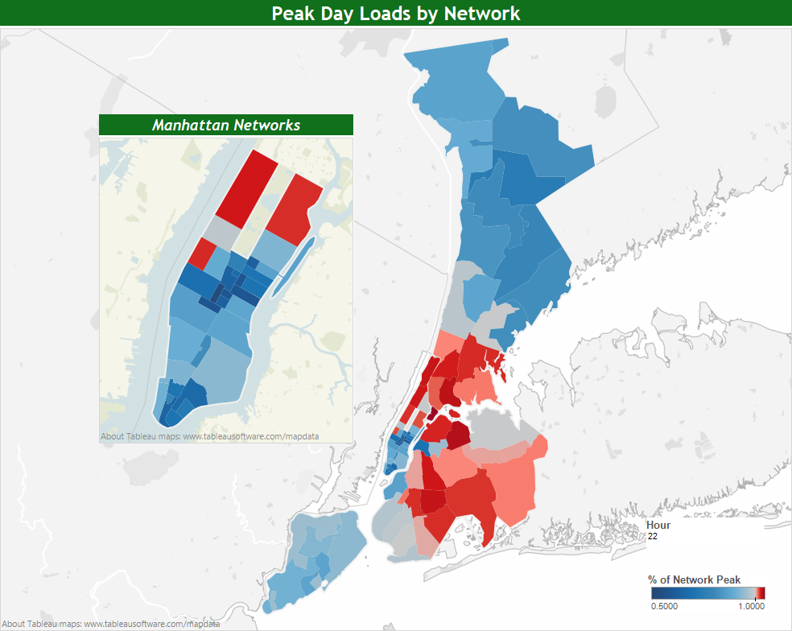
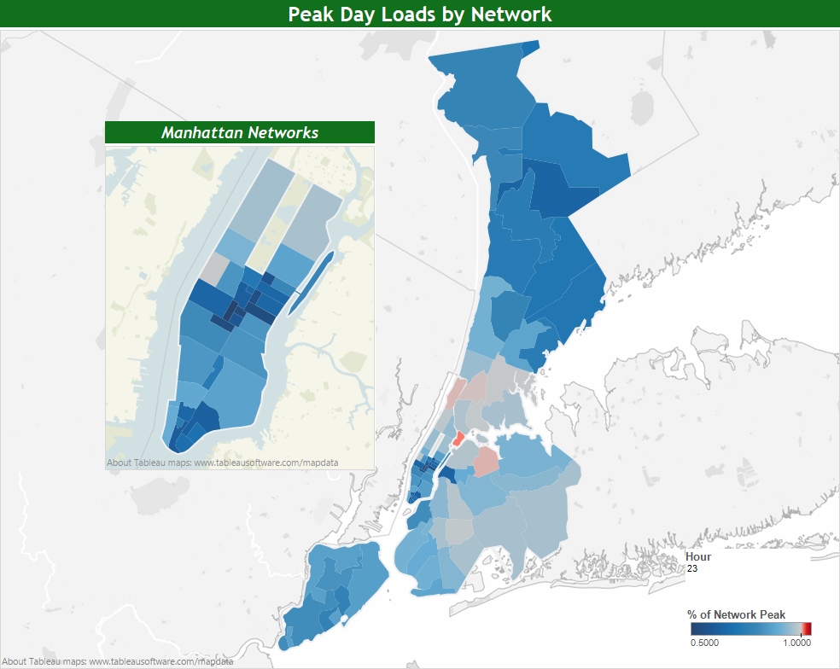
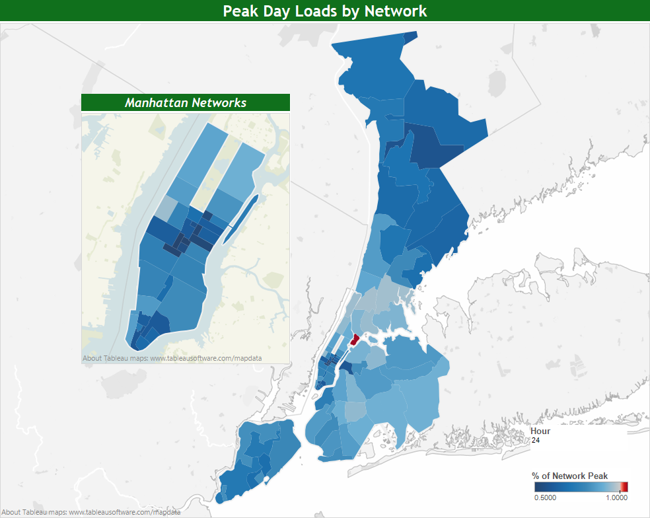
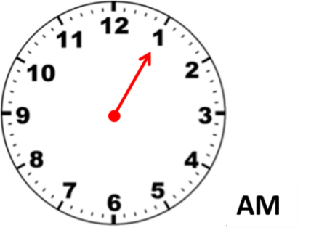
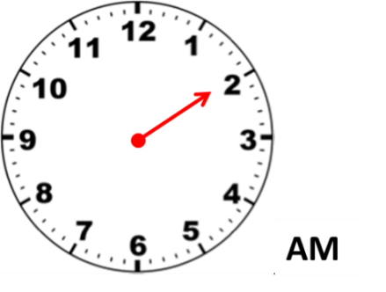
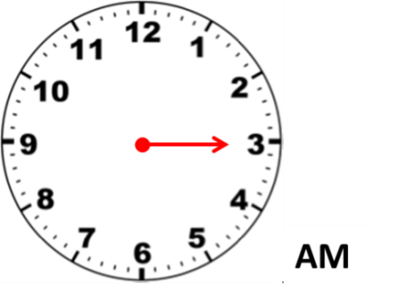
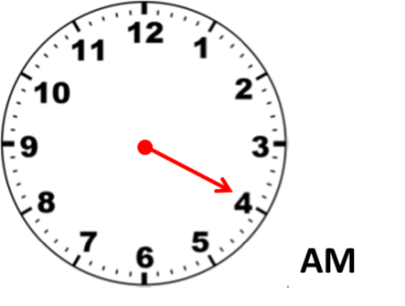
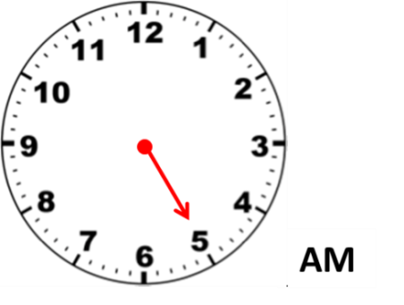
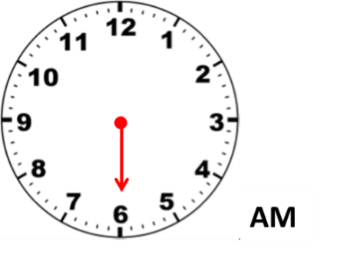
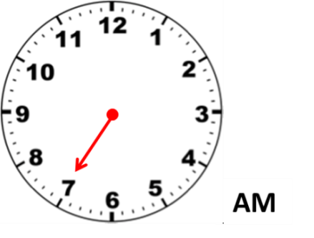
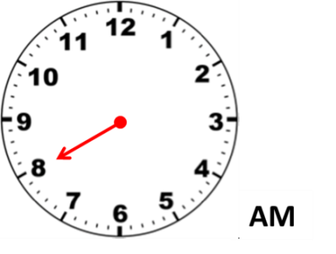
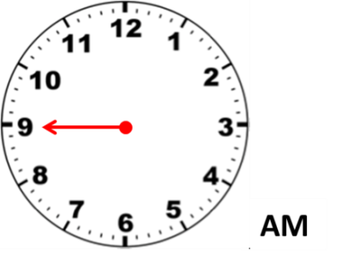
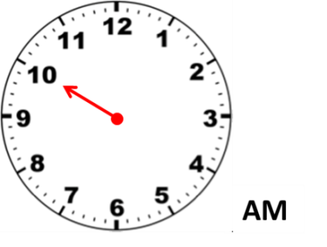
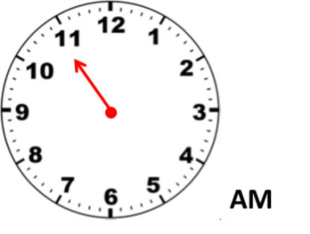
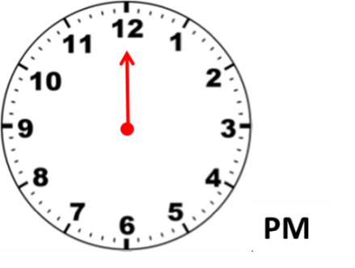
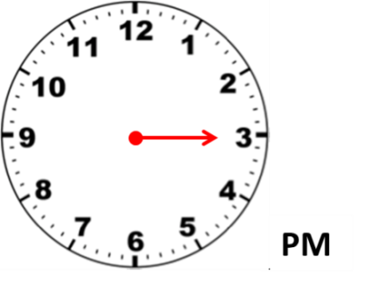
Animated illustration of network load changes over 24 hours of a peak day
Notes:
FYI – this is the 24 hours of Thursday July 17 – the peak day load shape used by forecasting (they do not use “atypical” Fridays)
Animation notes:
Animation will start with a click (starts at hour ending 1am)
Animation will proceed until HE 2pm where it will pause to show commercial peaks, click to continue click
Animation will continue from 2pm to HE 5pm to show system peak time, click to continue click
Animation will continue from 5pm to HE 9pm to show residential peaks in BQ, QN, BX, and upper MN, click to continue to end of animation
Above can be run in reverse (i.e. you can go back to previous point, by clicking back)

Slide 7
Brooklyn Queens Demand Management (BQDM) Program Overview
Subtransmission feeders serving two networks in Brooklyn and one network in Queens overloaded (>800MW)
Company developed multi-faceted solution to address forecasted overloads including:
Traditional utility solutions (e.g. load transfers)
Non-traditional customer and utility solutions (BQDM)
BQDM filing on July 15, Order received on December 12
Commission approved $200m
Customer Sided 41 MW ($150m) and Utility Sided 11 MW ($50m)
Expenditures treated as 10 year capital assets with regulated return
Includes a 100 basis points bonus incentive per 3 performance metrics

Slide 8
BQDM Networks
MANHATTAN
LONG ISLAND
Notes:
Describe geographic region of focus
Discuss RFI here
Issued an RFI for potential solutions
Received 78 responses (this number is public)
Wide variety of responses across almost a dozen DSM categories
Responses ranged from traditional energy efficiency and demand response to controls to microgrids, solar, and storage
SBDI ADDER:
Targeted existing small business program
Adjusted existing 70% incentive to 100% incentive
Considered measure impacts outside TRM (e.g. outdoor lighting)
Sold 2,000 customers, > 7.5 MW; installed 1,200 customers,>4.1 MW
Expanded MW goals (achieved initial 5.6MW goal 3 months ahead of schedule) and incentivized measures (LEDs)
1600 customer initial customers said they would do for free. But not CFLs. Customers are getting savvy – they are requesting LEDs
Positive community impact. Trust and engagements to drive overall outcomes. Community stakeholders are key.
NEXT STEPS:
RFI selections and purchasing (79 responses rec’d)
Evaluate progress against checkpoints (on-going)
Stakeholder engagement (on-going)
Expand Small Business EE program targeting
Implement Multi-family EE program targeting
Dispatch strategy for dynamic resources (DR, DG, ST)
Load area and customer reduction load curves tracking
2016 reduction needs checkpoint review

Slide 9
DSM Resource Portfolio Selection (for illustration purposes only)
Effective MW of resources calculated based on:
Technology characteristics
Customer segment type
Demand reduction duration
Notes:
Load Carrying Capacity Factor (LCCF) normalizes the duration and the average load reduction of the proposed DER within the 12 hour need period. LCCF calculations are specific to technology and customer segments. For example, a residential lighting solution has a different LCCF than the LCCF of a C&I lighting solution.
The LCCF are based on the Navigant loadshapes used in the E3 tool.

Slide 10
Integrated Demand Side Management model evaluates potential and economics
Baseline Market Characteristics
INPUTS
Technology Screen & Potential Analysis
OUTPUTS
Economic Potential Output by Load Area
Primary and Secondary Data
Universal List of EE/DR/DG/STR Measures
Screened Technical Potential
Maximum Achievable Potential
Adoption Plan
EE Module
Ranking and Economic Global Inputs
DR Module
MODELS
Economic Analysis
CSG Module
STR Module
INPUTS
User Adjusts
Forced and Removed Measures
Feedback Loop
Combined Ranking and Potential
Selection Module
Notes:
Top line: The Integrated Demand Side Management (IDSM) Potential Tool evaluates the market potential and cost effectiveness of energy efficiency, demand response, distributed generation and storage to defer capital expenditure infrastructure projects.
Key Features: user driven dynamic potential and economic model, designed to account for market and technology changes, provided cost effectiveness screening and results (all 5 standard tests), highly customizable for variety of iterations and scenarios, granular analysis and results across 16 customer segments and 81 measures (1300 total segment-measure combos, per network, per year)
Step 1: Tech Screen & Potential Analysis:
This is the process of taking CECONY primary data and other secondary data to form the measure lists, both universal and screened (acceptable for the CECONY service area). It is taken from technical to max achievable in the model. Load shapes, measure capital and O&M costs, network and system growth, and acceptance rates were developed and included in the model so as EE, DR, CSG and Storage evolve, the load shapes will change.
Step 2: Economic Analysis:
Overall schematic of integrator logic. The IDSM model is built to evaluate using any (or combination of) the standard BCA tests. The measures are evaluated and ranked within their respective Technology Module (EE, DR, CSG, STR) by economics and savings (kw or kwh). The integrator portion combines all the rankings and develops an overall ranking of measures.
Step 3: User Adjustments:
The ability to force an inclusion or exclusion of a particular measure is a surrogate for behavioral issues.
Step 4: Economic Potential Output by Load Area:
The model will provide a recommended list of measures, by network, by technology, by market segment. This list of measures along with potential estimates and cost effectiveness results are inputs into development of a DSM adoption plan to defer cap ex infrastructure. Output can also serve as an input to RFIs and RFPs by allowing comparison of vendor claims to potential estimates by technology and customer segment.
Step 5: Iterations
Loop back to beginning to run different scenarios and iterations – by changing different parameters and assumptions

