Slide 2
THE MARRIAGE OF ENERGY EFFICIENCY, SOCIAL EQUITY, AND ECONOMIC DEVELOPMENT
Ted Trabue, Managing Director
February 20, 2015

Slide 3
What Is the DC Sustainable Energy Utility?
Clean & Affordable Energy Act (2008)
Ratepayer-funded, nonprofit operated
$20 million budget in FY 2014
Delivering $105 million in ratepayer benefits
<12% program administration costs
Performance based contract
Notes:
This is a 1 minute slide – I’d suggest only speaking to the following three points as this is just background information
Clean and Affordable Energy Act was passed by DC City Council in 2008 and created the DC Sustainable Energy Utility to deliver demand-side management programs for District ratepayers
In 2010, the DCSEU was officially started when the Vermont Energy Investment Corporation won a competitive bid
Now, in its fourth year, the DCSEU has a budget of $20 million with which we delivered $***** in ratepayer benefits in 2014.

Slide 4
DCSEU Goals
Create green jobs for District residents (88 FTEs)
Stimulate the local economy (35% local business spending)
Reduce energy use throughout the District (1%)
Improve the energy efficiency of housing for low-income residents (30% low-income spending)
Reduce growth in peak demand
Increase renewable energy generating capacity
Notes:
This is a 1 minute slide
The DCSEU has goals that extend beyond energy savings. As you can see from this list, the DCSEU has annual goals to
Create jobs
Support local businesses
Reduce citywide electricity AND natural gas consumption
Ensure clean energy benefits are extended to low-income residents
Reduce peak demand
And increase distributed generation in the District

Slide 5
DCSEU Initiatives
RESIDENTIAL
Efficient Products
Food Banks
Home Performance with ENERGY STAR
RENEWABLE ENERGY
Solar Photovoltaic
Solar Thermal
LOW-INCOME MULTIFAMILY
Low-Income Multifamily Comprehensive
Low-Income Multifamily Direct Installation
COMMERCIAL AND INSTITUTIONAL
Business Energy Rebates
T12 Lighting Replacement
Benchmarking Help Center
Custom Rebates

Slide 6
Seamless Integration of Services
Notes:
This is a 2 minute slide
(This is the punch line)
In order to meet these intertwined goals each year, we must design a portfolio of integrated initiatives. We have to create programs that help the customer to take advantage of multiple technologies and do so using local businesses that hire District residents.
We have to become the trusted energy advisor and incentivize customers to move along a continuum of energy upgrades with us over time.

Slide 7
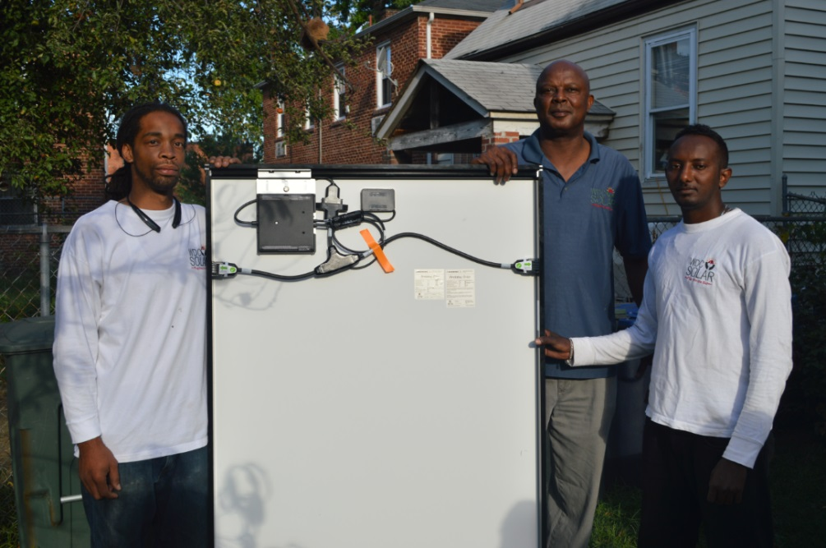
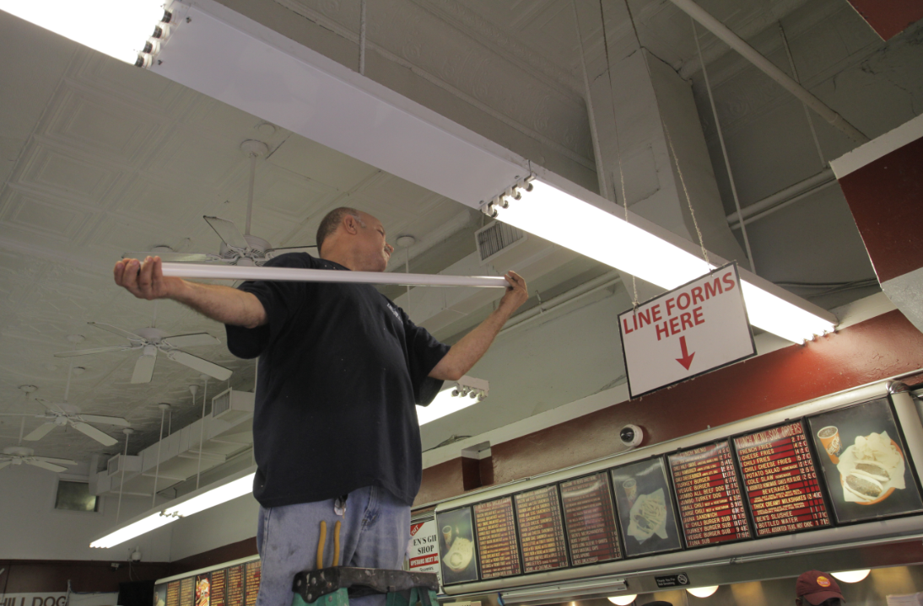
Local Economic Development
Notes:
This is a 2 minute slide
This would need to be a very brief example, but could you paint a quick picture of an affordable housing customer that received solar thermal or PV, installed efficient systems, AND efficient products? Or, the best possible example would be a low-income homeowner that received solar PV, some home efficiency upgrades (not necessarily the whole Home Upgrade), and efficient products.
If that hasn’t come about yet, perhaps this slide is about becoming the customer’s trusted energy adviser across technologies and that now in DCSEU is in its fourth year you’re starting to have customers with longer term relationships and will be able to move them towards deeper savings and into DG and then later storage over time.

Slide 8
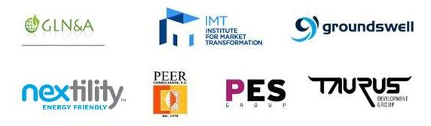
Sustainable Energy Partnership
The DC Sustainable Energy Utility is a project of the Sustainable Energy Partnership under contract to the District Department of the Environment.

Slide 9
Ted Trabue
Managing Director
DC Sustainable Energy Utility
ttrabue@dcseu.com
www.dcseu.com
www.veic.org
Notes:
1 min slide to say thanks and invite questions
I’d pause here during the Q&A; the slides will be sent out to the audience following the presentation

