Slide 1
Residential IDSM program in Nevada Energy Territory
Vivin Nath, February 2015
Vivin.nath@ecofactor.com

Slide 2
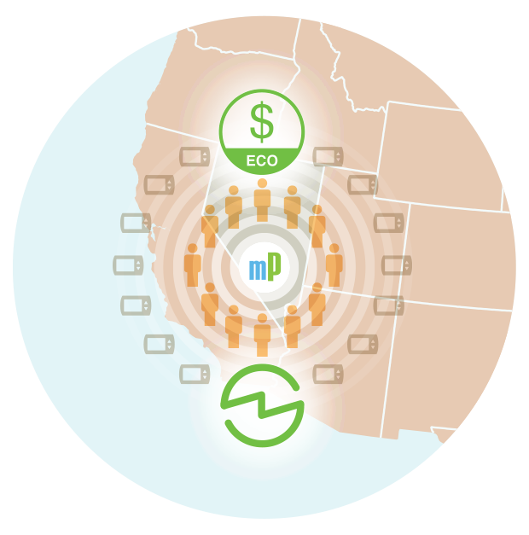
NV Energy mPowered program
Powegrid International Project of the Year 2015
One of the largest and most successful IDSM programs in the country
Publicly launched in October 2012
By the end of 2013: 14,500 customers participating and 21,000 thermostats installed
More than 22,000 customers and more than 34,000 thermostats deployed to date

Slide 3
Program Objectives
Primary Goal: Maximize peak to reduction avoid expensive capacity
Secondary goal: Maintain satisfaction - keep consumers comfortable so they remain in the program and consistently shed load

Slide 4
mPowered Program Incentives
Free EcoFactor enabled Smart Thermostat and Gateway
Free Professional Installation
Free Energy Efficiency Service powered by EcoFactor
Participation credits during energy events
24/7 mPowered customer care
Mobile and Portal Apps access to control thermostat remotely from anywhere at any time

Slide 5
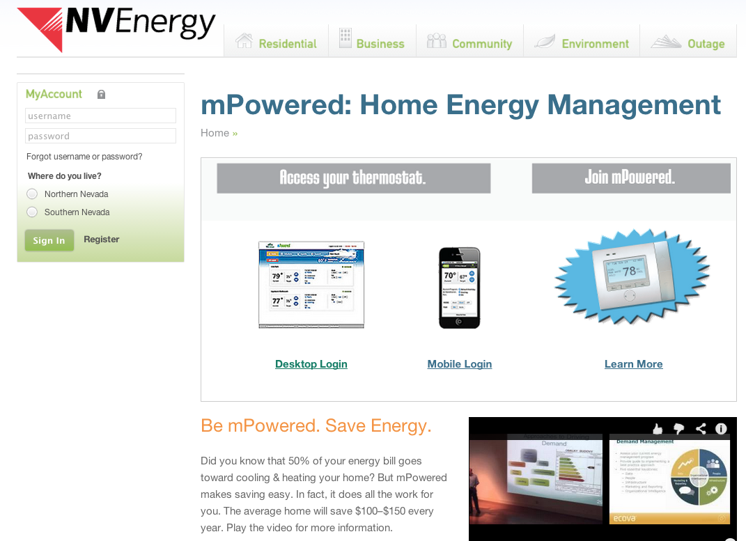
mPowered in NV Energy website

Slide 6
Traditional thermostat-based DR
Customer Opts Out
DR Set Back
Customer Comfort Impacted: +4°F inside temp rise
80°
78°
° F
76°
74°
HVAC ON Minutes per Hour
12:00pm
1:00
2:00
3:00
4:00
5:00
Time

Slide 7
EcoFactor’s occupant-centric approach to DR
Controlled cycling using machine learning
Greater customer comfort: 1°F avg inside temp rise
80°
78°
Tailored Pre-cool
° F
76°
74°
Pre-cooling + No Opt-Outs =
Greater DR Yield
HVAC ON Minutes per Hour
12:00pm
1:00
2:00
3:00
4:00
5:00
Time

Slide 8
EcoFactor approach to DR at aggregate level
Precooling: Makes consumers more comfortable for longer when AC is off increasing event energy savings
Staged Resource Calling: Calling resources in waves flattens the curve
Minimize snapback: Spread out when consumers turn AC on over 15 minutes so there is no spike
Ideal handling of DR
Pre-cooling
Minimize snapback
Original Demand:
Staged calling of resources
Staged DR:
Resulting demand:

Slide 9
mPowered M&V(*) results – Customer Sat
Drove Sustained Participation and High Customer Satisfaction
86% overall customer satisfaction rating
Sustained customer participation in 28 DR events in 2013 and in 2014
Including a stretch of 8 consecutive days with DR events in 2013
12% fewer Manual Overrides than next-best performing residential two-way PCT program in report
$100/year in savings (635 kWh + 18 Therms)
(*) Independent Measurement and Verification report published by ADM associates, submitted to PUCN in July 2014

Slide 10
mPowered M&V results – Utility Value Add
Delivered Best Value to the Utility
EcoFactor DR+EE program had a TRC benefits-to-cost ratio of 1.33 in 2013, expect 1.89 in 2014
More than 63MW avoided capacity
Events dispatched directly from Utility DRMS to EcoFactor platform via Auto-DR API
DR as a Reliable Supply side resource – 28 DR events/summer
Flexibility in using both as a Day-Ahead and a 10-min spin reserve

Slide 11
Integrated Demand Side Management works
Dual Benefits of DR + EE= Increased Savings in both Capacity and Energy
Demand Savings (kW)
Energy Savings (kWh)
3.1 kW load reduction per home (***) | 24.2 kWh/season Savings per home
0.5 kW “latent” load reduction per home | 94.7 kWh/month Savings per home ^{(*)}
> 3.5 kW per home | 1,162.4 kWh / year per home (**)
DR
EE
Overall IDSM Benefit
(*) Control group that included homes with PCTs. Figures are for summer months.
(**) Electric and natural gas equivalent kWh combined
(***) Dispatch-ready Peak load factor at 105°F Outside Temperature

Slide 12
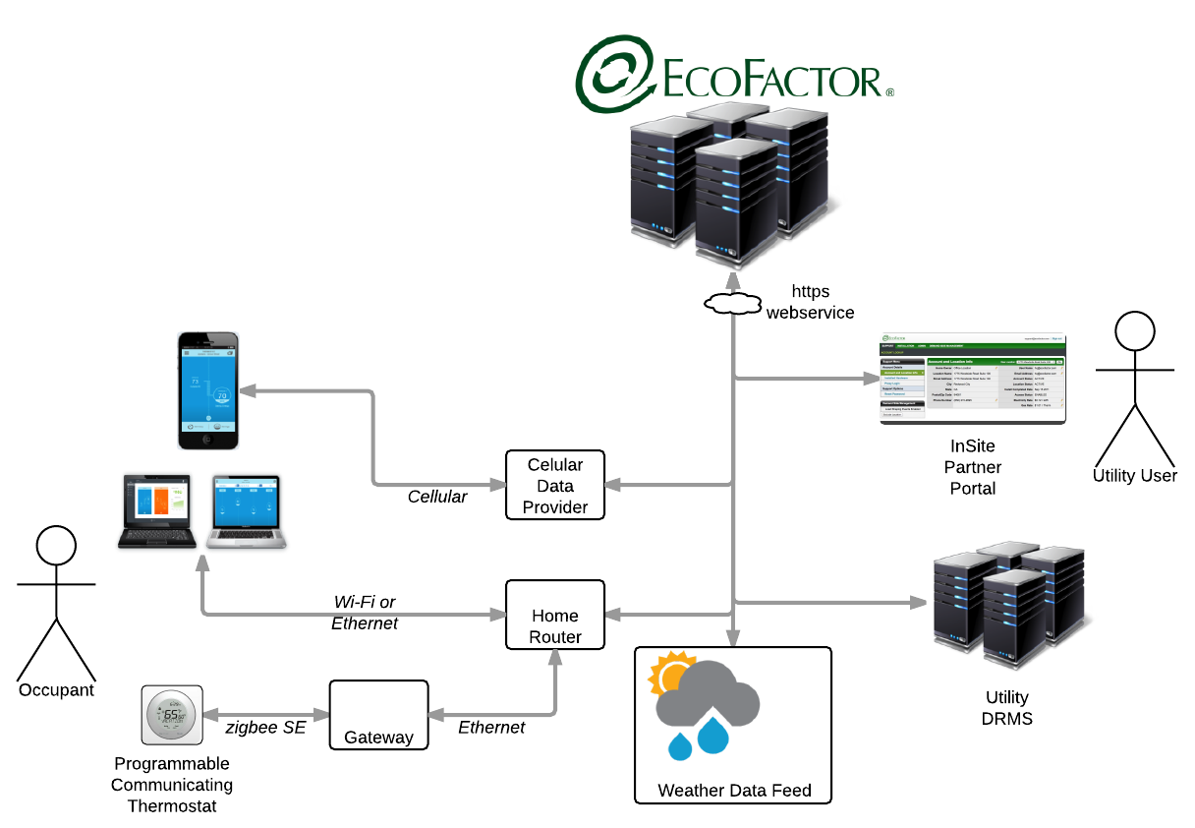
EcoFactor’s Smarts-as-a-Service approach
Automation
Data

Slide 13
Thank You.
www.ecofactor.com

