Slide 1
Overview of Outcomes of Commission-Regulated Activities
IDSM Rulemaking
Jan 22 Workshop
Lisa Paulo
Cathy Fogel
Energy Division Staff
Christie Torak, Evergreen Economics

Slide 2
IDSM directives
Overview of Outcomes of Commission-Regulated Activities

Slide 3
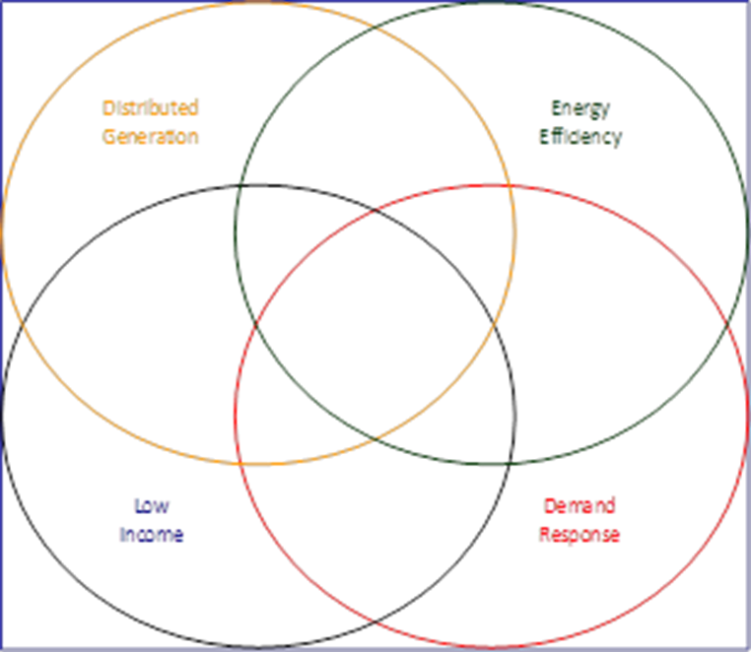
Integrating Demand Side Management

Slide 4
The Energy Action Plan (EAP)
Policy Goals:
Meet California’s energy growth needs while optimizing energy efficiency & conservation.
Decrease per capita energy use & reduce toxic & greenhouse gas emissions
“Loading Order” for Energy Resources:
Energy Efficiency
Demand Response
Renewable Generation
Cleanest Available Fossil Generation
EAP II adds climate change, RD&D, & transportation to the strategies

Slide 5
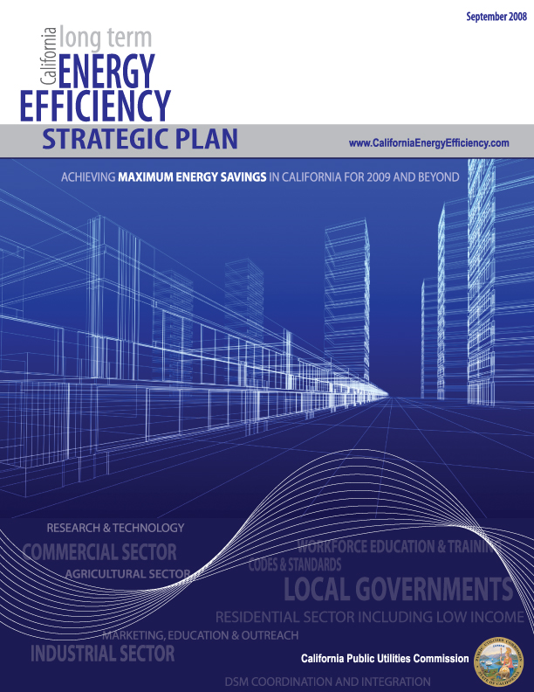
EE Strategic Plan (2008): Integrated Demand Side Management
Energy efficiency, energy conservation, demand response, advanced metering, and distributed generation technologies are offered as elements of an integrated solution that supports energy and carbon reduction goals immediately, and eventually water and other resource conservation goals in the future
Provide packages rather than products to maximize energy savings, minimize program costs and increase customer education, choice and ability to manage energy

Slide 6
Ca EE Strategic Plan- Vision (2008): Integrated Demand Side Management (IDSM)
Strategy 1: Market Integrated Demand Side Management (IDSM) opportunities across all customer classes
Strategy 2: Support integrated pilot program in all commercial segments.
Strategy 3: Develop integrated programs across resources including energy, water, and transportation.
Strategy 4: Develop technologies that facilitate or enable IDSM.

Slide 7
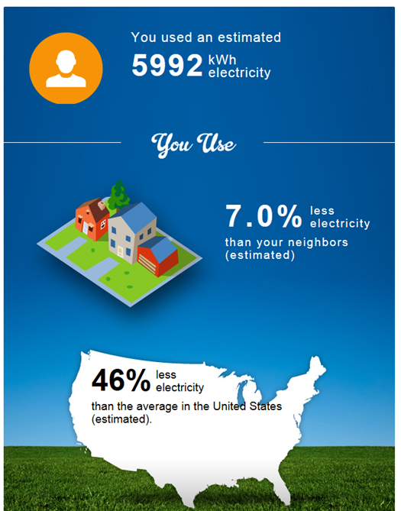
IDSM Process Evaluation General Findings – Positive Findings
Utility personnel / account reps have a good understanding of the concepts of IDSM.
Commercial and industrial customers are provided with information necessary to promote integrated projects.
Development of Online Integrated Energy Audit for Residential and Small Commercial.
The IOUs are leveraging smart meters to support identification of comprehensive demand side energy improvements in the residential sector.

Slide 8
D.09-09-047 IDSM Directives
Cost-effectiveness protocols for integrated projects and programs
Measurement and evaluation protocols for IDSM programs and projects;
IDSM enabling emerging technologies;
Standardized integrated audit tools;
Integration pilot programs
Report on IDSM progress;
Utility Reorg to support IDSM strategies
Integrated marketing campaigns

Slide 9
General Areas for Improvement
Integrated Pilots should be designed to test integration of DSM resources.
CPUC guidance needed to resolve conflicting costs, program goals, and incentives for different DSM Technologies.
Coordinate timing of EE, DR, and DG program cycles
Develop clear definition of IDSM.
Develop shared funding sources to promote integration
Streamline program application and participation processes.

Slide 10
PG&E Summary of Results
Account Executives are actively promoting integration
A widespread internal IDSM training program
Implementation of an online integrated residential audit tool.
Challenges continue with integrating marketing budgets to support IDSM.
Tracking of IDSM accomplishments are unsophisticated.

Slide 11
SCE Summary of Results
Account managers are actively promoting.
Implementation of an online integrated residential audit tool.
Implementation of a new data management system will improve the utility’s ability to track projects and integrated projects.
General knowledge of IDSM was good, but attitude that “there’s nothing new here,” particularly among the more experienced reps, could be refreshed, possibly with some new approaches or tools to delivering integrated program messaging
EE and DR are better integrated than either is with DG.

Slide 12
SDG&E Summary of Results
The Local Island Pilot Program.
SDG&E has implemented an online integrated residential audit tool.
Segment Advisors are responsible for being informed of all the DSM strategies.
Currently tracks EE, DR, and DG participation but has no means to easily track the integration of DSM at a site.
The top barriers include internal silos/communication (61%), budgets and funding (54%), and CPUC/regulatory policy (35%).

Slide 13
SCG Summary of Results
SCG and SCE have developed a good working relationship to make sure their low income customers benefit from natural gas and electricity low income programs.
SCG has developed relationships with water utilities to not only reduce use of water but also natural gas used to heat water.

Slide 14
Next Steps
The IOUs Included how they would address the IDSM Process Evaluation findings in their 2013 – 2014 IDSM Program Implementation Plan.
The CPUC clarified that the IOUs can utilized EE funding to support integration activities (D.12-11-015)
On October 6th the CPUC issued a new IDSM Order Instituting Rulemaking (OIR).
Energy Division is currently managing a more in-depth IDSM evaluation as part of the 2013-2014 Evaluation Roadmap.

Slide 15
IDSM Activities Summary
Summary Based on Quarterly Reporting by the IOUs, Q1 2012 through Q3 2014
Duplicate reporting not included
Self-Reported, Not Confirmed
IDSM Activities encompass a wide range of areas – not necessarily comparable in size and scope of effort
From research and development to customer education, rebates programs, etc.
Primary activity areas are
Marketing and Outreach
Support, Education, Audits
Less than half of each activity below includes all three DSM resources (EE DG and DR)
Support Education Audits Research
Rebates / Financial Small Commercial
Upstream/WE&T Institutional Government
Projects Low Income
Online Tools Behavioral
ZNE

Slide 16
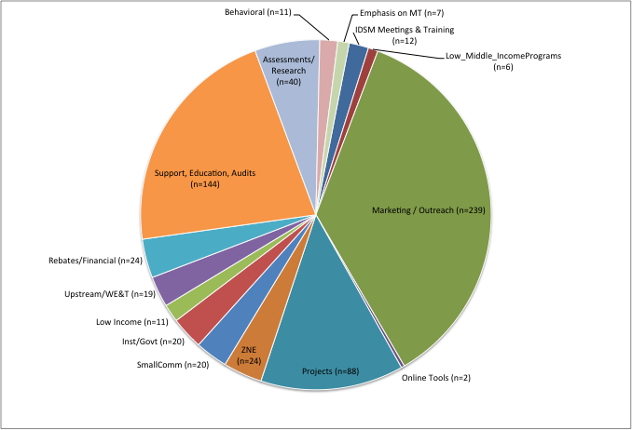
IDSM Activities Q1 2012- Q3 2014

Slide 17
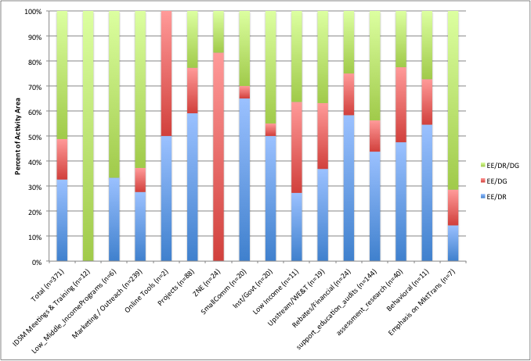
Integration Elements in Current IDSM Activities
Notes:
If information is complicated or takes time to find, customers will lose interest, and try Google instead.
when we want to present something more complicated – more choice, more measures, and/or more money invested, it is difficult to accomplish effectively without a one-on-one interaction. – But one-on-one is not a scalable solution for small commercial or residential segments.
The IOU marketing goal is to equip the customer with the tools and education to formulate an energy strategy that makes sense for their particular situation.

Slide 18
Smart meter decisions
Overview of Outcomes of Commission-Regulated Activities

Slide 19
Smart Meter Business Case Assumptions— PG&E (D. 09-03-026)
Approved application included $269 M in EE electric conservation benefits and $263 in DR benefits
Assumed 2- 21% of homes adopt devices, 2012-20
~6.5% electric conservation savings/home
Smart Meter-enable DR programs assumptions were:
2-way communication with LC Programmable Thermostats
New peak time rebate program
Current reported penetrations are very low*
<1% for Consumer devices
~ 5% of res consumers on Time Variant/ Dynamic Pricing tariff
38% have accessed energy use info; 2% enrolled in energy info programs
IDSM rulemaking: enhance use of AMI capabilities
*Oct 2014 PG&E Annual Report on Smart Grid Investments
http://www.cpuc.ca.gov/PUC/energy/smartgrid.htm
Notes:
Estimated EE incremental avoided costs included were: $479 million
Estimated DR incremental avoided costs included were: $446 million
60% of non res are on time variant/dynamic pricing.

Slide 20
Smart Meter Business Case Assumptions— SCE D. 05-12-001
Assumed $164 M in EE conservation benefits and $652 M in DR benefits (PVRR)
Depended on rapid growth in building integrated, handheld and PC- based graphic displays and PCT programs
“May integrate sales with other DR and EE programs…”
Current reported penetration levels are very low
0% penetration of customer devices
For res customers: 21 K and 390 K on TOU/PTR respectively
~14% have accessed interval usage data / enrolled in energy info programs
IDSM rulemaking: enhance use of AMI capabilities
*Oct 2014 SCE Annual Report on Smart Grid Investments
http://www.cpuc.ca.gov/PUC/energy/smartgrid.htm
Notes:
Building integrated
Building integrated graphic display (new and existing homes)
HANs reduce energy consumption by 6.5%
Assumes 10% of new homes have IHDs installed (new homes)
Assumes adoption rate starts at .5% and grows .5% annually (existing)
Handheld:
Assumes existing products modified to receive Zigbee signals
Assumes customers using these reduce energy consumption by 6.5%
“May integrate sales with other DR and EE programs”
PC Based Graphical Display
Assumes customers connect a PC to HAN to access real time information, which reduces customers energy consumption by 6.5%
Assumes Zigbeen radio device to link PC to HAN is $15, and is included in business case
Assume downloadable software from SCE, in addition to services from 3rd parties
Outreach to customer via integrated product marketing of ‘bundles’ targeted to customer personas
Assume a 1% penetration rate (2009) and a 1% growth rate/year
Like PG&E, assumed a PCT voluntary (new construction and retrofit) and Peak Time Rebate programs
PCT: Raise enrollment cap to 350,000, and assume a sign up rat3e of 70,000 customers per year
Assumed rebates offered:
2012: $125 PCT rebate, targeting 50% home builders and 50% retrofit companies
2012-2032, SCE assumes: starting in 2012, Title 24 will require customers of new construction and HVAC retrofits to install a HAN-enabled PCT; if there is no Title 24 requirement, SCE will provide a $50 rebate toward the PCT; penetration is 84% new homes and 50% retrofit companies.

