Slide 1
Overview of the FCC’s CAF II program
Build-Out Commitment over a 5 year period
  40% coverage in each state by end of 2017
  60% by 2018, 80% by 2019, 100% by 2020
  Need to be able to provide service within 10 days of order
  Minimum 10Mbps downstream & 1Mbps upstream
  170GB monthly usage required
In California, AT&T will use the CAF II support to offer high-speed Internet access to more than 141,000 homes and small businesses in the FCC-specified census blocks.
AT&T FWI service will support speeds of at least 10 Mbps download and 1 Mbps upload.
AT&T’s Fixed Wireless Internet is a service that uses a fixed-wireless “last mile” connection between the fiber at a cell tower and the customer premises to provide high-speed Internet access.

Slide 2
Majority of AT&T’s CAF II deployment is through Fixed Wireless Internet
Fixed Wireless Internet (FWI) is a service that uses a fixed-wireless “last mile” connection between the fiber at a cell tower and the customer premises to provide high-speed Internet access.
This service supports speeds of at least 10 Mbps download and 1 Mbps upload.
Customers will also have the ability to bundle DirecTV video services and/or AT&T postpaid wireless services seamlessly with AT&T Fixed Wireless Internet.
Current pricing is $50-$70/month depending on bundling. Lifeline discount available for eligible customers.
The service will require the installation of a small wireless antenna at the customer premise that will connect to a wireless router in the home.
Cell coverage expansion – concurrent with the FWI build, AT&T Mobility Coverage will be expanded in many areas.

Slide 3


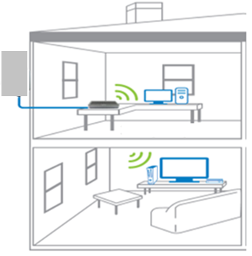

AT&T Fixed Wireless Internet℠ Overview
AT&T Wireless Network
Residential or Small Business Location
Fiber Backhaul from hundreds of rural towers to the AT&T Network and the Internet
AT&T cell site
“Square”
Outdoor Antenna
AT&T Fiber
Internet
Residential Gateway --
Wi-Fi Router
Core Network Radio Access Network Wireless/Spectrum Customer Premise
Note: Illustrative only and not to scale. While the expectation is most locations will be served via FWI, AT&T may serve required locations via other technologies

Slide 4
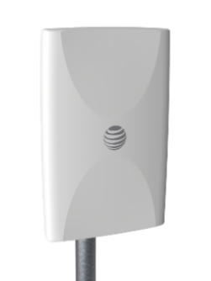



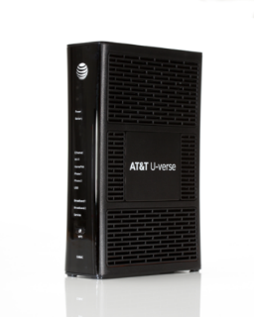

How does it work?
Outdoor Antenna
3 Antennae/ 4x4 MIMO
Satellite
Video
Outdoor
Antenna (OA)
Up to 4-6miles (RF dependent)
1
1
10x10MHz WCS Spectrum
2
1
2
Sectors
2
Remote Radio Head (RRH)
DTV STB
Shelter
Central Office
Wi-Fi
Dedicated
eNode B
10Mbps Down/1Mbps Up
Home
Rural
Cell Tower
Access
Core
Using LTE, Band 30 (WCS-2.3Ghz Spectrum)
Outdoor antenna connecting to wireless network
In-home experience just like any Internet service
Arris 5268AC
AT&T Proprietary (Restricted)
Only for use by authorized individuals or any above-designated team(s) within the AT&T companies and not for general distribution

Slide 5
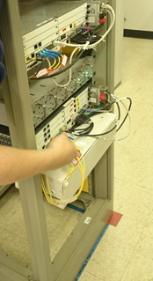
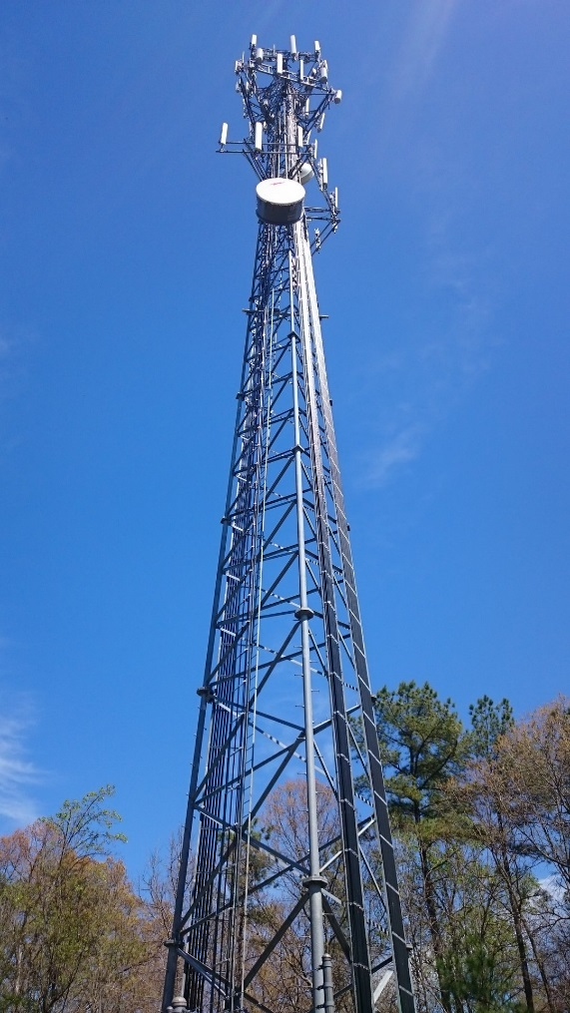
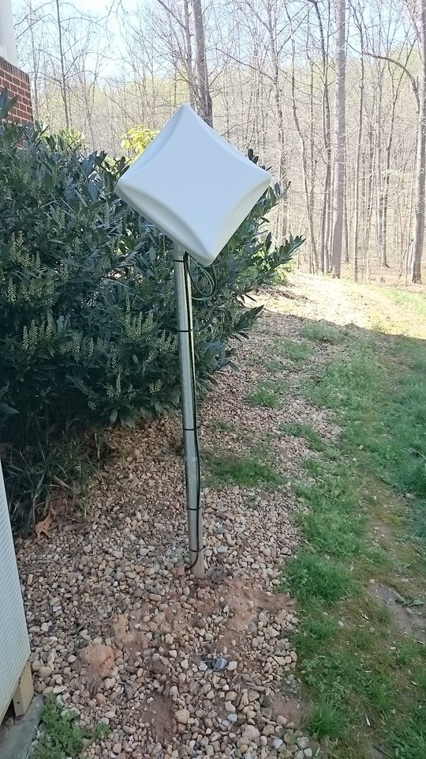
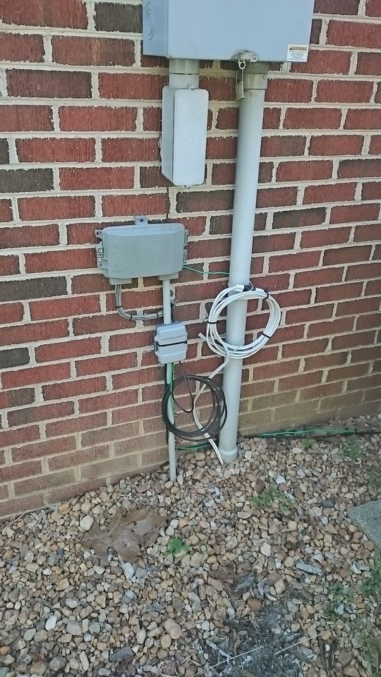
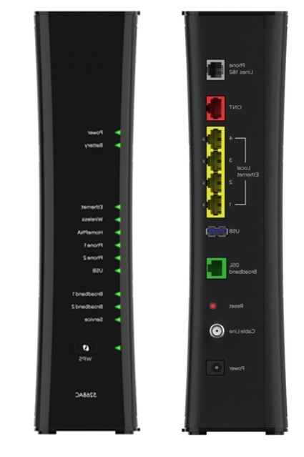
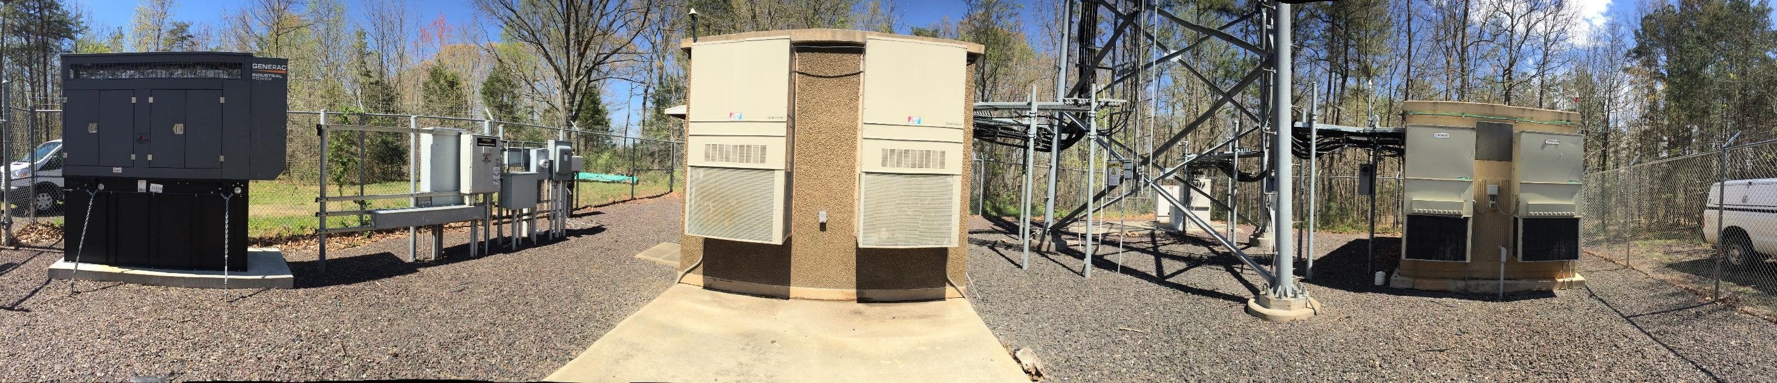
Cell Site Shelter Electronics
FWI Enabled Cell Tower
Antenna at
Customer Premise
Grounding and Power
Residential Wi-Fi Gateway
FWI Enabled Cell Site

Slide 6
CAF II Build Progress in California – EOY 2017
© 2017 AT&T Intellectual Property. All Rights reserved.

Slide 7
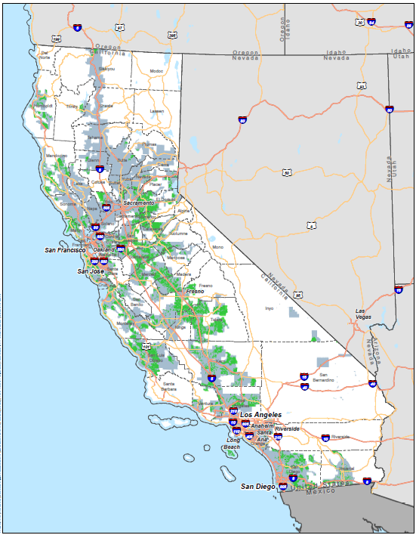
California:
Planned FWI Site Locations will be Broadly
Distributed Across AT&T’s
Rural Territory throughout California
Legend
AT&T Traditional Service Territory
CAFII Supported Area

Slide 8
AT&T CAF II Build Progress in California:
Locations Reached by CAF II Build as of EOY-2017
The majority of these living units are reached by fixed wireless technology
Initial build in 2017 focused on areas where FWI could be added to existing cell sites
Build in 2018 and beyond relies on new site builds and associated permitting
COUNTY | Locations
Alameda | 194
Amador | 1,009
Butte | 410
Calaveras | 1,125
Colusa | 220
Contra Costa | 902
El Dorado | 1,996
Fresno | 1,925
Glenn | 282
Humboldt | 1,325
Imperial | 243
Kern | 2,874
Kings | 435
Lake | 244
Los Angeles | 2,253
Madera | 889
Marin | 550
COUNTY | Locations
Mariposa | 373
Mendocino | 2,264
Merced | 1,881
Monterey | 5,951
Napa | 19
Nevada | 527
Orange | 93
Placer | 904
Riverside | 330
Sacramento | 1,043
San Benito | 118
San Bernardino | 675
San Diego | 9,288
San Francisco | 511
San Joaquin | 3,673
San Luis Obispo | 1,786
San Mateo | 519
COUNTY | Locations
Santa Clara | 1,206
Santa Cruz | 1,697
Shasta | 108
Sierra | 29
Siskiyou | 5
Solano | 355
Sonoma | 883
Stanislaus | 5,188
Sutter | 656
Tehama | 271
Tulare | 2,591
Tuolumne | 762
Ventura | 111
Yolo | 662
Yuba | 535
Grand Total | 61,917
© 2017 AT&T Intellectual Property. All Rights reserved.

Slide 9
San Diego
ALPINE | 731
BONSALL | 209
BORREGO SPRINGS | 240
BOULEVARD | 518
CAMPO | 488
CHLA VSTA | 1
DEL MAR | 2
DESCANSO | 191
DESCNSO | 1
DULZURA | 141
EL CAJON | 58
ENCINITAS | 2
ESCONDIDO | 514
FALLBROOK | 240
JACUMBA | 127
JAMUL | 186
JULIAN | 463
LAKESIDE | 201
MOUNT LAGUNA | 74
OCEANSIDE | 3
PALA | 215
PALOMAR MTN | 2
PAUMA VALLEY | 378
PINE VALLEY | 77
POTRERO | 2
POWAY | 16
RAMONA | 973
RANCHITA | 139
RANCHO SANTA FE | 466
SAN DIEGO | 406
SAN MARCOS | 2
SANTA YSABEL | 174
SPRING VALLEY | 4
VALLEY CENTER | 1448
VISTA | 23
WARNER SPRINGS | 573
San Diego Total | 9288
Imperial
CALIPATRIA | 11
EL CENTRO | 10
NILAND | 88
OCOTILLO | 134
Imperial Total | 243
Riverside
COR | 1
CORONA | 239
EASTVALE | 41
JURUPA VALLEY | 1
RIVERSIDE | 48
Riverside Total | 330
San Bernardino
BLOOMINGTON | 41
COLTON | 594
FONTANA | 19
HIGHLAND | 17
RIALTO | 4
San Bernardino Total | 675

Slide 10
To determine eligibility, interested consumers living in the counties listed here may call toll-free
1-877-990-0041 or visit the following url for more information:
https://www.att.com/internet/fixed-wireless.html

