Slide 1

CALIFORNIA ADVANCED SERVICES FUND
Infrastructure Account Workshop
July 25th, 9:30am – 4:00pm
Sacramento, California EPA
1001 I St, Sierra Hearing Room

Slide 2
Presentation Agenda
9:30 | Welcome and Introductions – Commissioner Guzman Aceves
10:00 | Eligibility and Challenges – Rob Wullenjohn, Program Manager
10:45 | Funding Criteria Determination- Tom Glegola, Supervisor
11:30 | Community Prioritization – Caleb Jones, Analyst
12:15 | Lunch
1:30 | CASF and the Connect America Fund – Rob Osborn, Senior Analyst
2:15 | Middle-Mile Infrastructure – Clover Sellden, Senior Analyst
2:45 | Line-Extension Program – Tom Glegola, Supervisor
3:30 | Summarizing Discussion and Next Steps – Commissioner Guzman Aceves
4:00 | Adjourn
Remote Participation Options Livestream Available At: https://video.calepa.ca.gov/ Listen Only: 887.692.8578 Participant Code: 7035345

Slide 3
CASF Program Eligibility and
“What should be the definition of a served Census Block”
Robert Wullenjohn
Manager; Broadband, Video and Market Branch
Communications Division, CPUC

Slide 4
CASF Program Eligibility Implementation Needs
Applicants want a definitive map that indicates what census blocks are program eligible (unserved)
Staff wants definitive criteria and objective measures so that applications can be reviewed expeditiously
Current served census block definition: A census block area is identified as presumptively served if a provider reports availability at least 6 Mbps downstream and 1 Mbps upstream and there are subscriptions reported in the block, and/or for Fixed-wireless, tower propagation shows service availability

Slide 5
Problem 1: Applicants Use the Wireline Availability Map to Determine Eligibility
Challenge process is relied upon to correct the presumptions depicted on the availability map
Challenges increase costs to parties
Challenge process requires consideration of testing and validating, which causes further delays

Slide 6
Problem 2: The Map May Be Overstating Served Status
Many census blocks have very low subscriptions relative to households in the block, which implies that service isn’t available to all households or more households would be subscribing.
Example: Fixed-Wireless Only Census Blocks
Statewide Fixed-broadband Census Blocks
262,497 Households
64,981 Consumer Connections
25% adoption rate
$41k median income
13,020,413 Households
10,867,355 Consumer connections
84% adoption rate
$67k median income

Slide 7
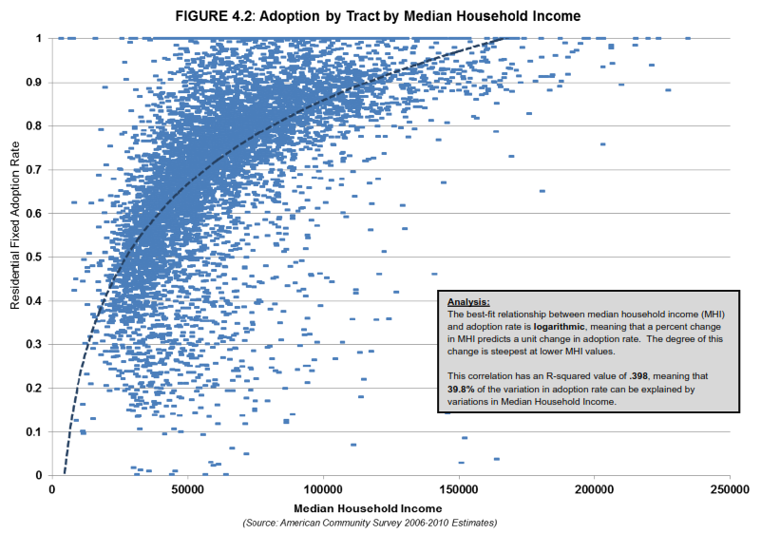
Is low subscription evidence of lack of availability throughout the census block?
Availability is a predicate to adoption
Income is related to adoption (lower in rural areas)
Price of service affects adoption (higher per bit in rural areas)
If broadband were ubiquitously available in rural census blocks, what would we expect the adoption rate to be?

Slide 8
Why is this a problem?
Example: Fixed-wireless uniquely covers large areas that do not have alternative wireline service available (See maps)
Given the low-subscription rate, considering these areas as served likely overstates fixed-wireless availability thereby understating areas in need of broadband (See Consortia table)
Therefore, large areas remain CASF ineligible (most of California is served according to definitions)

Slide 9
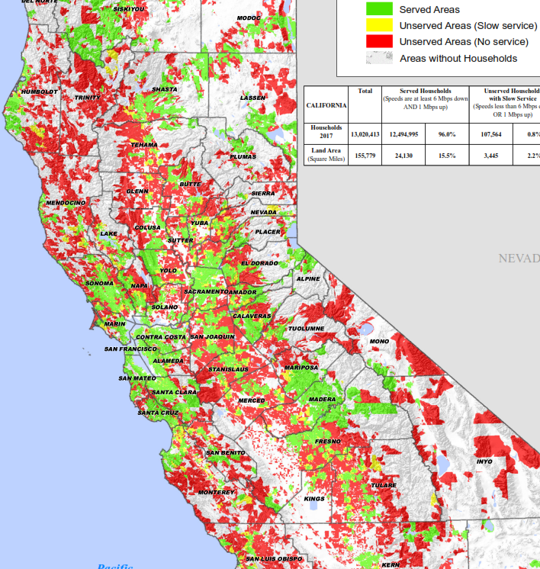
Wireline Broadband Served Areas in California

Slide 10
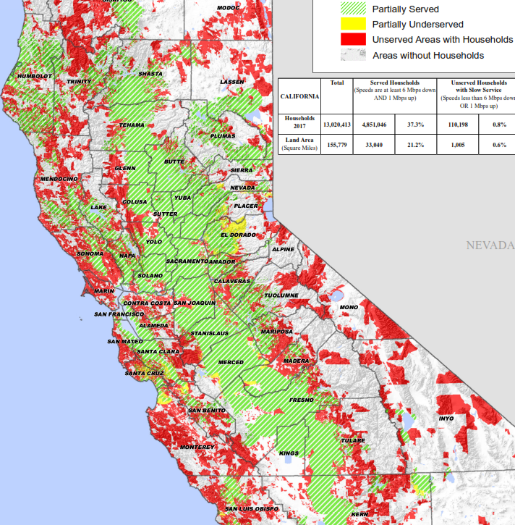
Fixed-Wireless Broadband Served Areas Cover Large Areas

Slide 11
Broadband Availability Changes with Consideration of Fixed-Wireless
Where Speeds Are At Least 6 Mbps downstream and 1 Mbps Upstream | Wireline Served Households | Total Fixed Served Households
Consortium
Bay Area (no consortium: SF, San Mateo and Santa Clara) | 98.4% | 99.8%
Broadband Consortium of the Pacific Coast | 95.6% | 96.5%
Central Coast Broadband Consortium | 91.2% | 93.2%
Central Sierra Connect Consortium | 77.9% | 95.1%
Connected Capital Area BB Consortium | 96.9% | 99.8%
East Bay Broadband Consortium | 98.5% | 99.4%
Eastern Sierra Connect Regional Broadband Consortium | 81.7% | 85.5%
Gold Country BB Consortium | 84.4% | 98.4%
• Tahoe Basin Project | 93.1% | 93.7%
Inyo / Mono Broadband Consortium | 72.7% | 75.1%
Inland Empire Regional BB Consortium | 96.0% | 96.3%
Los Angeles County Regional Broadband Consortium | 98.8% | 98.9%
North Bay / North Coast Broadband Consortium | 94.1% | 96.4%
Northeast California Connect Consortium | 82.5% | 97.2%
Orange County (no consortium) | 96.4% | 96.5%
Redwood Coast Connect Consortium | 77.0% | 94.6%
San Joaquin Valley Regional Broadband Consortium | 92.5% | 98.9%
Southern Border Broadband Consortium | 96.1% | 96.7%
Upstate California Connect Consortium | 80.9% | 95.9%

Slide 12
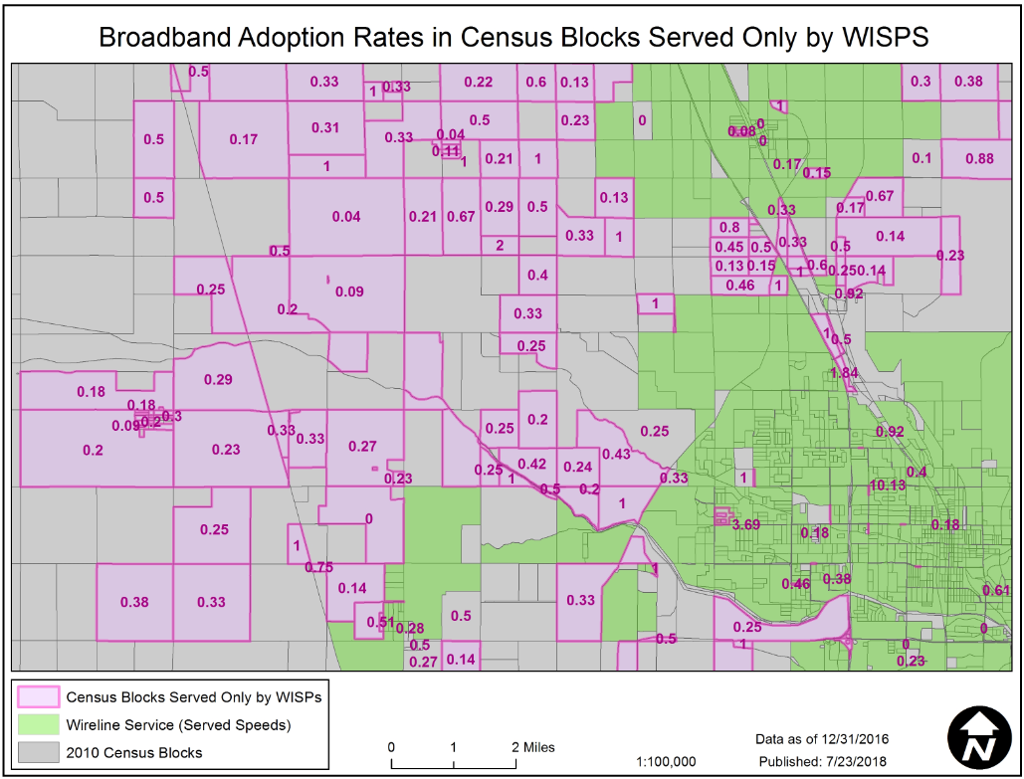
Example of How Low the Subscription Rate Is Relative to Claimed Served Areas Having Assumed Ubiquitous Availability
Grey and Purple are claimed fixed-wireless served areas
Purple areas denote having subscribers and rate of subscription

Slide 13
Solution Affecting All Technologies?
Establish a single eligibility map incorporating fixed-technologies and reduce challenge opportunities
Revise served census block definition to reduce overstatement of availability: A census block area is identified as presumptively served if a provider reports availability at least 6 Mbps downstream and 1 Mbps upstream and there are substantial subscriptions reported in the block (> 40% adoption rate) and/or for Fixed-wireless, tower propagation shows service availability

Slide 14
Funding Criteria Determination
Tom Glegola, Supervisor

Slide 15
Funding Criteria Res T-17613 & T-17614
Criteria | Lytle Creek | Desert Shores
Baseline Funding – 60% All CASF-eligible projects receive 60% funding, maintaining continuity with previous rules (D. 14-02-018 and T-17443). | 60% Funding | 60% Funding
Service Level Preference – 10% CASF projects in areas with only dial-up or no Internet service must receive preference, per Section 281(b)(2)(B)(i); this is consistent with previous rules. | 0% Funding Mobile service. | 0% Funding Mobile service.
Location and Accessibility – 10% As per Section 281(f)(13), “The Commission shall… consider… the location and accessibility of the area.” | 10% Funding Located in a canyon inside a National Forest | 10% Funding Located in the Sonoran Desert, far from cities.
Existing Infrastructure – 10% As per Section 281(f)(13), “The Commission shall… consider… the existence of communication facilities that may be upgraded to deploy broadband.” | 10% Funding Will use existing infrastructure. | 10% Funding Will use existing infrastructure.
Significant Contribution – 10% As per Section 281(f)(13), “The Commission shall… consider… whether the project makes a significant contribution to achievement of the program goal.” | 0% Funding Not on High-Impact or High-Priority lists. | 10% Funding On High-Impact and High Priority lists.
Total – 100% Available | 80% Funding | 90% Funding

Slide 16
Frontier Proposed Criteria
Lack of Existing Service
Uses Existing Facilities
Geographic Location
Public Health Benefits
No Business Case
Public Safety Benefits
No Federal Funding
Improved Fire Safety
Low-Income

Slide 17
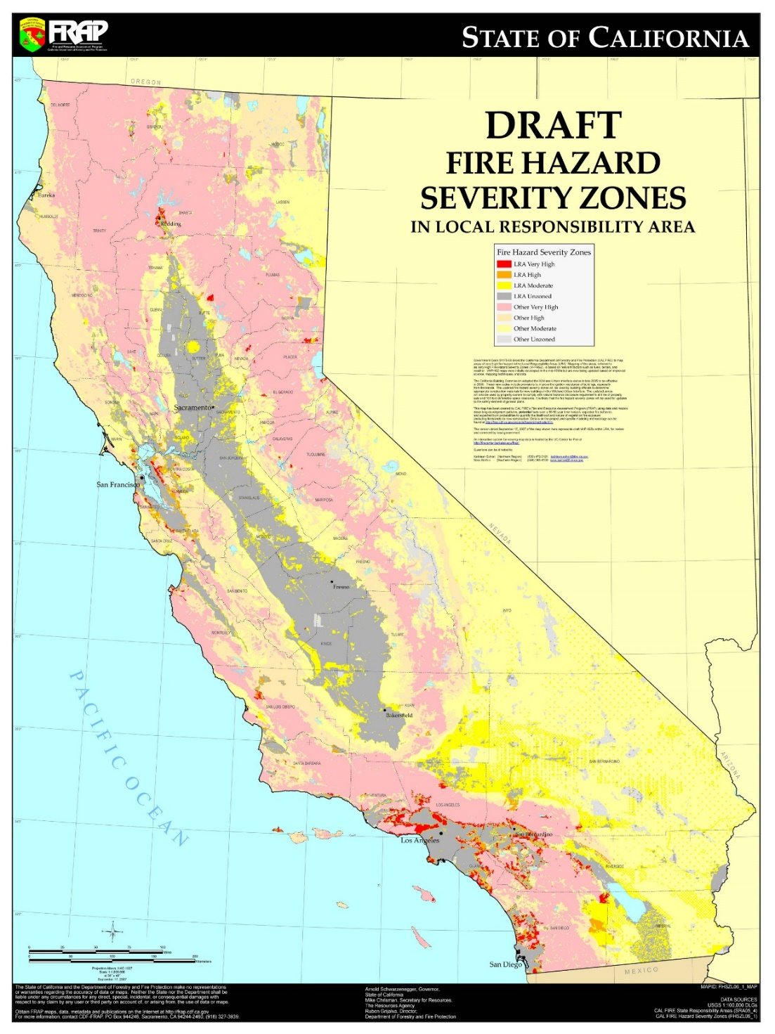

Slide 18
Potential Funding Criteria
Criteria | Percent
Baseline – Eligible | 60%
Service Level Preference | ?
Location and Accessibility | ?
Existing Infrastructure | ?
Significant Contribution – Appears on a Priority List? > 500 HHs? | ?
Others – Low-Income? Higher Speeds? | ?

Slide 19
Community Prioritization
Caleb Jones, Analyst

Slide 20
The Current System
Eligible Projects
Scoring Criteria
  Funds/Customer: 35
  Speed: 20
  Financial Viability: 15
  Pricing: 10
  Households: 5
  Timeliness: 5
  Guaranteed Pricing: 5
  Low-income Areas: 5
Interim Funding Criteria
  Eligible Projects: 60%
  Dial-up Only: 10%
  Uses Existing Infrastructure:10%
  Inaccessible Location: 10%
  Makes Significant Contribution: 10%

Slide 21
Staff Proposals
Provide Expedited Review to low-cost projects in priority-areas.
Provide additional funding to priority areas.
Increase the significance of low-income areas served in the scoring criteria, at the expense of speed.

Slide 22
Which Communities to Prioritize
Which census blocks, census tracts or communities should be considered priorities?
  Which criteria should be used for determining priority-communities? If so, how should those criteria be defined?
  Are there processes for determining priority-areas that you would like to suggest? How does it compare to the methods used by the Commission in Resolutions T-17443 (June 26, 2014) and Staff’s High Impact Analysis (May 25, 2017)?
  Are there specific communities you would like to suggest?

Slide 23
How to Serve Priority Communities
How should the Commission treat priority areas?
  Should these priority areas be eligible for expedited review?
    If so, what should the maximum costs/household be for expedited review?
    Should priority-communities need to be low-income? If not, should priority-communities need to be low-income to receive expedited review?
  Should these priority areas receive higher funding levels?
    Should this be the basis for determining which projects make a “significant contribution?”
    How much funding should priority-communities receive?
  Should priority areas receive more points in the scoring criteria?

Slide 24
CASF and the Connect America Fund
Rob Osborn, Senior Analyst

Slide 25
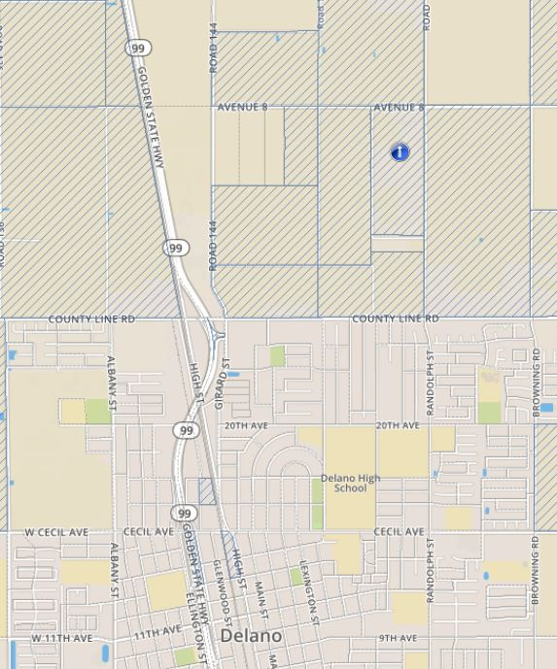
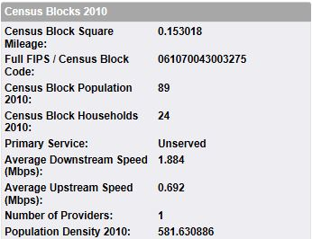
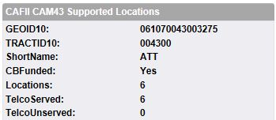
Q: What would it take for AT&T to provide CAF II-level service to all 24 households?
6 CAF II eligible locations in this
census block

Slide 26
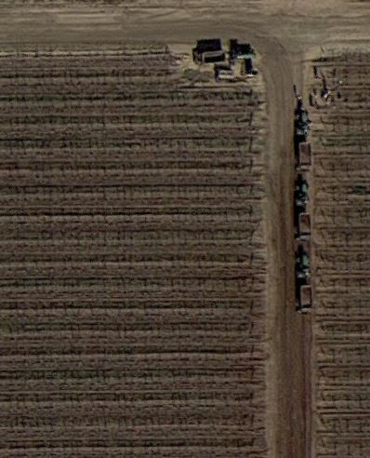
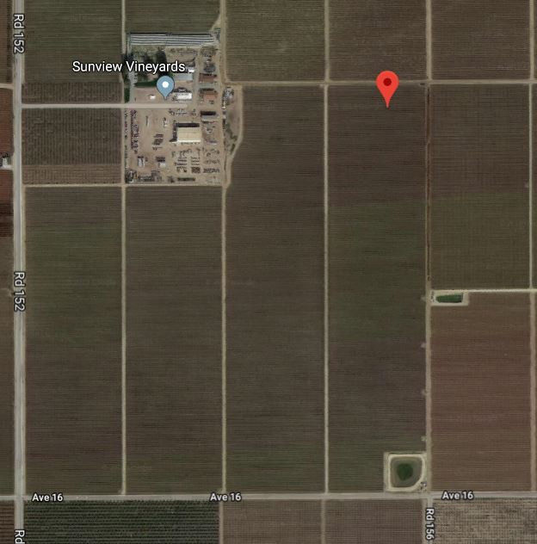
Satellite View

Slide 27
Relevant CAF II language (AB 1665)
(C) (i) Except as provided in clause (ii), until July 1, 2020, the project is not located in a census block where an existing facility-based broadband provider has accepted federal funds for broadband deployment from Phase II of the Connect America Fund, unless the existing facility-based broadband provider has notified the commission before July 1, 2020, that it has completed its Connect America Fund deployment in the census block.
(ii) An existing facility-based broadband provider is eligible for a grant pursuant to this subdivision to supplement a grant pursuant to Phase II of the Connect America Fund to expand broadband service within identified census blocks, as needed.
(12) A grant from the Broadband Infrastructure Grant Account shall not include funding for costs of broadband infrastructure already funded by the Connect America Fund program or other similar federal public program that funds that infrastructure. This paragraph does not apply to funding from the federal high-cost support programs that support operations, including High Cost Loop Support (HCLS), Connect America Fund-Broadband Loop Support (CAF-BLS), or the Alternative Connect America Cost Model (A-CAM).

Slide 28
Middle-Mile Infrastructure
Clover Sellden, Senior Analyst

Slide 29
Middle-Mile Infrastructure
From PU Code Section 281 (f)(5)(B)
  All or a significant portion of the project deploys last-mile infrastructure to provide service to unserved households. Projects that only deploy middle-mile infrastructure are not eligible for grant funding. For a project that includes funding for middle-mile infrastructure, the commission shall verify that the proposed middle-mile infrastructure is indispensable for accessing the last-mile infrastructure.

Slide 30
Middle-Mile Infrastructure
How do we determine if building Middle-Mile infrastructure is indispensable in a project/proposal?
Under what circumstances does a project absolutely need to build Middle-Mile infrastructure?

Slide 31
Line Extension Program
Tom Glegola, Supervisor

Slide 32
Questions
What costs should be covered?
Limits based on cost or length of extension?
Components of a fixed wireless extension?
Can an ISP apply on behalf of property owner?

Slide 33
Summarizing the Discussion and Next Steps
Commissioner Guzman Aceves

