Slide 1

Chemehuevi Indian Tribe
Energy Savings Assistance Program
Project Summary
November 22, 2016

Slide 2
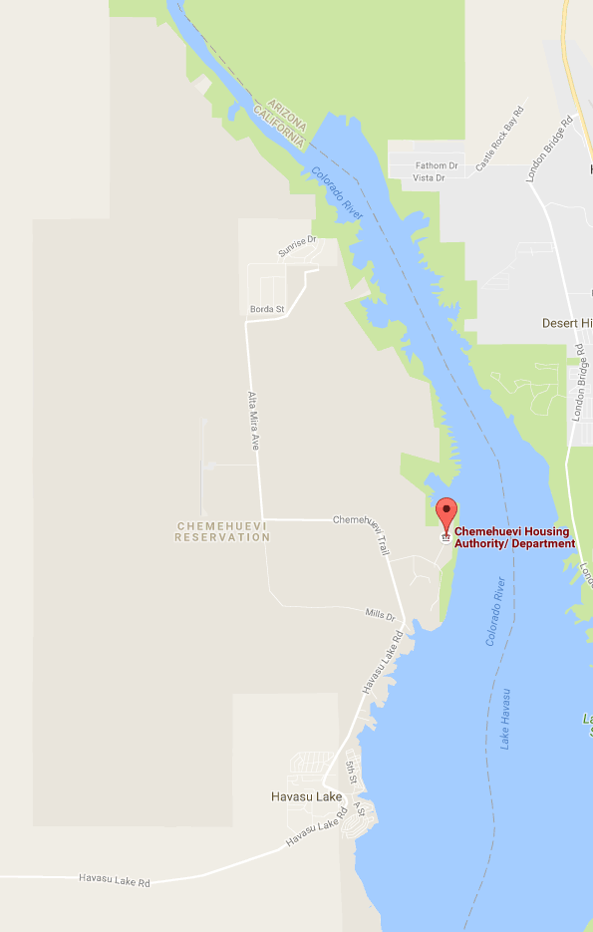
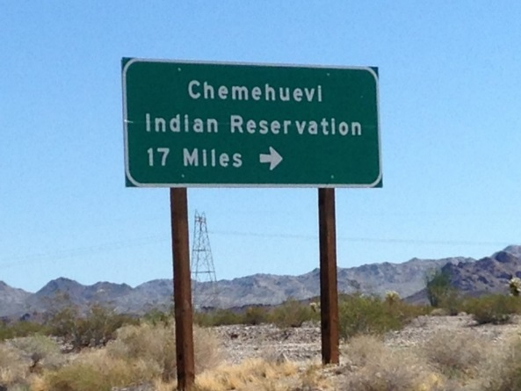
Chemehuevi Indian Tribe
The Chemehuevi Indian Reservation was established by an Executive Order in 1970
The Reservation is located on the shores of Lake Havasu, in southeastern California on the Arizona border
25 miles of the 35,000 acre reservation runs along the Colorado River

Slide 3
Background
Low customer participation in the Energy Savings Assistance (ESA) Program
Members of the tribe had negative experiences from other assistance programs when they did not receive promised services
Only four SCE customer referrals (two CARE High Usage leads and two SCE referrals) for an area more than 200 miles away
Contractor had questions when qualifying customers from this tribe:
  Chemehuevi Housing Authority Department used different income guidelines
  Property ownership did not meet ESA Program guidelines
  Property addresses on reservation did not match SCE service address

Slide 4
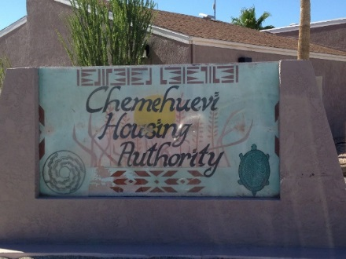

Opportunity to Serve
Coordinated through SCE’s Local Public Affairs representative for Tribal Nations
Meeting on July 24, 2015 brought together Southern California Edison, Chemehuevi Housing Authority Department (CHD)
On July 25, 2015, Tribal Council formally approved SCE’s request to offer the ESA Program
Discussions centered on gaining the trust of tribal members by showcasing the benefits of the ESA Program and outlining a comprehensive approach in the installation of energy efficient measures

Slide 5




Strategic Planning
Project Scope
  Promote the ESA Program and generate member interest
  Enroll all interested members
  Develop and implement a comprehensive logistical plan
Installation Plan
  Focus on units (homes) owned and managed by Chemehuevi Housing Authority Department, but continued to offer ESA to all residents of the reservation
  Replace and install HVACs, evaporative coolers, refrigerators, compact fluorescent lamps (CFLs), advanced power strips and provide energy education
Not Actual Model. Reference Images Only.

Slide 6
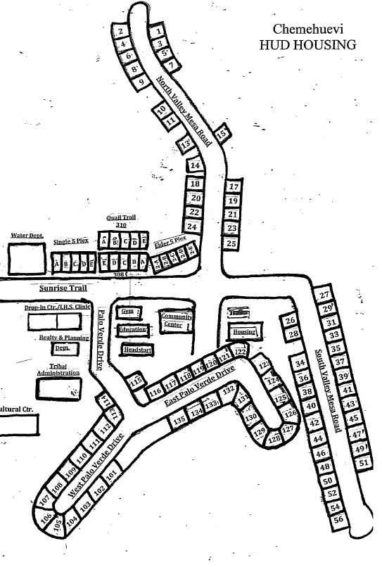

Project Preparation
Brief CHD and ESA Contractors on the Project Scope and Installation Plan
Promote the ESA Program through local efforts, including flyers, and word-of-mouth
  Sponsored CHD open house to encourage members to enroll
  Interested members were coordinated between CHD and ESA Contractor
Coordinate all efforts around the installation of the HVAC equipment
Schedule “trial-run” of the installation of all measures in two homes

Slide 7
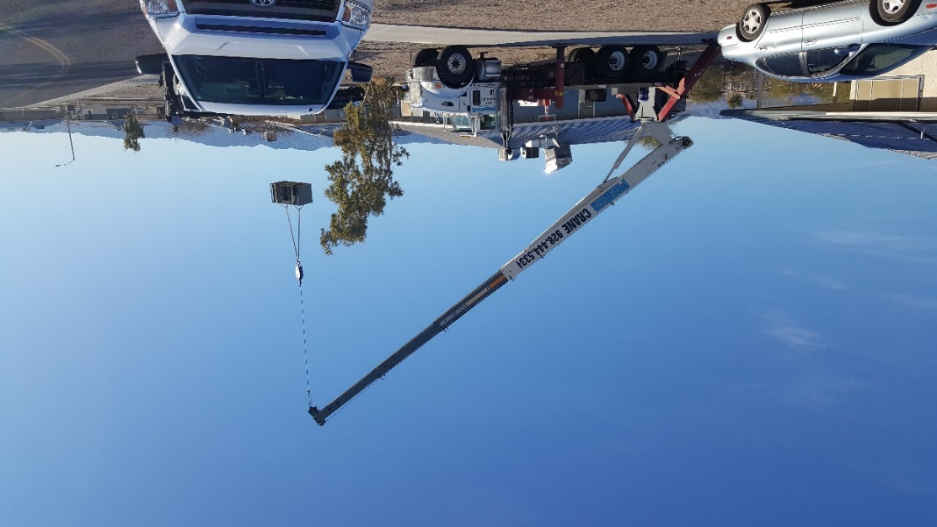
Trial-Run for HVAC Installation
Hired local crane provider for the installation project
Identified adjacent homes of eligible residents
  Reduced crane travel time between jobs
  Increased installation productivity.

Slide 8
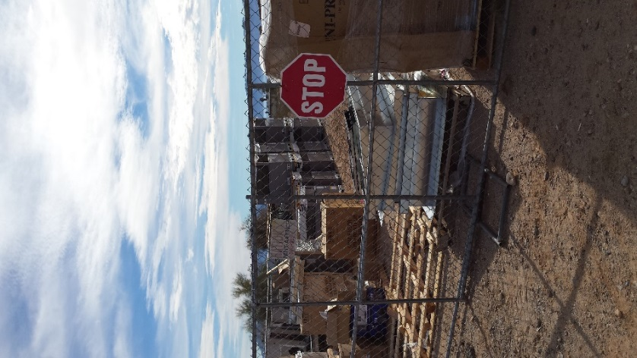
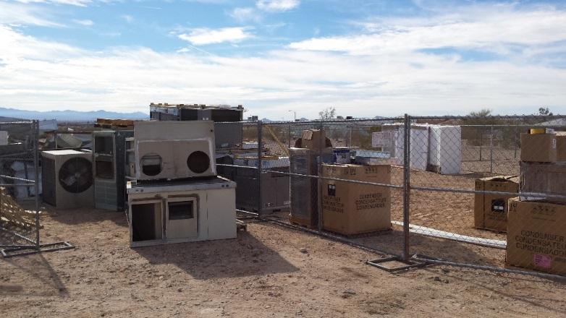
Implementation
Appointments for enrollments, installations, and inspections were scheduled in phases one week at a time
Delivery of equipment was methodically planned
  Smaller equipment such as refrigerators and evaporative coolers were brought to the reservation by the Contractor’s installation crews
  HVAC units were delivered directly by the vendor to the reservation who coordinated with CHD for a secure storage area
Old, inefficient equipment was recycled
  Units were delivered at the secure area and recycled by the installation crew

Slide 9
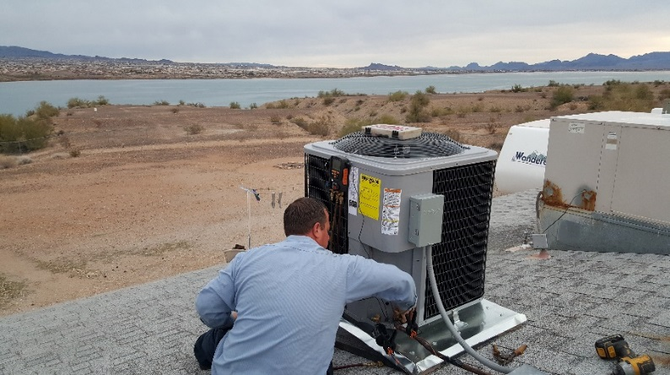
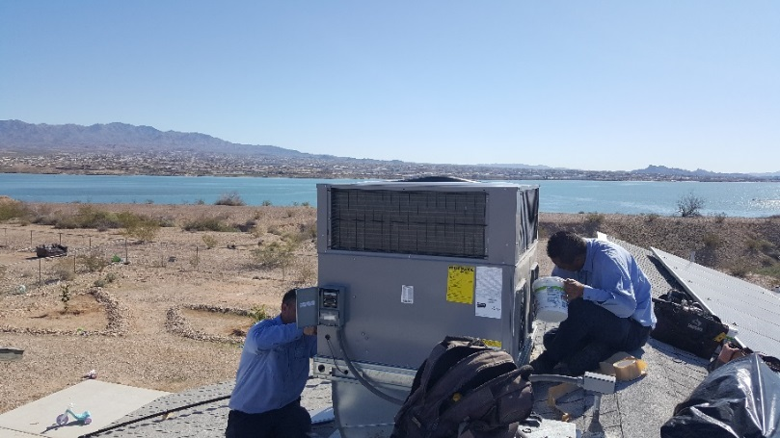
Permits and Inspections
Chemehuevi Tribal Nation did not require building permits
  CHD maintenance crew conducted inspections during and after installations assuring that the systems were installed and functioning properly
Home Energy Rating System (HERS) testing and verification was completed on each HVAC installation
  All HVAC installations complied with Title 24 standards
SCE selected all HVAC installations for inspection

Slide 10
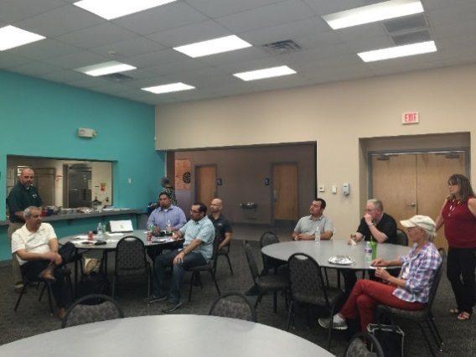
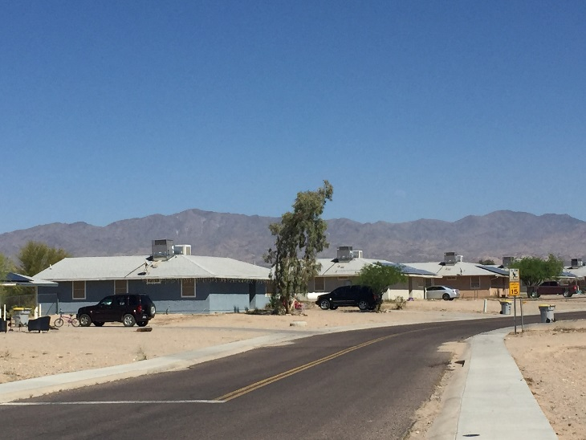
Town Hall Meeting
ESA Program team presented results on March 17, 2016
Received positive feedback from the community on the overall program, measures offered, and quality of installation
Project Team toured the completed homes

Slide 11
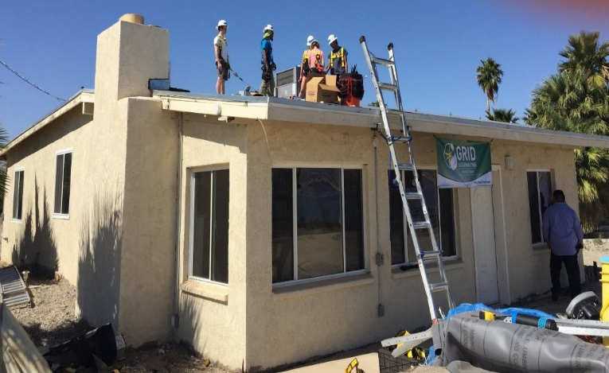
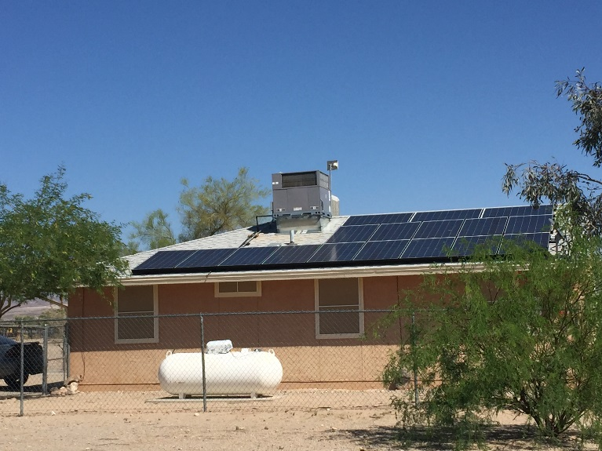
Results
Installation work was completed in multiple phases between January and July 2016
  93 tribal members qualified and participated in the Program
  87% of CHD’s units were included in the project
Project yielded over 69,800 kWh and 20 kW
The Chemehuevi is the first tribal nation to have solar panels on members’ homes
  During the summer, welcomed interns from Duke University who installed panels with GRID Alternatives

Slide 12
Results
Service | Quantity
CFL* | 370
Central AC | 2
Central Heat Pump | 57
Evaporative Cooler | 14
Outdoor Fixture | 1
Refrigerator | 13
Smart Power Strip | 72
Torchiere | 3
Weatherization** | 2
*An average of 5 CFLs were provided to each customer
**Refers to number of homes weatherized. Weatherization measures included weather-stripping, Outlet Cover Plate Gaskets, Faucet Aerators, Water Heater Pipe Wrap

Slide 13
Next Steps
Coordinate with SCE Local Public Affairs to identify opportunities to serve other Indian tribes:
Use lessons learned from Chemehuevi project as a model for serving other remote and hard to reach communities
Agua Caliente Band of Cahuilla Indians | Benton Paiute Tribe
Bishop Paiute Tribe | Bridgeport Paiute Indian Colony
Colorado River Indian Tribes | Death Valley Timbisha Shoshone Tribe
Morongo Band of Mission Indians | Pechanga Band of Luiseno Indians
San Manuel Band of Mission Indians | Soboba Band of Luiseno Indians
Tule River Indian Tribe | Twenty-Nine Palms Band of Mission Indians

Slide 14
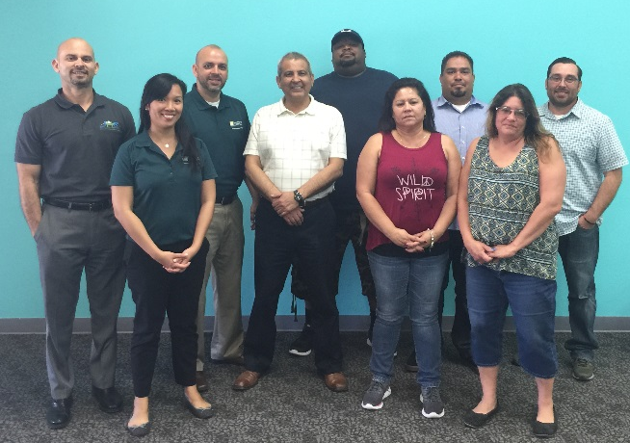
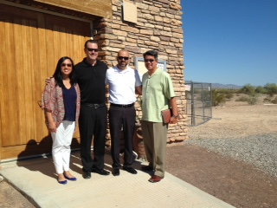
Project Team
Chemehuevi Indian Tribe
  Housing Authority Department
Contractors
  John Harrison Contracting (Installation)
  Richard Heath and Associates (Inspection
Southern California Edison
  Local Public Affairs
  ESA Program Management

