Slide 1
LIOB Presentations - Residential Rate Reform Marketing, Education & Outreach
February 23, 2016
Caroline A. Winn
Chief Energy Delivery Officer
© 2016 San Diego Gas & Electric Company. All copyright and trademark rights reserved.

Slide 2
SDG&E’s Interactive Customer Experience
2
Notes:
Click on center image to move to slide 6

Slide 3
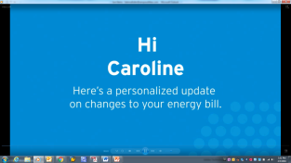
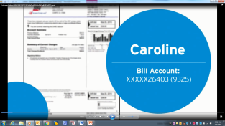
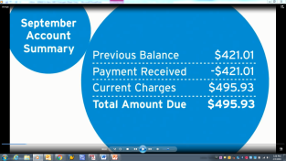
Video Bill Customers have said….
“It was a great way to simplify a lot of information so that it was easily understood. Great job!”
“Innovative way to connect with and educate customers”
“It was different and exciting to see something new”
“I liked the video because it made it easier to understand my bill, unlike trying to figure it out on my own”
3
Notes:
Click on center image to move to slide 6

Slide 4
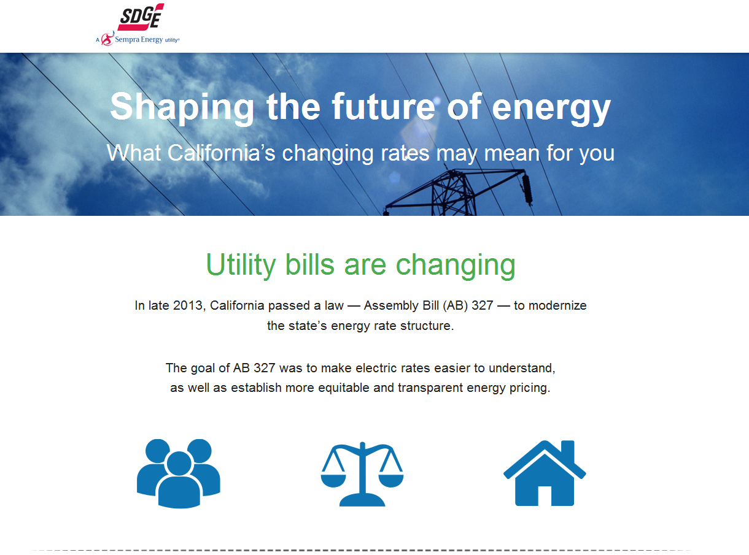
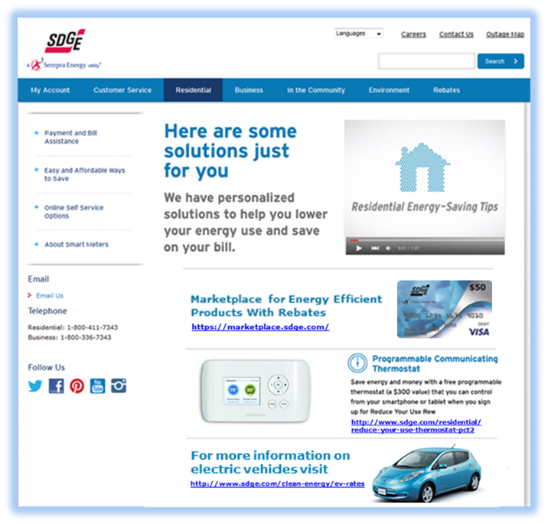
Microsite
Coming soon
3 Easy Steps
Go to sdge.com\ratereform
Answer a few short questions
Information tailored just for you!
4
Notes:
Click on center image to move to slide 6

Slide 5
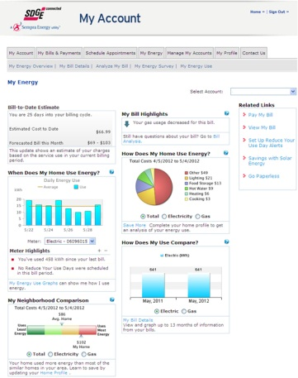
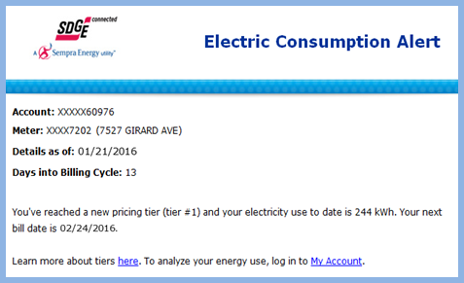
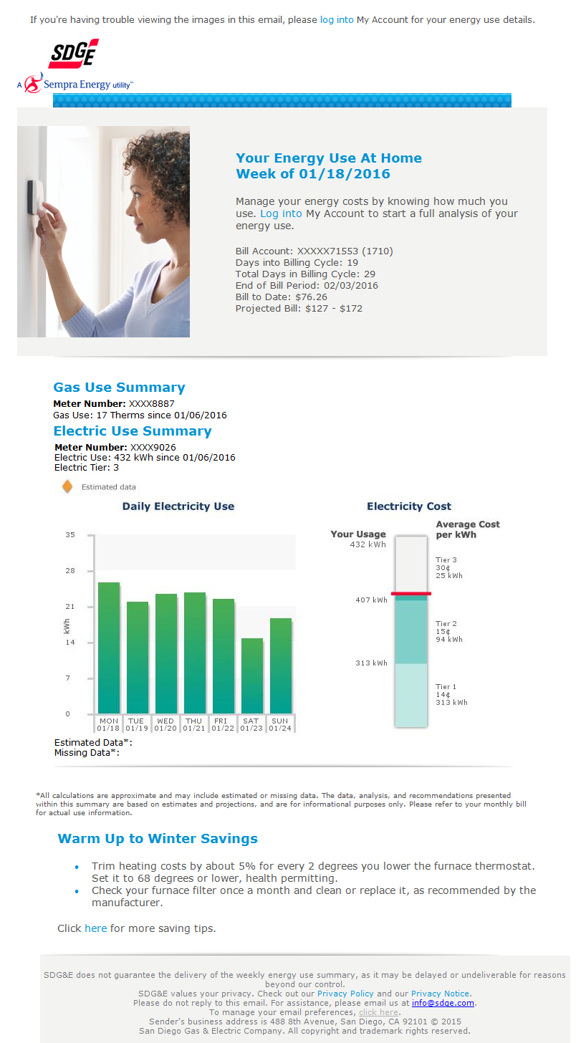
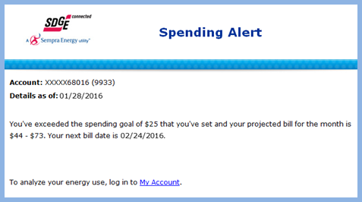
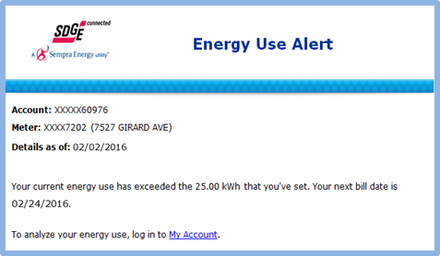
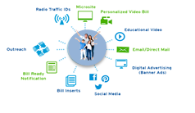
My Account: My Energy; Goals & Alerts
5
Notes:
Click on center image to move to slide 6

Slide 6
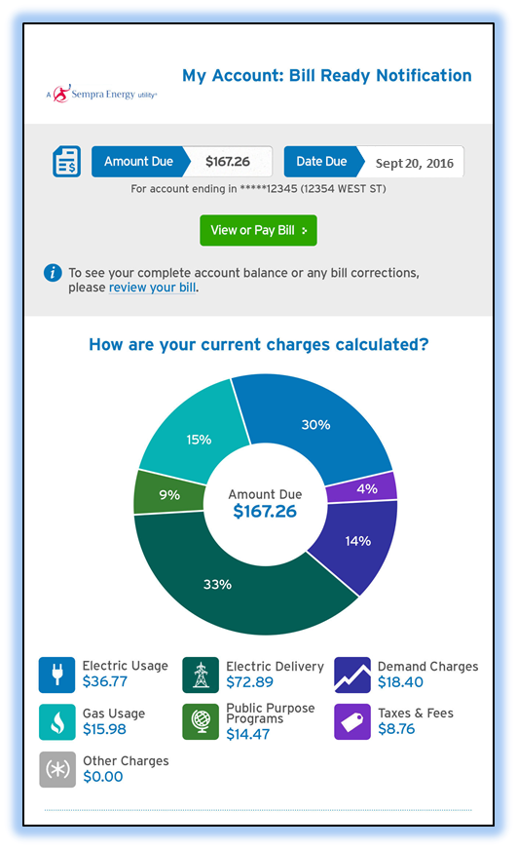
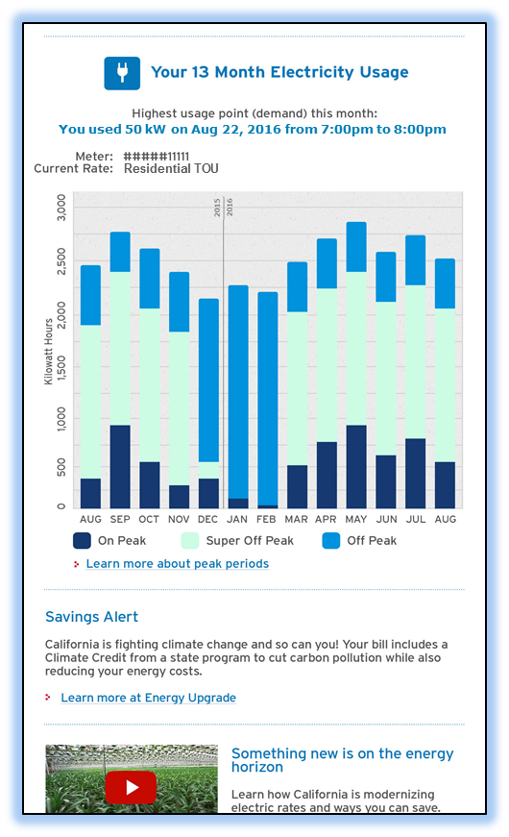
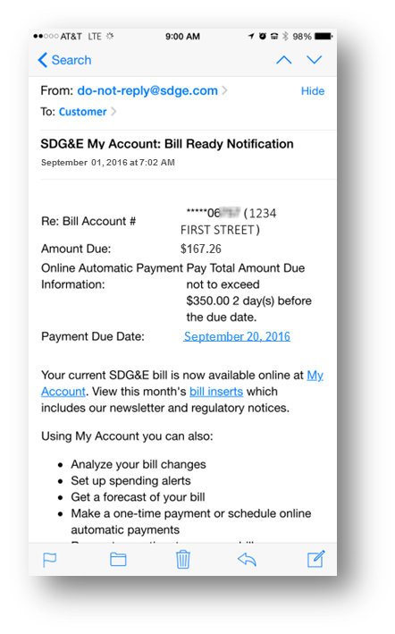
Bill Ready Notification
Before
Coming this month!
6
Notes:
Click on center image to move to slide 6

Slide 7
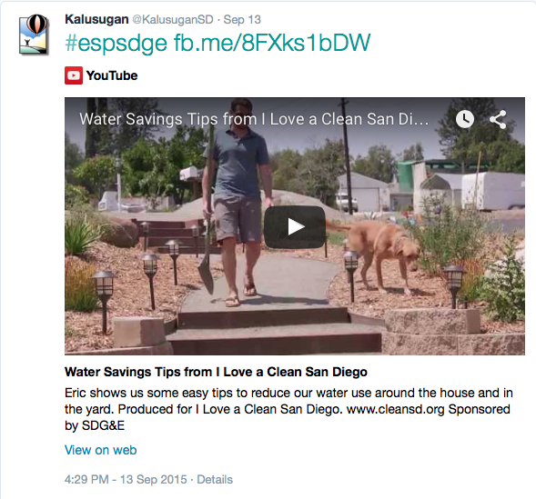
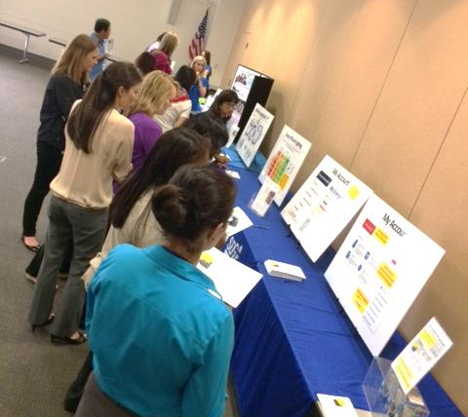
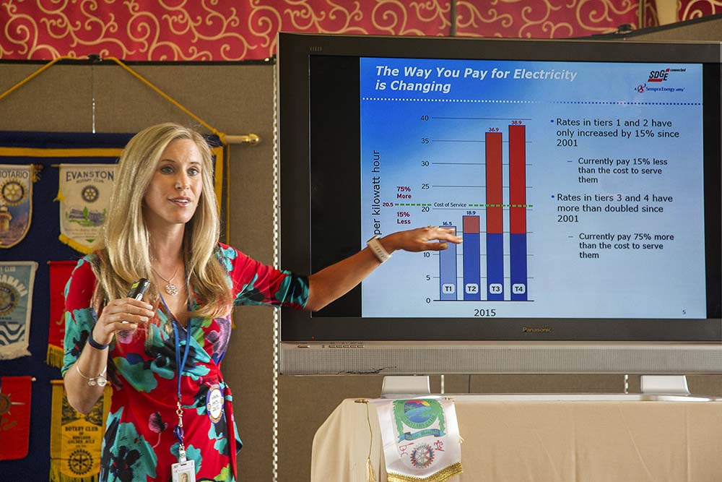
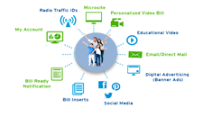
Community Outreach & Engagement
Engagement Results … just a few
285 community partners – Energy Solutions Partner Network -- directly engaging customers in rate education & solutions
Nearly 3,000 activities including events, presentations and solutions messaging through online and social media channels
Over 1,000 energy saving solutions messages reaching 2,000,000+ potential viewers
16 Customer Solutions tailgate events at SDG&E Branch Office locations
7
Notes:
Click on center image to move to slide 6

Slide 8
Thank You

