Slide 1
SoCalGas CARE Program
CARE Enrollment, Penetration and Expenditures
Year | Customers Enrolled | Estimated Eligible Customers | Penetration Rate | Expenditures | % of Authorized | Discounts
2016 – YTD July 31* | 1,571,892 | 1,907,892 | 82.39% | $62,031,578 | 72.37% | $57,947,180
2015 Year-End | 1,556,906 | 1,899,820 | 81.95% | $109,296,227 | 74.00% | $102,281,402
2014 Year-End | 1,568,011 | 1,898,302 | 82.60% | $117,510,411 | 80.00% | $109,488,808
Note: *Pursuant to D.15-12-024 and D16-06-018, budgets have been updated to reflect a Jan 2016 - Dec 2016 full year budget, which was based of the Phase II Decision authorized 2014 budget amounts per D. 14-08-030.

Slide 2
SoCalGas ESA Program
Number of Homes Treated and Program Expenditures
Year | Homes Treated | Goal | % of Goal | Expenditures | % of Authorized
2016 –YTD July 31* | 31,765 | 136,836 | 23.21% | $28,885,986 | 21.81%
2015 Year-End | 80,316 | 136,836 | 59.00% | $74,817,588 | 57.00%
2014 Year-End | 92,967 | 136,836 | 67.94% | $93,781,355 | 71.00%
Note: *Pursuant to D.15-12-024 and D16-06-018, budgets have been updated to reflect a Jan 2016 - Dec 2016 full year budget, which was based of the Phase II Decision authorized 2014 budget amounts per D. 14-08-030.

Slide 3
SoCalGas ESA Program
2015 Year-End Expenditures and Unspent Funds
Expenses 2015 | Amount Authorized 2015 | Unspent Funds in 2015 ¹ | Total Unspent Funds Through 2014 ² | Total Unspent Funds Through 2015
$74.8M | $131.4M¹ | $57.1M | $113.2M | $170.3M
¹ Excludes $1.0 million 'Carry Back Funding' authorized for 2014, not applicable to the 2015 Bridge period.
² Total unspent dollars is from 2012-2014.

Slide 4
SoCalGas ESA Program
Good News
Partnerships with Anaheim Public Utilities, Los Angeles Department of Water & Power, and Riverside Public Utilities
Positive Program Developments
Repairing (Capping) leaking water heater drain valves
Areas Requiring Improvement
Different inspection criteria between cities, counties etc., challenge for HVAC contractors.
Success with the integration of SCE/SCG contractor training initiatives
Exploring the use of SCG’s online store to promote a common uniform for SCE and SCG ESA Program Contractors
Joint IOU customer enrollment form between SCE and SCG.
Joint SCE and SCG ESA Program Mobile site on track for Q4 implementation.
Invoice Scanning Initiative on track for Q4 implementation
Alignment of Computer Based Training Learning System between both IOUs

Slide 5
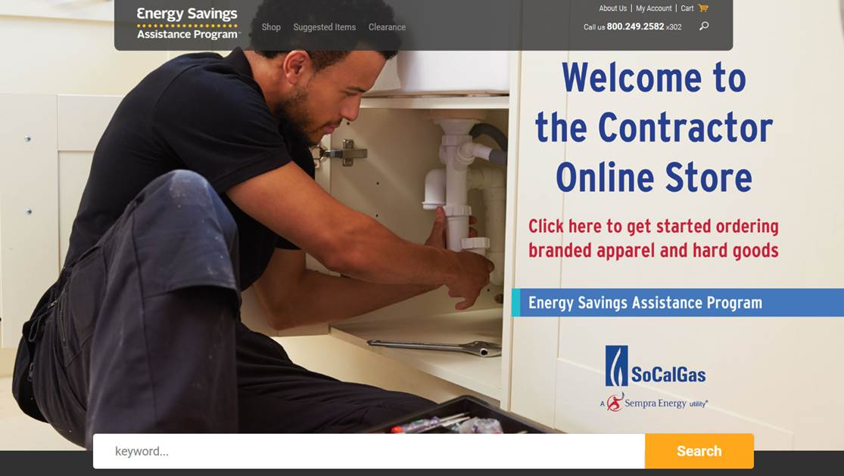
SoCalGas ESA Program

Slide 6
SoCalGas CARE Program
Good News
Continued best practices for CARE customer retention
Continued internal and external leveraging with GAF, LIHEAP, SCG ESAP, and SCE CARE Program
Positive Program Developments
Redesign of the SCG website for mobile-friendly access
Areas Requiring Improvement
CARE penetration is at 82%
Mobile-friendly CARE application will allow for ease of enrollment
Automation of data sharing with PG&E
3,400 applications were mailed to mobile home park tenants in August vs a 100 monthly average as a result of the annual enrollment assistance by mobile home park owners
Streamline current CARE application process online and in My Account

Slide 7
SoCalGas Marketing & Outreach
Good News
CARE/ESA Program media roundtables have been successful. (See slide 7.) To date*, four media roundtables included:
Positive Program Developments
Recent new partnership with the City of Colton to serve joint customers.
Areas Requiring Improvement
Non-responders and can’t reach customers.
27 media outlets
Developed follow-up marketing effort to target “can’t reach” customers assessed for high efficiency clothes washers.
Attention to evolving customer communication channels.
Collaboration and Co-branded materials with IRWD and SCE for Water / Energy Nexus, 10/01 deployment (in slide 8).
29 community partners
*Information does not include fifth media round table scheduled for 9/15/16 in Ventura, CA.

Slide 8

SoCalGas Marketing & Outreach
CARE/ESAP Media Roundtable
October: Water Energy Collaboration
Draft
Draft
Accessibility:
Disability advocate employed to support community outreach. As of last year, the ESA Program met it’s disability outreach goal.

Slide 9
SoCalGas Utility Contacts
CARE & ESA Program – Mark Aguirre, Program Manager MAguirre2@semprautilities.com
Marketing & Outreach – Regina Lugani, Program Manager Rlugani@semprautilities.com
Regulatory Policy & Reporting – Darren Hanway, Manager DHanway@semprautilities.com

