Slide 1
Medical Cannabis Cultivation Program
Marijuana Cultivation Program

Slide 2
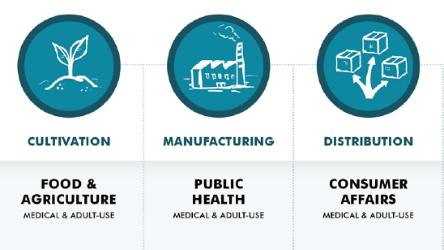
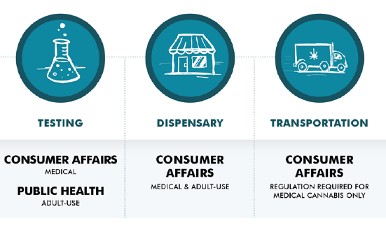

Slide 3
CDFA’s Statutory Requirements
Cultivation Licensing
Protect Human Health & Environment
Technology Projects

