Slide 1
Puget Sound Energy and Legalized Recreational Cannabis
Dave Montgomery
Consulting Energy Management Engineer
Energy Efficiency Services

Slide 2
About PSE
1.1 MM Electric Customers
800,000 Gas Customers
Largest Utility in Washington
Privately Held Utility
Delivered 20.5 MM MWh in 2014 and 2015
3,500 MW Generation Capacity

Slide 3
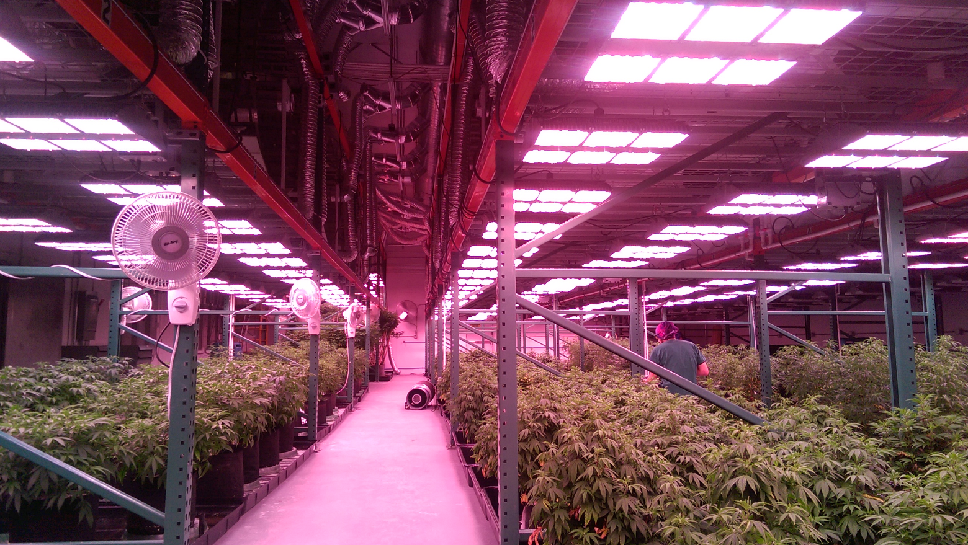
Typical Indoor Grow Operation

Slide 4
Puget Sound Energy
www.PSE.com
Dave Montgomery – Consulting Energy Management Engineer
Puget Sound Energy – Business Energy Management
david.montgomery@pse.com
425-424-6846

