Slide 1
California Public Utilities Commission Energy Impacts of Cannabis Cultivation Workshop

Slide 2
Oregon Overview
449 permitted recreational growers in Oregon
Northwest Power and Conservation Council’s 7th Power Plan addresses indoor agriculture using Washington data from 2014. The council also does a grower survey.
https://www.nwcouncil.org/media/7149941/7thplanfinal_allappendices.pdf
The Oregon Liquor Control Commission does not distinguish between outdoor and indoor grow facilities when reporting permitted growers

Slide 3
Energy Organizations Serving Oregon

Slide 4
Oregon Energy Stakeholders
HB 3400 –
TASK FORCE ON CANNABIS
ENVIRONMENTAL BEST PRACTICES

Slide 5
Challenges
We do not have a baseline of energy consumption for indoor grow facilities
Growers are not familiar with utility hook up process
Growers may have challenges forecasting energy needs and time to full facility operability
There has to be a customized approach to the grower customer class

Slide 6
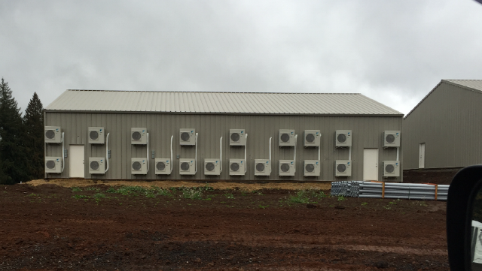
Challenges

Slide 7
Recommendations
This is a classic market transformation opportunity
Utilities need a consistent approach to the growers in California
Both the “New Connects” department and the Efficiency department need to coordinate in their outreach to growers.
California recreational cannabis licensing entity should require power and water forecasting and reporting
Need to encourage sharing facility energy data

