Slide 1
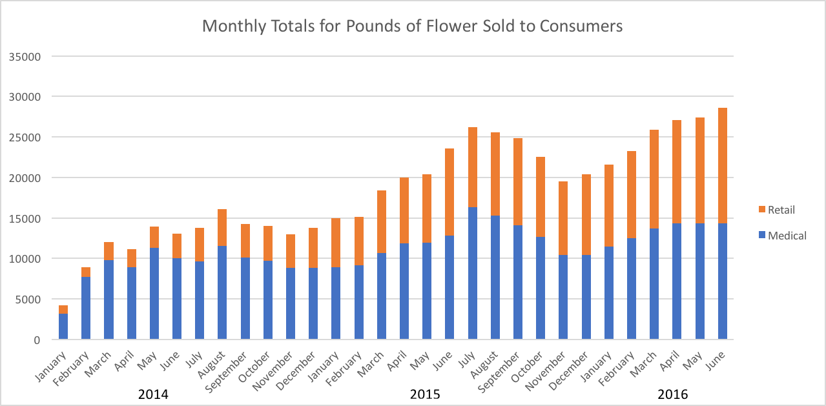
Colorado Overview
2012-2013 Denver Electrical Consumption increased 1.2%, ~50% Cannabis
2014 Cultivation - 2% Denver Total Electricity
June 2016 – 1,358 Cultivation Facilities, 430 Product Manufacturers
2016: Rec – 75% edibles, 69% concentrates
94,577 patients, 2,531 Caregivers
57% Caregivers increased plant count
13.6% Adults 18+ currently use (2014)

Slide 2
Trends
Indoor Grow Usage:
HVAC/Dehumidification: 40 – 50%
Lighting: 35 – 40%
Increase LED Lights, Hybrid Lighting
Majority Indoor Grows
Consideration for Greenhouses

Slide 3
Energy Programs
Boulder County’s
Energy Impact Offset Fund
Closing the Data Gap
Mandatory Energy Monitoring
Currently ~15 Grows
Paid cost of Meters upfront, credit towards future consumption
2￠per kWh
Funds: Meter Install, Analysis, Offset Schemes
No Production Data for Efficiency
Denver Department of Environmental Health’s Cannabis Sustainability Workgroup
Colorado Energy Office’s Marijuana Industry Energy Use Report
Colorado Department of Agriculture’s Cannabis Best Practices

Slide 4
Fun with Numbers
Indoor Grow averages 1000 kWh per lb. of Dried Flower
2015 CO sold 251,469 lbs.
Assuming it was all Indoors:
Energy Consumption for Dried Flower was 251,469 MWh
CO 2015 Net Electricity Generation - 52,393,077 MWh
0.4% of CO Total Electricity

