Slide 1
Energy Efficiency Observations for Agriculture Facilities
Adam D. White, PE
2/28/17

Slide 2
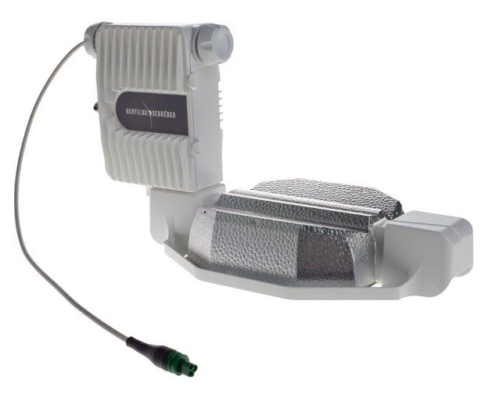
Industry Observations
Facility power delivery capacity range: 3.4 mVA to 24 kVA
Power load estimates (Gross facility area)
Estimated: 200 W/sqft
Actual: around 35 W/sqft
1000W HPS serves 16 sqft (industry est.) = 67.5 W/sqft of input power

Slide 3
Industry Observations (cont.)
A large percentage of total service requests have not come to fruition
Development impacted available real estate and local power
Required the installation of a new feeder in 2015
Mostly indoors with some greenhouses, for climate and security
Customers maximize production capacity by rotating operations
First cost is often the main or only driver in EE business decisions making utility incentives valuable to customers

Slide 4
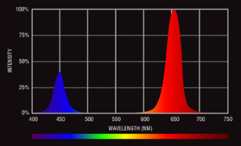
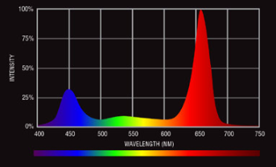
Industry Trends
LED manufacturers are adapting to local grower preferences on wavelength of delivered lighting
In 2015 to Mid-2016, most projects proposed/implemented were HID
Fangs (LED) vs Full Spectrum (HID)
Late-2016, majority of new projects are proposing LED

Slide 5
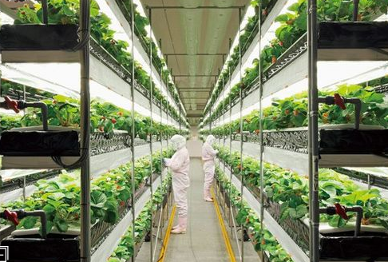
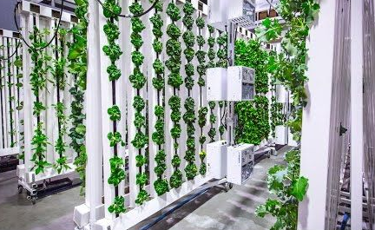
Industry Trends (cont.)
Going vertical in two ways to maximize production capacity/sqft
Big-box retail store style
Horizontal light projection: Medical-record style
Facilities that participate in our EE programs are growing in size.

